Slide 1
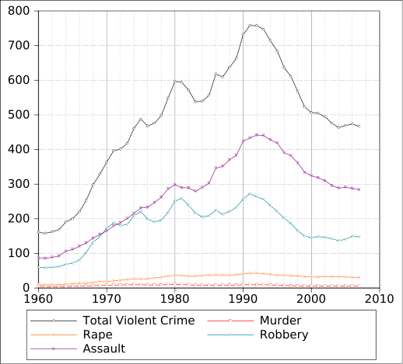
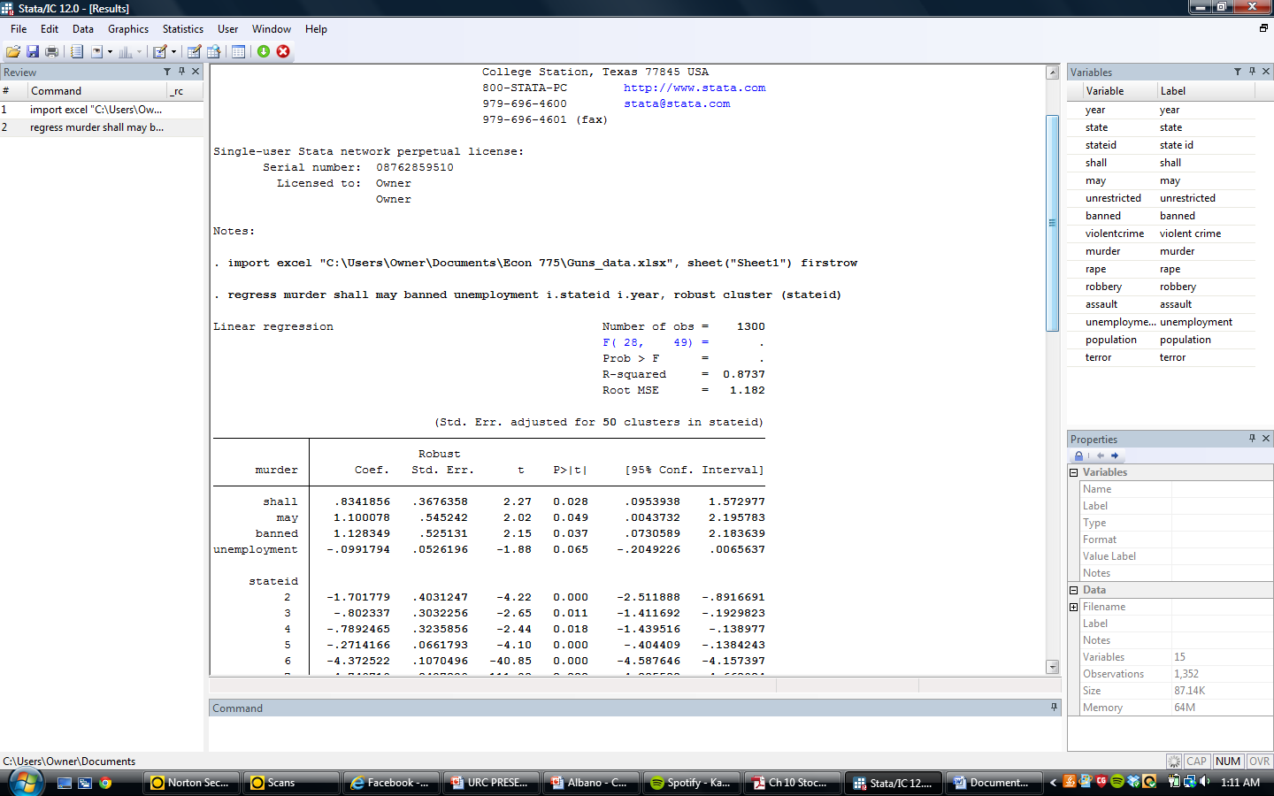
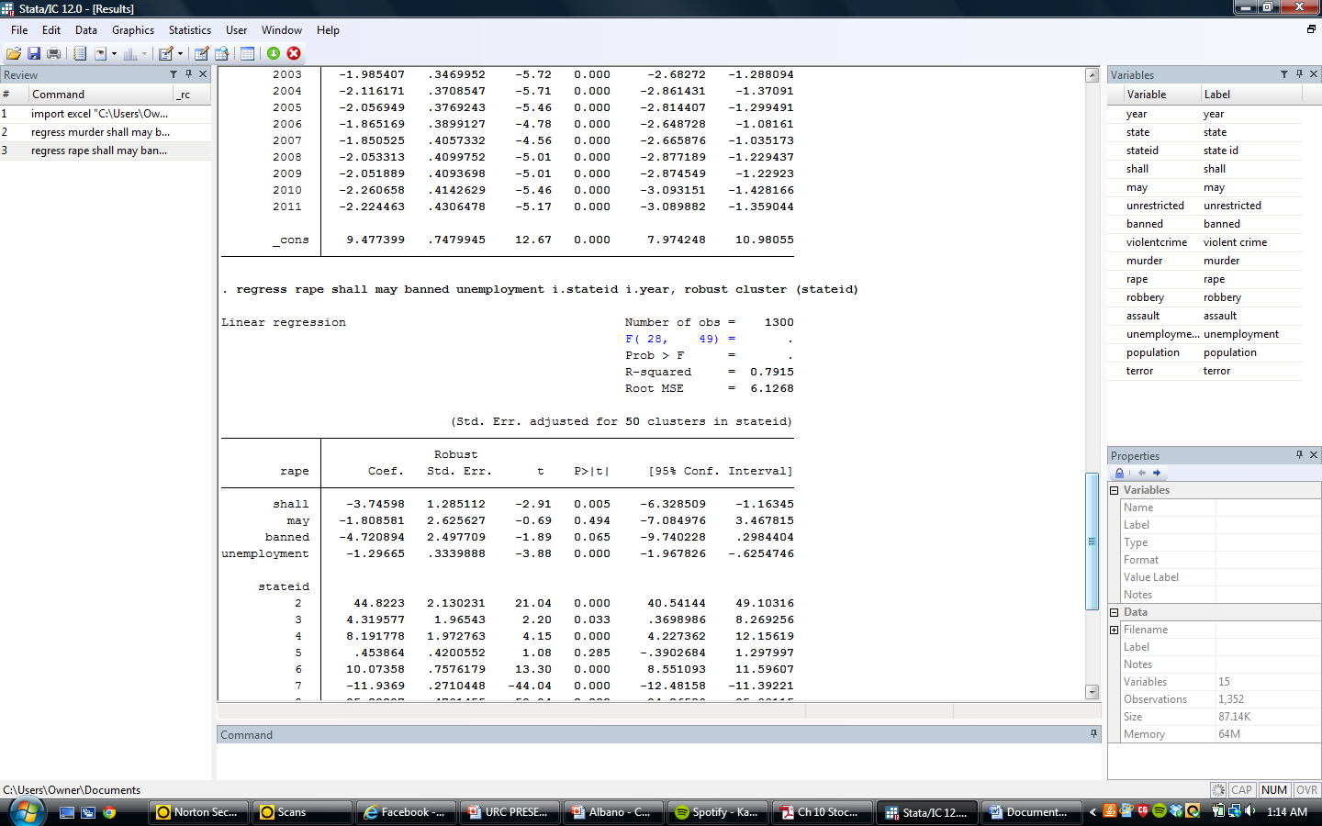
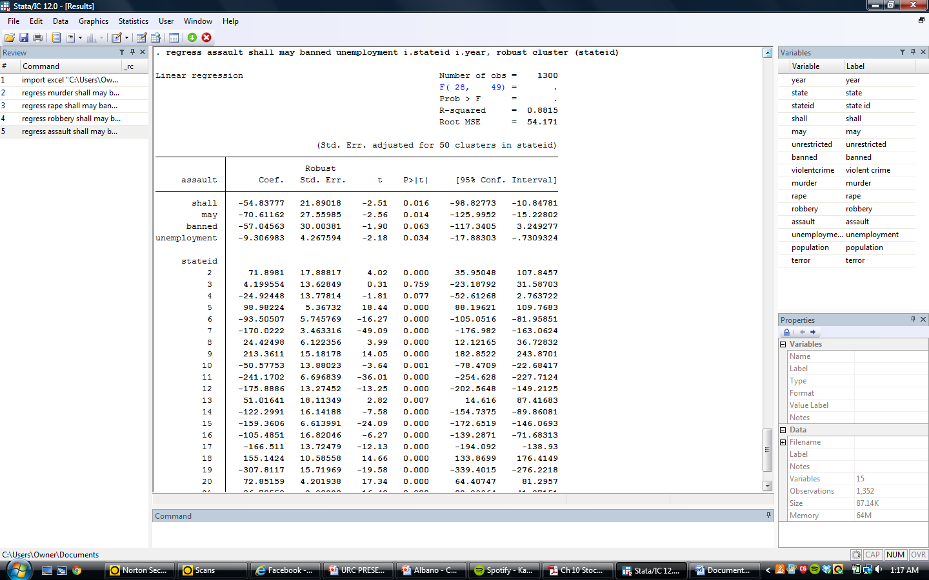
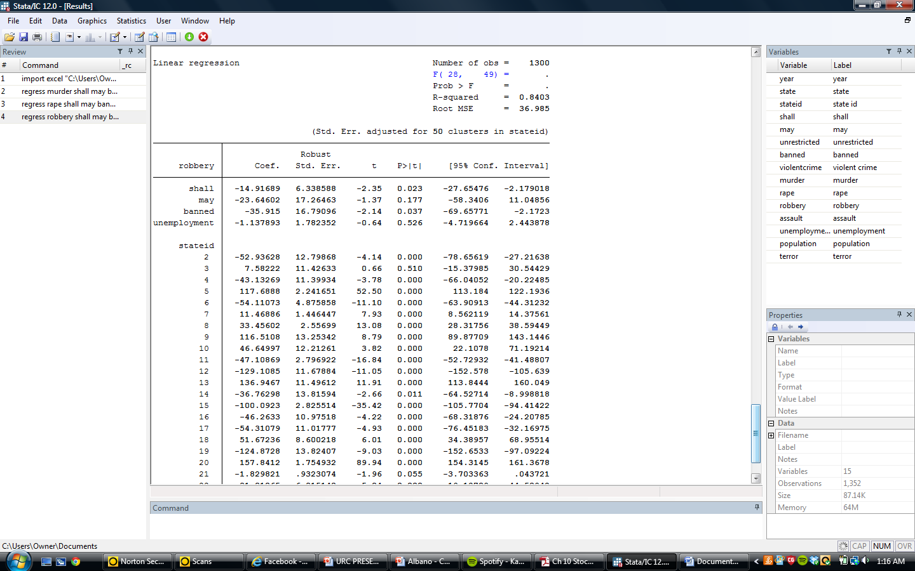
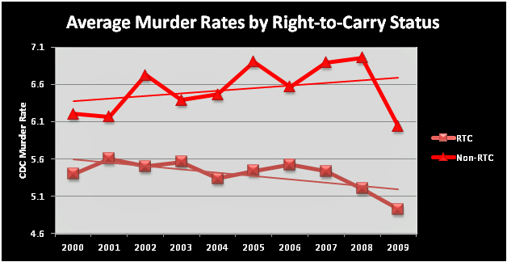
The Right to Carry and Its Effects on Violent Crime
Scot Hein
Introduction
Results
Right to Carry:
  Right to carry is defined as “Handling of a firearm or other weapon in public in a concealed manner.”
As of April 2013, only Illinois prohibits right to carry
Importance:
  With past tragedies such as the Columbine and Virginia Tech shootings, and much more recent tragedies such as the Aurora Theatre and Sandy Hook shootings, gun control legislation has become a major topic of debate.
4 Types of Laws
  Unrestricted: No permit required
  Shall: Permit required, anyone can obtain
  May: Permit required, up to discretion of state who is granted one
  Banned: No permits allowed
Restrictions on Premises
  Government Facilities
  Political Venues
  Educational Institutions
  Recreational areas
    Parks/Carnivals
  Hospitals
  Religious Institutions
    Church
    Temple
Violent Crime
  Violent crimes are composed of murder, rape, robbery, and aggravated assault.
  In 2011
    Assault: 62.4%
      Firearms used 21.2% in all assaults
    Robbery: 29.4%
      Firearms used in 41.3% in all robberies
    Rape: 6.1%
    Murder: 1.2%
      Firearms used 67.7% in all murders
Econometric Models
M_{it} = β₁ + β₂Shall_{it} + β₃May_{it} + β₄Banned_{it} + β₅Unemployment_{it} + β₆α_{i} + β ₇λ_{t} + e_{it}
Ra_{it} = β₁ + β₂Shall_{it} + β₃May_{it} + β₄Banned_{it} + β₅Unemployment_{it} + β₆α_{i} + β ₇λ_{t} + e_{it}
Rob_{it} = β₁ + β₂Shall_{it} + β₃May_{it} + β₄Banned_{it} + β₅Unemployment_{it} + β₆α_{i} + β ₇λ_{t} + e_{it}
A_{it} = β₁ + β₂Shall_{it} + β₃May_{it} + β₄Banned_{it} + β₅Unemployment_{it} + β₆α_{i} + β ₇λ_{t} + e_{it}
M: Murder rate per 100,000
Ra: Rape rate per 100,000
Rob: Robbery rate per 100,000
A: Assault rate per 100,000
Shall: Dummy for if state has shall law
May: Dummy for if state has may law
Banned: Dummy for if state has banned law
Unrestricted: Baseline dummy for state law
Unemployment: Unemployment rate
α: State fixed effects
λ : Time fixed effects
Panel data is used over 26 years (1986-2011) across 50 states.
Interpretations
Murder: The results show that as opposed to unrestricted (baseline), all forms of gun control increased the murder rate. All of these were significant at the α = .05. This makes sense since firearms are used extensively in murder cases (about 7/10).
Rape: The results show that as opposed to unrestricted (baseline), shall and banned laws decreased the rape rate.
Assault: The results show that as opposed to unrestricted (baseline), all forms of gun control decreased the assault rate. All of these were significant at the α = .05. Note that the coefficient for banned was less in magnitude than may. This implies that allowing citizens the right to carry decreased assault more than banning the right to carry.
Robbery: The results show that as opposed to unrestricted (baseline), shall and banned laws decreased the robbery rate. Note that only about 4/10 robberies included the use of a firearm.
Theoretical Analysis
Conclusions
Gun Control Advocates:
Imposing regulations on the right to carry are supposed to prevent criminals from acquiring firearms.
The idea is to keep firearms in the hands of law abiding citizens and out of criminals
Stricter right to carry laws aren’t taking away firearms from law abiding citizens
Advocates claim this will lead to less crime, and also less accidental gun related deaths.
Opposing sides say:
The 2nd amendment guarantees the right to bear arms to citizens of the United States
Regulations on gun control make it harder for law abiding citizens to acquire guns
  Even though it’s harder for law abiding citizens to acquire firearms, criminals still have access to illegally purchased firearms
When citizens have firearms, the criminal’s cost of committing a crime increases
  Criminals sometimes choose not to commit crimes in fear that a civilian concealing a weapon might intervene.
    Citizens with firearms can stop crimes more effectively than waiting for police to show up.
Goal: Prevent criminals from gaining access to firearms. This keeps them from possibly committing violent crimes.
Bottom Line: Most gun crimes are committed with legally obtained firearms. However, criminals are gaining access to firearms both illegally and legally. Regulations on right to carry only delay, not stop criminals from getting them.
The right to carry does have an effect on violent crime.
When it came to murder, increasing restrictions on the right to carry increased the murder rate. This was the most important statistic because it is the component most affected by firearm use.
  Stricter right to carry laws increase the amount of murders
    Cost of crime decreased to criminals
Rape, assault and robbery all experienced decreases when a stricter law was enacted (with exception of the may law. However, the firearm usage rate in these crimes were all less than 50%.
  Stricter right to carry laws decreased rape, assault and robbery
    Cost of crime increased to criminals
Limitations
Unemployment had a negative relationship with violent crimes. Theory would suggest a positive relationship between unemployment and crime.
The different categories of violent crime all have different percentages for firearm usage. For instance, firearms are used more extensively in murders as opposed to assaults.
Other gun laws weren’t taken into effect such as “Stand Your Ground”
Not enough variation in right to carry laws

