Slide 1

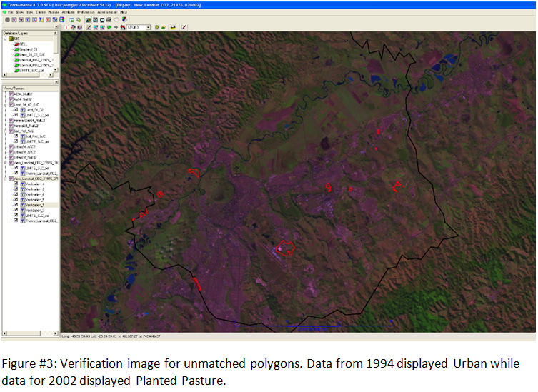
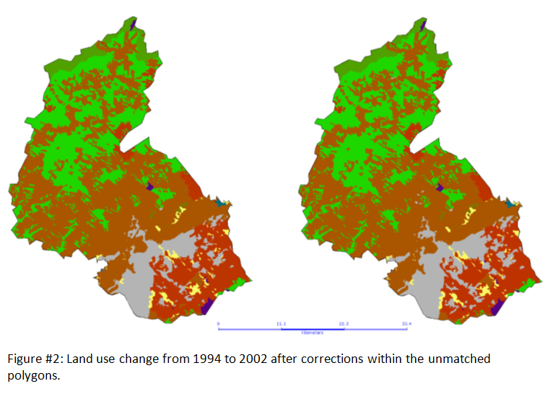
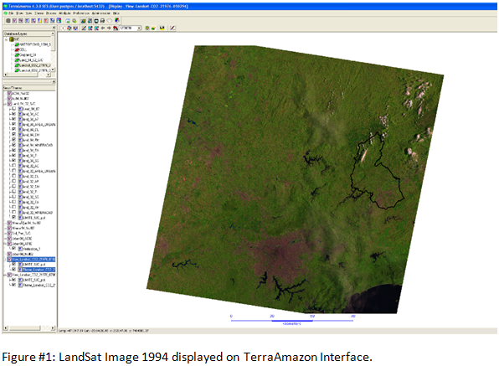

The Influence of Land Cover Dynamics on CO₂ Flux:
A Case Study in São José Dos Campos, Brazil
Gabriel Paiva
Introduction
The United Nations Framework Convention on Climate Change (UNFCC) has rallied countries around the world to increase efforts in limiting the rise of average global temperatures. Brazil has been a top contributor in the cause, and has established greenhouse gas (GHG) emission targets for the year 2020 that project reductions by 36.1%-38.9%. Mean annual net emissions in land use change and forestry were obtained by following the principles of the Intergovernmental Panel on Climate Change (IPCC). Sources and sinks of anthropogenic CO₂ were estimated from 1994 to 2002 for all six Brazilian biomes: Amazon, Cerrado, Pantanal, Atlantic Forest, Caatinga and Pampa.
Data Layers
Municipal Borders
Vegetation map for Atlantic Forest
Landsat Image1994
Landsat Image 2002
Methods
Overlay Techniques
  Union between Vegetation Map + Land Use 1994
  Union between Vegetation Map + Land Use 2002
  Intersection between the two unions
Used the Good Practice Guidance LULUCF
  Methodologies for estimating CO₂ stock
Query Analysis
  Verification for unmatched polygons
Soil Type
Land use 1994
Land use 2002
Land Use Change 1994 vs. 2002
Study Area
Site: São José dos Campos, São Paulo, Brazil.
  Area: 1,099,600 km2
  Population: 636,876
Biome: Atlantic Forest
Legend
AC | Cropland
AP | Planted Pasture
S | Urban Area
DM | Montane Dense Humid Forest
DL | High Montane Dense Humid Forest
FM | Montane Semi Deciduous Seasonal Forest
PA | Fluvial and/or lacustre influenced Vegetation
SG | Woody-grass Savanna
R | Reservoirs
O | Other
TerraAmazon Software
Multi-user GIS environment (up to 20 users)
Manages remotely sensed images of Brazil’s Forests
Compatible with TerraLib database
Developed by National Institute for Space Research(INPE) and Foundation of Spatial Science, Applications and Technology (FUNCATE).
Results
Table #1 shows urbanization contributing the most to land use change in the period from 1994 to 2002. Land that converted to urban consisted of 156.21 ha and 88.67 ha of cropland and planted pasture respectively. Table #3 shows this urbanization process is responsible for a total of 1494.8435 tons of CO₂ being emitted to the atmosphere. We see forest lands and grasslands that remain the same having a significant impact in removing CO₂
Table #1: Area (ha) transition matrix for land use changes from 1994-2002.
Land Use |  |  |  |  | Land Use in 2002
in 1994 | AC | AP | S | DM | DL | FM | PA | SG | R | O | Total 1994
AC | 48329.97 |  | 156.21 |  |  |  |  |  |  |  | 48486.18
AP |  | 14087.75 | 88.67 |  |  |  |  |  | 11.88 |  | 14188.3
S |  |  | 10633.6 |  |  |  |  |  |  |  | 10633.6
DM |  |  |  | 30276.02 |  |  |  |  |  |  | 30276.02
DL |  |  |  |  | 3418.51 |  |  |  |  |  | 3418.51
FM |  |  |  |  |  | 256.27 |  |  |  |  | 256.27
PA |  |  |  |  |  |  | 107.06 |  |  |  | 107.06
SG |  |  |  |  |  |  |  | 2031.94 |  |  | 2031.94
R |  |  |  |  |  |  |  |  | 552.29 |  | 552.29
O | 14.33 |  |  |  |  |  |  |  |  | 9.94 | 24.27
Total 2002 | 48344.3 | 14087.75 | 10878.48 | 30276.02 | 3418.51 | 256.27 | 107.06 | 2031.94 | 564.17 | 9.94 | 109974.44
Table #2: Methodology used in the Good Guidance Practice LULUCF.
Land Use |  |  | Variable | Definition
1994 - 2002 | Change in Carbon Stock |  | Ei | Carbon Emission Associated with polygon I in period T (tC)
AC-AC | null |  | Ai | Area of polygon (ha)
AC-S | Ei = Ai * (avAvg - S) |  | T | Time (8 years)
AP-AP | null |  | avAgr | Median carbon stock in agricultural areas (tC/ha)
AP-S | Ei = Ai * (Pec - S) |  | Pec | Median carbon stock in planted pasture (tC/ha)
AP-R | null |  | RebG | Median annual increment of carbon in secondary fields (tC/ha/yr)
S-S | null |  | Remf | Median annual removal of carbon in forest types (tC/ha/yr)
DM-DM | Ei = Ai * Remf * T
DL-DL | Ei = Ai * Remf * T |  | Variable | Constants
FM-FM | Ei = Ai * Remf * T |  | O | 0 tC/ha
PA-PA | Ei = Ai * RebG * T |  | S | 0 tC/ha
SG-SG | Ei = Ai * RebG * T |  | Pec | 8.05 tC/ha
R-R | null |  | Remf | -0.62 tC/ha/yr
O-AC | Ei = Ai * (O - avAgr) |  | avAgr | 5 tC/ha
O-O | null |  | RebG | -1.5 tC/ha/yr
Table #3: Carbon stock according to
various land use change possibilities.
Land Use
1994 - 2002 | Change in Carbon Stock (tC)
AC-AC | 0
AC-S | 781.05
AP-AP | 0
AP-S | 713.7935
AP-R | 0
S-S | 0
DM-DM | -150169.0592
DL-DL | -16955.8096
FM-FM | -1271.0992
PA-PA | -1284.72
SG-SG | -24383.28
R-R | 0
O-AC | -71.65
O-O | 0
Conclusions
Layers used in this study provided the data sources needed to estimate anthropogenic CO₂ emissions and removals for São José dos Campos in the period from 1994 to 2002. We see urbanization taking over portions of cropland and planted pasture contributing to the anthropogenic CO₂ emissions.
Acknowledgements
This study was part of an internship done at FUNCATE. I would like to thank Ubirajara Moura de Freitas for the opportunity as well as Dr. Clotilde Ferri Santos, Adriana Siqueira and my mentor Michael Palace.
Contact Information
Gabriel Paiva
Environmental Science Major, UNH
Contact me at grk74@wildcats.unh.edu

