Slide 1

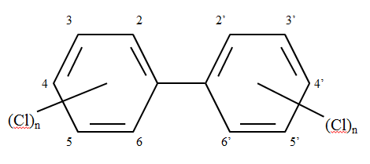
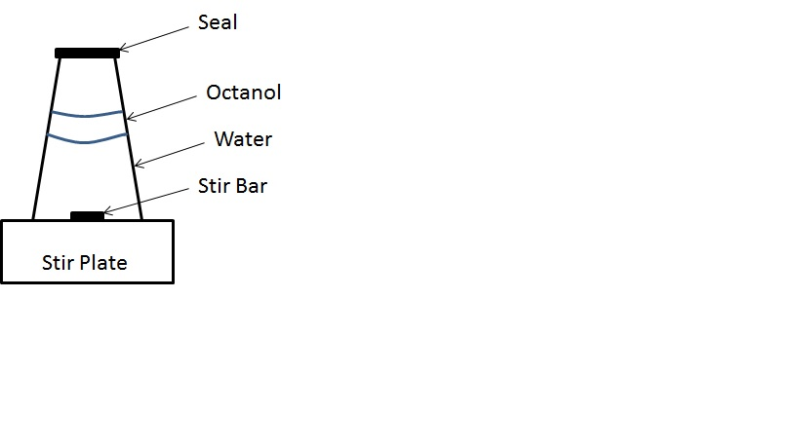
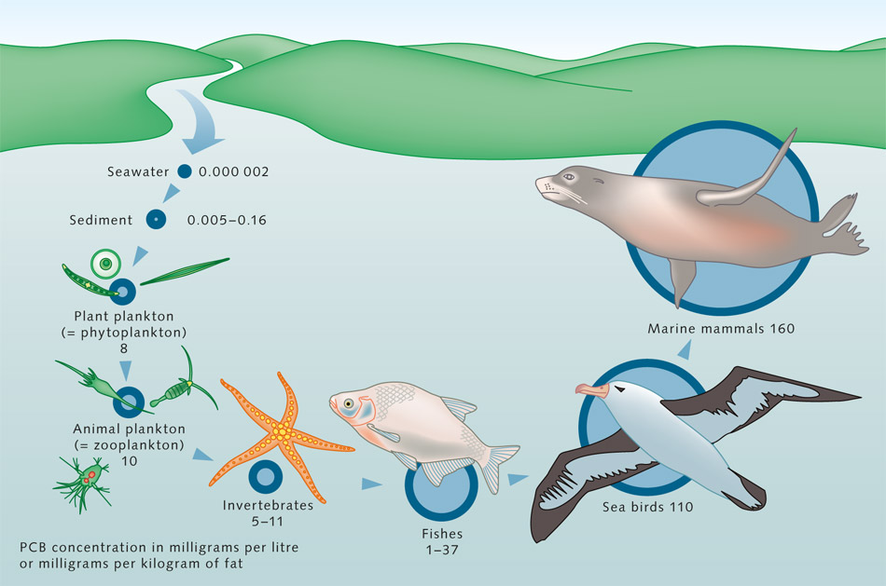
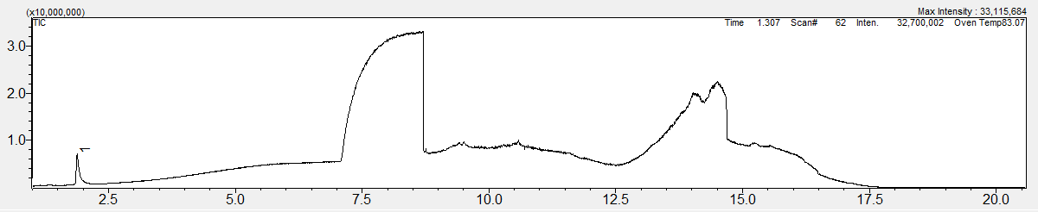
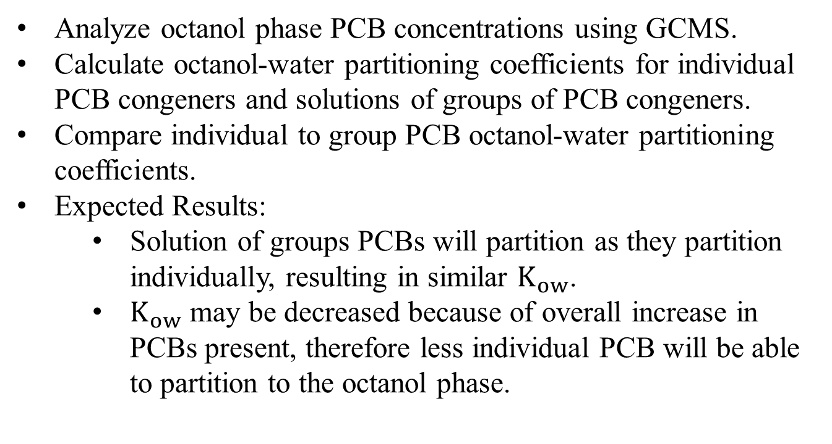
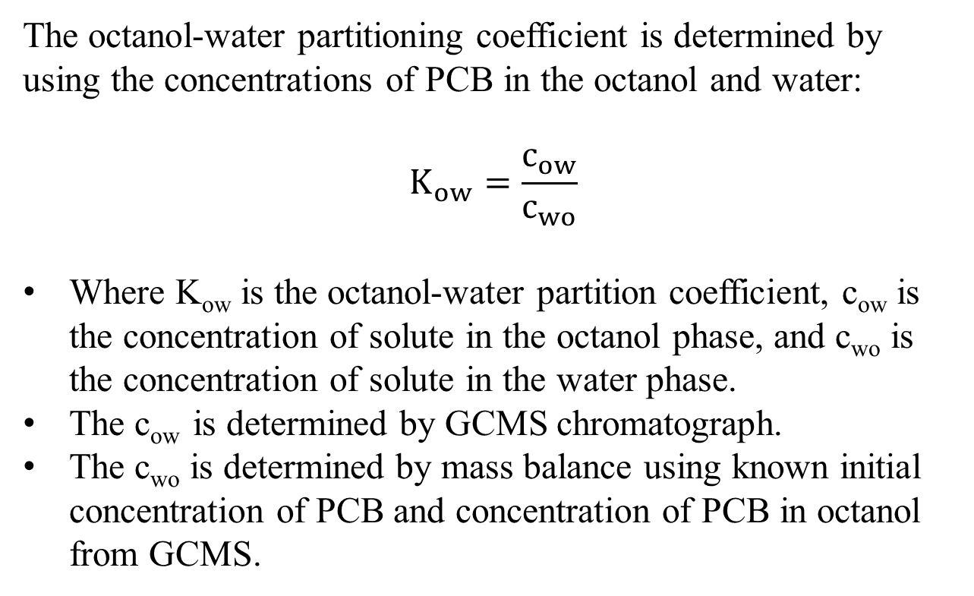
Octanol/Water Partitioning Coefficients of PCB Mixtures for Environmental Fate and Transport
Phylicia Cicilio, Jillian L. Goldfarb
Department of Chemical Engineering, University of New Hampshire, 33 Academic Way, Durham, NH 03824
Abstract
Background
Theory
Polychlorinated Biphenyls (PCBs)
Group of synthetic chemicals containing 209 congeners
Human and Environmental Threats
PCBs deemed probable carcinogen by EPA in 1976
Restrictive Ban on manufacturing and processing of PCBs put in place by EPA in 1979
PCBs detected in air, soils, and water
Environmental bioaccumulator due to low water solubility and chemical stability
The octanol-water partitioning coefficient is determined by using the concentrations of PCB in the octanol and water:
$$K_{ow}=\frac{c_{ow}}{c_{wo}}$$
Where K_{ow} is the octanol-water partition coefficient, c_{ow} is the concentration of solute in the octanol phase, and c_{wo} is the concentration of solute in the water phase.
The c_{ow} is determined by GCMS chromatograph.
The c_{wo} is determined by mass balance using known initial concentration of PCB and concentration of PCB in octanol from GCMS.
Polychlorinated biphenyls (PCBs) are a human and environmental toxin introduced to the environment from the 1920’s to the 1970’s from manufacturing items such as transformers and capacitors. PCBs remain in the environment today due to their low water solubility and resistance to chemical reaction. Due to their properties PCBs bioaccumulate in the environment and pose health risks to animals and humans, as they are deemed a probable carcinogen by the EPA. Octanol-water partitioning coefficients are a means of measuring how PCBs will travel in the environment, either partitioning to water or into organic carbon. Octanol-water partitioning coefficients will be determined for individual congeners of PCB and for solutions of groups of PCB congeners to see if mixtures of PCBs behaved differently from groups of PCBS. Partitioning coefficients were experimentally determined for individual PCBs and groups of PCBs.
Figure 1: Standard PCB Chemical Structure
Purpose of Research
Octanol-water partitioning coefficient is quantitative means of measuring how PCB’s will partition into water or organic carbon in the environment.
Compare individual congener octanol-water partitioning coefficients to partitioning coefficients of congeners in solution of a group of congeners.
PCBs are introduced to the environment in commercially made groups, such as Aroclors, therefore it is necessary to understand if they behave differently as a group in solution compared to individually.
Polychlorinated Biphenyls (PCBs)
Chemical Properties:
  Hydrophobic
  Highly resistive to chemical reaction
Sources:
  Manufacturing: Transformers, hydraulic fluids, carbonless copy paper, and many more
Future Work
Analyze octanol phase PCB concentrations using GCMS.
Calculate octanol-water partitioning coefficients for individual PCB congeners and solutions of groups of PCB congeners.
Compare individual to group PCB octanol-water partitioning coefficients.
Expected Results:
  Solution of groups PCBs will partition as they partition individually, resulting in similar $K_{ow}$.
  $K_{ow}$ may be decreased because of overall increase in PCBs present, therefore less individual PCB will be able to partition to the octanol phase.
Experimental Methods: Slow-Stirring Method
Bioaccumulation
Slow-Stirring Procedure:
Insert magnetic stir bar into 250mL Erlenmeyer flask
Pour 120mL of deionized water into 250mL flask
Slowly pipette 10mL of 1-octanol along side of flask
Stir solution at 70rpm for 1 hour ensuring no emulsion created
Slowly pipette 29mL of 1-octanol along on side of flask
Stir solution at 70rpm for 1 to 3 hours
For individual congeners:
  Slowly pipette 1mL of diluted PCB solution along side of flask.
For group congeners:
  Slowly pipette 1mL of each diluted PCB solution along side of flask.
Stir solution at 70rpm for 1, 6, or 14 days.
Extract octanol phase from solution using glass pipette for quantification using GCMS.
Figure 2: Equipment Diagram of Slow-Stirring Method
References
Description of Equipment:
250mL Erlenmeyer Flask
Agros Organic 99% 1-octanol
Deionized water
Stir bar with stir plate
Dilute Polychlorinated Biphenyl Congener(s): 18, 153, 29
Environmental Protection Agency. "Polychlorinated Biphenyls (PCBs) (Arochlors)."Technology Transfer Network Air Toxics Website (n.d.): n. pag. Technology Transfer Network Air Toxics Website. Web. 29 Nov. 12.
Shiu, Wan Ying, and Donald Mackay. "A Critical Review of Aqueous Solubilities, Vapor Pressures, Henry's Law Constants, and Octanol-Water Partition Cofficients of the Polychlorinated Biphenyls." J. Phys. Chem. Ref. Data 15.2 (1986): n. pag. Print.
Ellington, J. Jackson, and Terry Floyd. "Measuring Octanol/Water Partition Coefficients by the "Slow-Stirring" Method." National Exposure Research Laboratory (1995): n. pag.
Van Noort, Paul C.M. "Estimationg of Amorphous Organic Carbon/water Partition Coefficients, Subcooled Liquid Aqueous Solubilities, and N-octanol/water Partition Coefficients of Nonpolar Chlorinated Aromatic Compounds from Chlorine Fragment Constants." Chemosphere (2008): n. pag. Print.
Bench, Dan W. "PCBs, Mining, and Water Pollution." Mine Design, Operations & Closure Conference (2003): n. pag. Print.
Burkhard, Lawerence, David Armstrong, and Anders Andren. "Henry's Law Constants for the Polychlorinated Biphenyls." Environmental Science Technology 19 (1985): n. pag. Print.
Hawker, Darryl, and Dee Connell. "Octanol-Water Partition Coefficients of Polychlorinated Biphenyl Congeners." Environmental Science Technology 22 (1988): n. pag. Print.
Sather, Paula J., John W. Newman, and Michael G. Ikonomou. "Congener-Based Aroclor Quantification and Speciation Techniques: A Comparison of the Strengths, Weaknesses, and Proper Use of Two Alternative Approaches." Environmental Science & Technology 37.24 (2003): 5678-686. Web.
Erickson, Mitchell D. Analytical Chemistry of PCBs. Boston: Butterworth, 1986. Print.
"Bioaccumulation." Toxic Substances Hydrology Program. USGS, n.d. Web.
"Organic Pollutants." WorldOceanReview.com. World Ocean Review, n.d. Web. 21 Apr. 2013.
Figure 3: Bioaccumulation diagram of PCBs in the environment (World Ocean Review)
Experimental Methods: GCMS
Shimadzu GCMS with EI detection
Compounds travel through the GC at different rates based on molecular weight, size and shape.
Compounds then travel to the MS ionizer where they are detected
GCMS Operating Conditions
Carrier Gas: He
Column Oven Temp: 80°C
Injection Temp: 225°C
Injection Mode: Split
Pressure: 29.8kPa
Temperature Program: 80°C hold 1 min, 10°C/min to 210°C, 0.8°C/min to 250°C, 10°C/min to 290°C.
Column: Restek Rxi-5
Calibration curve for determining PCB concentrations will be created from 3 concentrations calculated from chromatograph by integrating area under the curve of peak corresponding to PCB.
Figure 4: Chromatograph of 10⁻⁶ M PCB 18 in octanol
The peak shown in Figure 4 represents octanol and PCB 18.
The first peak is octanol, and the second peak is PCB 18, and the area of the peak is proportional to the concentration off each.
The roundness of the peaks suggests overloading of column, meaning the concentration of PCB in solution needs to be reduced.
  Future calibration samples run on the GCMS will be below 10⁶ M in PCB

