Slide 1
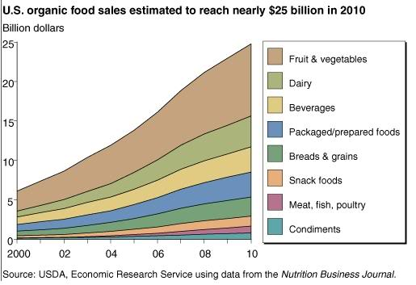
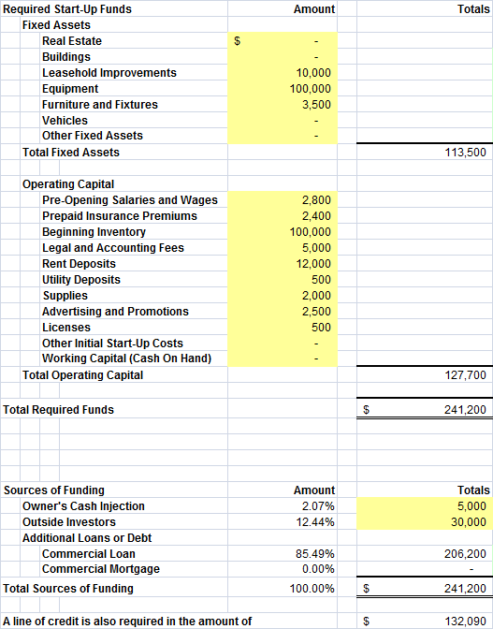
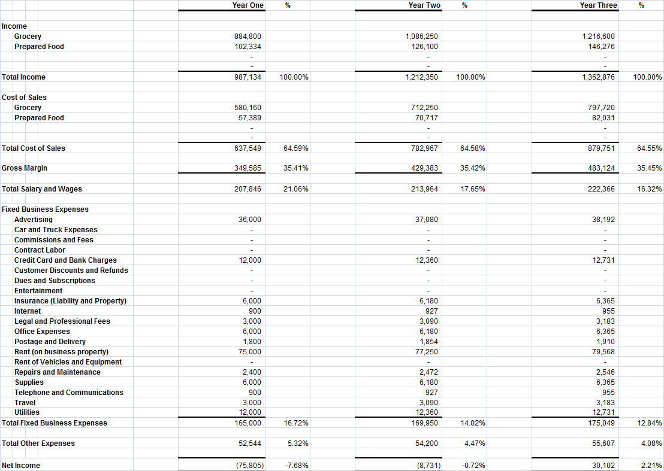
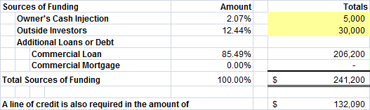
Nature’s Alley
Who Are We?
Nature’s Alley is an all natural and organic health food market that provides the opportunity for customers to interact and shop with registered dieticians and nutritionists. The assortment will consist of locally provided natural and organic products including fresh produce and dairy.. The store will be located in close proximity of Portsmouth, NH, with approximately 4,000-5,000 sq. feet.
Natural and Organic Market
What We Offer
Bobby Cormier, Jenna Gao, Greg Poggi
__________________________________________________
Peter T. Paul College of Business and Economics
Employ board certified dieticians whose services include
  Personalized nutrition plans
  Grocery tours
  In depth nutritional consultations (covered by most major health insurance providers
Locally grown , organic fresh foods department
Prepared food section including made-to-order café’ with seating
Weekly cooking demonstrations
Community Supported Agriculture Program (CSA)
Industry Trends
Target Market
Segment 1:
  Health-conscious, young to middle aged urban dwellers who have already established organic and natural eating habits
Segment 2
  Middle-aged heads of households that are unfamiliar with the nutritional and environmental benefits of organic foods
  Desire to provide healthier lifestyles for their families but lack the resources to educate themselves
Portsmouth, NH market
  Population: 20,848
  Median age: 40.3
  Average Income: $64,459
Actual US natural and organic industry grew to over $31 billion in 2011(9.4% growth) and outpaced the growth of conventionally produced food and beverages
78% of Americans purchased organic foods in 2012
  16% claimed they were unaware of the added benefit organic products provide
4/10 families say they are buying more organic products than a year ago
Financials

