Slide 1
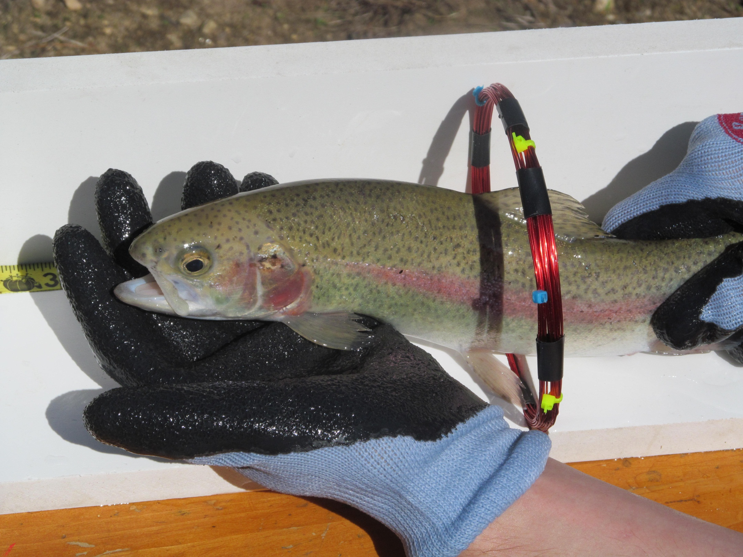
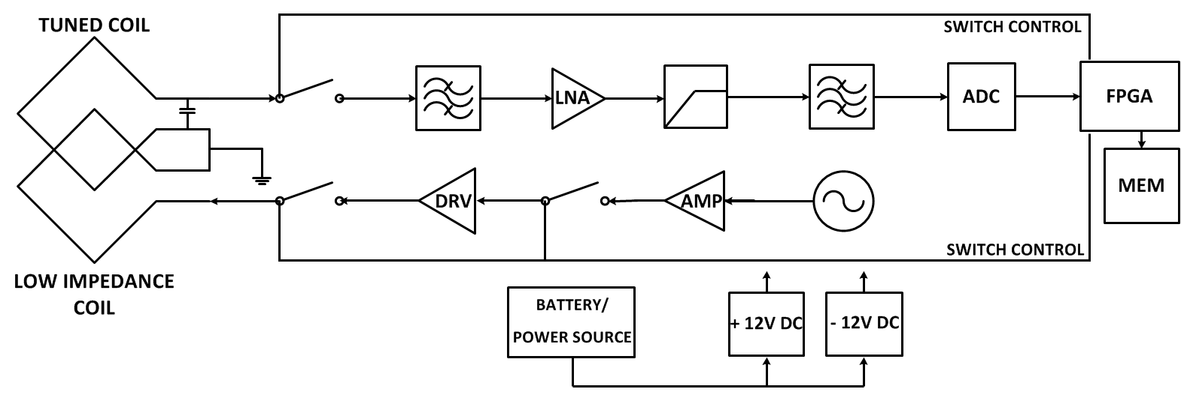
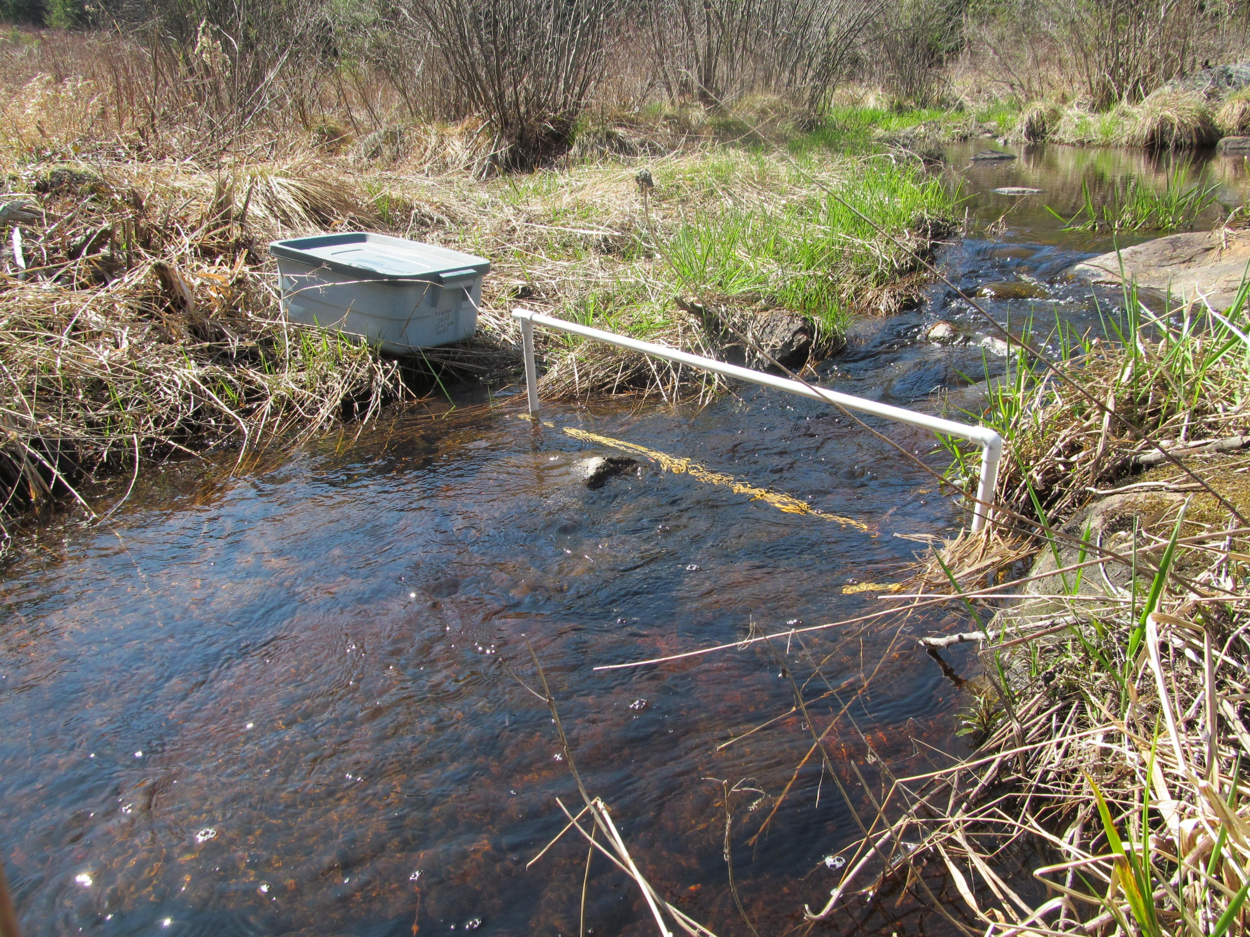
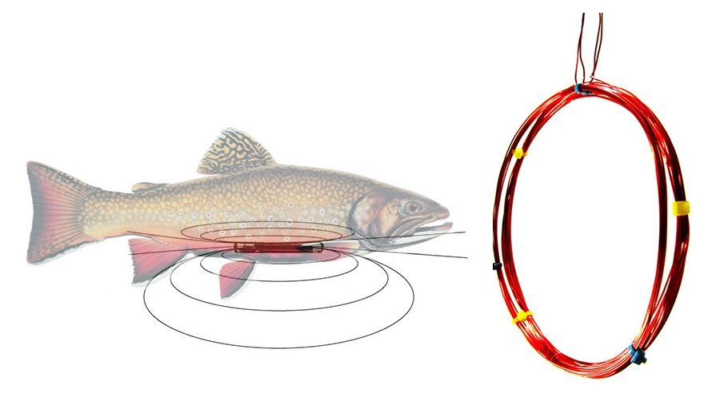
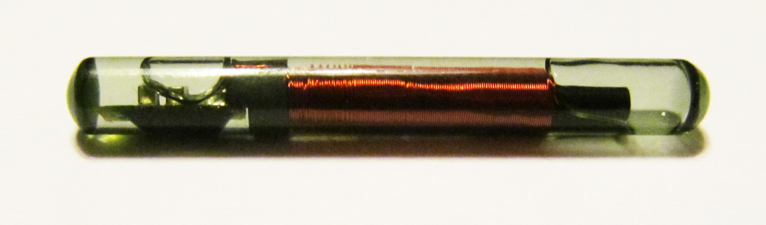
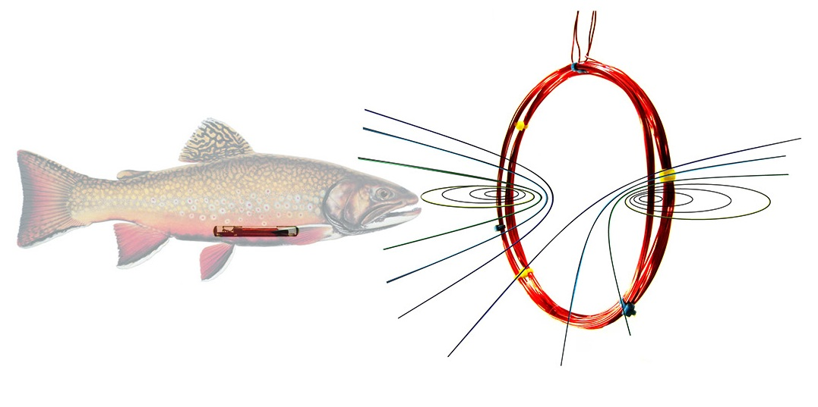
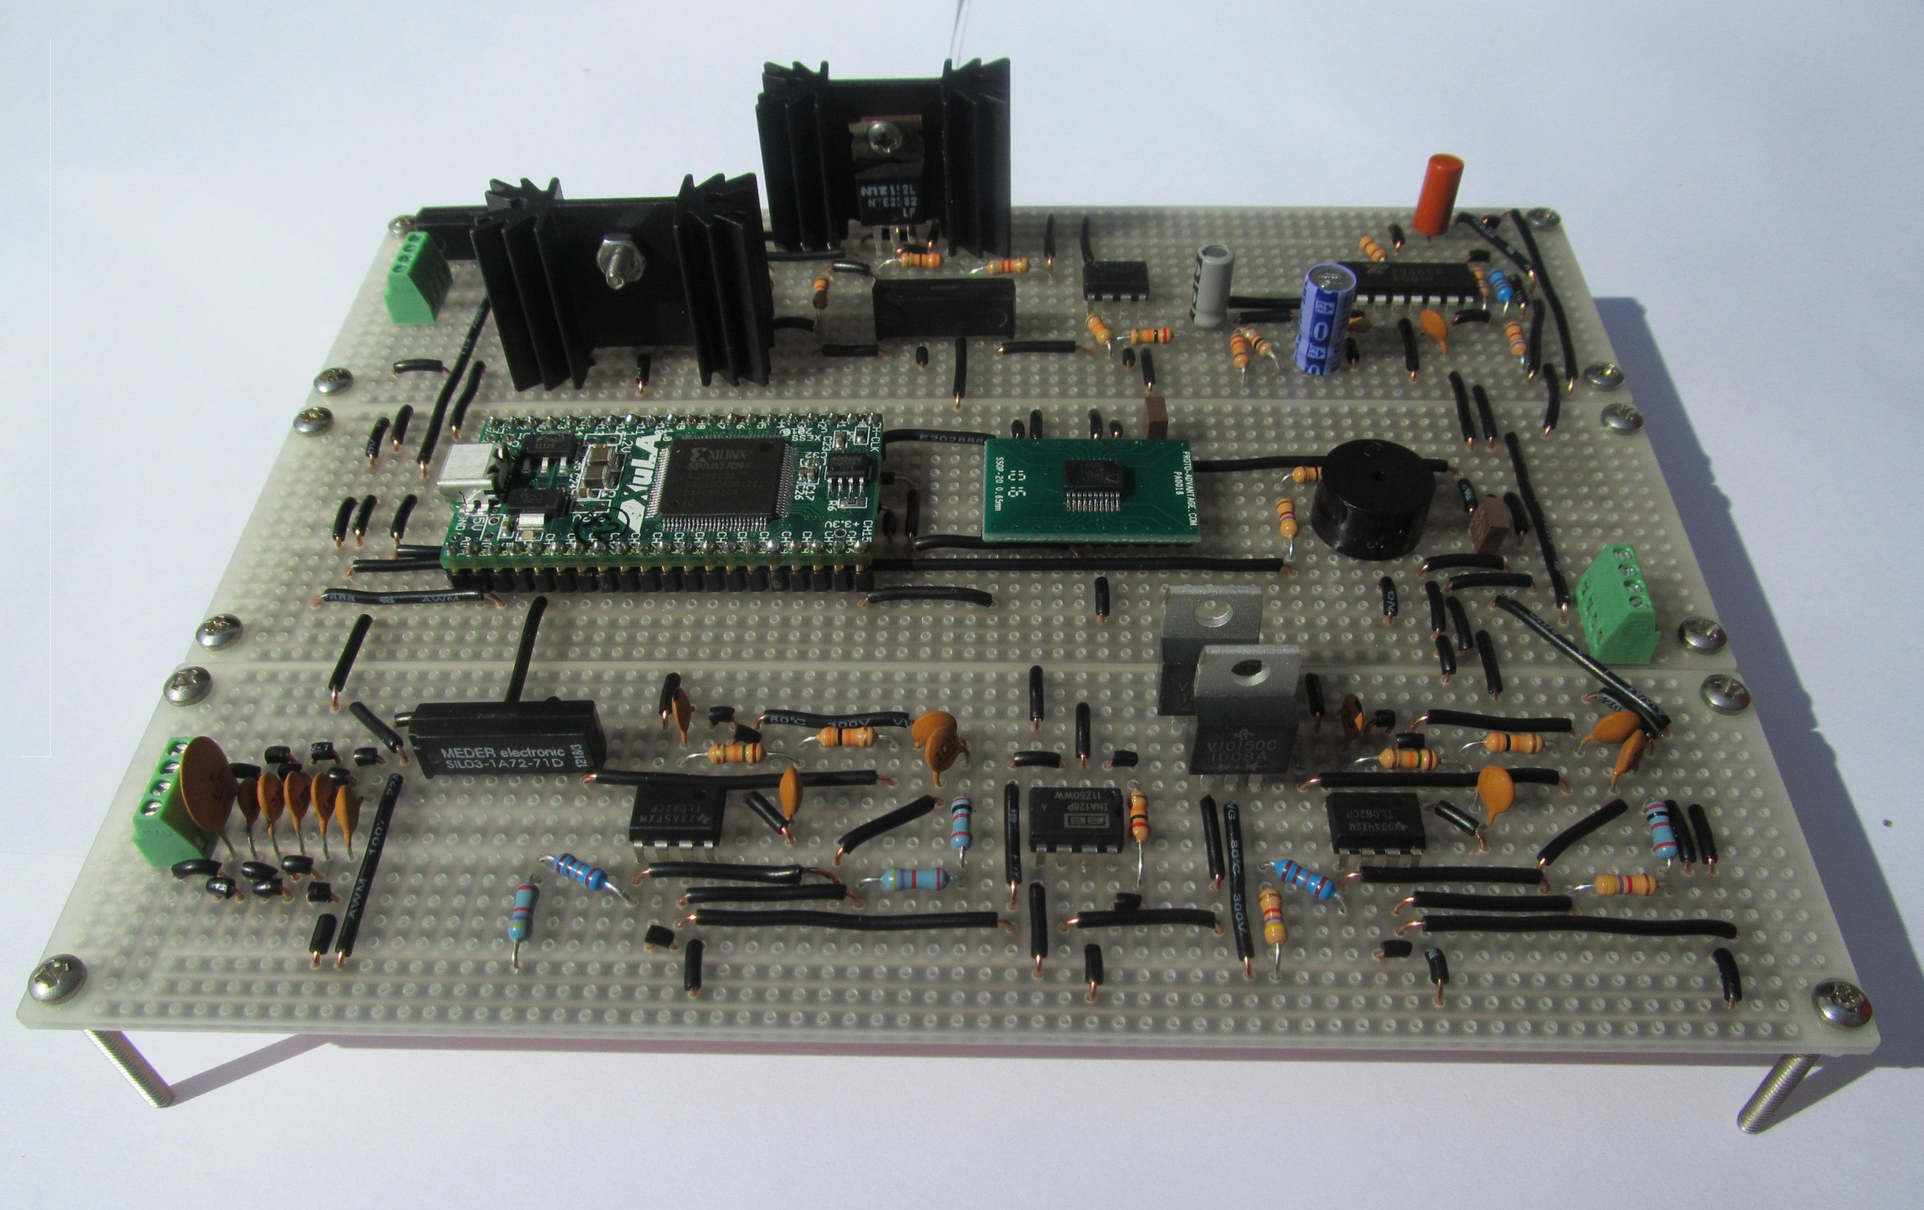
RFID Fish Tracker
PROBLEM: State fish and game agencies have limited funds for extensive research projects that help to enhance and conserve local fisheries
SYSTEM DIAGRAM
SOLUTION: A low – cost RFID reader will increase the fiscal feasibility of many fish population studies
The antennas can be scaled up for monitoring fish in small streams
METHOD:
A Passive Integrated Transponder (PIT)
is implanted in the fish
READ CYCLE
The transponder transmits a unique code that is received by the tuned coil and processed by the receiver
Dual Coil Half – Duplex Transceiver
CHARGE CYCLE
SYSTEM FEATURES
TRANSCEIVER BOARD
Low cost – less than $100 in components
Low power – can operate for 14 days with two marine batteries
Fast read rate – 15 cycles per second
Current driven through the low impedance coil creates a magnetic field and charges the transponder
Engineer: Nate Alix • Advisor: Mike Carter

