Slide 1





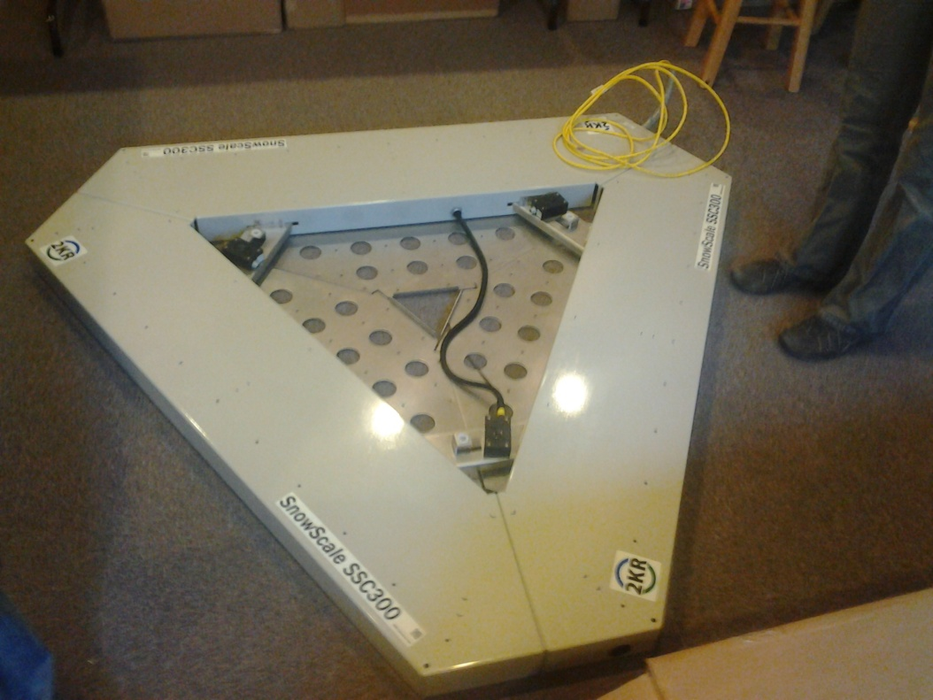
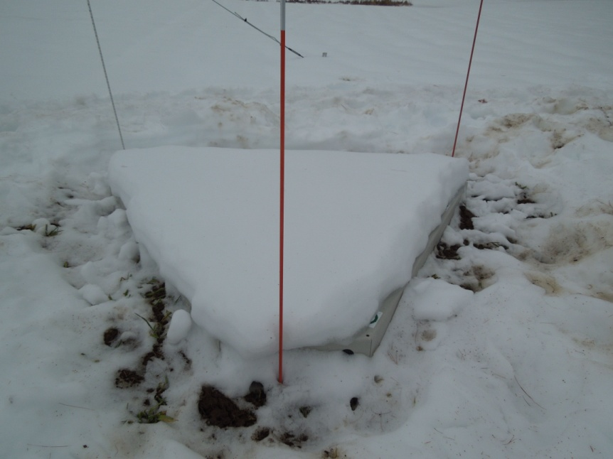
Snow Water Equivalent and Albedo
Ian Chase
PhD Candidate Elizabeth Burakowski and Dr. Scott Ollineger
Department of Earth Sciences, University of New Hampshire
Introduction
Results
Albedo is the amount of solar radiation is reflected off a given surface.
Snow albedo ranges from 0.9 for fresh snow to 0.6 for old snow.
As the density of snow increases, grains become larger and absorb more light, lowering the albedo.
Once-daily snow density samples may not capture the rapid change in albedo as a snowpack melts.
Here, I compare two snow density methods to albedo and evaluate the performance of the 2KR SnowScale that collects 30-min averaged snow density.
(a)
ANOVA
Source of Variation | SS | df | MS | F | P-value | F crit
Between SWE Groups | 6.023776 | 1 | 6.023776 | 7.567153 | 0.006581 | 3.896092
Within Groups | 136.9193 | 172 | 0.796043
Total | 142.9431 | 173
(e)
(b)
(c)
Methods
(d)
The 2KR SnowScale weighs the snow using three load cells to calculate the Snow Water Equivilant (SWE) of the snow pack every 30-min.
Conclusions
When plotted against one another the daily SWE and the SnowScale SWE show a weak correlation at best (b). An ANOVA test (a) shows a significant difference between the two methods. The metal SnowScale would heat up and melt the snow faster on the SnowScale than in the field.
It is clear that the canopy holds its snow pack longer than the pasture. Over the course of the snow season, it holds its depth better (c). The pasture is open to the full force of solar radiation, while the canopy has some shading from the tree branches.
There is an overall trend for density to increase as the snow pack melts and refreezes over the course of the snow season (d). Seen as density increases as depth decreases.
Albedo decreases as density increases (e). But the correlations or R-squared values are not high enough to be a significant finding. There needs to be more data collected to find a stronger correlation, possibly over a multiple seasons.
SWE data was collected using snow tubes at noon from January 3rd to April 1st 2013.
The daily data was processed using the following equations:
Snow Density (kg/m³) = mass (kg)/volume (m^3)
Snow Density (%) = Snow Density (kg/m³)/1000 kg/m³
SWE = Depth * Density (%)

