Slide 1
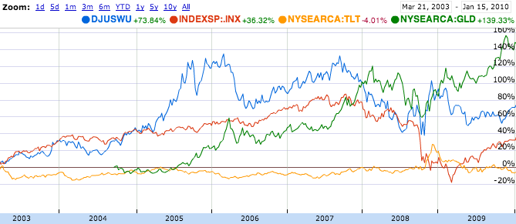
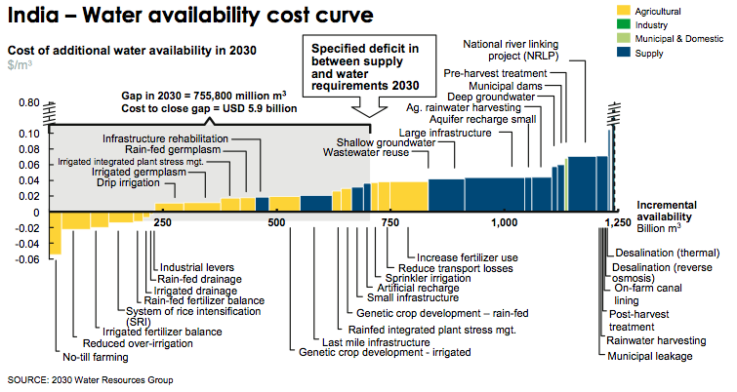
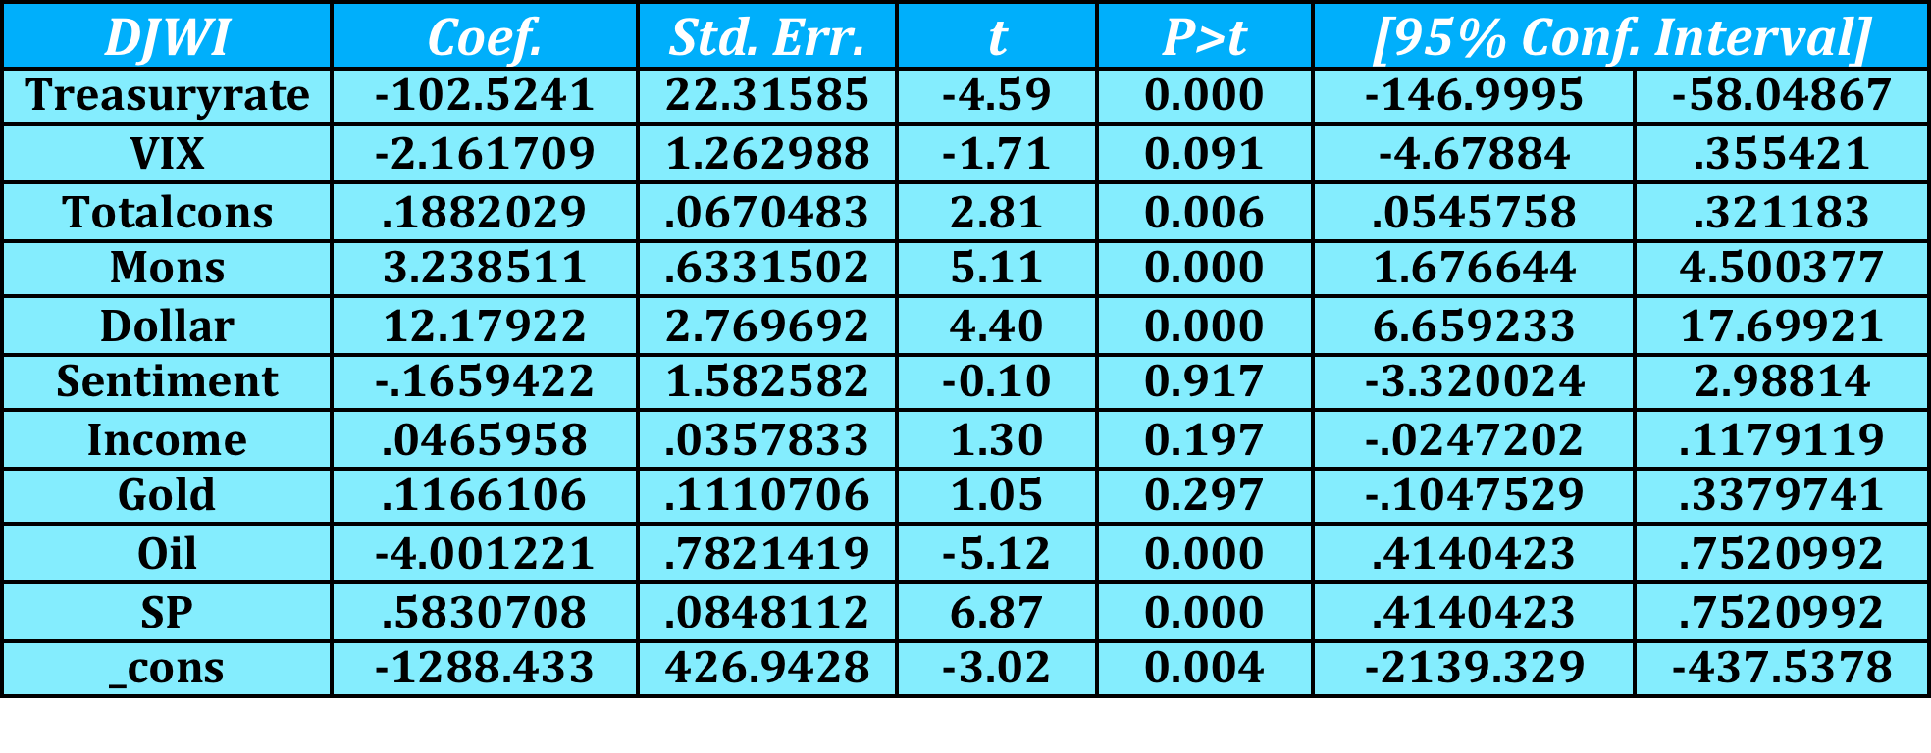
Can Financial Markets Solve the Looming Water Crisis?
Chris Celi
Abstract
Objective
The objective of this study was to explore an alternative aimed at encouraging the efficient use of water by appealing to financial markets. The idea is that information should be reflected in the market price, provided that the market is competitive, where there are many buyers and sellers.
Results
Table 2. Relative Performance of Water Index
INTRODUCTION: In principle, faces no shortage of water supply. Despite this striking fact, demand exceeds current supply of usable water, and we face dire constraints given current consumption trends. While much has been done to analyze different water market structures, I seek to find whether financial markets can provide for a way to convey the true price of water as a mechanism for curbing excess consumption and encouraging more investment.
METHODS: I use a multivariable regression model to estimate the factors that influence the price of the Dow Jones US Water Index. By referring to previous research, I use variables which theory would suggest impacts the “price” of water, such as the exchange rate, interest rates, and economic growth. I also use commodities such as oil, gold, and agricultural commodities, to analyze the relationship between their price and the “price” of water. Moreover I incorporate construction spending on water supply by both the government and private sector to see how it may impact price. I use monthly price data for all variables dating from January 2003 to December 2009.
RESULTS: I observed 84 months of data and found that the index is, to a large degree, representative of the type of security one would buy if their intent were to purchase rights to water outright. That is to say, the Dow Jones US Water Index seems not only to be an index that moves in relation to expectations of future earnings, but as a bellwether for investor demand for a precious commodity such as water. There was a significant inverse relationship between the 30-year Treasury rate and the index, suggesting the perceived safety of the index is comparable to the safety of the risk-free US 30-year. There was also a significant relationship between the index and commodity input giant Monsanto, suggesting that as demand for commodity inputs rises, so does demand for water (the largest input for farmers).
CONCLUSION: In light of this research, I found that the Dow Jones US Water Index is a good proxy for water demand. At the very least, it is a good starting point for working towards a financial instrument whose goal is to reflect future supply and demand expectations, so as to provide price signals regarding the optimal amount of investment and consumption changes needed now to avoid a crisis in the future.
The results of my primary model illustrated a significant relationship between the water index and the 30-year risk free rate, the volatility index, total construction spending on the water supply, Monsanto corporation, the U.S. dollar index, the price of oil, and the S&P 500 index.
The average for the index over the time period observed was 588. Based on this figure, table 1 illustrates the following findings:
  A 1 percent increase in the treasury rate is associated with a 17% decline in the index
  a 1 point increase in the VIX is associated with a .003% decline in the index
  A 1 dollar increase in Monsanto’s stock price corresponds to a .005% increase in the index
  A 1 point increase in the dollar index corresponds to a 0.02% increase in the index
  A 1 dollar increase in barrel of oil corresponds to a .007% decrease in the index
  A 1 point (very negligible) increase in the index
The ultimate goal of my research is to find a financial security and/or instrument that can accurately reflect future supply and demand expectations for water. The use of such a tool would be to guide investment decisions.
Figure 1. McKinsey/2030 Water Resource Group Cost-Curve
Limitations and Conclusions
Since I am observing actual financial markets data, the results may not be fully reflective of a potential measure with which to gauge water demand and supply expectations, per se, since investors are largely driven by profit-maximization.
Potential multicollinearity bias
Trying to obtain data that extended far back enough to provide for good variation over time was relatively difficult to come by. It might be the case that a better gauge for true water demand, and thus a true “price” or water could be available but there is not enough data to provide for a thorough analysis.
By conducting a falsification test, I found that the Dow Jones US Water Index is a relatively good proxy of true water demand. Specifically, the test consisted of a multivariable regression between a water utility, American States Water, which replaced the DJWI. The results varied enough to conclude that the Index embodies enough diversity that it is not solely driven by profit expectations, but are more focused on the dynamics of the water market.
Methods
The data for my analysis comes largely from the Federal Reserve Board of St. Louis’s Federal Reserve Economic Data (FRED) Database.
I received data on the Dow Jones US Water Index and on various water related companies, as well as Monsanto Corp., from Yahoo! Finance.
I used monthly data ranging from January 2003 – December 2009. The goal of using this range of data was to capture effects of normal market activity, as well as the volatile market activity that occurred at the end of 2008 into early 2009.
I used multivariable regression analysis to analyze the effects of my independent variables on the dependent variable, Dow Jones US Water Index.
I conducted a falsification test to ensure that the independent variables did not affect other (similar) dependent variables as well. To test this, I used a publicly-traded water utility company (American States Water).
I also conducted tests controlling for year 2009 to see how index performed during times of extreme market turmoil.
Table 1. Primary Model Results
Background & Objective
Background
  Agriculture accounts for about 70% of global water withdrawals
    Approximately 3,100 billion m³, and without efficiency gains will increase to 4,500 billion m³ by 2030
  Industrial withdrawals account for 16 percent of today’s global demand, growing to a projected 22 percent by 2030
  Investment of $335 billion over the next twenty years needed to maintain our drinking water infrastructure at acceptable levels
  Water prices have increased with an by 30% per annum
  In the long run, inefficient prices alter land- use patters, industrial location decisions, and other important factors
  There exist cost curves which can approximate the amount of water that can be yielded given an investment (Figure 1). The question becomes, when do we actually make these investments, and where do we invest?
References
Federal Reserve Bank of St. Louis Economic Research (FRED) Database
Field, Barry. "Water Resources.” Long Grove: Waveland, 2001 Print.
Google Finance
McKinney, Daene. Economics Analysis of Water Resources: Lecture Notes. University of Texas - Austin, 10 Jan. 2003. Web.
Olmstead, Sheila, and Robert Stavins. "Managing Water Demand Price vs. Non-Price Conservation Programs." Pioneer Institute White Paper 39 (2007): 4-40. Pioneer Institute. Web.
Saliba, Bonnie C., David B. Bush, William E. Martin, and Thomas C. Brown. "Do Water Market Prices Appropriately Measure Water Values?" Natural Resources Journal vol. 27 (1987): 617-51. Print.
Yahoo! Finance
2030 Water Resources Group. Charting Our Water Future Economic Frameworks to Inform Decision-making. McKinsey & Company, 2009. Web.

