Slide 1
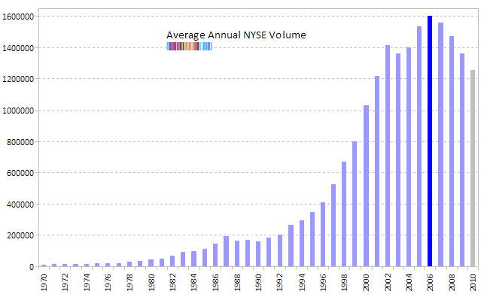
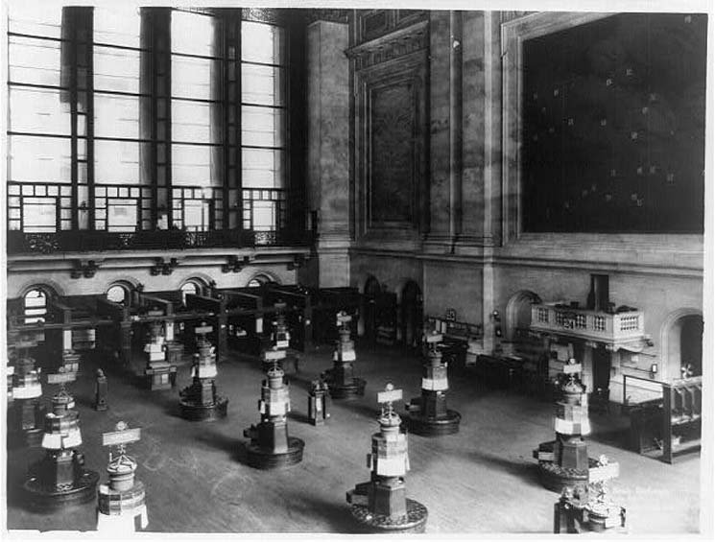
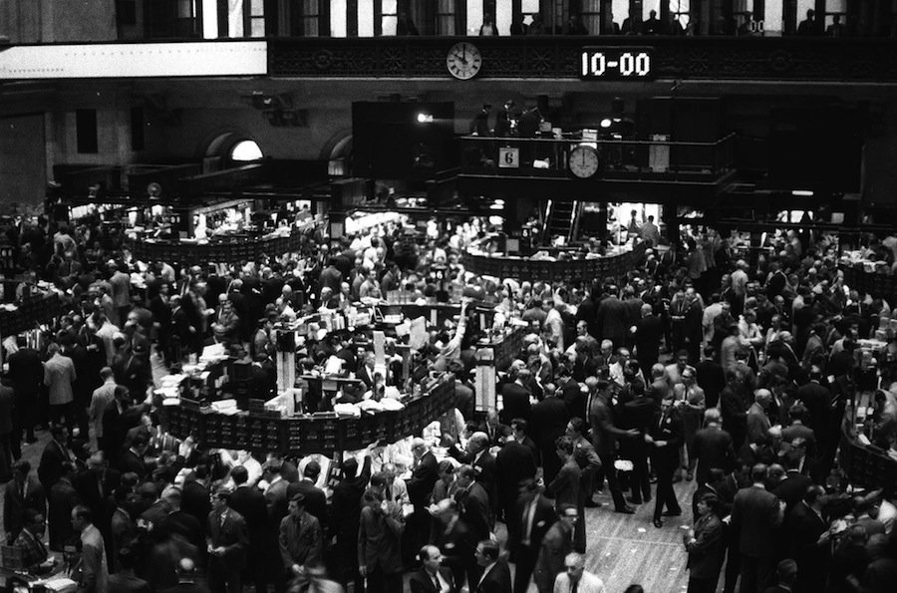
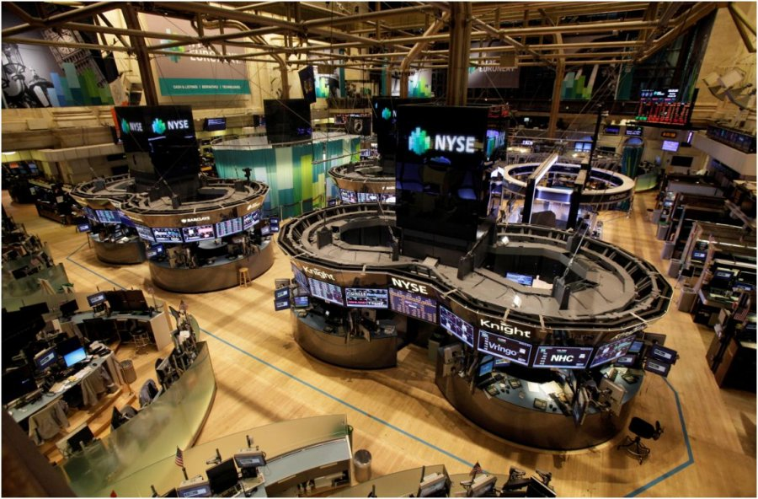
How Technology has Effected Trading in Finance
By Darren Brown
Pencil and Paper.
Prices put on wall manually.
All trades made on floor.
Invention of computers.
Easier record keeping and calculations.
Online Trading makes it’s debut.
“Day Traders” enter the market.
New Online Trading Industry (ETRADE, Charles Schwab, etc.)
1920’s
1980’s
1900
Introduction of telephone.
Trades allowed to be called in.
1950’s
Internet is created.
Stocks can be viewed online by trading professionals.
Late
1990’s
2013
New York
Stock Exchange
NYSE
Average Annual Trading Volume
Positive correlation between the NYSE trading volume and DART’s of ETRADE and Charles Schwab.
Daily Average Revenue Trades for both ETRADE and Charles Schwab correlate with Nasdaq and S+P 500.
In 2000, all three graphs spike just prior to significant drop in 2001 (due to 9/11).
Steady increase from 2002 to 2008 until housing bubble burst.
ETRADE and Charles Schwab DART’s affected much less by the 2008 crisis than the Nasdaq and S+P 500 market indexes.
1920
1970
2013

