Slide 1
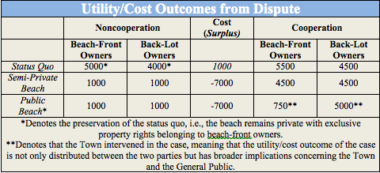
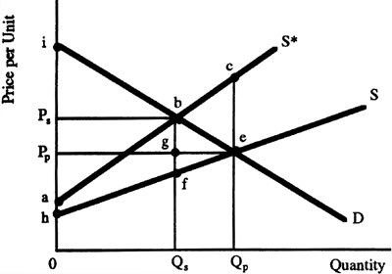
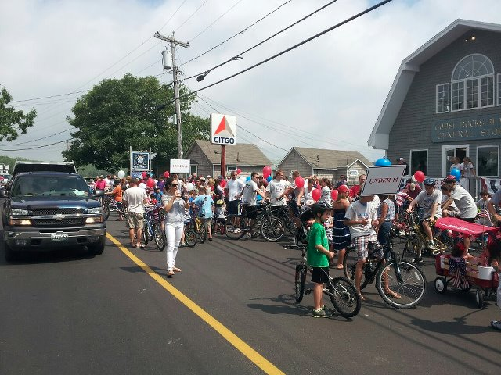
An Economic Analysis of Almeder v. the Town of Kennebunkport
Christopher Celi
Law and Economics, Spring 2013
Peter T. Paul College of Business and Economics
Almeder v. Town of Kennebunkport
Economic Issues
Analysis: Coase Theorem
Table 1. Alternative Solutions
Property law case concerning ownership of Goose Rocks Beach
Owners of Goose Rocks Beach brought action seeking a declaration that they hold the fee title for the beach in front of their properties extending to the low water mark, and sought to quiet that title
Complications resulted in state intervention, which could entail granted public access to the beach to the low water mark under the stipulation that the fee title belongs to the town of Kennebunkport
Back-lot owners, as well as the Town, counterclaimed for an easement by prescription or custom
Property values
  Legal ownership to the beach will have distributive effects between back-lot owners and beach-front owners
Local commerce
  A public beach would result in increased congestion, inhibiting ease with which to travel to and from the beach
  Increased volume of visitors would benefit local shop owners, namely the Goose Rocks Beach General Store (Figure 1)
Tax revenues
  Changes in tax revenues resulting from changing house values
  Earnings from parking passes and other transportation costs
Coase Theorem suggests, if transactions are zero, a dispute should be handled between the parties involved and an efficient solution will be reached
Figure 2. Coase Theorem
Conclusion
Court ruled in favor of back-lot owners and of the Town by appealing to various legal doctrines
  Doctrine of Public Trust
  Doctrine of Adverse Possession
The records stating that beach-front owners owned to the mean low water mark no longer serve as a complete index of ownership
After the period of prescription has run its course an adverse possessor becomes an unrecorded owner. In the context of Almeder v Town of Kennebunkport, the adverse possessor is the general public who freely used the entirety of the beach for a sufficient number of years
The court presumably viewed this as the efficient ruling, as future disputes will likely be avoided by clearly defining these property rights
Inefficient ruling
  Efficient outcome could have been reached if both parties (beach-front and back-lot owners) engaged in private negotiations
Transaction costs are high when:
  Many parties involved
  Property rights are uncertain or complex
  Good at question is unique, i.e. there is a scarcity of close substitutes
  Due to high transaction costs, private parties were unable to bargain to an efficient outcome
Case proceeded to court due to prohibitive transaction costs
Legal issues
Legal right to use of the beach by the public
Legal ownership of the beach
    Does the town in fact have a title to the intertidal zone?
Does the law/efficiency require that these rights be defined by prescriptive easement and/or easement by custom
What is the extent to which the public does have a legal right to the beach if is an adequate case is presented for easement by prescription or custom
Figure 1. Goose Rocks Beach General Store
Analysis: Alternative Courses of Action
A more efficient outcome could have been reached if both parties (beach-front and back-lot owners) engaged in private negotiations viz. cooperated
References
Cooter, Robert, and Thomas Ulen. Law and Economics. 6th ed. Glenview, IL: Scott, Foresman, 2012. Print.
Richard Posner, Economic Analysis of Law (New York: Aspen, 2007)

