Slide 1
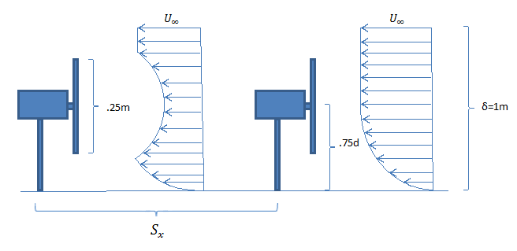
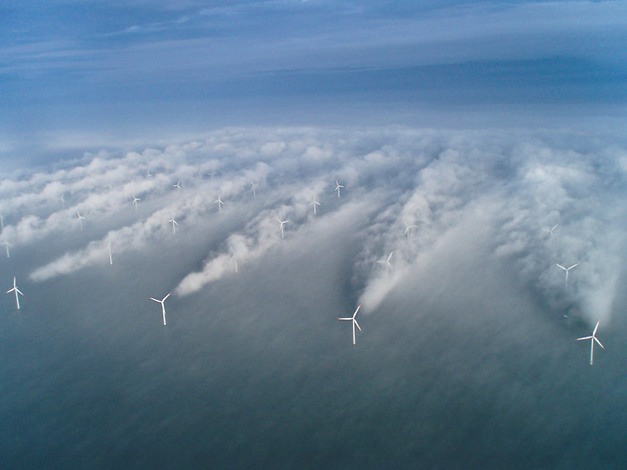
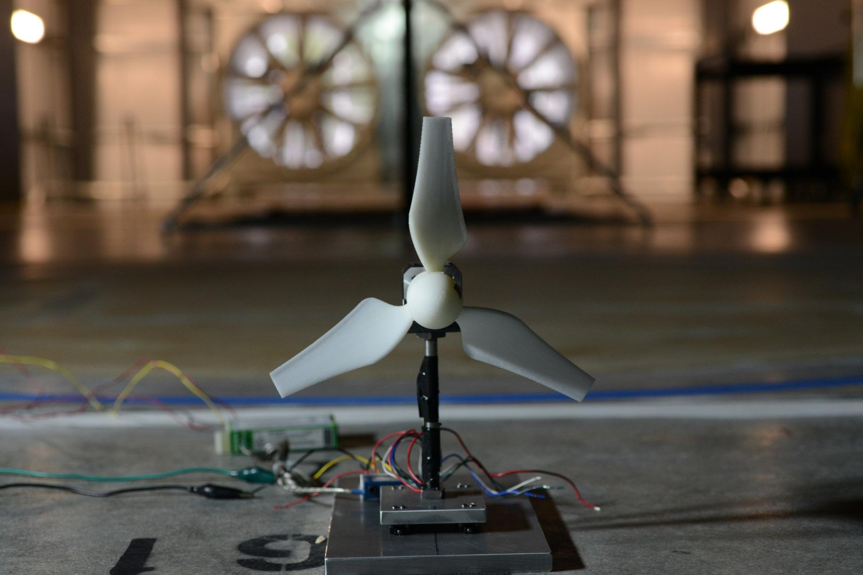
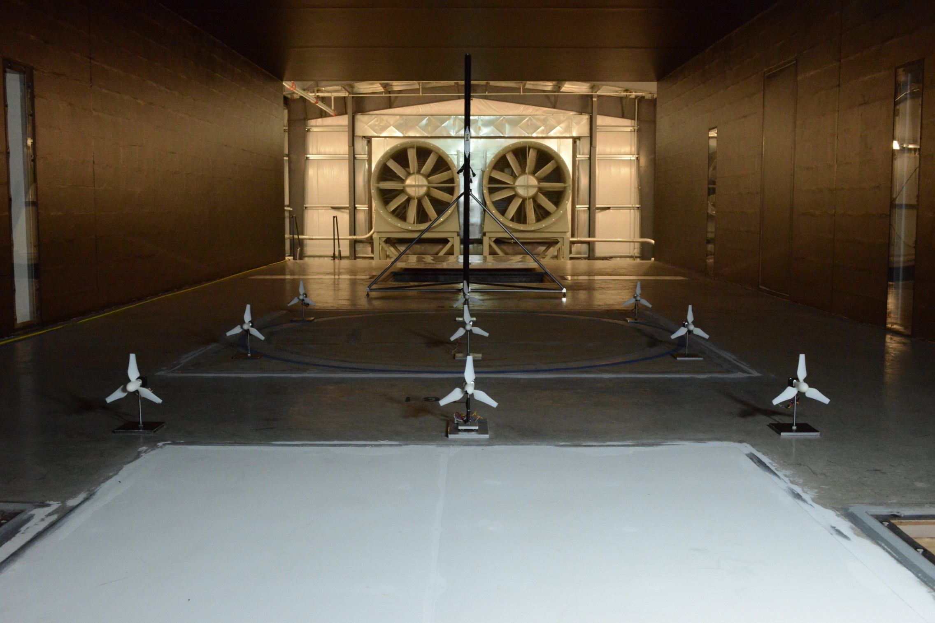
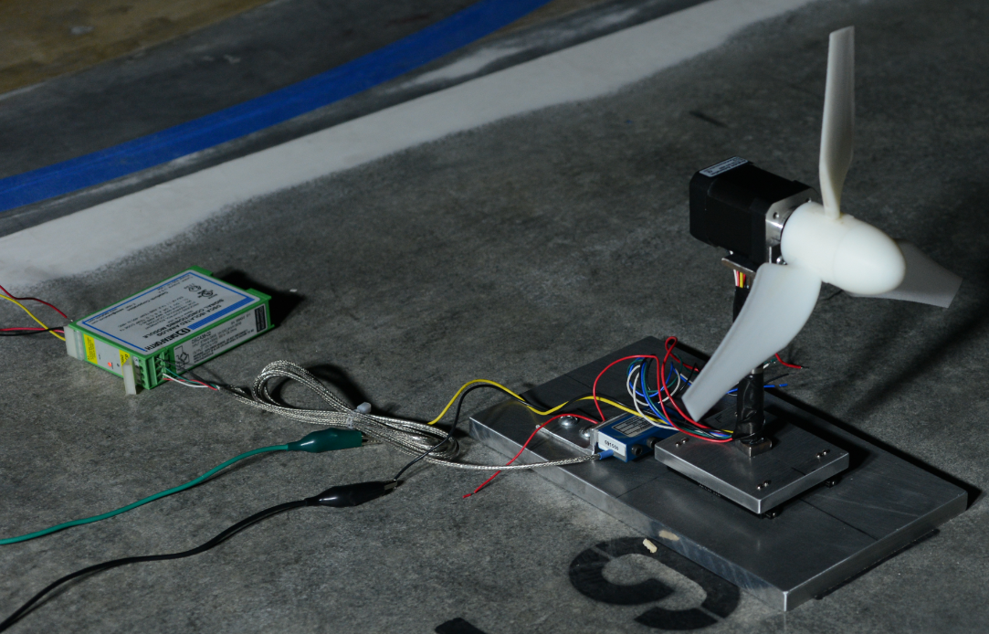
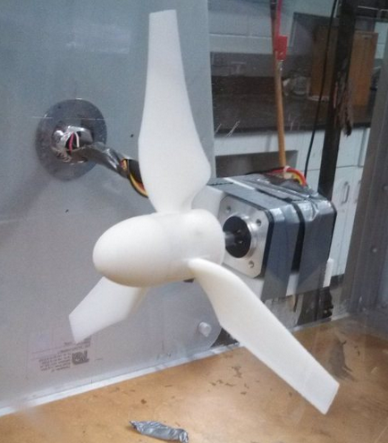
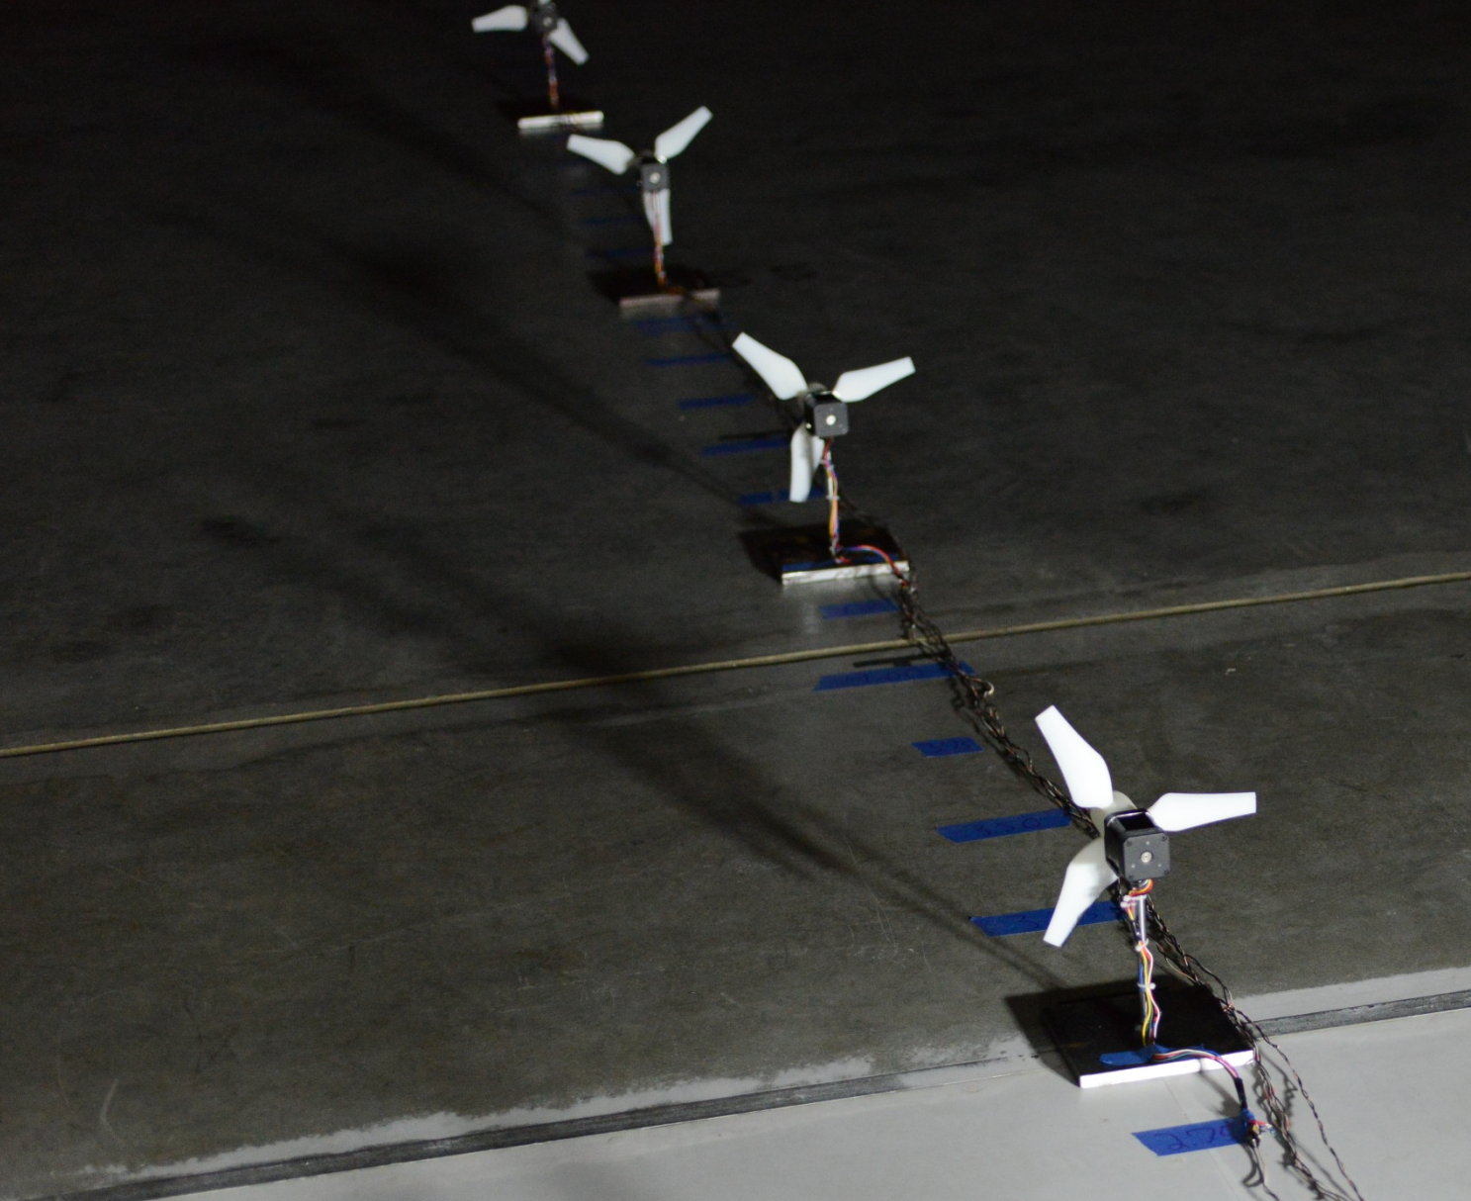
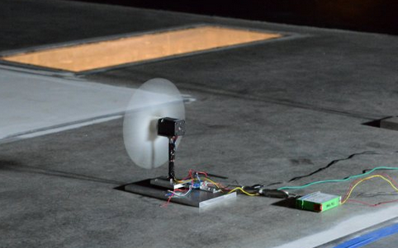
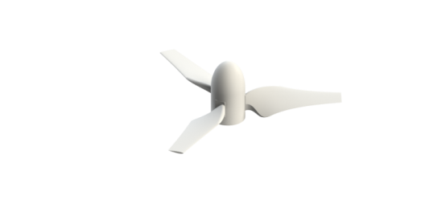
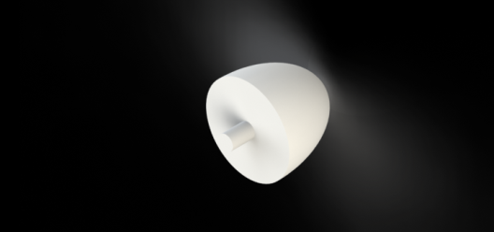
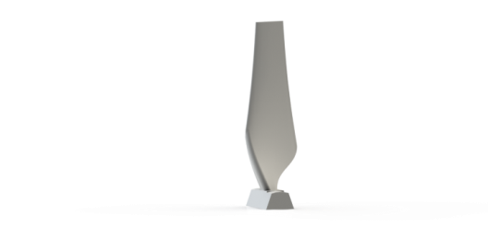
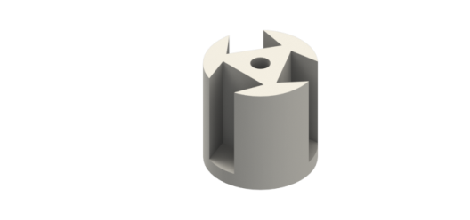
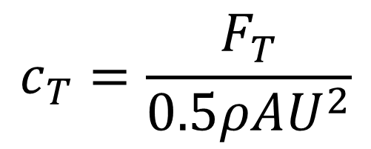
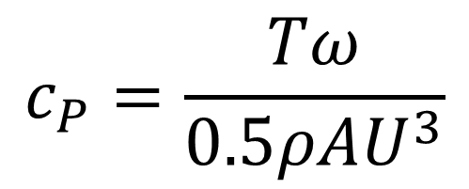
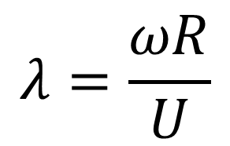
Kyle Beland, Jeremy Bibeau, Christopher Gagnon, Jacob Landry
Offshore Wind Turbine Array
Background and Motivation
Research Methodology
Unites States has target to produce 20% of electricity from wind energy by 2030 (at 2.9% in 2011)
Many very large wind farms will be installed, including offshore wind turbine arrays.
Millions of dollars are lost each year due to inefficient array spacings.
The University of New Hampshire's Flow Physics Facility (FPF) is capable of producing high Reynolds number turbulent boundary layers comparable to the earth’s atmospheric boundary layer (FPF test section dimensions: width 6.0 m, height 2.7 m, length 72 m)
The objective of this study was to design realistic, scaled offshore wind turbines, and investigate the effects of wind turbine array spacing on wind farm power output.
Characterize blade design/turbine performance in free stream in student wind tunnel (and validate in FPF)
Investigate power output vs. turbine array spacing in FPF turbulent boundary layer
A potentiometer was used to vary loads on the model wind turbines to characterize the power output.
Pitot-static tubes were used to measure average wind speed at hub height.
The custom-designed force balance was used to measure thrust (drag) on turbine rotor.
Wind Turbine Array Test Plan:
  1x1, 2x1, 3x1, … , 6x1: vary S_{x} in diameter increments
  3x3 array: vary both S_{x} and S_{x} in diameter increments
Figure 6: (below left) model turbine with force balance set up for testing in FPF (shown at downstream location x=61m, δ ~ 1m).
Figure 7: (below right) 3x3 model offshore wind farm array
Generator
Figure 1: (above) Diagram showing velocity deficit caused by upstream turbines.
Figure 2: (right) Horns Rev offshore wind farm located in the north sea off of the shore of Denmark
Force Balance
Model Wind Turbine Design
Results
Conclusions
Scaling of 1:500, D=25 cm diameter rotor
Turbine performance = f ( c_{P} , c_{T} , λ )
Design Tip Speed Ratio: λ = ωD/2U = 3.5
Hub height H = 0.75 D
Blades designed using 1D Blade Element Momentum (BEM) Theory
Blades modeled within SolidWorks, and rapid-prototyped in ABS plastic.
3 different designs were tested.
1 turbine mounted on force balance
8 turbines rigidly mounted to base plate
Wind turbines are able to operate at higher power coefficient in free stream (uniform flow) vs. in boundary layer (shear flow)
Velocity deficit produced by first row turbine causes a significant reduction in power for downstream turbines
Increasing turbine spacing improves overall array power output
Real world installations of wind farms cannot have turbines spaced too far apart, turbine spacing based on cost-benefit analysis (increased earnings from larger Sx vs. increased cost, e.g., from land/ocean lease and connection cost/power cables).
This study can provide engineering input for cost-benefit analysis
Figure 4: : Model turbine undergoing performance testing in small wind tunnel.
Power Coefficient:
Thrust Coefficient:
Tip Speed Ratio:
Figure 8: Turbine placed in free stream velocity with varying loads to characterize the performance of the blades.
Figure 9: Turbine placed in turbulent boundary layer with varying loads to characterize the performance of the blades.
$$c_{P}=\frac{Tω}{0.5ρAU_{}^{3}}$$
$$c_{T}=\frac{F_{T}}{0.5ρAU_{}^{2}}$$
Further Studies
Determine distance to fully recover boundary layer velocity profile behind leading turbine.
Study 3x3 array varying S_{x} and S_{y}
Figure 3: Model turbine undergoing performance testing in small wind tunnel.
$$λ=\frac{ωR}{U}$$
Figure 5: Power coefficient vs. tip speed ratio for selected turbine design (mod 3).
Advisor
Martin Wosnik
Graduate Co-Advisor
Kyle Charmanski
Figure 10: 6x1 array while varying spacing from 6 to 12 diameters as shown to the right. All turbines given same load with front at a TSR=4.5
Figure 11: (1xN) array spacing experiments in FPF(shown here S_{x} = 6D) . (bottom left) turbine collecting data in turbulent boundary layer.

