Slide 1

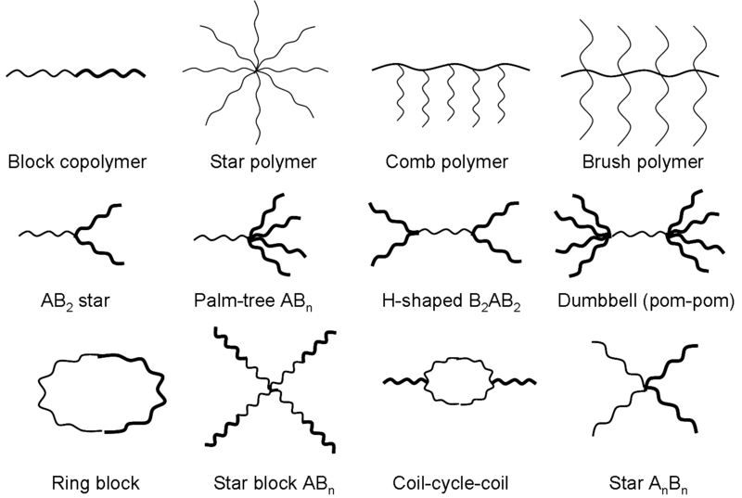
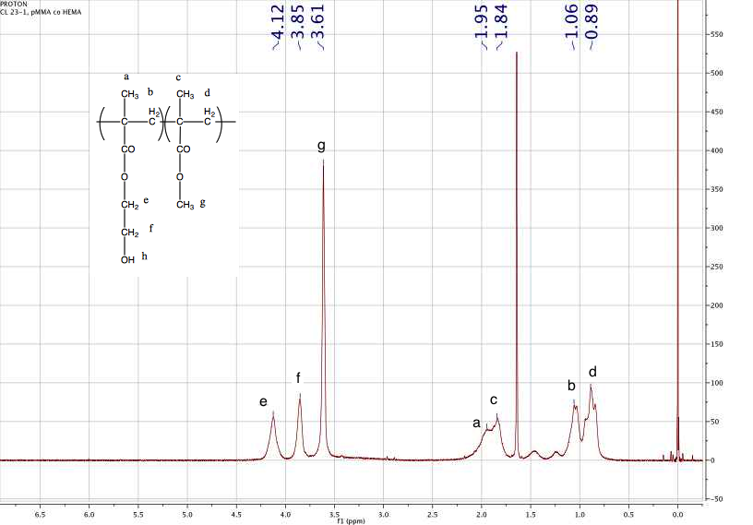
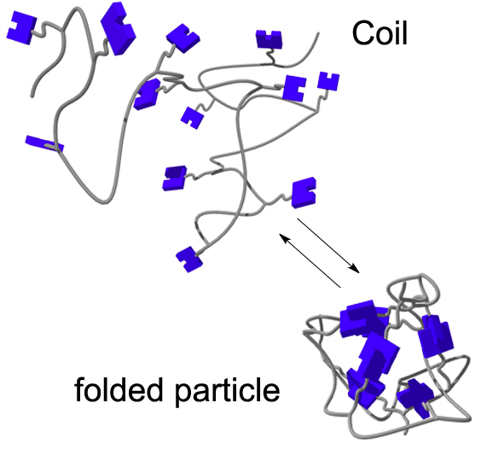
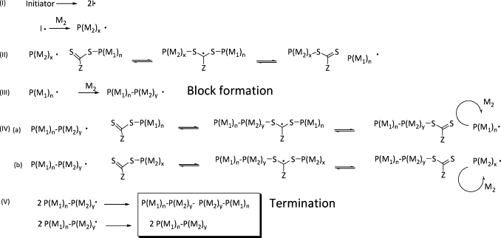
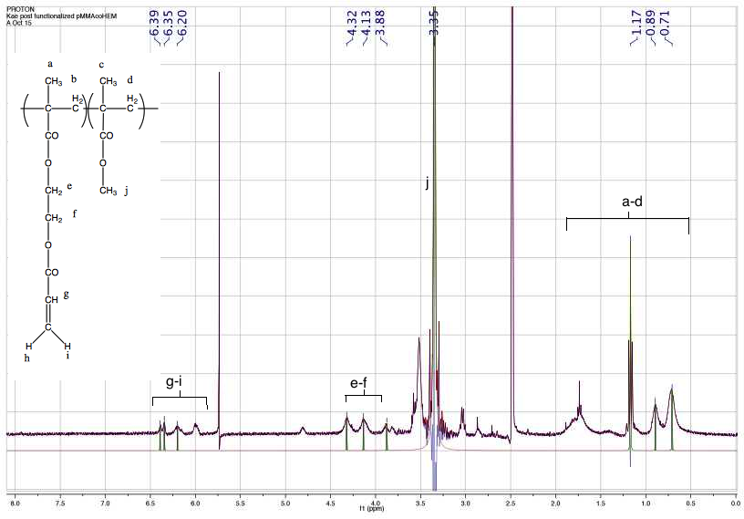
Selective Olefin Metathesis as an Intra-Chain Cross-linker for Single-Chain Nanoparticle Formation
Kathryn N. Dube, Christopher Lyon, Andrea Duke, Dr. Erik Berda
Chemistry Department, University of New Hampshire, 23 Academic Way, Parsons Hall, Durham, NH 03824.
knp6@unh.edu
Background
Polymers:
  Chemical structure made of many repeating units
  Form many different structures:
Nanomaterials:
  Materials that are less than 100 nm in size⁴
  Further classified by shape:
    Nanofibers, nanotubes, nanoparticles, nanodots
RAFT
  Reversible addition-fragmentation chain transfer polymerization
  Mechanism³:
Current Work
Reaction Schemes^{1,2}:
NMR Spectra:
Future Work
Modifications to Current Work:
  Investigate new solvent systems
  Revisit monomer ratios, as well as monomer to initiator and monomer to chain transfer agent ratios
  Investigate cross-linking units like divinylbenzene:
Cross-linking to Form Nanoparticles:
  Reversible or irreversible
  Covalent or ionic
  Inter-chain or intra-chain
  Decreases fluidity
  Increases surface area to volume ratio⁵
Ortho-, para- and methyl-divinylbenzene
¹H NMR of pre-functionalized poly(HEMA-co-MMA) in CDCl₃
¹H NMR of post-functionalized poly(HEMA-co-MMA) in DMSO-D₆
Formation of particle by intra-chain crosslinking.
References: ¹ Chiefari, J.; et. al.; Macromolecules, 1998, 31, 5559. ² Cuervo-Rodriguez, R.; Bordege, V.; Sanchez-Chaves, M.; Fernandez-Garcia, M.; Jour. Polym. Sci., Part A, Polym. Chem., 2006, 44, 5618. ³ Gregory, A.; Stenzel, M. H.; Prog. Poly. Chem., 2012, 37, 38. ⁴ Nanomaterials. http://ec.europa.eu/environment/chemicals/nanotech/. (April 23, 2013). ⁵ Zhang, K.; Fang, H.; Shen, G.; Talyor, J. A.; Wooley, K.; Ann. Am. Thorac. Soc., 2009, 6, 450
Acknowledgements: I would like to thank the my advisor, Dr. Erik Berda, as well as Chris Lyon and Andrea Duke for their help on this project. I would also like the rest of the research group for their help and support throughout this project.

