Slide 1

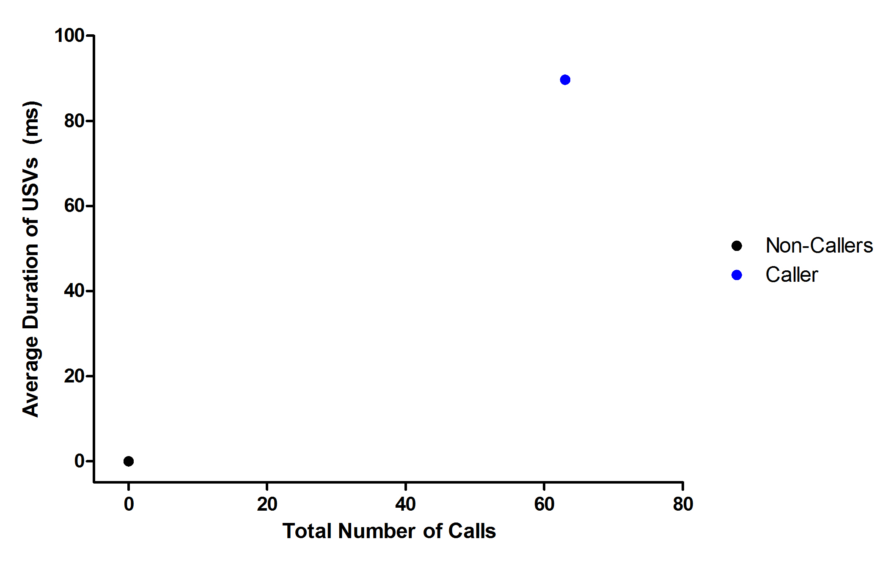
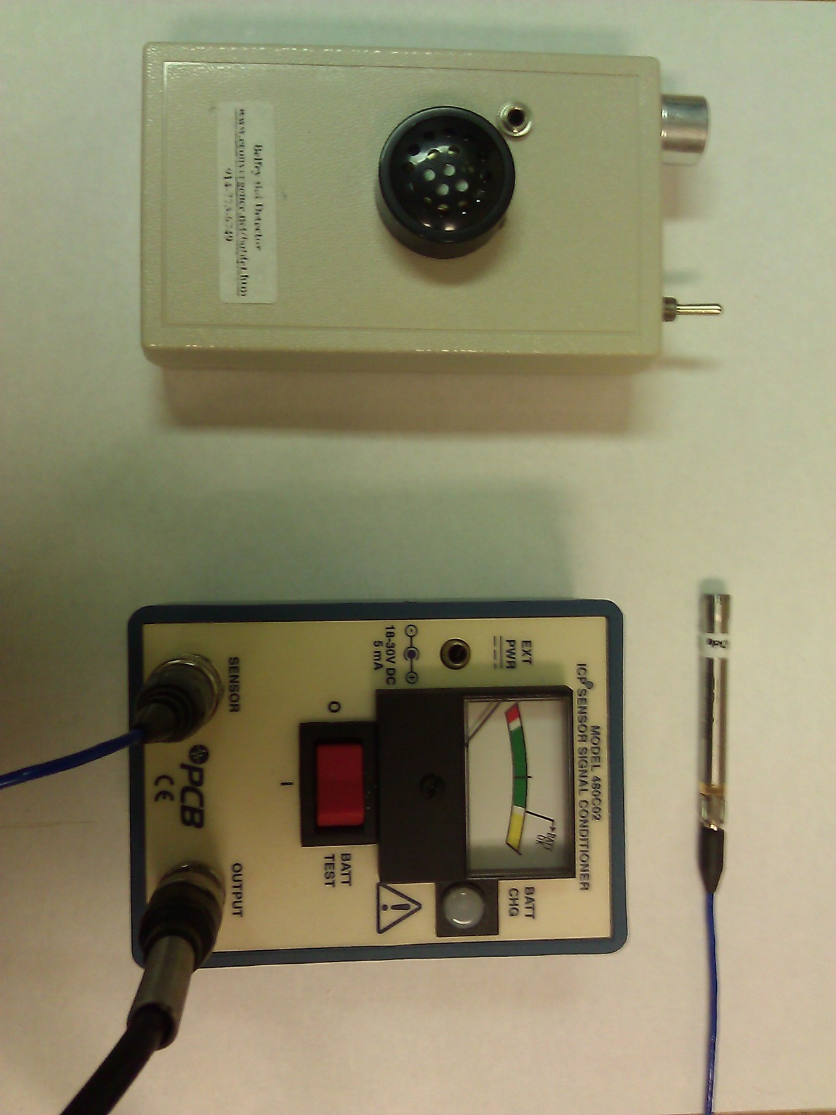
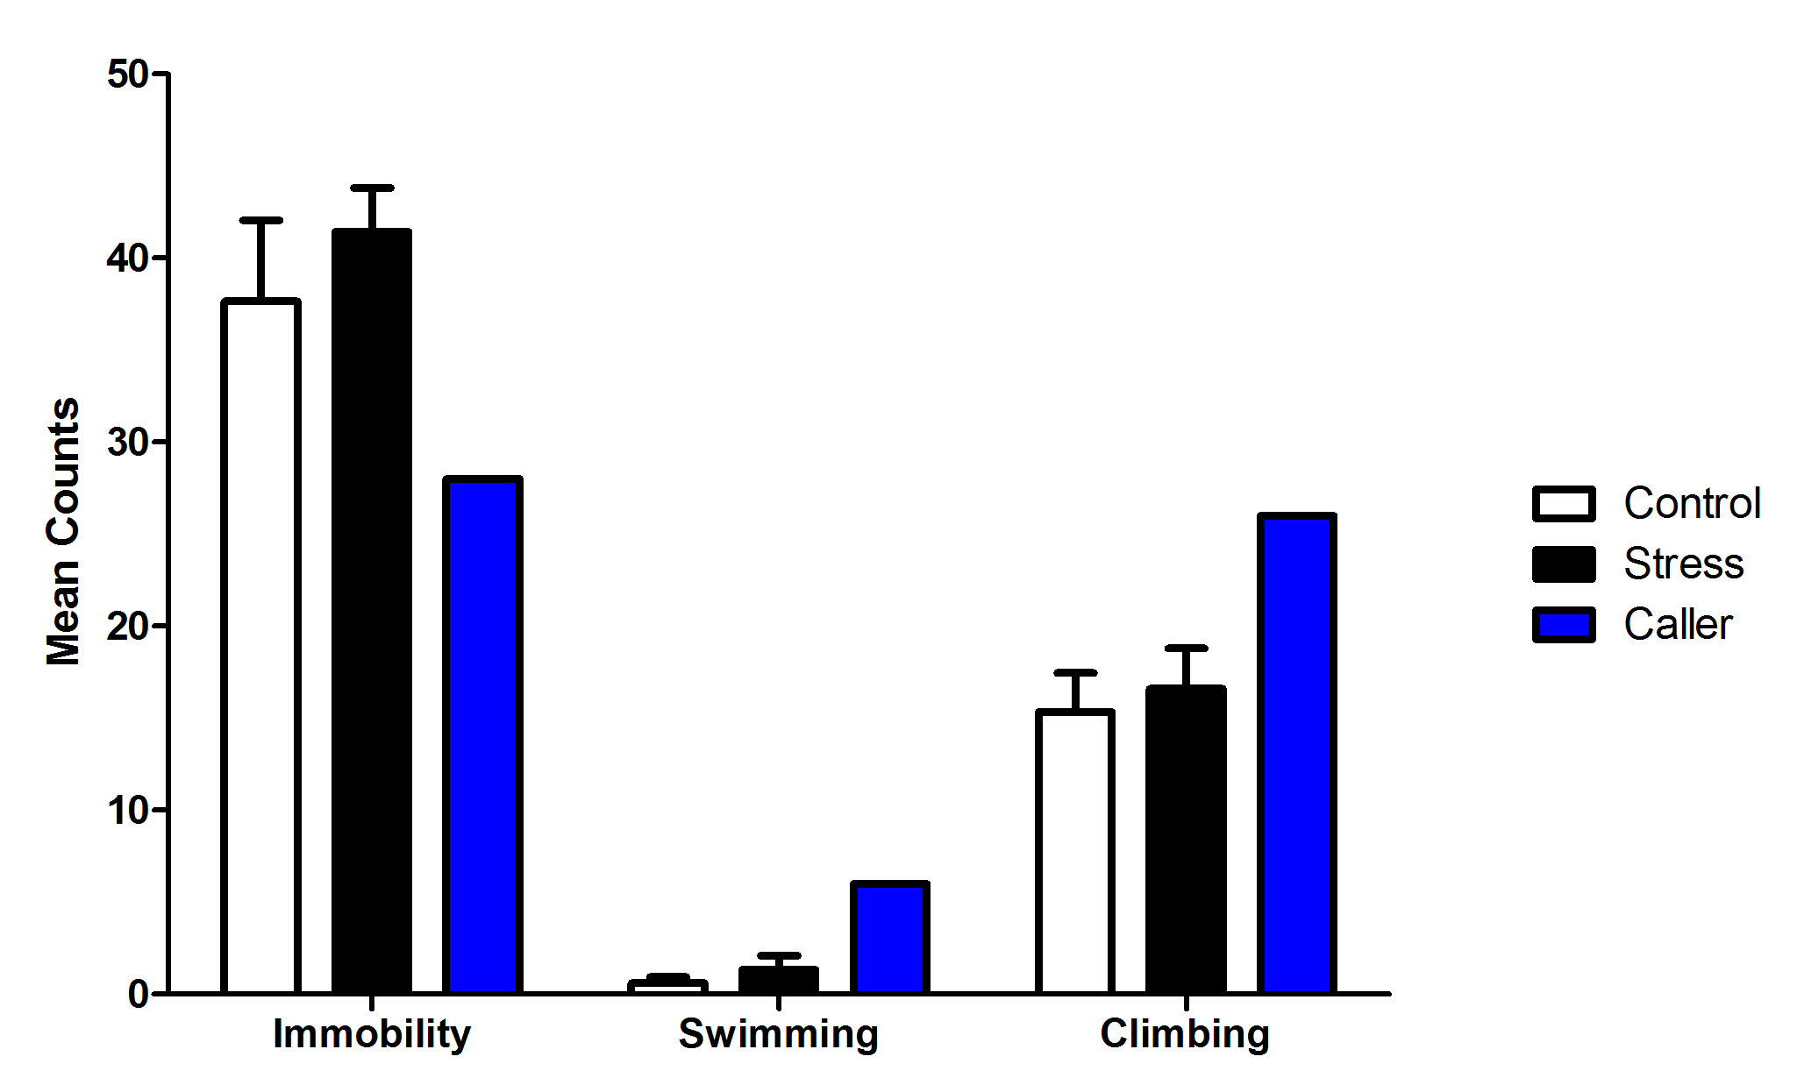
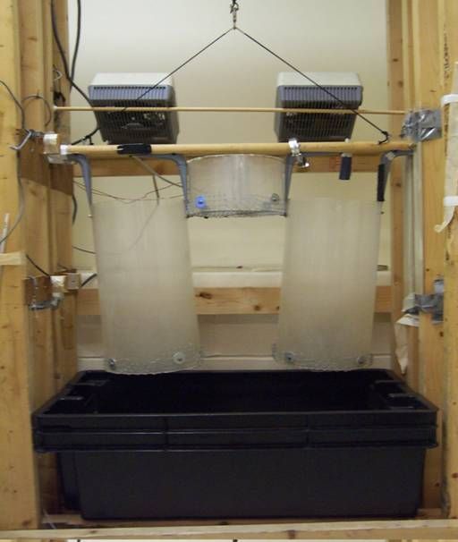
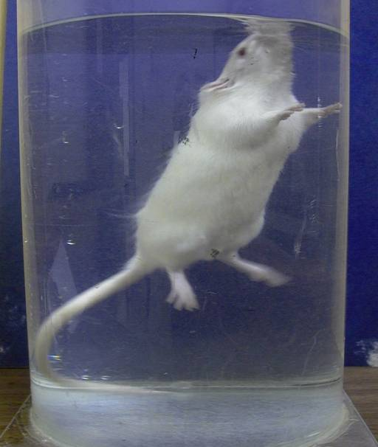
Do Ultrasonic Vocalizations During Intermittent Swim Stress Forecast
Resilience in a Subsequent Forced Swim Test?
Tristan A. Papallo, Nathaniel P. Stafford, Timothy A. Warner, & Robert C. Drugan
Psychology Department, University of New Hampshire, Durham, NH 03824, USA
Introduction
Methods
Results
Conclusions
Depression is a persistent, highly heritable, potentially life threatening illness that effects one-fifth of the world’s population. Those who are depressed suffer from a multitude of symptoms, e.g. fixated with feelings and thoughts of worthlessness, helplessness, self-hatred, and attempted suicide. However, fewer than 50% of depressed patients fully recover from current treatment methods.^{[1]}
Animal models of depression, such as intermittent swim stress (ISS), can elicit signs of depression seen in humans. Previous studies have focused on the animals that were vulnerable to stress. This study instead focused on those animals that underwent stress, but were resilient. By understanding the differences between resilient and vulnerable subjects, new treatments can be produced.
We had reported that exposure to 100 trials of ISS increases immobility in the forced swim test (FST).^{[2]} These consequences could resemble behavioral depression. It had also been reported that high amounts of ultrasonic vocalizations (USVs), a predictor of resiliency, during the ISS could produce a change in learning during the swim escape test, an instrumental learning task.^{[4]}
To determine the role of USVs during the ISS paradigm, and their effects on behavior, rats were recorded during 80 trials of ISS —— a threshold for the paradigm. 24 hours later, rats underwent the FST^{[6]}.
The purpose of this study was to assess the implications of USVs during ISS to predict resiliency in the FST.
Procedure
On Day 1, rats were randomly assigned to one of 2 groups: ISS or Confined Control (CC). The trials in the ISS apparatus were set on a variable interval of 60 seconds, which occurred for 80, five second trials. The ISS rats were submerged in water, while the CC rats were placed in the same apparatus without the presence of water. All ISS rats were recorded for USVs during this time period.
Approximately 24 hours later, rats were video recorded undergoing a 5 min FST. These videos were analyzed by two observers blind to group membership, (to ensure proper inter-rater reliability), who recorded the rats behavior every five seconds. Behaviors were separated into immobility, swimming, and climbing.
Average Duration and Number of Calls per Subject
There was no difference in behaviour (immobility, swimming, climbing) after 80 trials for either the ISS of CC.
However, the vocalizing rat, had a marked difference on all behaviours when compared to both the ISS and the CC group.
These data may suggest that USVs during the ISS can forecast resilience in subsequent FST, a measure of behavioural depression.
Future studies will expand on the impact of USVs and resiliency, look into differences in brain morphology between resilient and vulnerable rats, as well as sex differences.
Data Analysis
Pearson’s r was used to determine inter-rater-reliability for the three behaviors in the FST. Analysis of immobility, swimming and climbing were conducted with a one-way ANOVA.
Fig. 1 Average duration of the caller’s 68 ultrasonic vocalizations was 94.662 milliseconds. The remaining 9 stress rats were non-callers
References
Apparatus
Average Time Spent Immobile, Swimming, or Climbing for the CC group, ISS Group, and Caller.
Berton, O., & Nestler, E. J. 2006. New approaches to antidepressant drug discovery: Beyond monoamines. Neuroscience, 7, 137-151. doi: 10.1038/nrn1846
Christianson, JP., Drugan, RC. 2005. Intermittent cold water swim stress increases immobility and interferes with escape performance in rat. Behavioral Brain Research, 165(1): 58-62.
Detke, MJ., Rickels, M., Lucki, I. 1995. Active behaviours in the rat forced swimming test differently produced by serotonergic and noradrenergic antidepressants. Psychopharmacology. 121, 66–72.
Drugan, R. C., Christianson, J. P., Stine, W. W., & Soucy, D. P. (2009). Swim stress-induced ultrasonic vocalizations forecast resilience in rats. Behavioral Brain Research, 202, 142-145. doi: 101016/j.bbr.2009.03.021
Plaznik A, Tamborsak E, Hauptmann M, Bidzinski A, Kostowski W. 1988. Brain neurotransmitter systems mediating behavioral deficits produced by inescapable shock treatment in rats. Brain Research, 447, 122-132.
Porsolt, RD., Le Pichon, M., Jalfre, M., 1977. Depression: a new animal model sensitive to antidepressant treatments. Nature. 266, 730–732.
Top: Bat Detector (left) and Microphone (right) used to collect the 22 khz Ultrasonic Vocalizations. Left: The Swim Stress Apparatus During the Inter-Trial-Interval. Right: The Forced Swim Test.
Materials
Animals:
Male Sprague Dawley rats (Charles River Labs) weighing 180-200g on arrival. They had free access to food and water for 1 week before experiments. Rats were group housed, 4/cage prior to experiments but singly housed on Days 1 and 2.
Apparatus:
ISS treatments^{[2]} were conducted in in the apparatus shown to the right. On a trial, the cylinders were lowered into the cold water (59°F) to a depth of 20 cm. A space heater blew warm air (36°C) into the stress cylinder, while a fan was placed on the control cylinder, between trials.
Forced swim tests were conducted in clear plastic cylinders (20 cm DIA) filled with 84°F water to a depth of 29 cm.^{[2,3,6]}
Acknowledgements
The experiments presented in this poster were funded by the COLE Fund and the UNH Psychology Department. All procedures were reviewed and approved by the UNH Institutional Animal Care and Use Committee (IACUC).
Fig. 2 Mean counts of immobility, swimming and climbing behaviors when sampled every 5 seconds during the 5-minute forced swim test testing period, for the control group, stress group, and the caller.

