Slide 1

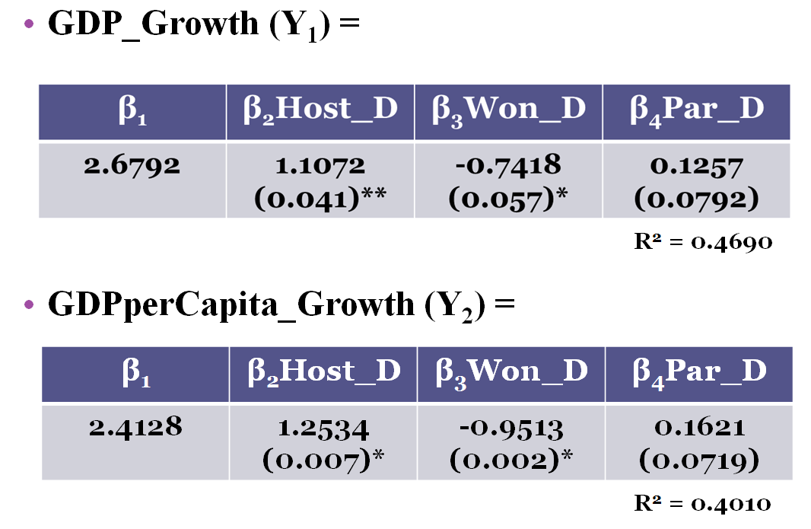


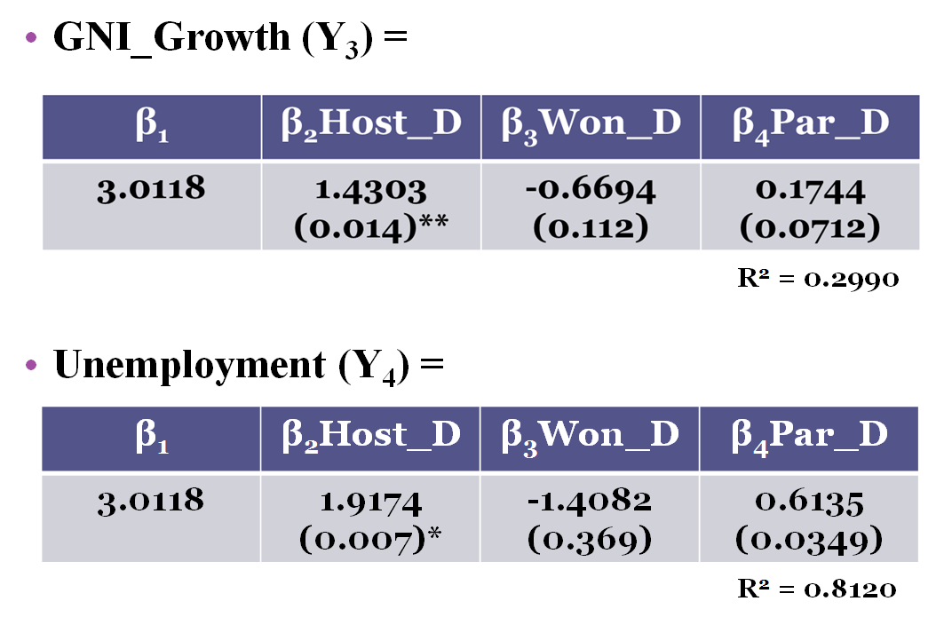

The Economic Benefits of the FIFA World Cup
Goran Galić
Department of Economics
University of New Hampshire
Abstract
Data Modules
Results-Conclusions-Issues
The FIFA World Cup is the largest sporting event in the world and hosting it in the past decade has spread to continents that have never previously hosted the event before, such as Asia and Africa. In 2010, FIFA members voted on the hosts of the 2018 and 2022 World Cups while considering bids by 13 different nations. With the enormous costs of preparing to host the largest global sporting event, why do nations compete to host it? Are the economic benefits of hosting the World Cup great enough to offset the costs? Drawing on data from the World Bank and the International Federation of Association Football, this paper discusses the contrast between the macroeconomic numbers of nations that hosted the FIFA World Cup and other comparable nations that have not. In particular, OECD nations’ gross domestic product, gross national income, and employment numbers, from 1996 to 2007, are examined. The paper also analyzes if winning or participating in the World Cup provide any sort of economic benefit as well. My conclusions show growth of gross national income and gross domestic product to have larger increments for host nations compared to other while also showing a boost in national unemployment. Contrary to those results, nations who win the World Cup show to have an opposite effect when looking at gross national income and gross domestic product, while only participating in the FIFA World Cup shows to have no economic effect.
1998 World Cup
Host: France
1996 | 1997 | 1998 | 1999
2 Years Before | Year Before | World Cup | Year After
2002 World Cup
Host: Japan &
South Korea
2000 | 2001 | 2002 | 2003
2 Years Before | Year Before | World Cup | Year After
2006 World Cup
Host: Germany
2004 | 2005 | 2006 | 2007
2 Years Before | Year Before | World Cup | Year After
Models
1996-2007 International, time-series data
Fixed Effects: Years and Nations
Economic data from the World Bank was used and regression was run to find the differences of various economic variables for each World Cup module.
Data was then used to compare host nations to other OECD nations, who joined before 1997, from Europe and Asia.
World Cup winners and participants were also compared.
23 Nations were analyzed overall.
Host nations experience larger annual GDP growth, while winners experience lower.
GDP per Capita variable shows that GDP numbers are not based on population increases/decreases.
GNI growth larger than GDP as it measures total value produced within the country.
Unemployment rate shows downside to hosting, data shows increase occurs after World Cup.
Issues: Small sample, limited time, national data issues when comparing FIFA statistics and economic numbers.
Model 1: | Model 2: | Model 3: | Model 4:
GDP_Growth (Y₁)= | GDPperCapita_Growth (Y₂) = | GNI_Growth (Y₃)= | Unemployment (Y₄)=
β₁ | β₁ | β₁ | β₁
+ β₂Host_D | + β₂Host_D | + β₂Host_D | + β₂Host_D
+ β₃Won_D | + β₃Won_D | + β₃Won_D | + β₃Won_D
+ β₄Par_D | + β₄Par_D | + β₄Par_D | + β₄Par_D
+ β₅Country | + β₅Country | + β₅Country | + β₅Country
+ β₆Year | + β₆Year | + β₆Year | + β₆Year
Sources
International Federation of Association Football http://www.fifa.com/worldcup/index.html
The World Bank http://data.worldbank.org

