Slide 1
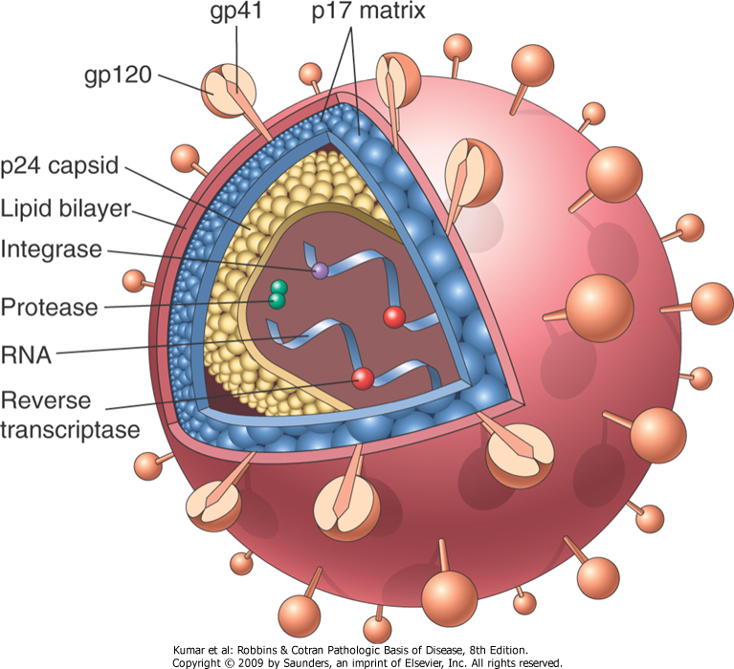
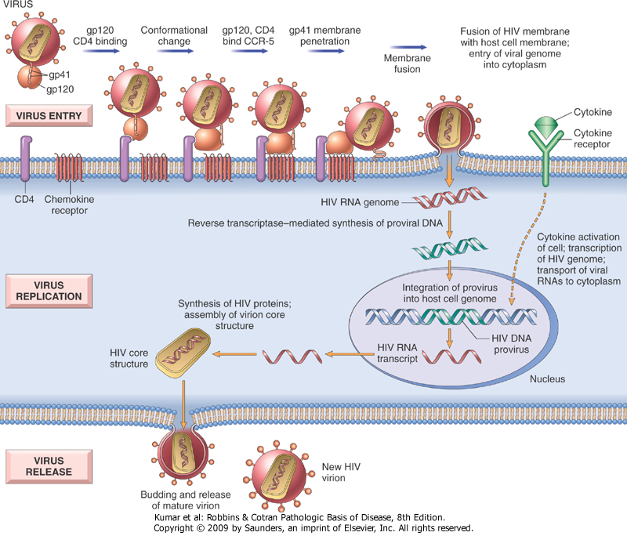
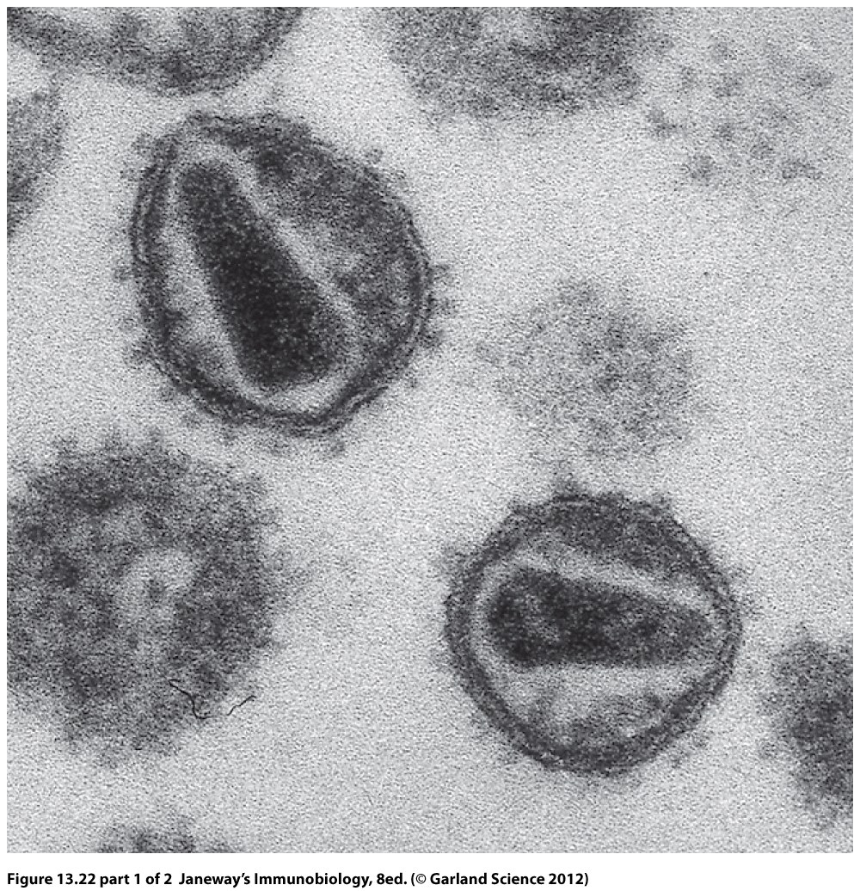
Natural Resistance to HIV Harnessed for a Potential Cure
Lea M. Trush
Department of Molecular, Cellular, & Biomedical Sciences
University of New Hampshire
Durham, NH
Human Immunodeficiency Virus
Viruses insert their genomes into host cells to utilize normal functions and machinery for their own replication. HIV is composed of a core, protein coat, and lipid envelope^{[1]}.
HIV predominantly infects CD4+ T lymphocytes. Viral entry requires co-receptor CCR5 or CXCR4.
T cells activate macrophages, help B-cells produce antibodies, & kill infected cells.
Depletion of CD4+ T cells is due to direct cytopathic effects of HIV & leads to gradual loss of immune competence.
AIDS diagnosed when T cell count below 200 cells/ul.
Opportunistic infections develop responsible for the majority of deaths associated with AIDS^{[2]}.
SB-728-T Clinical Trials
Sangamo Biosciences has engineered a Zinc Finger Nuclease that efficiently targets the disruption of the CCR5 gene.
By generating a double stranded break in the CCR5 coding region upstream of the natural CCR5Δ32 mutation T-cells can be modified, producing healthy, stable, and heritable HIV resistant CD4 T cells.
Modified HIV resistant T cells could be reintroduced into HIV+ subjects potentially improving immunological health.
Currently, the safety and tolerability of SB-728-T is being evaluated in ongoing phase 1/2 trials and two phase 1 clinical trials^{[10]}.
Official Title | Purpose | Description | Outcome Measures
A Phase 1 Study of Autologous T-cells Genetically Modified at the CCR5 Gene by Zinc Finger Nucleases SB-728 in HIV-Infected Patients | To find out if ZFN modified T-cells are safe for humans How ZFN modified T-cells affects HIV | Single infusion of 5-10 billion ZFN modified CD4+T cells will be given: Cohort 1- Patients failing HAART regimens Cohort 2- Patients doing well on HAART Cohort 3- Patients who have an undetectable viral load on HAART with suboptimal T cell counts | Primary: Safety Secondary: T cell response T-cell count & HIV RNA levels Viral load changes Persistence of modified T cells Monitor for viral drift
A Phase 1 Dose Escalation, Single Dose Study of Autologous T-cells Genetically Modified at the CCR5 Gene by Zinc Finger Nucleases SB-728 in HIV-Infected Patients Who Exhibited Suboptimal CD4+ T-Cell Gains During Long-Term Antiretroviral Therapy | To find out if ZFN modified T-cells are safe for humans How ZFN modified T-cells affects HIV | Single infusion of 5-10 billion ZFN modified CD4+T cells will be given: Cohort 1- 0.5-1.0 x 1010 SB-728-T Cohort 2- 2.0 x 1010 SB-728-T Cohort 3- 3.0 x 1010 SB-728-T Cohort 4 - Up to 4 HAART failure subjects; 0.5 to 3.0 x 1010 SB-728-T Cohort 5 (Phase 2) - 20 subjects heterozygotic for CCR5Δ32; 0.5 to 3.0 x 1010 SB-728-T | Primary: Safety Secondary: Persistence and activity of CCR5 ZFN-modified T-Cells
A Phase 1, Open-Label Study to Assess the Effect of Escalating Doses of Cytotoxan® on the Engraftment of SB-728-T in Aviremic HIV-Infected Subjects on HAART | Evaluate escalating doses of Cytotoxan® given 1 day prior to infusion regarding: Safety Tolerability Effect on HIV viral load | Infusion of 5 to 30 billion ZFN modified CD4+ T cells 1 day following IV Cytotoxan® 1.0 g/m2: Cohort 1- IV Cytotoxan® 200 mg Cohort 2- IV Cytotoxan® 0.5 g/m2 Cohort 3 - IV Cytotoxan® 1.0 g/m2 | Primary: Safety Secondary: Effect of Cytotoxan® Effects on HIV-1 RNA levels Change in CD4+ T-cell counts
A Phase 1/2, Open Label, Single Infusion Study of Autologous T-Cells Genetically Modified at the CCR5 Gene by Zinc Finger Nucleases (SB-728-T) in HIV Infected Subjects | To find out if ZFN modified T-cells are safe for humans How ZFN modified T-cells affects HIV | Each infusion will be 5-30 billion modified CD4+ T-cells: Cohort 1 – Subjects will receive one intravenous infusion of SB-728-T | Primary: Safety Secondary: Persistence of HIV RNA Change in CD4+ T-cell count Persistence of SB-728-T in blood
Acquired Immune Deficiency Syndrome
HIV infection leads to AIDS.
The most extreme cause of immune suppression caused by a pathogen.
Officially recognized in 1981 by the USA.
Worldwide pandemic.
The World Health Organization (WHO) estimates more than 25 million people have died from AIDS.
Currently 33.5 million people are living with HIV infection. This number continues to grow at an alarming rate^{[3]}.
CCR5Δ32 Mutation
Natural resistance to HIV infection is linked to a DNA mutation. Known as the, CCR5Δ32 mutation, it is a 32-base pair deletion leading to a non-functional CCR5 protein. Gene frequency of this mutant allele in Caucasian populations is 0.09 (10% are heterozygous carriers & 1% is homozygous). Homozygous CCR5Δ32 alleles exhibit natural resistance to infection. HIV entry is inhibited because of the absence of the functional co-receptor CCR5. Slower progression of HIV/AIDS correlates with carriers heterozygous for the CCR5Δ32 mutation^{[3]}.
Highly Active Antiretroviral Therapy
Standard Treatment
Cocktail of several drugs
Effective in improving the quality of life & prolonging survival rate.
Lifelong therapy that slows progression of disease (no cure)
Linked with severe side effects, rigid medication schedules & dietary restrictions that make compliance difficult.
High incidence of viral mutation
Requires constant monitoring of viral levels & medication adjustments.
Patients often face increasing outbreaks of infection^{[4]}
Toddler Cured of HIV Infection
March 2,2013, scientists announced, a 26-month-year-old is now “functionally cured” of HIV infection after exposure to HIV during birth by HIV+ mother.
HIV infection was confirmed on 2nd day of life by:
  Maternal HIV antibody
  Infant HIV antibody
  Plasma viral load (PVL) tests
Initiated on Antiretroviral Therapy at 30 hours of age but discontinued at 18 months for unknown reasons.
On day 29 undetectable levels (<20 copies virus/ml blood) of HIV RNA were observed.
Plasma HIV RNA levels remain undetectable between through 26 months of age
This is the first well-documented case of a functional cure in an HIV+ child
Suggests that very early ART may prevent establishment of a latent reservoir by preventing the infection of memory T cells. This potentially could lead to a cure in children. (Persaud D, Gay H, et al. Functional HIV Cure after a Very Early ART of an Infected Infant, CROI 2013).
Vaccines
Medical product administered to stimulate the body’s immune system in order to prevent or control an infection
Therapeutic-Designed to boost body’s immune response to better control an infection^{[5]}
Preventative-Designed to protect people from initial infection^{[6]}
HIV Vaccine Challenges
HIV attacks & destroys CD4+ T cells
Few human models of recovery
Viral antigenic shift
Lack of:
  Practical animal model
  Knowledge of antigens recognized in actual HIV encounter
  Unknown response needed to prevent HIV infection
  Eliciting both humoral and cell-mediated immune responses^{[7]}
Man Cured of HIV Infection
Case Report:
  Timothy Brown was the first person to be cured of HIV infection.
  Infected with HIV during the 1990s.
  Treated with HAART from 2003-2007.
  Diagnosed with acute myeloid leukemia (AML) in 2007.
    Bone marrow makes abnormal cells. Standard treatment is chemotherapy then infusing new stem cells from matching donor. They repopulate the immune system and kill any remaining leukemia cells.
Methods:
  Started on chemotherapy and HAART was discontinued.
  Leukemia relapsed 7 months later.
  Underwent stem cell transplant infusing CD4+ stem cells from a homozygotic CCR5Δ32 HLA-identical donor.
  The AML relapsed after 332 days
  Underwent second transplant from the same donor on day 391
Results:
  At a 20 month follow-up, testing revealed complete remission of the AML and no HIV RNA was detected during viral load testing.
Conclusions:
  It was difficult to find a donor match due to the rarity of the CR5Δ32 mutation. Therefore the practically of universal treatment by this approach is unfeasible.
  Findings highlight role of CCR5 receptor during HIV-1 infection and warrants further investigation into the development of CCR5-targeted treatment options, described in subsequent clinical trials^{[9]}.
Clinical Trials
HIV/AIDS clinical trials are research studies in which new therapies and prevention strategies for HIV infection and AIDS are tested in humans. All trials conducted are randomized, controlled, and double-blinded studies. Before FDA approval, a product must complete 5 phases of human testing^{[8]}.
SB-728-T Preliminary Results
Potent inhibition of HIV infection in cells expressing a portion of the HIV envelope fused to either CXCR4 or CCR5 HIV co-receptors.
Acute and long term increases in total CD4+ T-cell counts.
Improved CD4:CD8 T-cell ratio
Observed level of CD4+ T-cell reconstitution is significantly greater
Long term increases in total CD4+ T-cell counts correlate with increased T_{CM} and increased ZFN-mediated CCR5 disrupted T_{CM}.
Levels of CCR5 disrupted T_{CM} were stable or increased over time
Data suggests SB-728-T can provide sustained improvement in CD4 memory & potential to reconstitute the immune system in HIV+ patients. Ongoing phase 2 trials designed to maximize engraftment of SB-728-T. Preliminary data expected TBA during the first half of 2013 (Sekaly RP, Leslie G, presented at the CROI, Richmond, CA, 6 March 2013).
Phase | Study Characteristics
0 | Exploratory study involving very limited human exposure with no therapeutic or diagnostic goals.
1 | Studies that are usually conducted with healthy volunteers and that emphasize safety.
2 | Studies that gather preliminary data of effectiveness by comparing to a similar treatment, a placebo, or different treatment.
3 | Studies that gather more information about safety and effectiveness by studying different populations and dosages.
4 | Studies occurring after FDA approval for marketing.
References:
Kumar R, Abbas A, DeLancey A, Malone E. 2010. Diseases of the Immune System, p. 235-249. Robbins and Cotran Pathologic Basis of Disease, 8th ed. Saunders, Philadelphia, PA.
Goering R, Dockrell H, Zuckerman M, Wakelin D, Roitt I, Mims C, Chiodini P. 2008. Sexually transmitted diseases, p. 274-285. Mims’ Medical Microbiology, 4th ed. Mosby, Philadelphia, PA.
Murphy K. 2012. Failures of Host Defense Mechanisms, p. 543-563. Janeway’s Immunobiology, 8th ed. Garland Science, New York, NY.
Chung J. Rossi J. Jung U. 2011. Current progress and challenges in HIV gene therapy. Future Virology. 6 (11):1319-1328.
AIDSinfo. May 2006, positing date. Therapeutic HIV Vaccines. U.S. Department of Health & Human Services, Bethesda, MD. http://aidsinfo.nih.gov/contentfiles/Therapeutic_HIV_Vaccines_FS_en.pdf
AIDSinfo. May 2006, positing date. Preventative HIV Vaccines. U.S. Department of Health & Human Services, Bethesda, MD. http://aidsinfo.nih.gov/contentfiles/HIVPreventionVaccines_FS_en.pdf
National Institute of Allergy and Infectious Diseases. September 2008, posting date. HIV/AIDS, Challenges in Designing HIV Vaccines. NIH, U.S. Department of Health & Human Services, Bethesda, MD. http://www.niaid.nih.gov/topics/HIVAIDS/Understanding/Prevention/Pages/vaccineChallenges.aspx
AIDSinfo. May 2006, positing date. What Is an HIV/AIDS Clinical Trial?. U.S. Department of Health & Human Services, Bethesda, MD. http://aidsinfo.nih.gov/contentfiles/WhatIsAClinicalTrial_FS_en.pdf
Hutter G, Nowak D, et al. 2009. Long-Term Control of HIV by CCR5 Delta32/Delta32 Stem-Cell Transplantation. N Engl. J. Med. 360:692-698.
Maier D, Brennan A, Jiang S, et al. 2012. Efficient Clinical Scale Gene Modification via Zinc Zinger Nucleases Targeted Disruption of the HIV Co-Receptor CCR5. Human Gene Therapy., in press.

