Slide 1
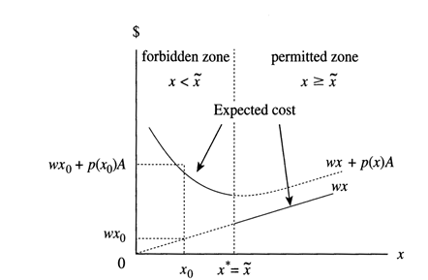
An Economic Analysis of Delbert Williamson v. Mazda Motor of America, Inc.
Major Legal Issues Presented By the Case
Tort Law: Personal injury, unfair loss or damages
Civil Court
Legal Precedence
  Federal Motor Vehicle Safety Standard 208
  Geier v. Honda Motor Company
Breach of Duty
Federal Preemption
certiorari, or a request to seek judicial review from a higher court
Summary of The Case
Williamson is suing on behalf of Thanh Williamson, who died in a car crash
1993 Mazda Minivan: The seat Thanh sat in only had a Lap band
The highest safety standard was a lap and shoulder seat belt
Federal standards were outdated, new safety information was available
The question:
“Should Mazda Be Held Responsible for Thanh’s Death”
Precaution and Costs
Outcome: Mazda should have designed their car with higher standards because it was known to them that they were not manufacturing with the highest standard of safety. Case was not Federally Preempt

