Slide 1


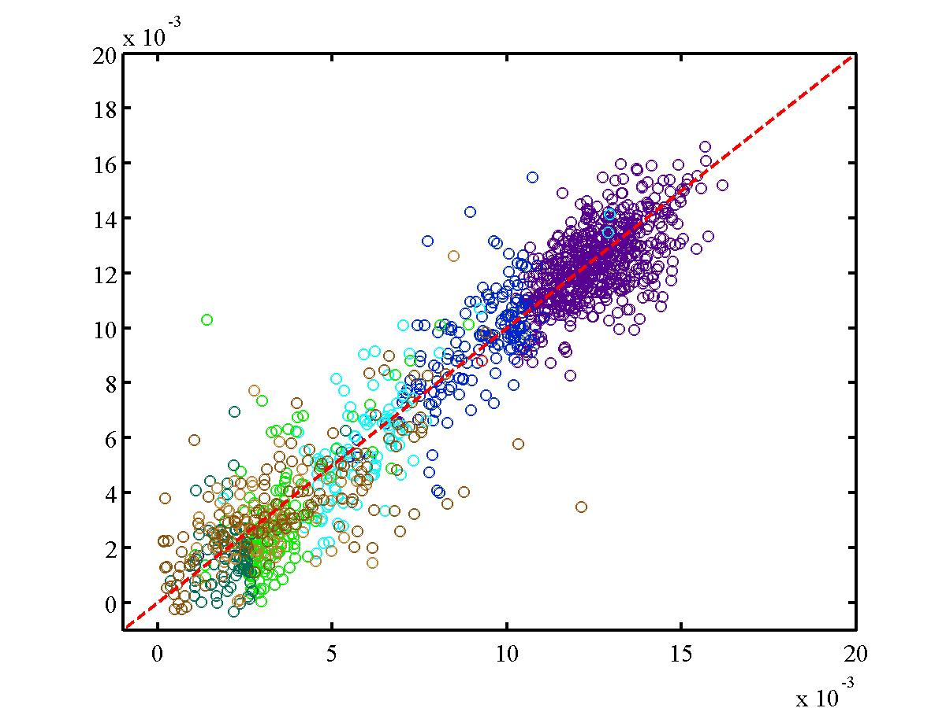
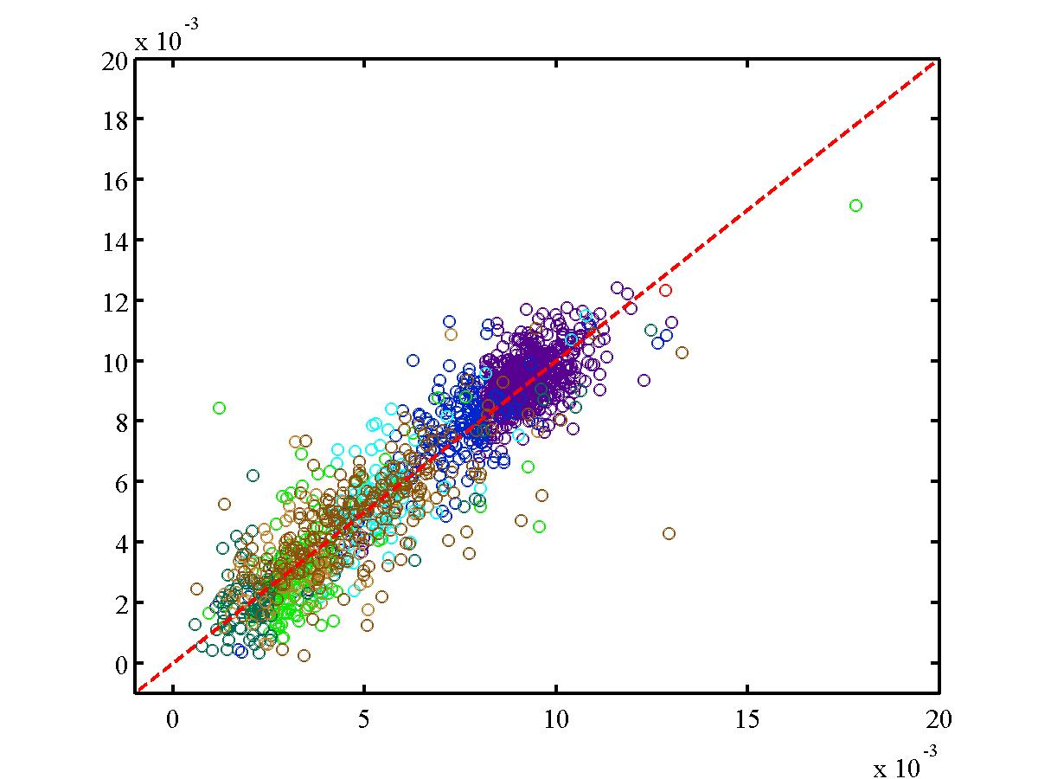
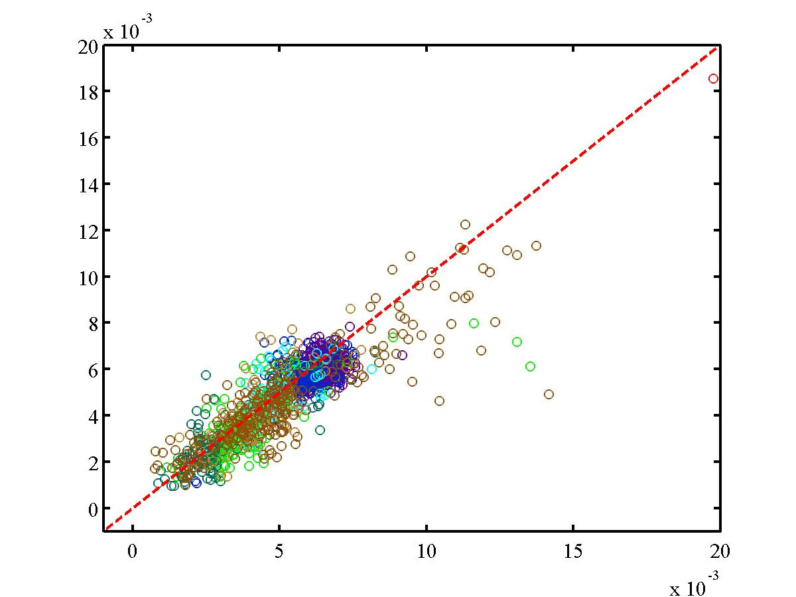
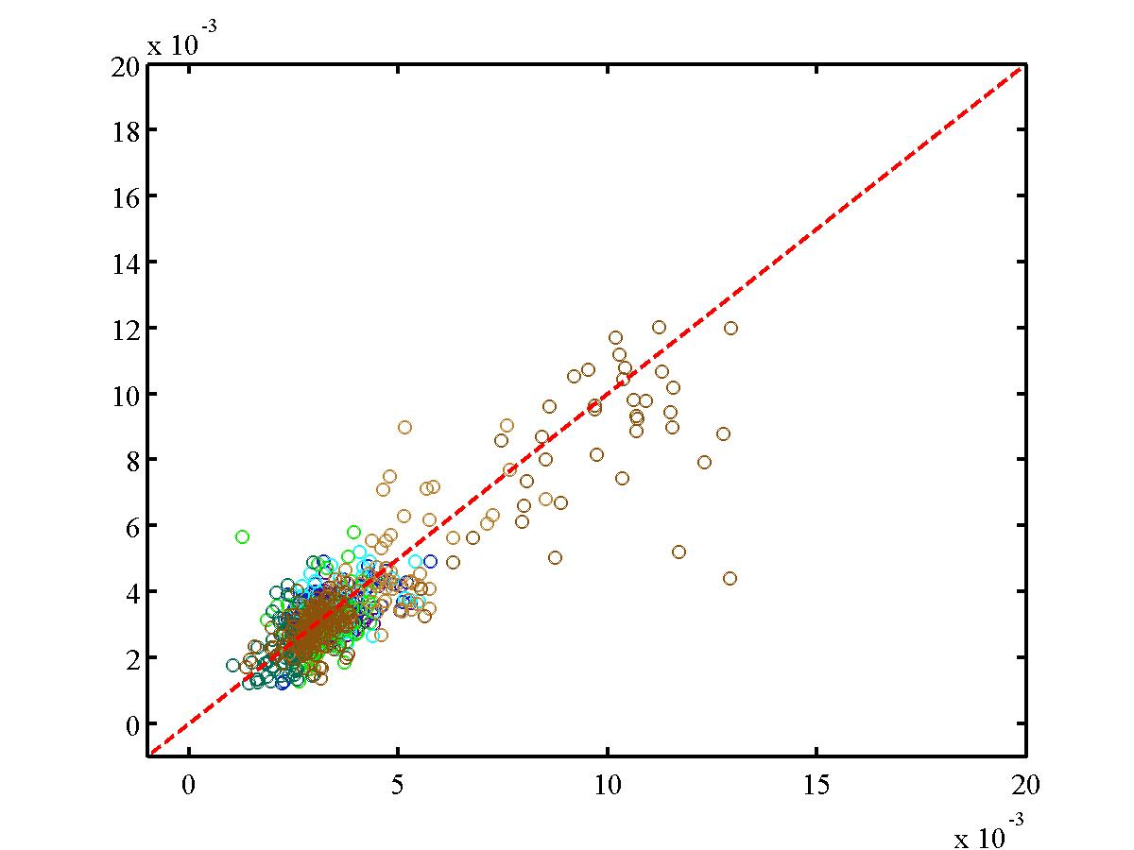
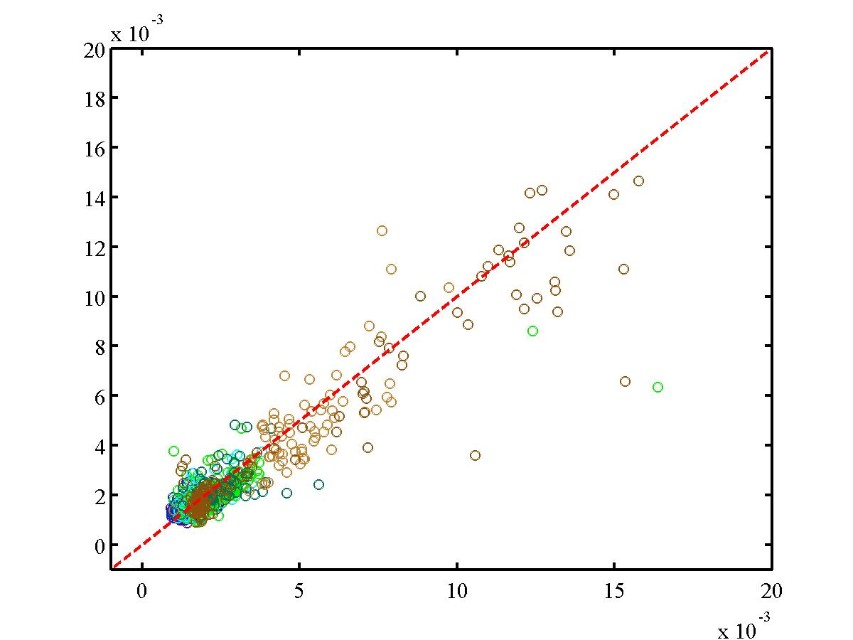
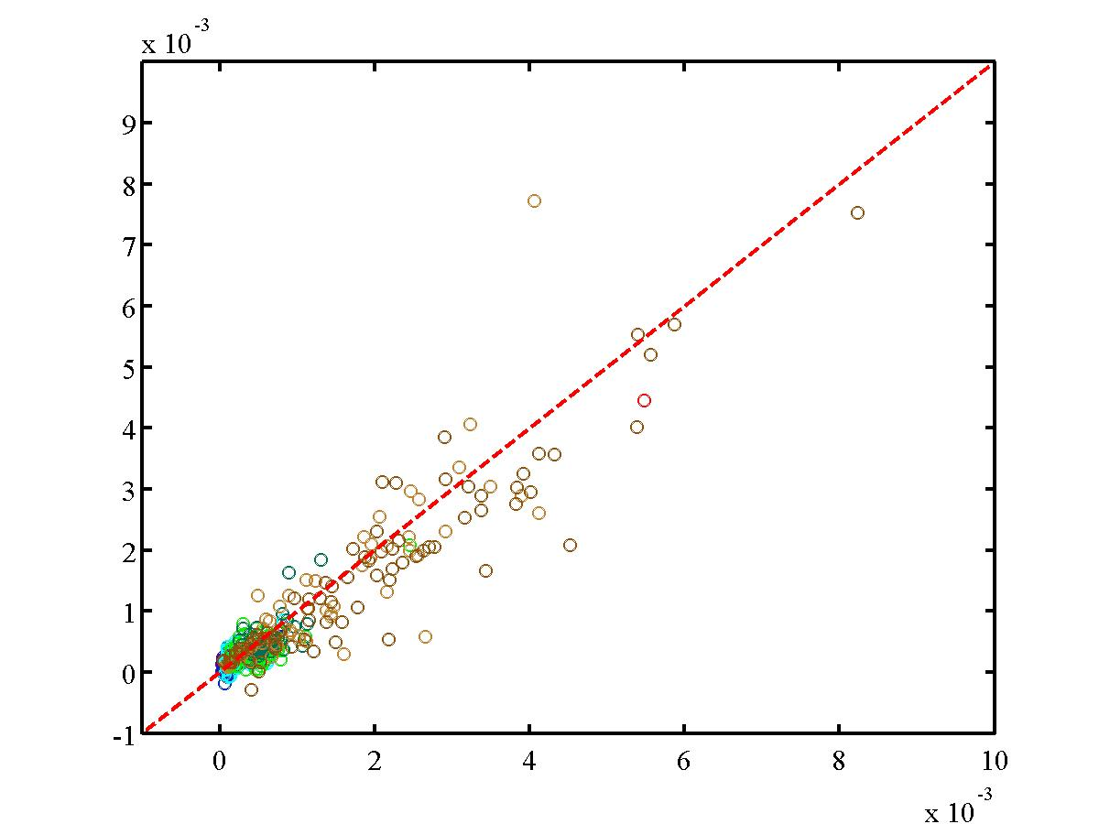
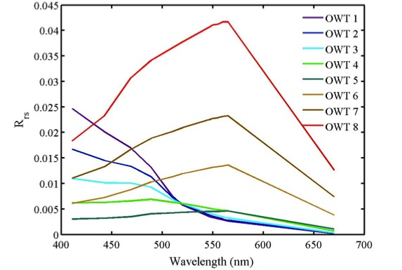
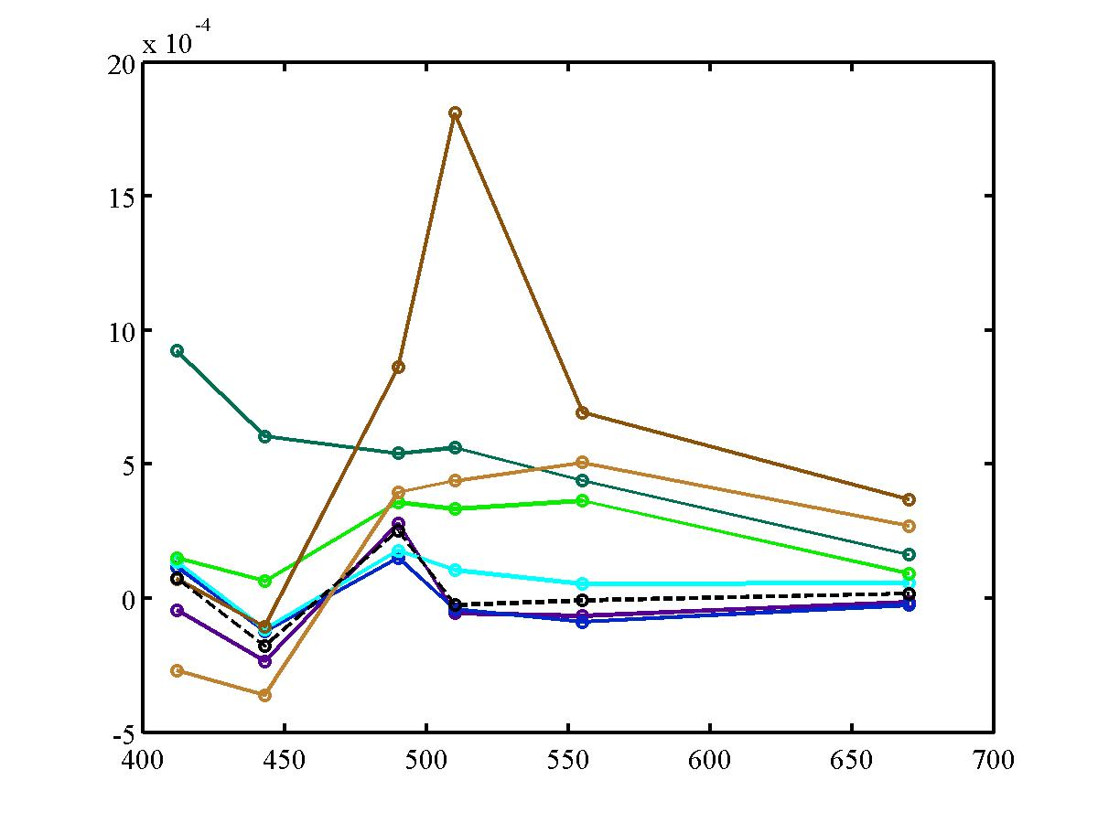
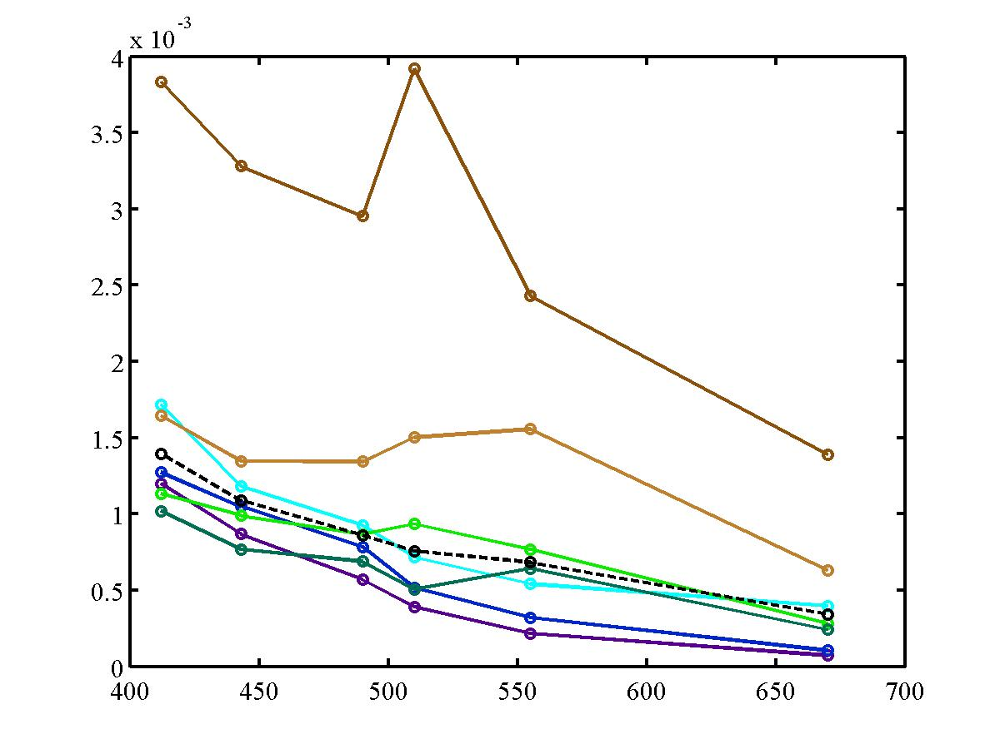
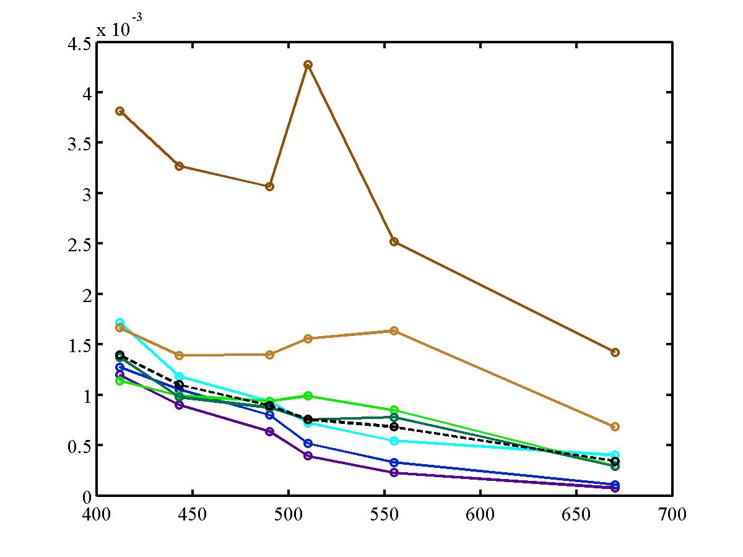
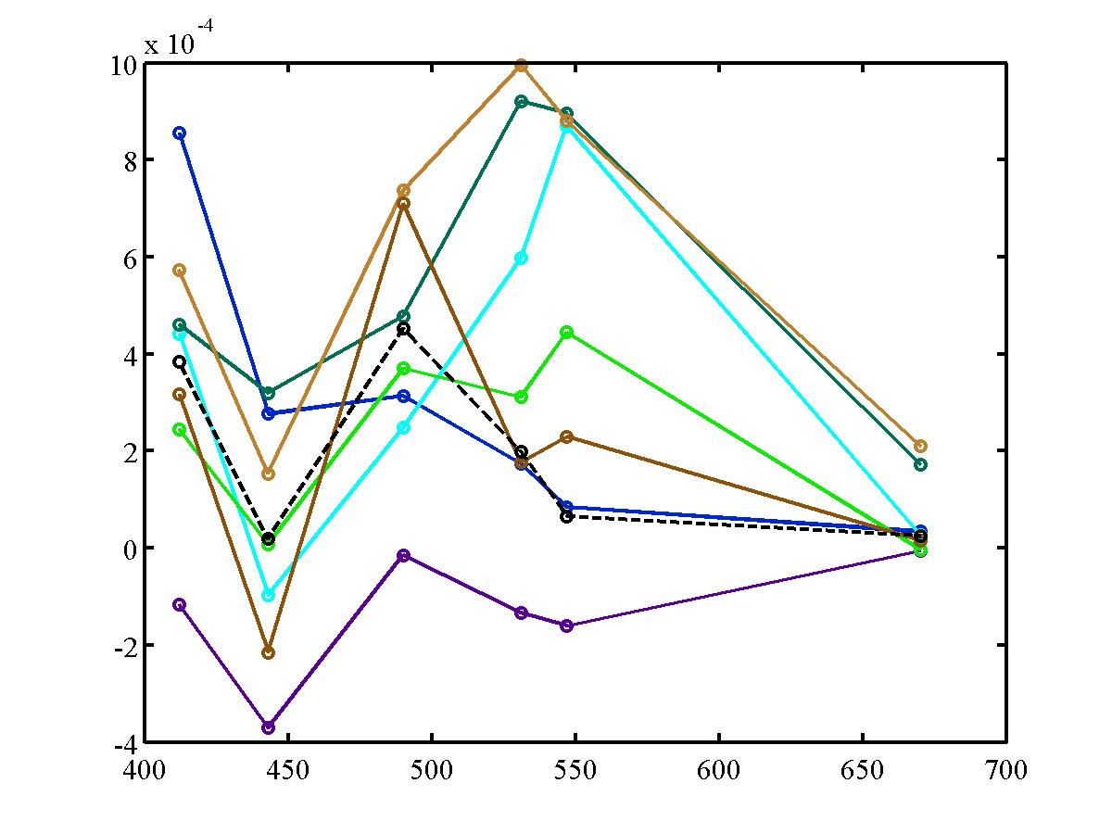
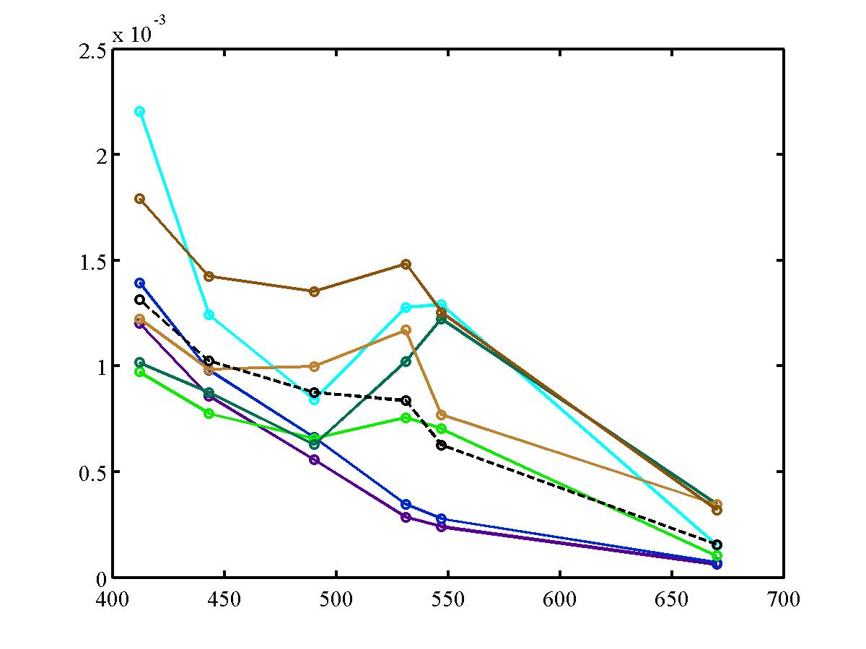
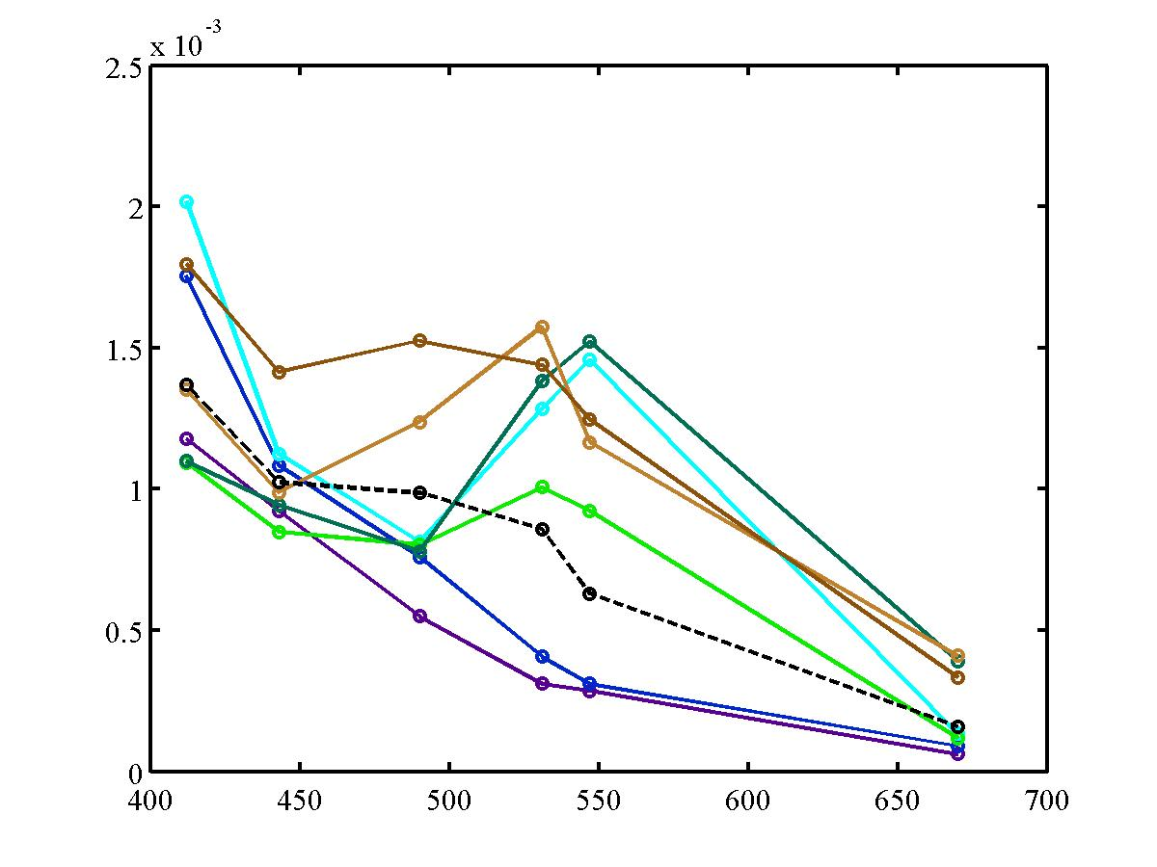
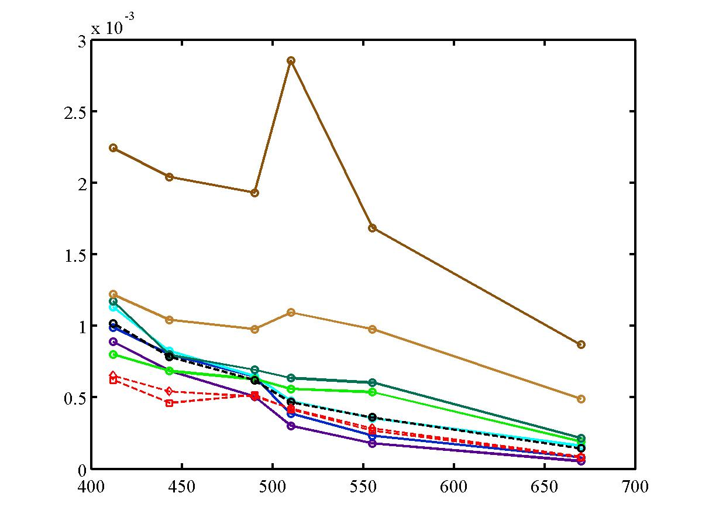
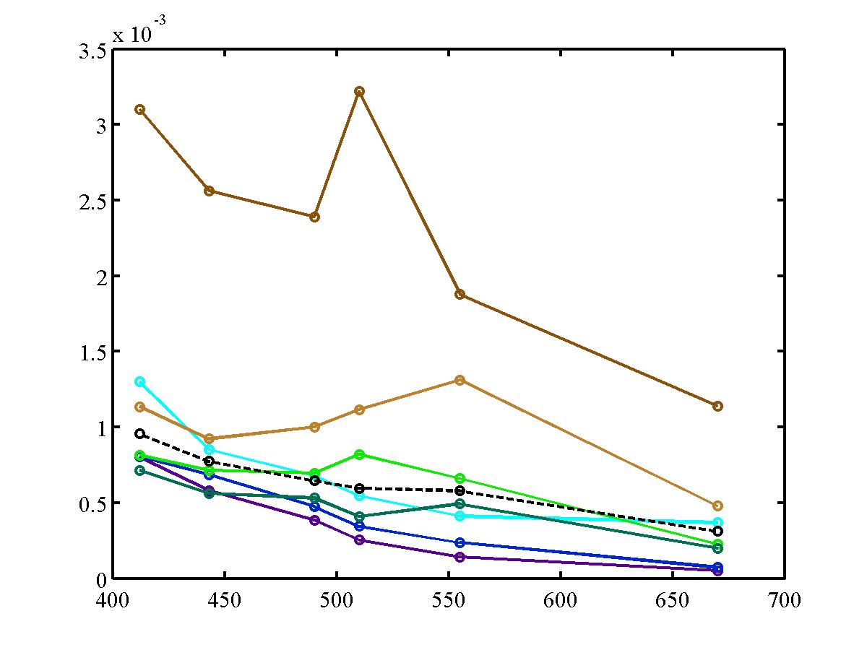
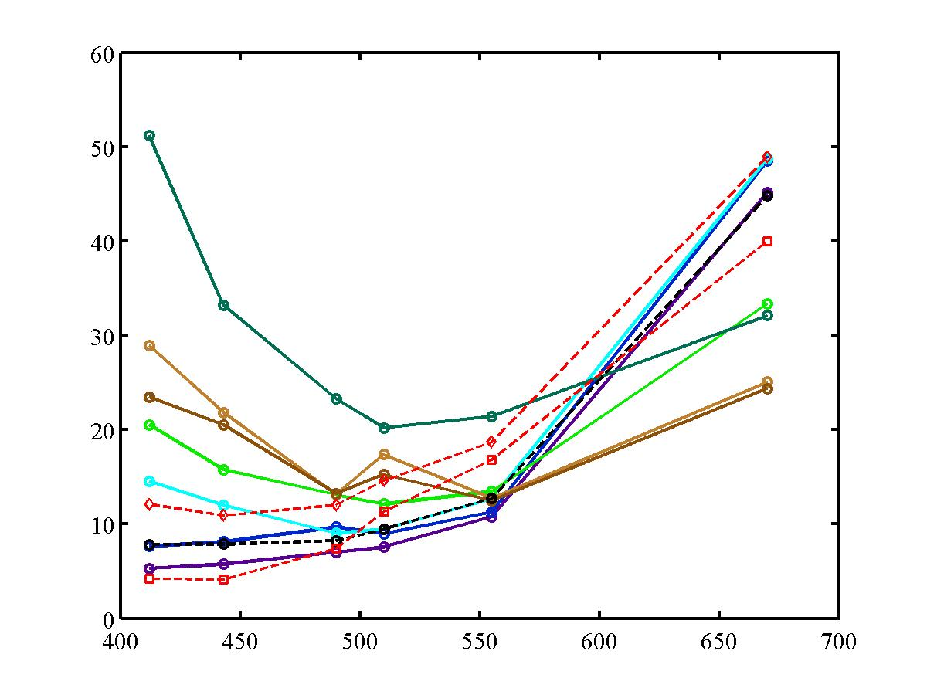
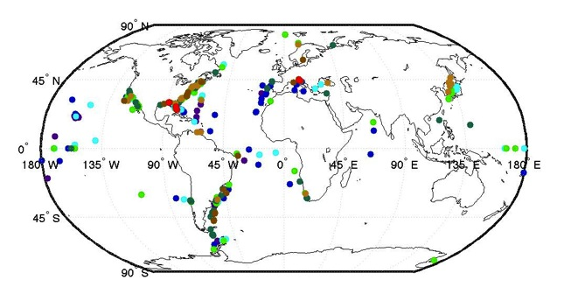
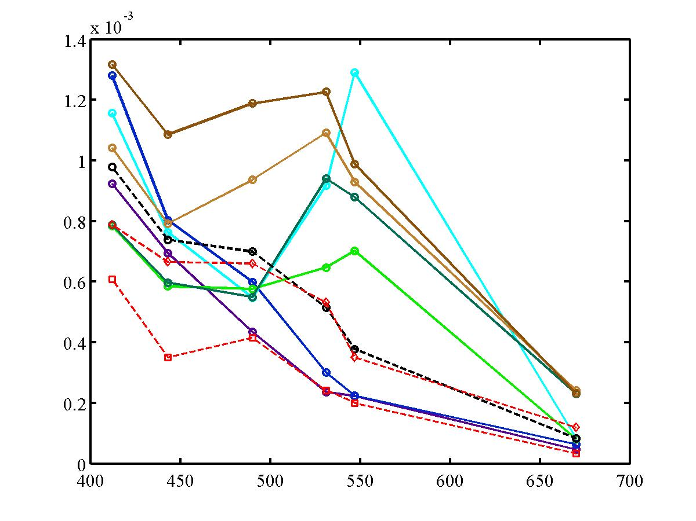
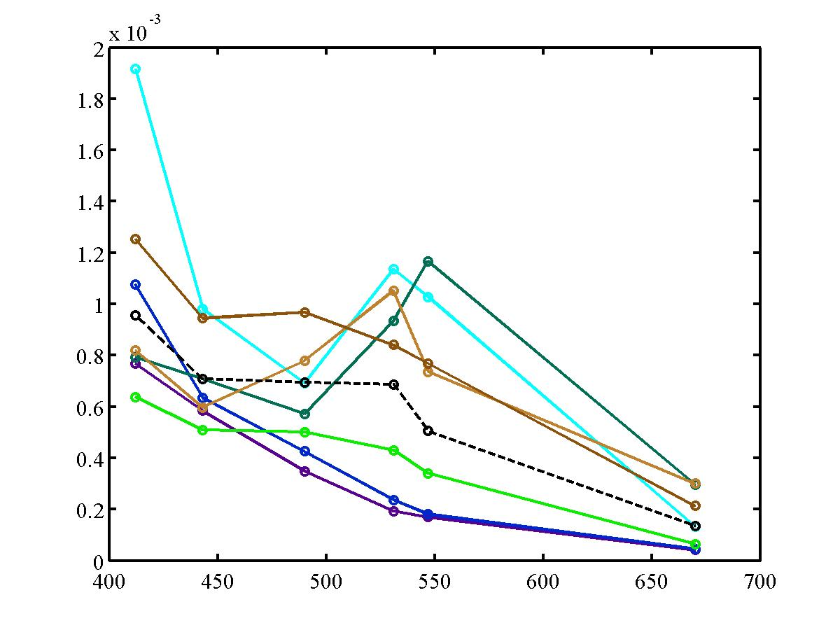
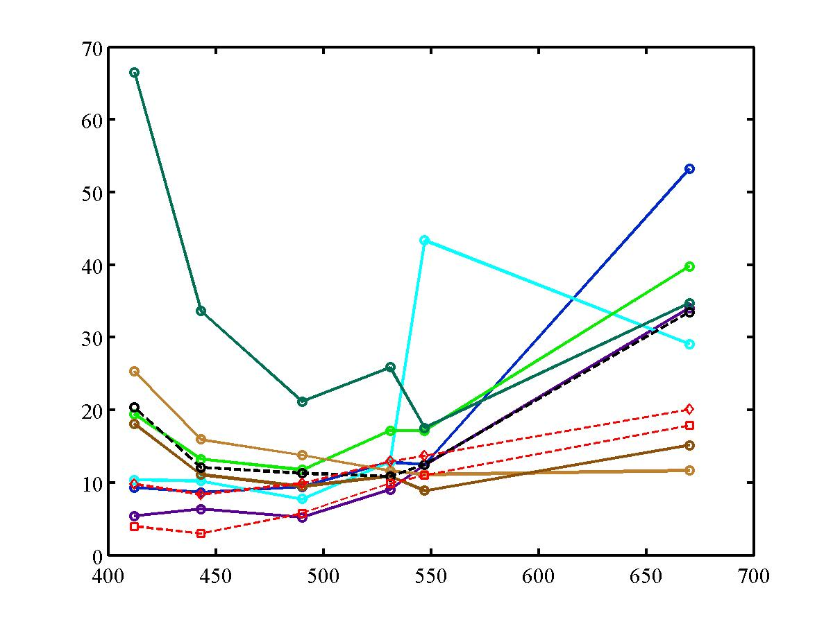
Characterization of radiance uncertainties for SeaWiFS and Modis-Aqua
Timothy S. Moore and Hui Feng
Ocean Process Analysis Laboratory
University of New Hampshire
Durham, NH USA
timothy.moore@unh.edu, hui.feng@unh.edu
Introduction
The spectral remote sensing reflectance is arguably the most important set of products measured from ocean color satellites, since all other products depend on these. However, the spatial distribution of uncertainties is not well known. Previous estimates typically use ‘bulk’ statistics. In this work, we have characterized the uncertainties of SeaWiFS and Modis-Aqua based on our optical water type (OWT) system (Figure 1) using extensive globally-distributed satellite/in situ match-up data sets (Figure 2). This characterization and method allows for pixel-by-pixel uncertainty maps for each reflectance band in the same context as Moore et al. 2009. (chlorophyll error mapping). Error sources based on match-up analysis include time of day and spatial location differences, calibration errors in both in situ and satellite radiometers, and atmospheric correction sources. We assess these match-ups through a variety of uncertainty measures.
Rrs412
Rrs443
Rrs490
Table 2. The relative distribution (in percent) of the SeaWiFS radiance validation data set from SeaBASS by data source and across OWT. Aqua distribution is in parantheses.
OWT
1
2
SeaWiFS Rrs (sr⁻¹)
3
4
5
Rrs510
Rrs555
Rrs670
6
7
8
In situ Rrs (sr⁻¹)
Table 3. Distribution of the number of match-ups fo SeaWiFS and Modis-Aqua (in parantheses) by OWT.
Figure 3. Match-up plots of SeaWiFS vs. in situ reflectance color-coded by optical water type. Red line is 1:1. N=2418.
Bias
Std. Dev.
RMS
OWT
1
2
SeaWiFS
3
4
5
6
7
8
Table 4. RMS distribution of SeaWiFS and Modis-Aqua (in parantheses).
Figure 1. The mean spectral reflectance for the eight global optical water types (OWTs) as dervied from the NOMAD data set.
Modis-Aqua
Methods
SeaWiFS and Modis-Aqua validation data sets for remote sensing reflectance were obtained from SeaBASS (Figure 2, Table 1).
Reflectance data were sorted by optical water type into their ‘dominant’ type.
Uncertainties were characterized for each OWT subset of data (Figure 3) and included: mean bias, standard deviation, RMS (bias + std. dev.), absolute bias, absolute standard deviation, and absolute median relative error (MRE).
Several fixed mooring sites were used to assess binning issues: daily error fields were averaged into monthly ‘composite’ errors for both SeaWiFS and Modis-Aqua.
Wavelength
Figure 4a. Bias, Standard Deviation and RMS for SeaWiFS (top row) and Modis-Aqua (botom row). Colors indicate dominant OWT. Black dash line is data set average.
ABS(Rrs _{insitu} – Rrs _{sat})
STD (Rrs _{insitu} – Rrs _{sat})
Median % diff. (MPD)
Table 5. Median percent difference (MPD) distribution of SeaWiFS and Modis-Aqua (in parantheses).
SeaWiFS
Rrs (sr⁻¹)
%
Rrs (sr⁻¹)
OWT
Modis-Aqua
1
Rrs (sr⁻¹)
Rrs (sr⁻¹)
%
2
OWT
3
1
4
2
5
3
6
4
7
5
8
6
7
Wavelength
8
Figure 4b. Absolute difference, Standard Deviation of absolute difference and relative error or mean percent difference (MPD) for SeaWiFS (top row) and Modis-Aqua (botom row). Colors indicate dominant OWT. Black dash line is data set average. Results from Hu et al. (2013) represented by red dash line (lower: South Pacific chl = 0.05; top dash: North Atlantic chl = 0.2 mg/m³).
Figure 2. Station locations of SeaWiFS validation match-up data for spectral reflectance. Colors indicate dominant OWT.
Table 1. The number of stations in the SeaWiFSand Modis-Aqua radiance validation data sest from SeaBASS by data source.
Summary
OWTs provide a mechanism to distribute uncertainties in a more equitable and informative way than bulk estimation.
SeaWiFS and Modis-Aqua track each other in general in all uncertainty measures.
Blue-water uncertainties agree with results of Hu et al (2013), and provide confirmation to both methods.
High-absorbing waters have highest errors, followed by high scattering waters.
Clear difference between uncertainties between open-ocean and coastal water types.
Uncertainties are lowered by when binned to monthly time scales.
Results
Uncertainties vary spectrally and with water type by a factor of about 2 or less form most wavelengths across OWTs(Figure 4a,b).
Variance plays a much larger role than bias in RMSE calculation for most bands for both SeaWiFS and Modis-Aqua (Figure 4a). These types of errors can be removed through binning (bias cannot be removed through binning).
Results for Absolute difference and Median Percent Difference (MPD) are in agreement with Hu et al (2013) uncertainty estimates for blue water, corresponding to OWTs 1 and 2 (the only region of overlap) (Figure 4b).
Uncertainty patterns are similar between SeaWiFS and Aqua. Aqua shows a pronounced increase in uncertainty at 531 and 547nm – likely due to few match-up points compared to other wavelengths (Tables 2, 3).
Uncertainties increase towards higher chlorophyll and ‘case 2’ waters (Figure 4a,b).
Largest relative errors (MPD) in high absorbing waters (OWT 5) for both SeaWiFS and Modis-Aqua (Figure 4b; Tables 4, 5).
Uncertainties decreased when radiance data were averaged over time (into monthly values) for both SeaWiFS and Modis-Aqua match-ups at 3 fixed mooring sites of MOBY, BOUSSOLE, and MVCO (Table 6).
Level-3 temporally binned products (e.g., monthly) will have lower uncertainties than daily match-ups indicate (Table 6).
Table 6. RMSE derived from the MOBY, Bousselle and MVCO match-up radiance data set for SeaWiFS and Modis-Aqua. Monthly RMSE was averaged from daily data. % change is the relative RMSE reduced (parantheses = Modis-Aqua).
References
Hu, C., L. Feng and Z. Lee (2013). Uncertainties of SeaWiFS and MODIS remote sensing reflectance: implications from clear water measurements, Remote Sensing of Environment, 133, 168-182.
Moore, T. S., Campbell, J. W., and Dowell, M. D. (2009). A class-based approach for characterizing the uncertainty of the MODIS chlorophyll product. Remote Sensing of Environment, 113, 2424 – 2430.
Acknowledgments
This work was funded by NASA grant NNX11AL20G.

