Slide 1

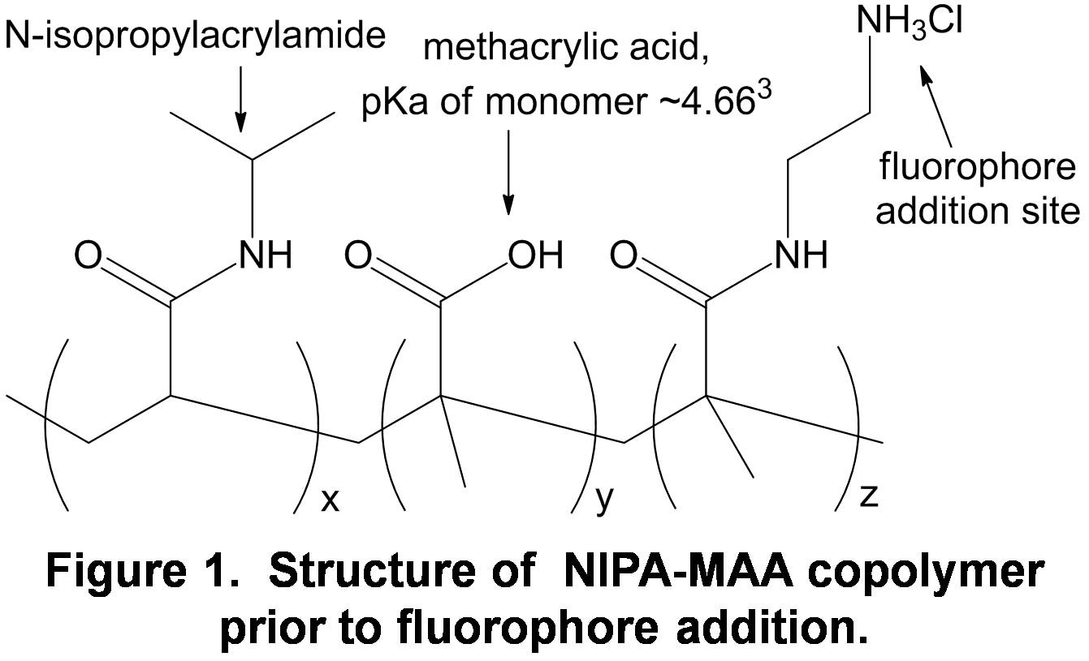
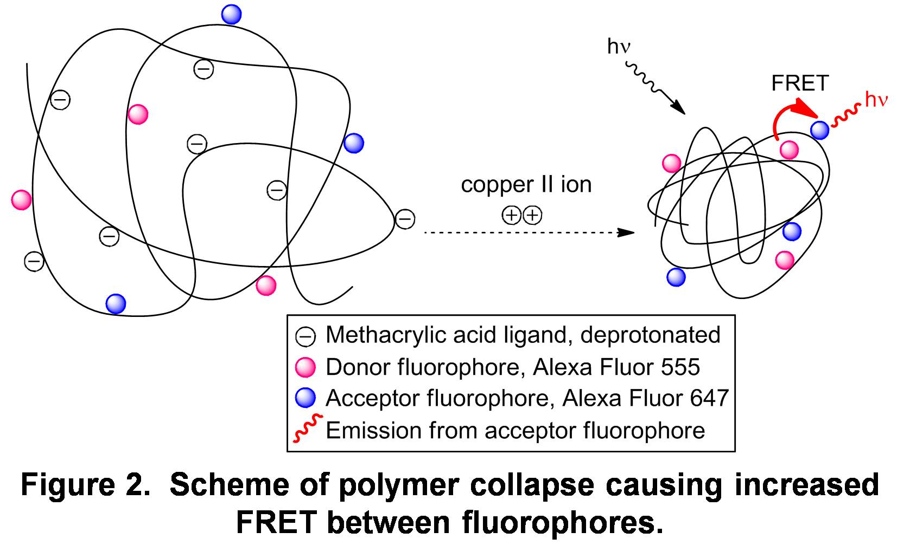
Synthesis and Fluorometric Analysis of a Metal Ion Sensitive Polymer
Alexis Kasparian, Lea Nyiranshuti, Christian Tooley, Roy Planalp ahf28@wildcats.unh.edu; Parsons Hall, 23 Academic Way, Durham NH 03824
Introduction
Fluorescent-tagged copolymers have been synthesized to act as a delivery system for metal sensor ligands and to determine extent of metal ion complexation. Polymers are synthesized containing ligand monomers sensitive to binding a specific metal ion. Binding alters the structure of the polymer, and structure changes can be detected by fluorimetry analysis of fluorophores attached to the polymer.^{1,2}
Experimental
Two copolymers were synthesized using the RAFT polymerization technique, consisting of N-isopropylacrylamide (NIPA) backbones, sites for fluorophore addition, and methacrylic acid (MAA) monomers, 10 mol% and 5 mol%. Dialysis in water was performed after synthesis and fluorophore addition for each polymer. Fluorimetry measurements were taken using buffered solutions with small quantities of polymer.
Results and Discussion
The polymer was determined to be prone to thermal quenching, with a decrease in fluorescence intensities at higher temperatures.
pH studies were attempted, expecting to see a decrease in acceptor/donor intensity ratio at higher pH, but the results were weakly correlated to the opposite effect and inconclusive.
Copper complexation was attempted, using a MOPS-buffered solution (pH 7.2) containing polymer and adding Cu^{II} solutions to give molarities of 10⁻⁷ to 10⁻² Cu^{II}. Results (Figures 4 and 5) indicated no notable change in intensity for 10⁻⁷ to 10⁻⁴ M. Higher molarities of Cu^{II} resulted in formation of precipitate which induced scattering to give lower intensities.
Absorbance spectroscopy verified the addition of fluorophores onto the polymer.
Alexa Fluor 555-donor
Alexa Fluor 647-acceptor
The fluorophores were expected to interact with each other through fluorescence resonance energy transfer (FRET) when the polymer was collapsed, producing a acceptor/donor intensity ratio that would increase with more FRET.
Polymer collapse was hypothesized for pH conditions less than the pKa of MAA, higher temperatures, and upon metal ion complexation.
10⁻⁷ – 10⁻⁴ M
10⁻⁷ – 10⁻⁴ M
10⁻³ M
10⁻² M
10⁻³ M
10⁻² M
Figure 3. Absorbance spectrum of 10 mol % MAA copolymer, verifying presence of fluorophores.
Figure 4: Fluorescence of 10 mol % MAA with added Cu^{II}.
Figure 5: Fluorescence of 5 mol % MAA with added Cu^{II}.
Future Work
  More quantitative characterization of the polymers would be helpful in linking polymer state to the fluorescence results under different conditions.
  Further study of pH trends with MAA copolymers can be explored.
  The creation of more polymers with more selective Cu (II) ligands is currently underway as a continuous exploration of quantitative metal sensoring.
Conclusions
The polymer is sensitive to temperature changes, but a viable pattern of sensitivity to pH has not been determined. The synthesized 5 mol % and 10 mol % MAA polymers cannot bind to copper (II) in sufficient ability to yield quantifiable fluorescence results.
Acknowledgements
We thank the the Department of Chemistry, UNH, for funding. Our sincerest thanks to John Scoros, Justin Massing, and Stephan Barkley for their help, and the Seitz group for providing materials.
References
[1] Seitz, W.R.et al. Analyst. 2011, 136, 5006-5011.
[2] Yao, S. et al. Analyst. 2012, 137, 4734-4741.
[3] Oxenford, L.R. 2006. Characterization of N-isopropyl acrylamide based polymers for pH sensing and metal ion binding. Masters Thesis, Oklahoma State University, Oklahoma. 133 p.

