Slide 1

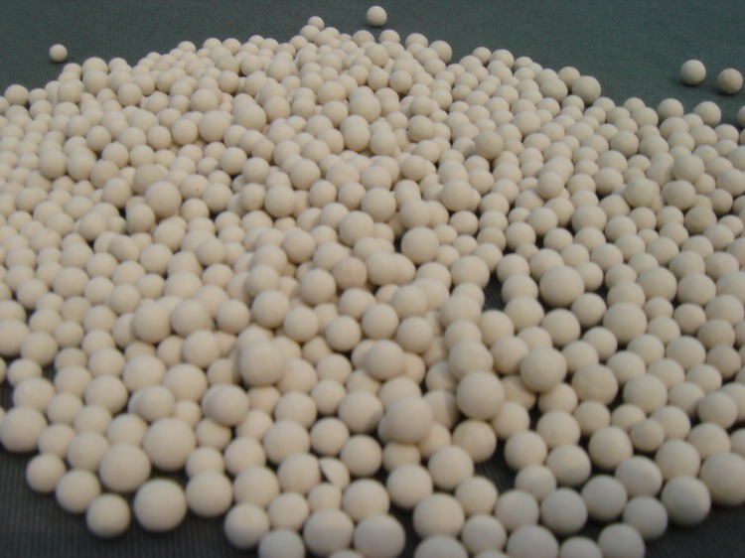
Comparative CC Coupling of Iron-based Catalysts
Jay Nelson, Christian Tooley, Lea Nyiranshuti
Jwf52@wildcats.unh.edu; Parsons Hall, 23 Academic Way, Durham NH 03824
Introduction
In chemistry the formation of a new carbon-carbon bond has been the focus of many Nobel Prizes. The Nobel Prize in 2010 was awarded to Ei-ichi Negishi and Akira Suzuki for their work on CC coupling reactions. The basics of CC coupling involve the joining of two organic compounds using a metal catalyst. The purpose the catalyst serves is typically to be used as a center for both of the joining compounds to come together and couple. CC coupling is very versatile as many different metal catalysts can be used, with palladium, nickel and copper being some of the more prominent ones.
Future Work
Future work includes the proposed reaction as well as characterization and measuring a yield in order to determine if CC coupling with it is possible as well as determine the rate and efficiency at which it couples.
Steps to return hydrated FeCl₃ to the anhydrous form typically involve refluxing with thionyl chloride.
Projected classification of the final product could include both a melting point and NMR as the expected final product is a white solid with a melting point range of 205-211 °C.
Experimental
In an attempt to remove all excess water from the hydrated FeCl₃ molecular sieves were placed in a sealed flash in which the FeCl₃ was already dissolved. After waiting roughly 20 minutes, the resulting mixture was poured into an N₂ purged flask leaving the sieves behind.
Figure 1. Projected Reaction Scheme for both Catalysts
Results and Discussion
The variation of the experiment from the known literature reaction was the replacement of FeCl₃ with FeBr₃ to see if the same reaction would occur. Complications arose concerning the status of the FeCl₃ used, as it was obtained in the hydrated form and although it was attempted to use molecular sieves to absorb the excess water from it, the desired reaction did not occur and is most likely a result of the reaction being hydrated. In theory, FeBr₃ would likely be a weaker coupling agent, as it is a weaker Lewis acid due primarily to the difference in electronegativity in the two halogens. The proposed mechanism would be as follows, with the only change being instead of FeCl₃, there would be FeBr₃.
Conclusions
The reaction proposed could be useful if one was using iron (III) bromide for other purposes in a reaction, such as halogenation of aromatic compounds, as well as its potential CC coupling ability.
Acknowledgments
Funding from the Department of Chemistry, UNH, is gratefully acknowledged.
References
Sarhan, A.; Bolm, C. Chem. Soc. Rev., 2009,38, 2730-2744
Wang, K.; Lu, M.; Yu, A.; Zhu, X.; Wang, Q. J. Org. Chem., 2009, 74 (2), pp 935–938
Figure 2. Proposed Reaction Mechanism

