Slide 1
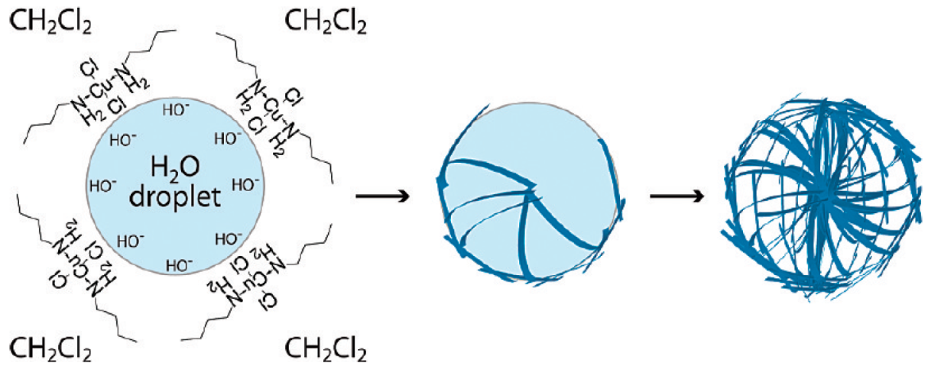
Synthesis of Copper Microspheres Via a Two-Phase System
Daniel Darcy, Lea Nyiranshuti, Christian A. Tooley, Dr. Roy Planalp deu86@wildcats.unh.edu; Parsons Hall, 23 Academic Way, Durham NH 03824
Introduction
The purpose of this experiment was to create copper microspheres by assembling copper hydroxide nanofibers around a water microdroplet and determine if there is a change in morphology of the spheres when varying the alcohol and concentration during the reaction synthesis. The synthesis of the microspheres were created in a two-phase system of H₂O/CH₂Cl₂ at the emulsion. Assembly of nanomaterials provides many different opportunities based on the geometry and size they take. By being able to control their size and morphology, their function can be manipulated, such as photovoltaic activity, which relies on porous/hollow materials.¹
Image taken from reference 1
Results and Discussion
Copper microspheres where successfully created in this experiment through a process known as soft templating, which takes place at the interface of the water/DCM layer.¹ Under rigorous stirring, small water microdroplets were pulled into the denser DCM layer. Being insoluble in DCM, the water forms small spheres. The DCM layer was basic due to the dissolved copper butylamine complex. When it came in contact with the microdroplet, copper hydroxide precipitated out on the surface of the microdroplet in a fibrous manner, forming the spheres. Addition of the alcohol however interfered with this process, resulting in and increase Cu₂(OH)₃Cl precipitating out over Cu(OH)₂. This hinders the formation of The alcohol somehow shifts the equilibrium of this reaction. As seen in the reaction containing 9 % pentanol, no microspheres where present. There appeared to be crystals, most likely compose of, Cu₂(OH)₃Cl because of the green color of the compound.
Experimental
0.4 mM of CuCl₂ 2H₂O is dissolved in 5mL of DCM with 5 equivalents of n-butylamine then 5 mL of DI water was added. The pH increased to around 10 in the aqueous phase. The powdered was isolated after a 5 minute reaction through suction filtration. The previous procedure was repeated for the different alcohol chains/concentrations, and the reaction will go for 35 minutes, instead of 5. The solution was then allowed to sit for an hour in a separatory funnel, and then it was isolated via suction filtration. The product was washed carefully with DCM and ether, followed by vacuum drying. This was repeated, only different alcohols were added at either a 4.5 % or 9 % concentration by volume to the DCM phase, prior to the H₂O addition. These alcohols include n-butanol, n-propanol, and n-pentanol.
4.5 %
9%
Future work
Future work would include working to see if a more consistent size could be obtained during a synthesis, as well as work up the microspheres with more care, due to their fragile nature. Conductivity of the material would also be taken.
n-Propanol Addition
n-Butanol Addition
Conclusions
The copper microspheres were successfully created in all of the reaction except in a 9 % n-butanol solution. The microspheres create varied in size from 1-6 μm, and many had been broken. With refinement of the current procedure, better samples could be prepared and analysed.
n-Pentanol Additon
Acknowledgements
Funding from the Department of Chemistry, UNH, is gratefully acknowledged
References (1.) Bourret G. R.; Lennox, R. B. J. Am. Chem. Soc. 2010, 132, 6657–6659

