Slide 1


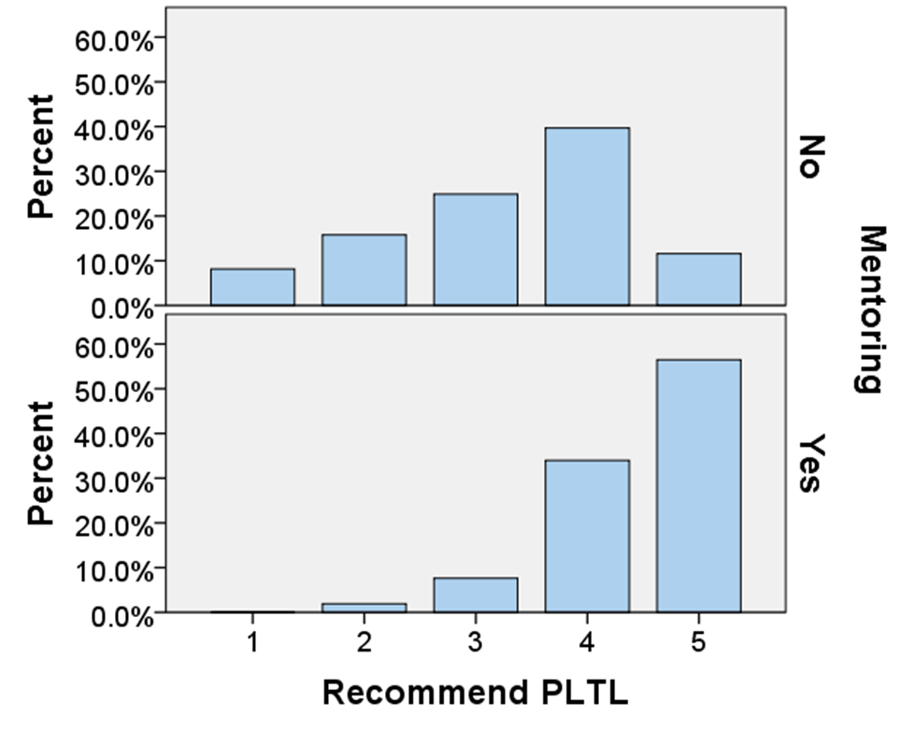
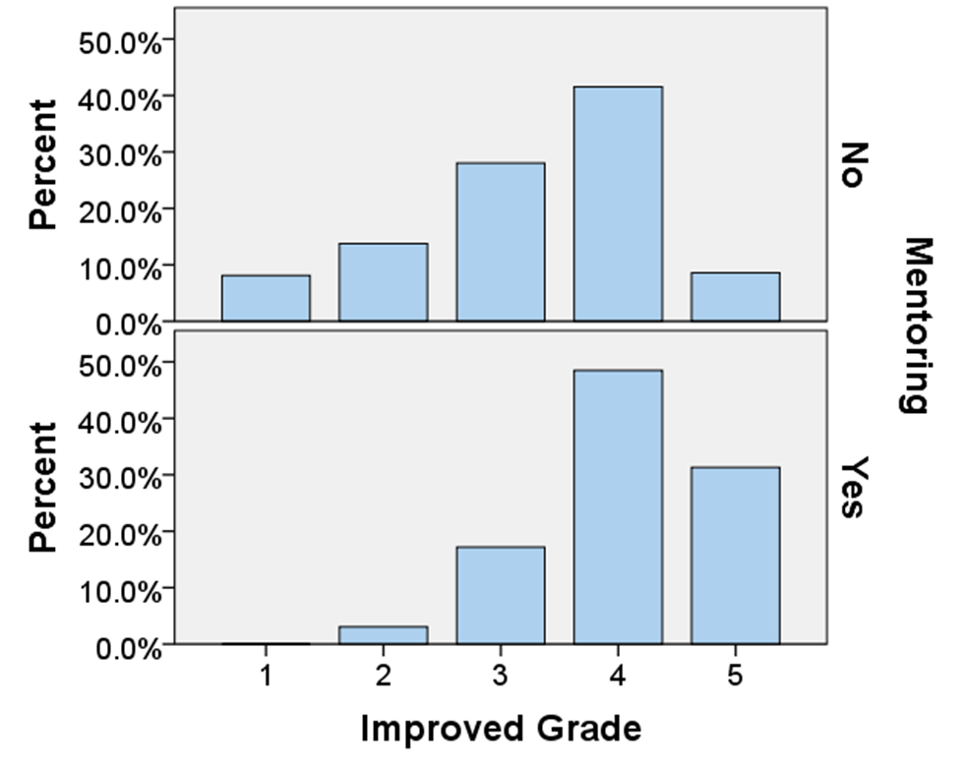
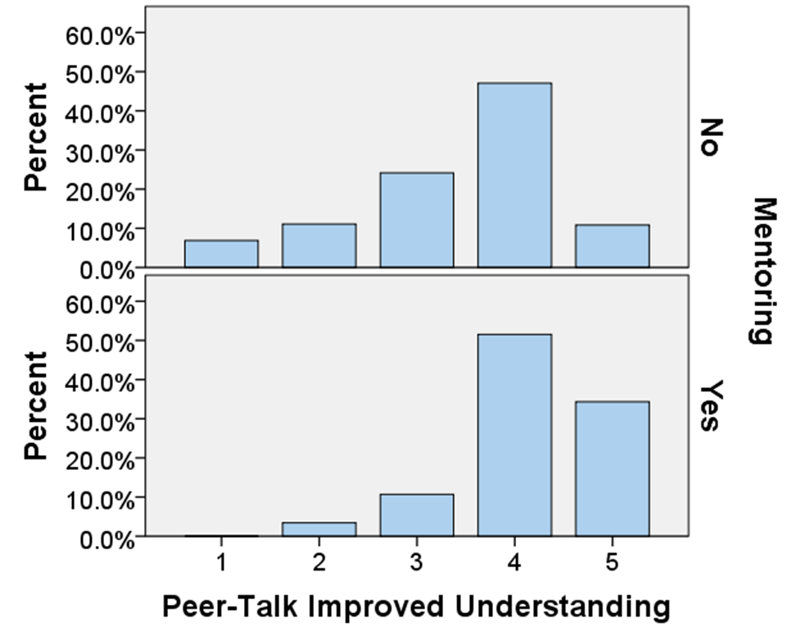
Peer-Led Team Learning in General Chemistry
Melissa Otis
Faculty Advisor: Dr. Chris Bauer
Department of Chemistry, University of New Hampshire
Background
History and Structure of PLTL at UNH
Peer-Led Team Learning (PLTL) is a nationally recognized instructional model in which students engage in peer-led workshops. In a typical group, six to eight students meet weekly for up to one and a half hours with their peer leader. The PLTL leader facilitates group discussion and problem solving based on that week’s lecture materials. The leaders consist of students who have successfully completed the course and demonstrate quality leadership potential. As the leaders are not experts in the subject matter, they are not meant to be tutors but rather group facilitators.
PLTL originated in the City College of New York in 1991 in an undergraduate Chemistry course. The model has been adapted across all STEM majors at over 100 institutions. PLTL first came about to address several issues including:
the shift to more conceptual, quantitative, and challenging courses where students must fully understand a concept to solve problems (rote memorization is no longer sufficient),
students’ difficulty in communicating scientific ideas,
students’ hesitancy to seek help,
and the growing trend of students not being actively engaged in their own learning.
Origins
PLTL has been at UNH since 2000 when Dr. Bauer integrated the model into his General Chemistry course. It closely follows the national program with the following components:
Weekly leader meetings (CHEM 501/502) where the novice leaders learn about group dynamics, review Chemistry content, share effective leadership strategies, discuss metacognition, etc.
Weekly hour and a half long group meetings with students
Leader-to-leader observations
Student feedback surveys, both mid and end of semester.
PLTL is currently optional. Students are graded strictly on attendance and constitutes a portion of their overall semester grade. Additionally, PLTL has been adapted to serve both introductory Biology and Physics classes.
The Mentoring Program
In the spring semester of 2010, Dr. Bauer and his then student coordinators developed the mentoring program which is still in effect today. The mentoring program was instituted in the fall of 2010 as a way to carry on PLTL during Dr. Bauer’s sabbatical. In this new approach to the PLTL model, novice leaders are paired with veteran leaders who act as their mentors throughout the first semester. The mentor’s role is to provide the novice with advice and feedback as
they take on the group leader role. Mentors meet with their mentees once a
week to give any feedback on the previous group meeting and to plan the next week’s activities. The typical mentor/novice roles within the group are
Week 1: mentor leads, novice observes
Week 2: mentor leads majority, novice leads a portion
Week 3: novice leads majority, mentor leads a portion
Week 4: novice leads, mentor observes and gives feedback
The Student-Coordinators
To ensure that the program runs smoothly, Dr. Bauer enlists the help of four student coordinators: two head coordinators (seniors) and two assistant coordinators (juniors). The coordinators are identified at the end of their sophomore year based on their exceptional leadership skills. The coordinator position is a two year commitment. Each year, the assistant coordinators learn the job responsibilities from the head coordinators who were assistant coordinators the previous year. Job responsibilities include
Assigning leader schedules
Developing student groups
Communicating with students and assisting them with their questions and concerns
Assisting Dr. Bauer in planning leader meetings
Organizing leader-to-leader visits
Collecting and reporting on student attendance
Student Response to Mentoring Program Implementation
 | Number of Students Served | Number of Leaders | Optional vs Mandatory
2007 | 350 | 30 | Mandatory
2009 | 265 | 25 | Mandatory
2011 | 208 | 18 | Optional
2012 | 222 | 28 | Optional
Student survey responses before and after the mentoring program implementation. The scale ranges from 1 (strongly disagree) to 5 (strongly agree). 674 students were surveyed.
Average student survey response for each novice leader participating in the PLTL program for 2007/2009 (before mentoring) and 2011/2012 (after mentoring).
Acknowledgements and References
Conclusions
I would like to thank Dr. Chris Bauer for the use of his data and resources as well as his assistance in analyzing the data. I would also like to thank Dr. Charles Zercher for his guidance throughout the project.
Gafney, Leo; Varma-Nelson, Pratibha. Peer-Led Team Learning: Evaluation, Dissemination, and Institutionalization of a College Level Initiative. Weston: Springer, 2008.
Gosser, David K.; Cracolice Mark S.; Kampmeier, J.A.; Roth, Vicki; Strozak, Victor S.; Varma-Nelson, Pratibha. Peer-Led Team Learning: A Guidebook. Upper Saddle River: Prentice Hall, 2001.
Gosser, David K. The Center for Peer-Led Team Learning. The City College of New York, 2012. Web. 20 April 2013.
PLTL has proven successful at UNH
The majority of student feedback suggests PLTL is improving the students’ overall experiences with Chemistry
Students have reported a more beneficial experience since the implementation of the mentoring program
Statistical differences are seen between the pre and post mentor surveys

