Slide 1

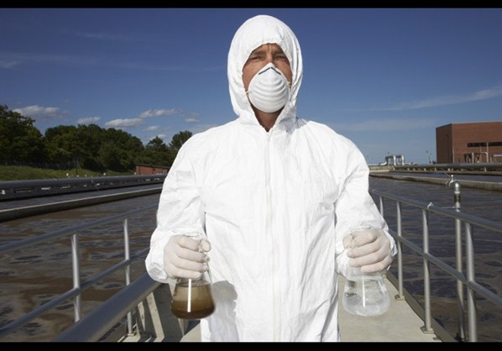
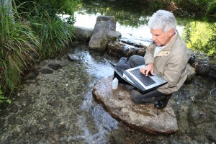
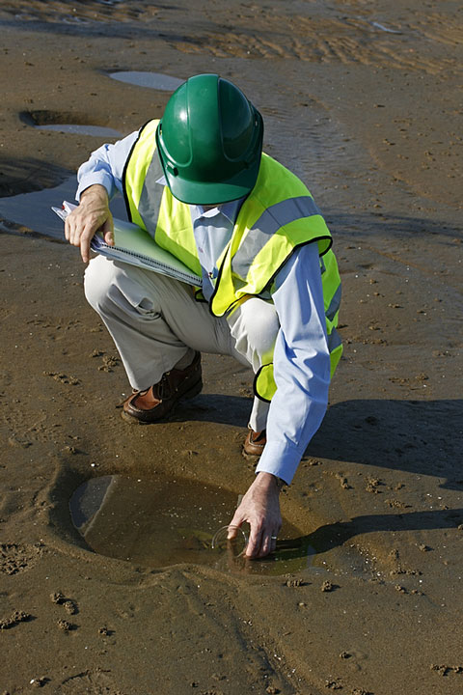
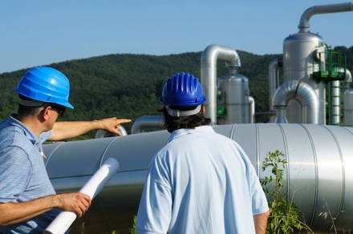
Environmental Engineering
Sam Foster scj36@wildcats.unh.edu; Parsons Hall, 23 Academic Way, Durham NH 03824
Introduction
Environmental Engineering is where public health and environmental needs meet. Many people take for granted amenities such as clean drinking water, food without contamination, etc., however Environmental Engineers along with other groups are working hard to make this possible. Environmental Engineers are working on cleaning up and preventing the contamination of air, soil, and water which makes for a wide range of professions in the field.
Objectives
Goals for Environmental Engineers range from cleaning up large, worldwide environmental problems to problems of a single community or household. These goals include, but are not limited to, safe disposal of solid waste, air pollution dispersion, water quality and treatment, and soil quality and treatment. The “Grand Challenge” for environmental chemistry is to develop a capability for monitoring air, soil, and water on a much more extensive and frequent basis than is now possible. This involves looking at environmental issues on a much more global level because, as of now, attention to environmental issues is much too low in some places.
Analytical Chemistry
The backbone of Environmental Engineering is analytical chemistry. Government run programs frequently test the water, air and soil supply of communities around the U.S. checking for contaminants. Private companies also allow for people to bring in samples of their own tap water, soil, etc. for testing. Common analytical techniques in Environmental Engineering include simple techniques such as gravimetric, titrimetric, and electrochemical methods as well as more complex techniques such as atomic spectroscopy, mass spectrometry, GC/MS, and LC/MS.
Future Work
I plan on working in New Orleans testing if the water is safe for agricultural use. Urban farms are starting to pop up all over this city to deal with the lack of nutritious food. However, the public water supply in a lot of these areas is still in question.
References
Clement, Ray; Yang, Paul. Environmental Analysis. J. of Analytical Chemistry. 2001, 73, 2761-2790.
Murray, Royce. Challenges in Environmental Analytical Chemistry. J. of Analytical Chemistry. 2010, 82, 1569.

