Slide 1
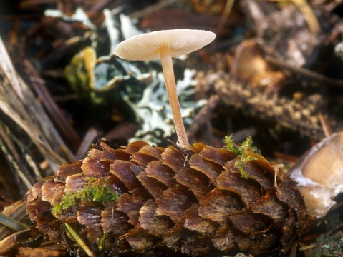
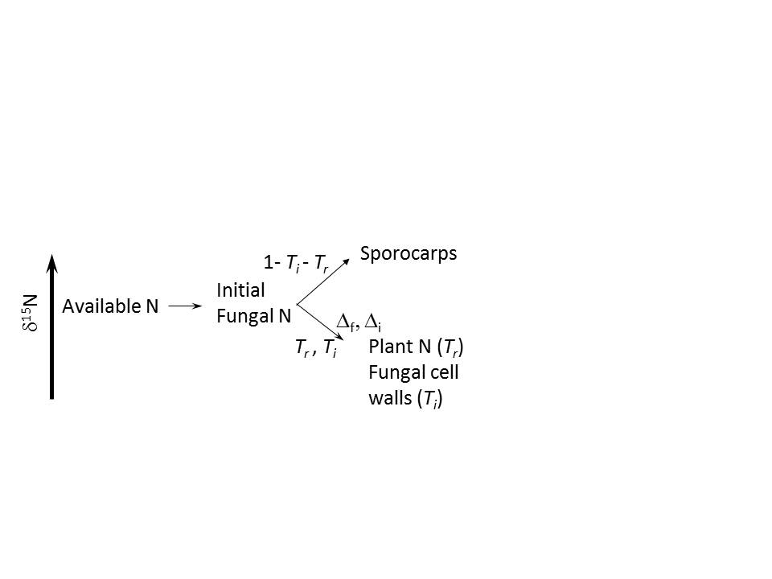
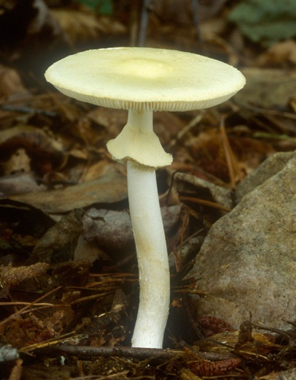
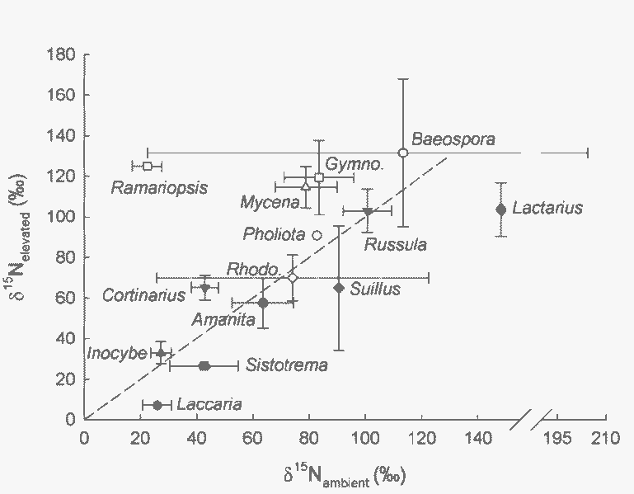
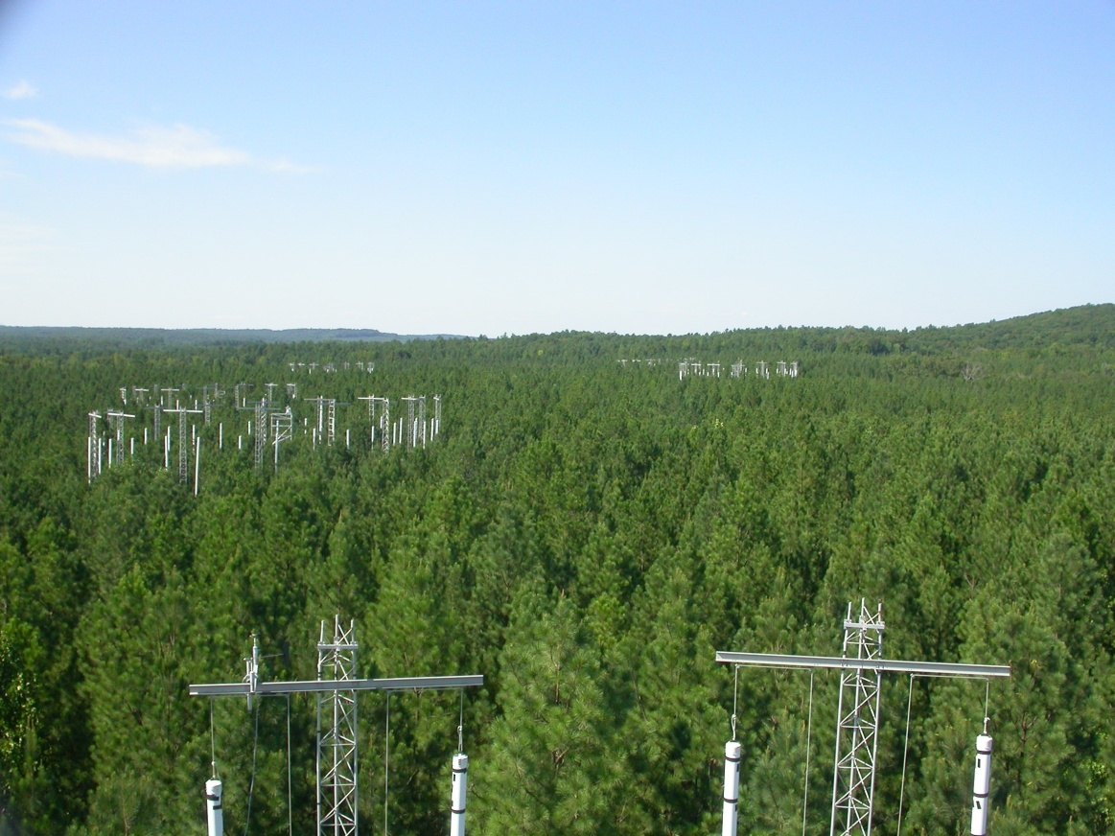
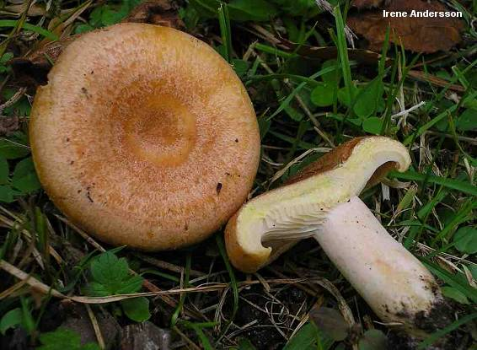
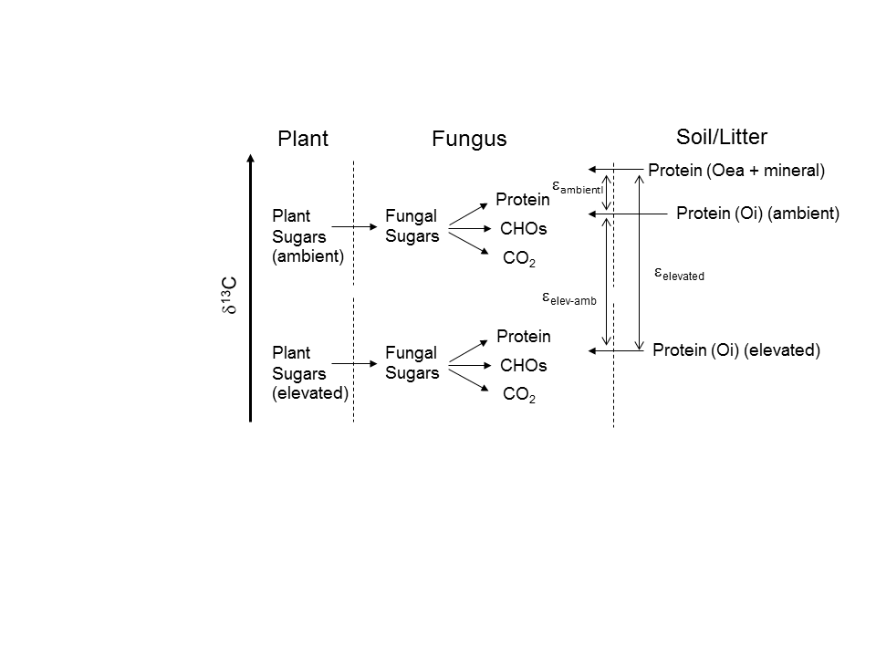
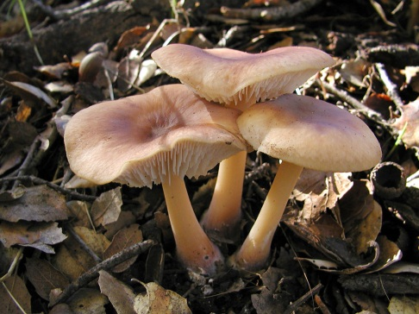

Stories a Mushroom Told Me: ¹³C and ¹⁵N in a Pine FACE Study Reveal Fungal Functioning
Erik A. Hobbie¹, Kirsten Hofmockel², Linda van Diepen³, ¹ESRC-EOS, University of New Hampshire; ²Iowa State University; ³Department of Natural Resources, UNH
Abstract
∙ We used natural and tracer δ¹³C and δ¹⁵N values in a Pinus taeda Free Air CO₂ Enrichment (FACE) experiment to investigate the functioning of saprotrophic and ectomycorrhizal fungi in nitrogen cycling from 2004 to 2010.
∙ Sporocarp δ¹³C and δ¹⁵N values in ambient and elevated CO₂ plots corresponded to the range of sources from which different saprotrophic genera acquired carbon including surface litter (Rhodocollybia and Mycena), pine cones (Baeospora), relatively older (> 8 years) wood (Gymnopilus and Pholiota), and soil (Ramariopsis).
∙ The δ¹³C values of ectomycorrhizal genera in ambient and elevated CO₂ plots correlated with a slope (4.3±1.2) much greater than the expected value of one, suggesting that these fungi assimilated carbon from two isotopically distinct sources, one derived from recent photosynthate and a second from organic matter (presumably protein) from litter or soil.
∙ Ectomycorrhizal fungi with hydrophobic ectomycorrhizae (e.g., Cortinarius) acquired nitrogen from deeper in the soil profile than taxa with hydrophilic ectomycorrhizae (e.g., Russula and Lactarius) that acquired nitrogen from the Oi horizon. ¹⁵N enrichments relative to source nitrogen for six sporocarp taxa ranged from 2 (Baeospora, restricted to pine cones) to 9‰ (Cortinarius); these enrichments correlate analytically with both increased allocation by fungi to hyphal development and decreased nitrogen transfer to host plants.
Baeospora
Fig. 6. Carbon isotopes of different genera of saprotrophic fungi (±SE) in elevated CO₂ (y-axis) and ambient (x-axis) treatments. Values for the putative saprobe Ramariopis kunzei are also included. Values for taxa of ectomycorrhizal fungi from Figure 3 are shown with clear symbols. The line fits the equation δ¹³C_{elevated} = δ¹³C_{ambient} – 12‰. Rhodo = Rhodocollybia.
Fig. 3. Schematic of nitrogen movement and isotopic patterns in a two-pool fungal model. In this scenario, δ¹⁵N_{sporocarp} is affected by the fractionation during creation of transfer compounds (Δ_{f}) and the proportion transferred to plants (T_{r}), in addition to the fractionation during creation of immobile compounds (Δ_{i}) and the proportion transferred to those pools (T_{i}).
Approach
∙ In a loblolly pine plantation at Duke University, carbon dioxide was elevated by +200 ppm within 30-m rings, changing the δ¹³C of CO₂ from -8‰ to -20‰.
∙ Experiment began in 1996 with final harvest in 2010.
∙ A pulse ¹⁵N labeling experiment began in 2003.
∙ Isotopic signatures in fungi and other ecosystem pools collected in 2004 and 2010 were used to explore fungal functioning of both ectomycorrhizal (symbiotic) and saprotrophic fungi.
Nitrogen Isotopes
Amanita
Fig. 4. The ¹⁵N enrichment of sporocarps (ε_{f-s}) relative to the nitrogen source varies in Equation (1) as a function of T_{i} and of T_{r}, with T_{r} = k x (1 – T_{i}). k is varied from 0.3 to 1, as indicated on figure, with Δ_{f} = Δ_{i} = 8‰:
δ¹⁵N_{sporocarp} – δ¹⁵N_{available N} = – Δ_{f} ln [(1 – T_{r}) x (1 – T_{i})] (1)
For realistic values of k (<0.5), higher ε_{f-s} in taxa correspond to greater N sequestration and consequently greater fungal C demand.
Fig. 7. Carbon isotopes of different genera of ectomycorrhizal fungi (±SE) in elevated CO₂ and ambient treatments. The regression line for mean values by genus between ambient and elevated treatments has a slope of 4.3±1.2, indicating an additional source of ¹³C-enriched carbon for fungi under elevated CO₂ other than plant photosynthate.
Duke FACE site
Carbon Isotopes
Fig. 1. High ¹⁵N levels correspond to litter-inhabiting fungi, low levels to organic horizons. Nitrogen isotopes of different genera of ectomycorrhizal and saprotrophic fungi (±SE) in ambient and elevated CO₂ treatments in 2004. A 1:1 line is also shown. Ectomycorrhizal taxa are solid symbols, saprotrophic taxa are clear symbols. Rhodo. = Rhodocollybia, Gymno. = Gymnopilus.
Lactarius
Fig. 8. Causes of carbon isotope patterns in ectomycorrhizal fungi under ambient and elevated CO₂. Fungal protein is synthesized de novo from fungal sugars, but a portion of fungal protein is synthesized from soil-derived organic nitrogen. Soil-derived organic nitrogen (protein) will differ in δ¹³C depending on whether it is from ambient or elevated litter (Oi) or from deeper in the soil profile (Oea + mineral). ε_{ambient} and ε_{elevated} are the ¹³C enrichment of protein derived from the Oea and mineral horizons relative to protein from the Oi horizon, in ambient and elevated CO₂ treatments, respectively. ε_{elev-amb} = ε_{elevated} - ε_{ambient}.
Rhodocollybia
Fig. 5. Carbon isotopes of ecosystem pools (±SE) in elevated CO₂ and ambient treatments. The line fits the equation δ¹³C_{elevated} = δ¹³C_{ambient} – 12‰. ECM = ectomycorrhizal, SAP = saprotrophic.
Conclusions
∙ δ¹³C indicates age of saprotrophic carbon.
∙ δ¹³C suggests incorporation of litter-derived or deeper soil organic N into ectomycorrhizal protein.
∙ Fungal δ¹⁵N correlates with depth.
∙ δ¹⁵N_{fungi – source} quantitatively correlates with proportion of immobilized N, therefore with carbon allocation (see Hobbie & Hobbie, Ecosystems, DOI: 10.1007/s10021-008-9159-7).
∙ Paired natural and tracer ¹⁵N and ¹³C measurements proved extremely useful, with new, quantitative insights into interpreting natural abundance and tracer isotopic patterns.
Acknowledgements
Grant DEB-1146328 from the U.S. National Science Foundation (NSF), grant DE-SC0008324 from the Department of Energy, and a Bullard Fellowship to E.H. from Harvard University supported this work. Core funding for the Duke FACE site was provided by the Office of Science, U.S. Department of Energy, grant No. DE-FG02-95ER62083. NSF also supported the work on ¹⁵N tracer application and redistribution (DEB-0236356 and DEB-0235425). Sporocarp collection and identification by Matt Henn and Rytas Vilgalys are gratefully acknowledged, as are scientific insights from Erik Lilleskov and Adrien Finzi.
Baeospora
Fig. 2. δ¹⁵N values of six taxa of fungi and four soil pools compared between natural abundance samples in 2004 and ¹⁵N-enriched samples in 2010. Lines of constant ¹⁵N enrichment between 2004 and 2010 samples are shown as dotted lines between 5‰ and 30‰. The ¹⁵N enrichment of fungi relative to source nitrogen (ε_{f-s}) is then calculated as the ¹⁵N difference (on x-axis) between fungi and source nitrogen pools along the isolines. ε_{f-s} varied from 4‰ (Rhodocollybia) to 9‰ (Cortinarius). 2010 values for Baeospora are predicted, not measured.

