Slide 1
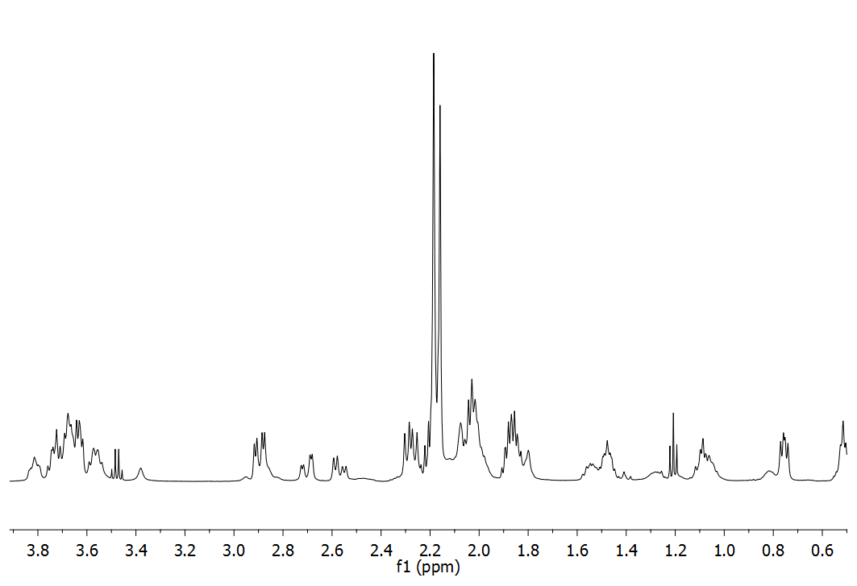
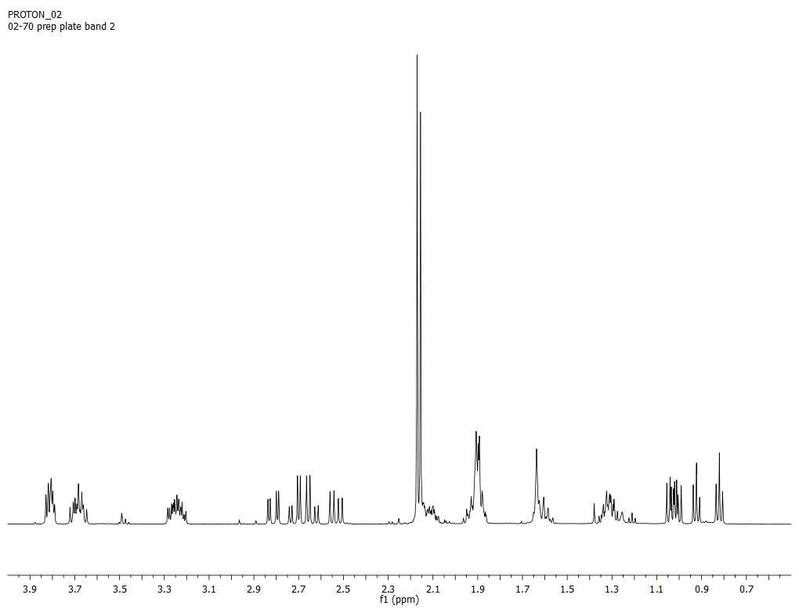
Synthesis and Rearrangements of Cyclopropyl Alcohols
Peter F. Moran, Matthew Mower, Ian Taschner, and Charles K. Zercher*
Department of Chemistry, University of New Hampshire, Durham, NH 03824
Zinc Carbenoid Mediated Homologation Cyclopropanation
In the original report by Brogan and Zercher for the zinc carbenoid mediated homologation, Brogan also identified a homologated cyclopropanol as a minor product.¹
A mechanism has been proposed for the zinc carbenoid mediated homologation cyclopropanation reaction.
Further Rearrangement Studies
Mower observed different ratios of aryl cyclopropanol isomers depending on the duration of the reaction, suggesting rearrangement was occurring.
Formation of the zinc alkoxide was
shown to interconvert the cyclopropanol
Isomers, proving a rearrangement
pathway existed.
Rearrangement of the cyclopropane ring is believed to proceed through the mechanism above.
Formation of Bicyclic Lactones
During Taschner’s first attempts at homologation cyclopropanation of a β-keto imide, minor amounts of a bicyclic lactone were observed.
Further studies reveled upon trapping with TMS-Cl the resulting TMS cycloproply ether could be obtained in relatively high yields. Upon deprotection rearrangement leads to the observed lactone.
Peptide Isosteres
Enzyme inhibitors can be created by replacing the peptide bond with a linkage that is resistant to hydrolysis.²
Ketomethylene peptide isosteres have been synthesized through a zinc carbenoid mediated tandem aldol reaction of various β-keto imides.³
Similar hydrogen bonging capabilities, as well as hindered rotation found in the original amide bond, can be afforded by the synthesis of a cyclopropanol peptide isostere.
Synthesis and Rearrangement of Proline Derived Isosteres
Recent work has been aimed at understanding the diastereoselectivity of cyclopropane rearrangement of proline-derived systems. In order to probe the selectivity, a rigid tricyclic species was synthesized and NOE analysis was performed.
NMR evidence provides insight into the ability to predict stereochemistry of the cyclopropane ring prior to condensation to the tricyclic compound.
Acknowledgements: Dr. Zercher, Pat Wilkinson, NIH RIS GM060967-02
[1] Brogan , J. B.; Zercher, C. K. J. Org. Chem. 1997, 62, 6444-6446.
[2] Mastrolorenzo, A.; Ruscouni, S.; Scozzafava, A.; Barbaro, G.; Supran, C.T. Curr. Med. Chem. 2007, I14I, 2734-2748
[3] Lin, W.; Therberge, C.R.; Henderson, T. J.; Zercher C. K.; Jasinski, J.; Butcher, R. J. J. Org. Chem. 2009, 74, 645-651.
C
D
d
A
B
a
b
c
a*,
A*
d
B
b
D
D
C,c*
b,B*

