Slide 1


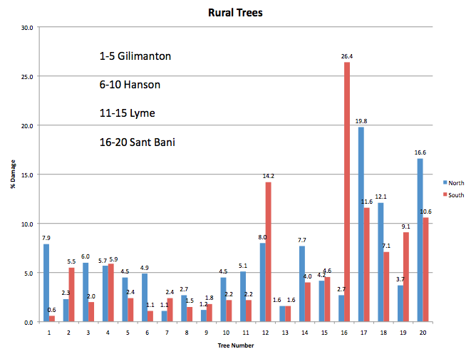
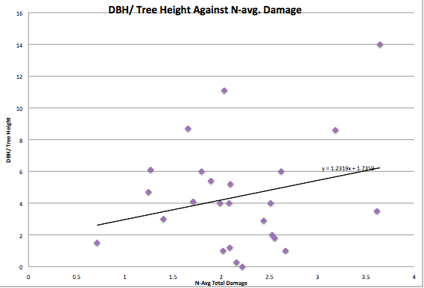
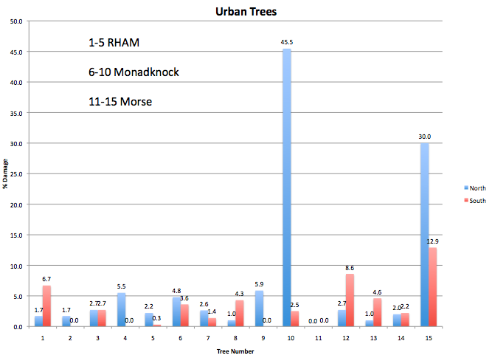
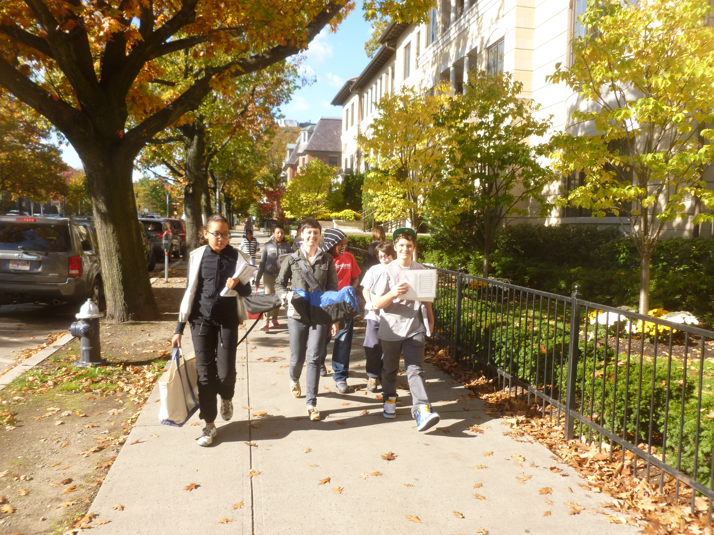
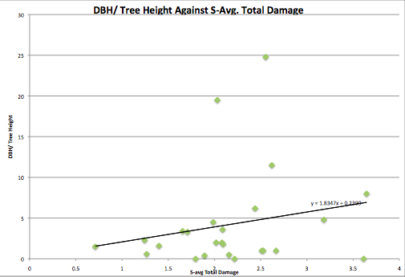
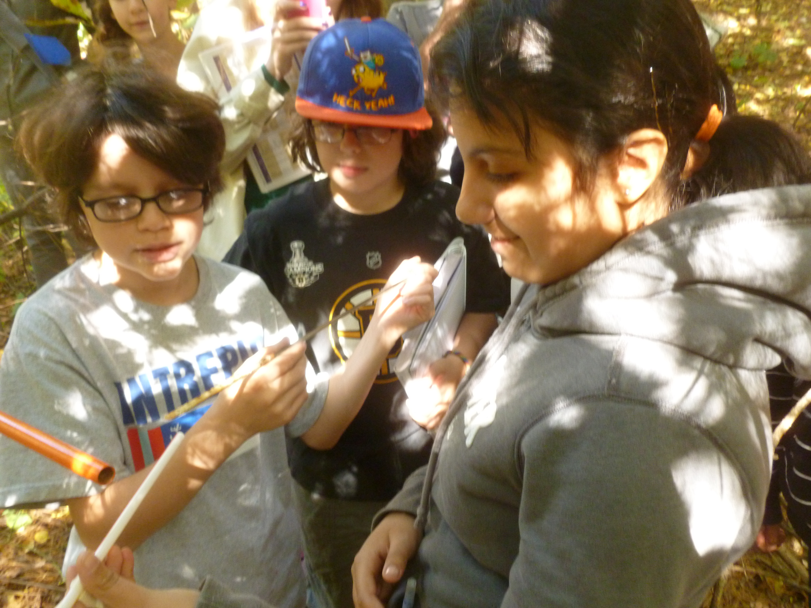
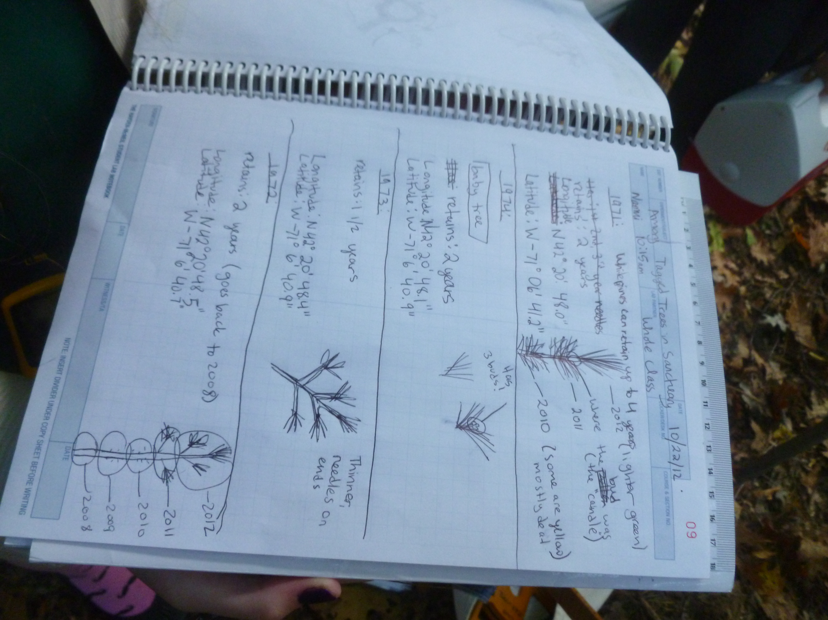
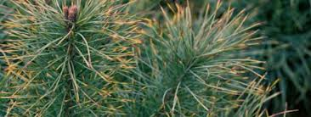
How do dimensions and location
affect the levels of ozone damage in Eastern White Pine trees?
University of
New Hampshire
J.Applebaum, C. Bascome-Duong, J. Elliot, J. Ramadan
A study in location
Rural trees will have less damage because of the lower levels of pollution in rural areas.
A study in dimensions
Tree proportionality (DBH/tree height) will affect the amount of ozone damage.
Introduction:
There are two types of ozone. The first is a barrier around the earth that protects us from the sun’s harmful rays. The second is called “Ground Level Ozone”. This type can cause severe lung damage if someone is overexposed to it. This is the type of ozone monitored by the Environmental Protection Agency. In different areas there are different levels of ozone, but on average there is more ozone in rural areas rather than urban.
Ground level ozone is a chemical reaction that enters through the stomata, the trees passageway for vapor water, carbon dioxide, oxygen and then begins to slowly kill the tree by causing tip necrosis, dead tips, and chlorotic mottle, colored spots, but does it take more or less ozone to hurt a tree if it is tall, short, wide, or thin?
No matter where a tree is it is affected by ozone. Although, can a tree hold more ozone depending on its attributes? If there were a tall (more than 33.3 meters tall) and wide (120 centimeters and above) Eastern White Pine tree would it take in more ozone than if there were a short ( less than 24.2 meters tall), thin (90 centimeters and less) Eastern White Pine tree?
Figure 1: Schools in rural areas were identified and included: Gilmanton, Hanson, Lyme, and Sant Bani. Five trees were analyzed from each location. This graph depicts the % average damage (chlorotic mottle and necrotic tips) by length. Overall, the average damage in rural areas is 6%.
Figure 3: All schools with available data were utilized. Five trees were analyzed from each location. This graph depicts the % average damage (chlorotic mottle and necrotic tips) on the North side of the trees by length vs. proportion (DBH/tree height). As tree proportion increases (width increases more than height) there is increasing damage (positive correlation).
Students walk along an urban street, heading to the plot where their Easter White Pines reside.
Students gather around to collect data, after taking the core sample from an Eastern White Pine.
Students record their data and observations during their experiments in carbonless lab notebooks.
Figure 1: Schools in urban areas were identified and included: RHAM, Monadnock, Morse. Five trees were analyzed from each location. This graph depicts the % average damage (chlorotic mottle and necrotic tips) by length. Overall, the average damage in rural areas is 5.3%.
These pine needles have necrotic tips, one of the main symptoms of ozone damage.
Figure 4: All schools with available data were utilized. Five trees were analyzed from each location. This graph depicts the % average damage (chlorotic mottle and necrotic tips) on the South side of the trees by length vs. proportion (DBH/tree height). As tree proportion increases (width increases more than height) there is increasing damage (positive correlation). This correlation is slightly less dramatic than that of Figure 3.
Conclusion:
From our two studies, we conclude that older trees have more damage from ground level ozone, and this damage is apparent regardless of whether the tree is in a rural environment or an urban one. This is likely because the older trees have sustained more damage over time, regardless of their setting.
In our study of tree locations, we determined that there is not a significant difference between the amount of ozone damage on rural versus urban trees (Fig. 1 and 2). Our data shows a 0.7% difference, which includes outliers, and we believe this to be relatively insignificant. Additionally, we saw no significant distinction between north and south sides of any tree. We speculate that this could be caused by one of two reasons. It could either be dispersed uniformly throughout the region(s), perhaps by the wind, or it may be that there are elements in urban areas that cancel out a lot of the ozone, without which there would be a drastic difference in ozone damage levels, and there isn’t as large of a quantity of these elements in rural areas.
In our study of tree dimensions, there was a clear relationship between the size of the tree, measured as the ratio of width over height, and the percent ozone damage (Fig. 3 and 4). Looking at the damage, you can tell that the bigger the ratio the more damage it contains. We believe that the ratio is a surrogate for the age of the tree, and that the older the tree is, the weaker it’s defense system is, and it’s been exposed to ozone for a longer period of time. Also, from the graphs it appears the the amount of damage it has taken in in the past may increase the potential for damage to new needles in the future.
In summary, while variables such as age, height, and width are correlated with differences in degree of ozone damage, location of the trees is not. We would suggest additional research to be conducted to determine whether it’s really the age of the tree, or the dimensions which is correlated with the degree of damage. Also, follow up research for the study on location would be to identify factors in urban areas that may reduce ozone, and/or expand the geographical range to include the southeast states, or the entire US.

