Slide 1
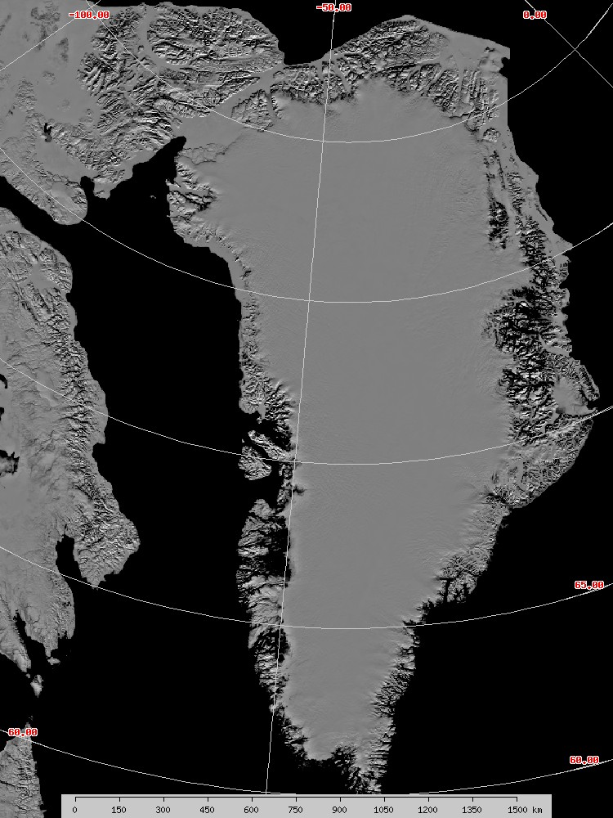
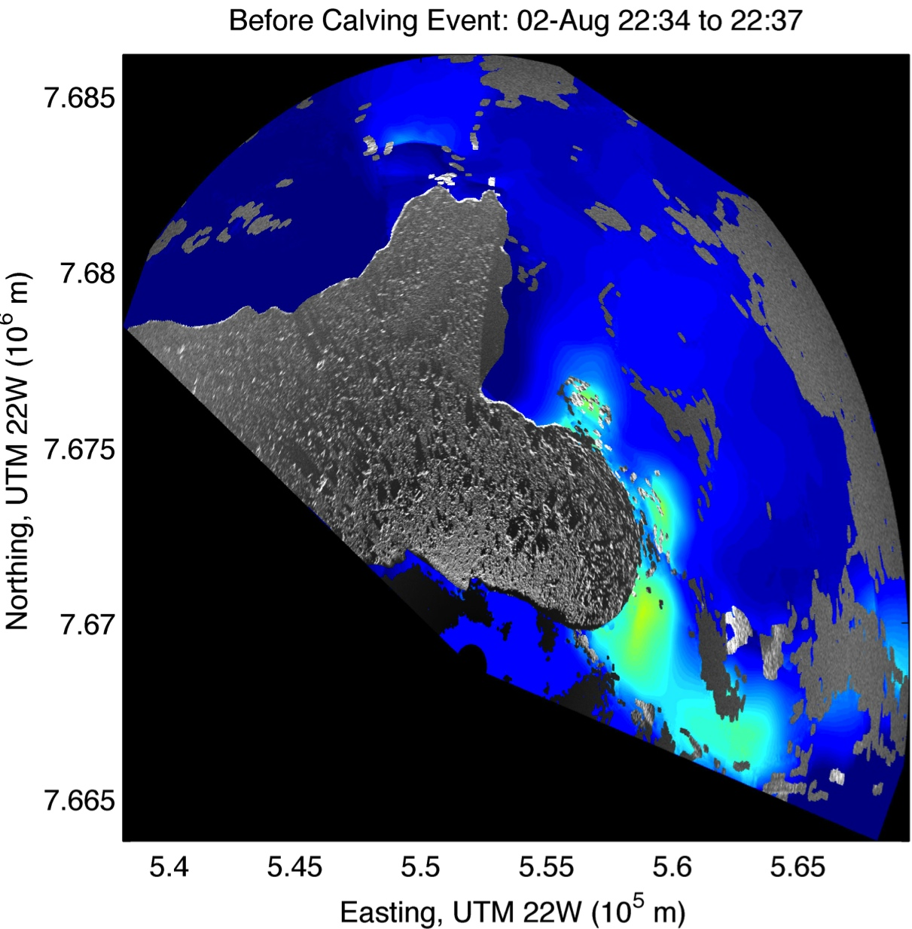
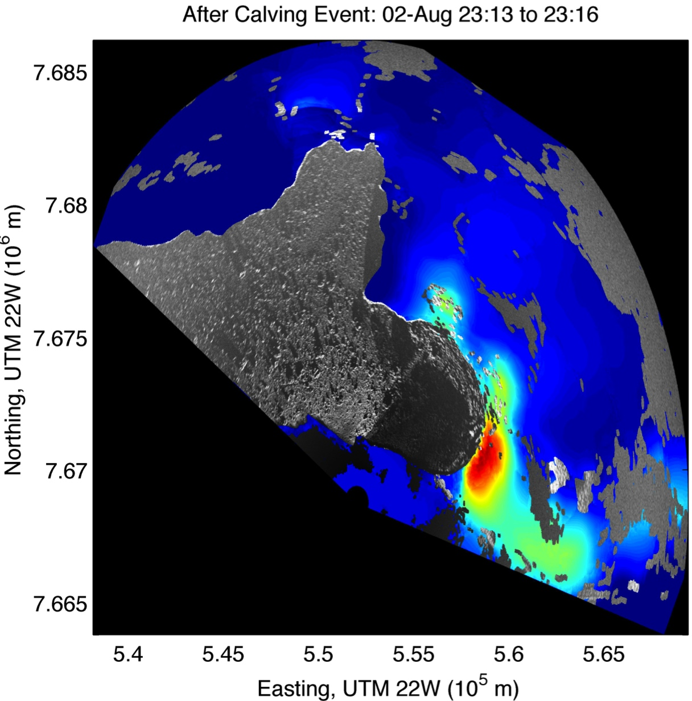
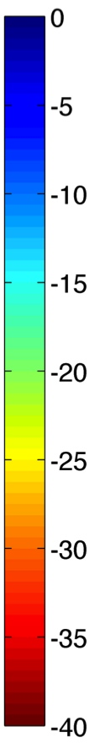
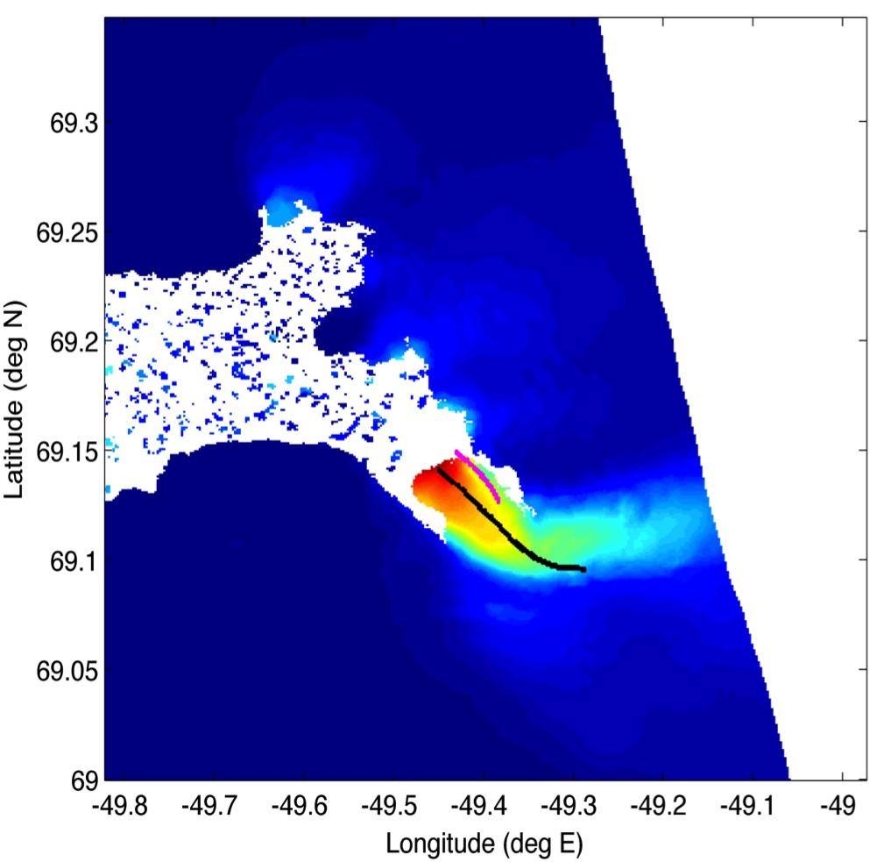
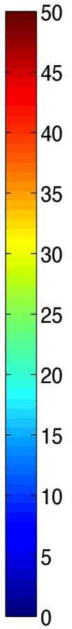
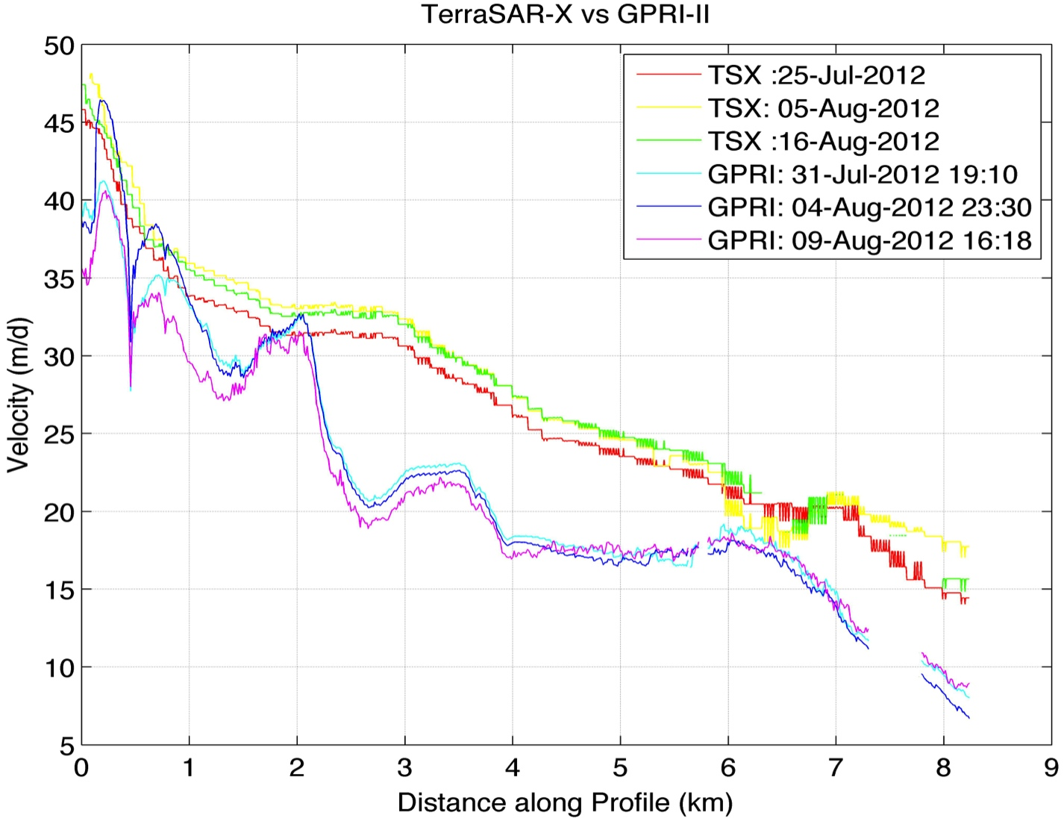
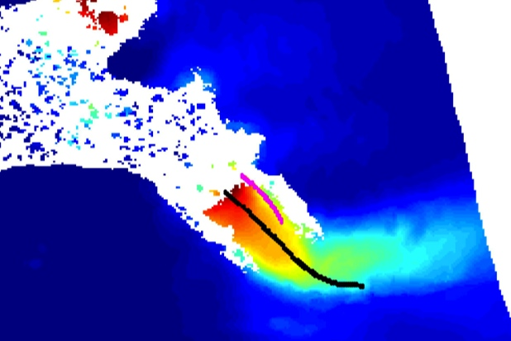
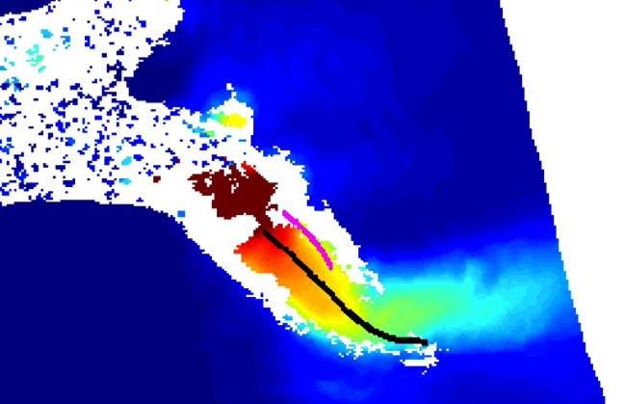
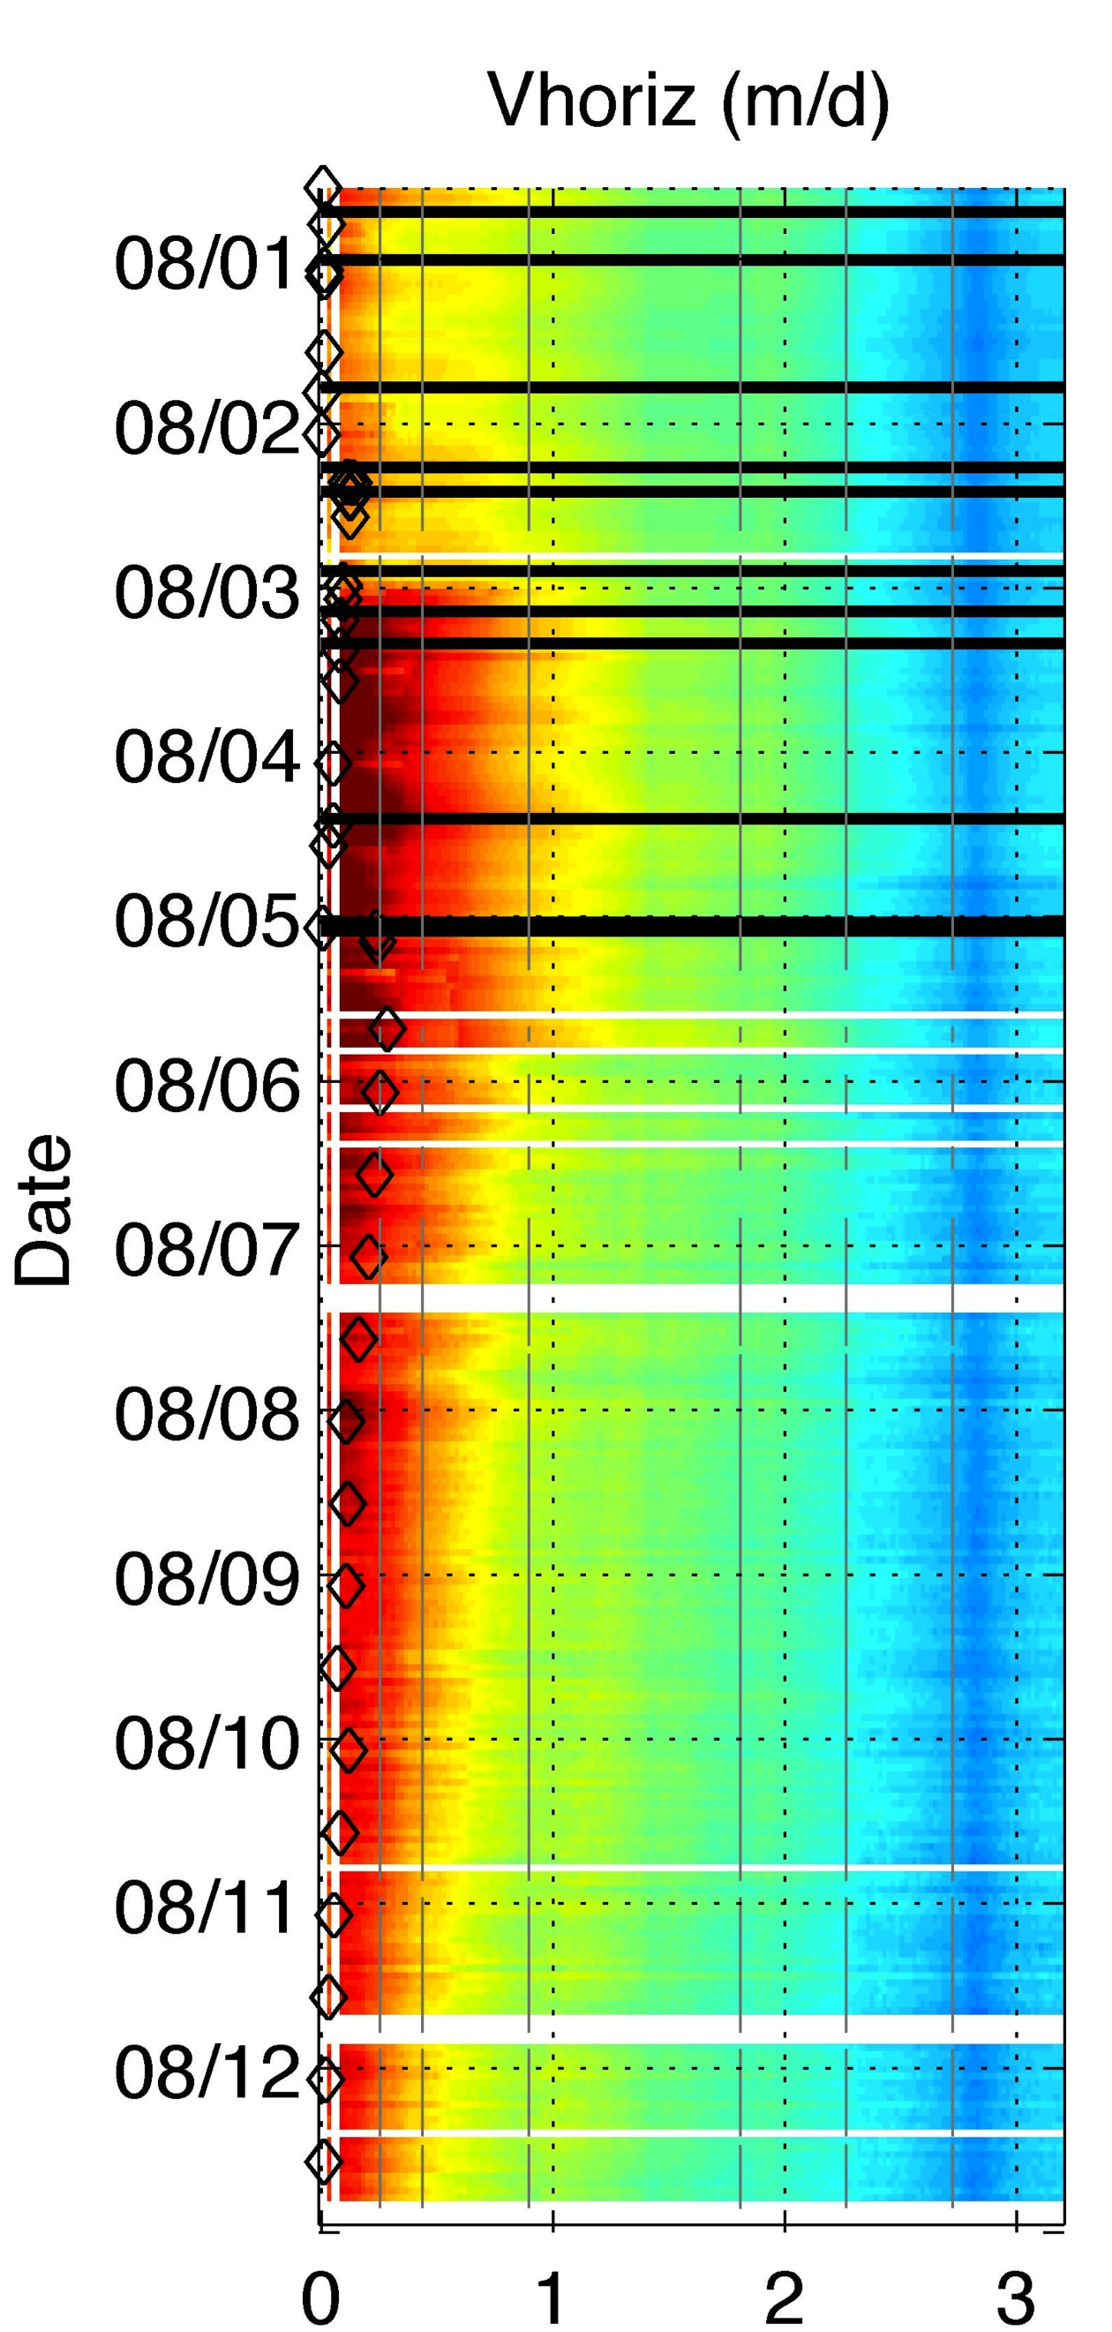
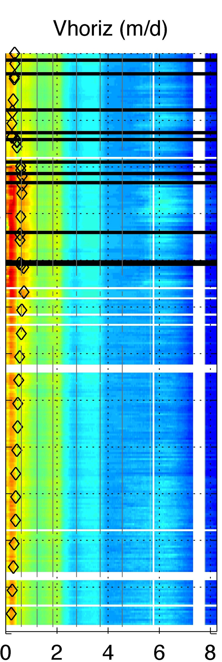
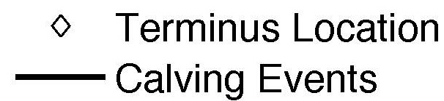
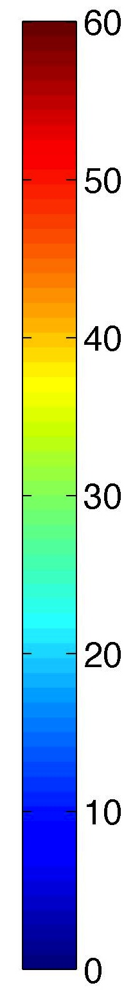
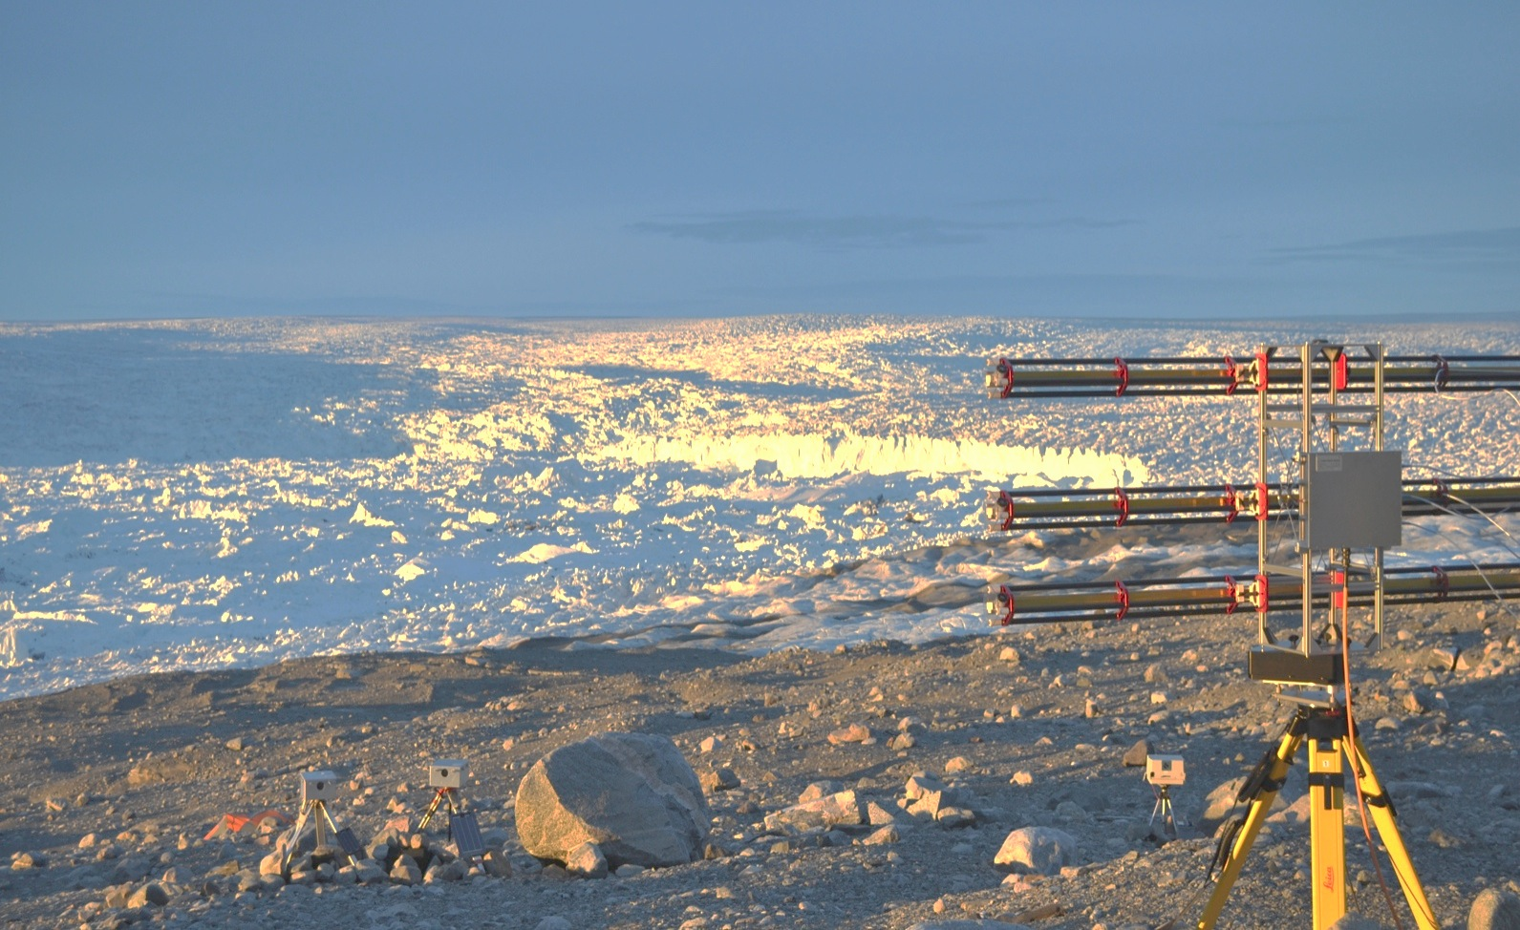
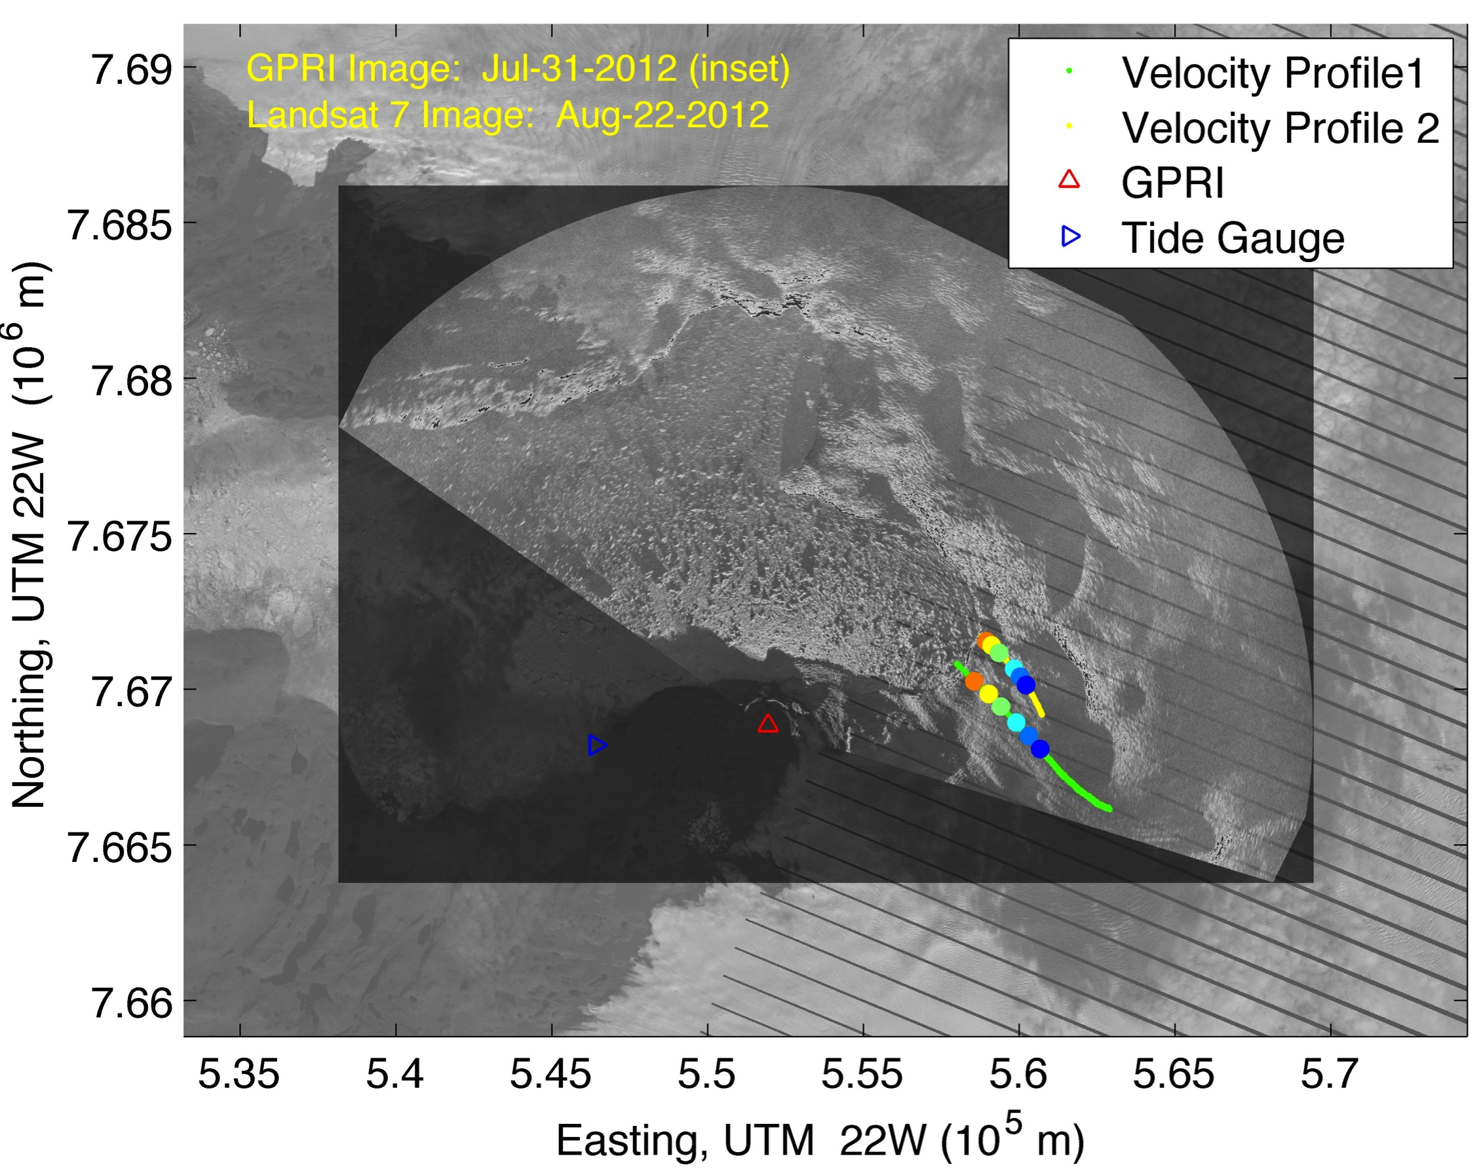
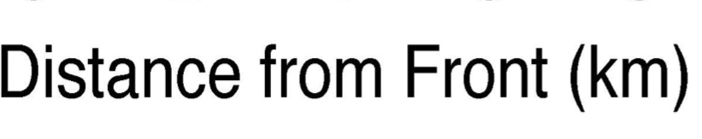
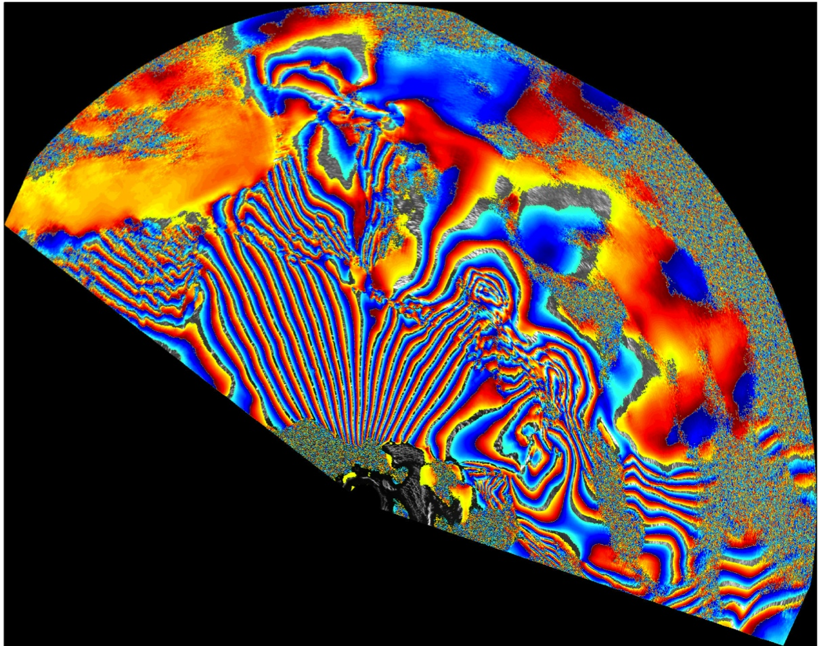
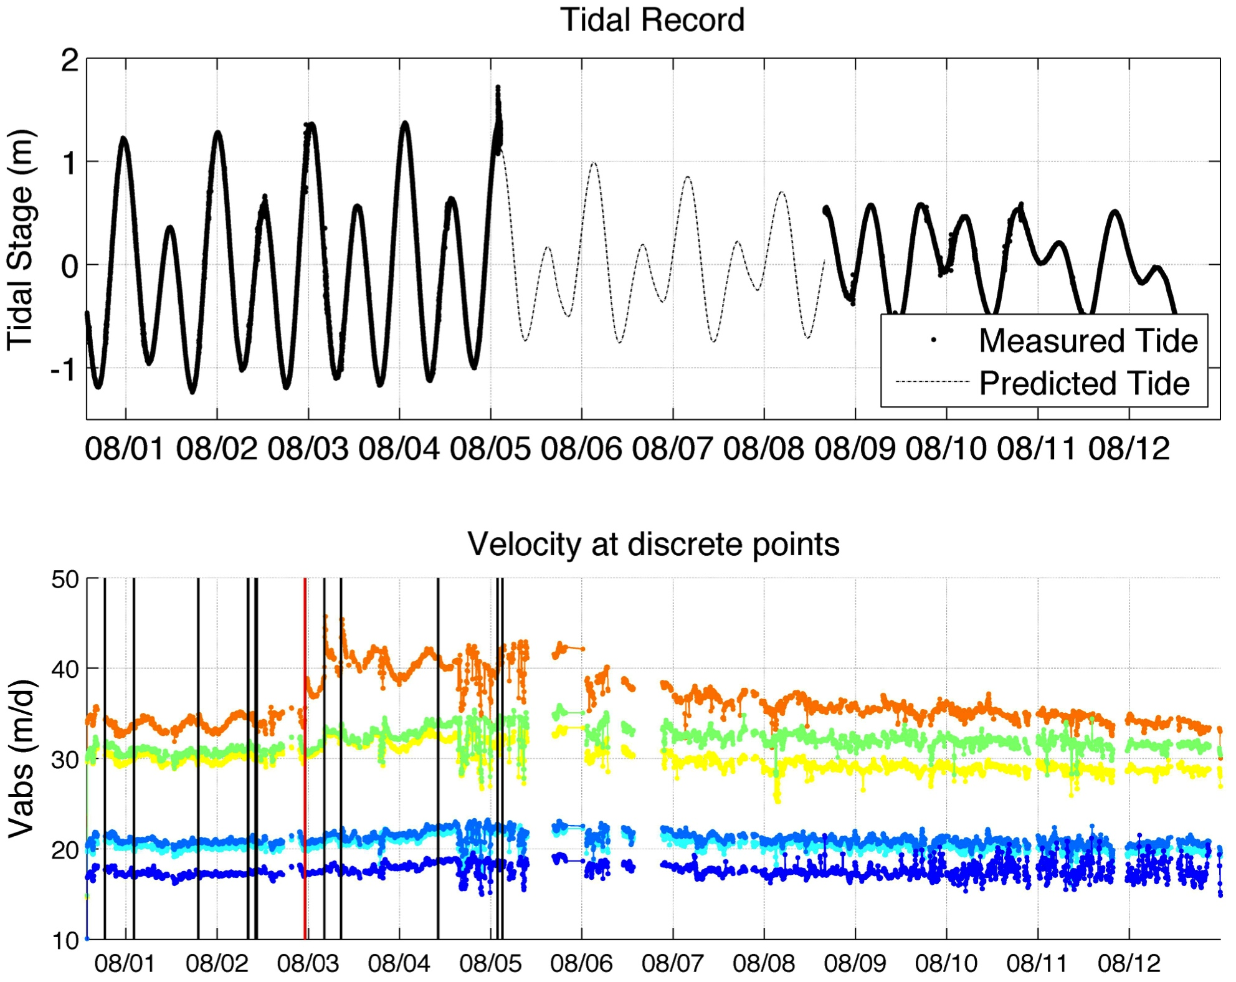
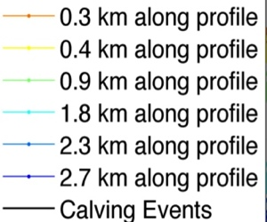
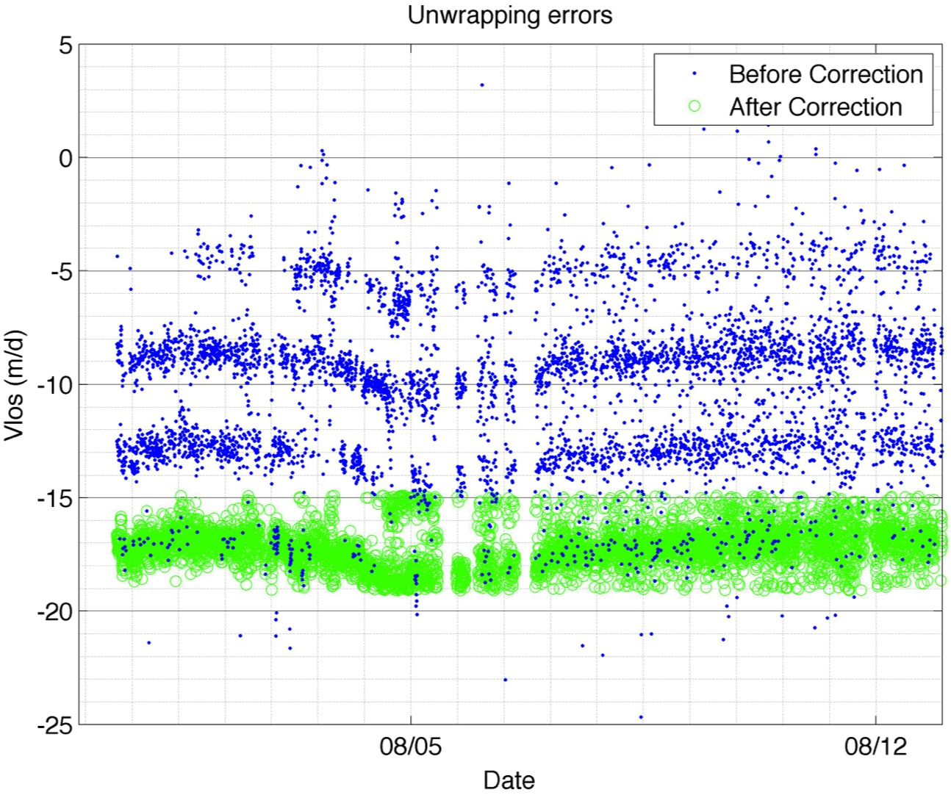
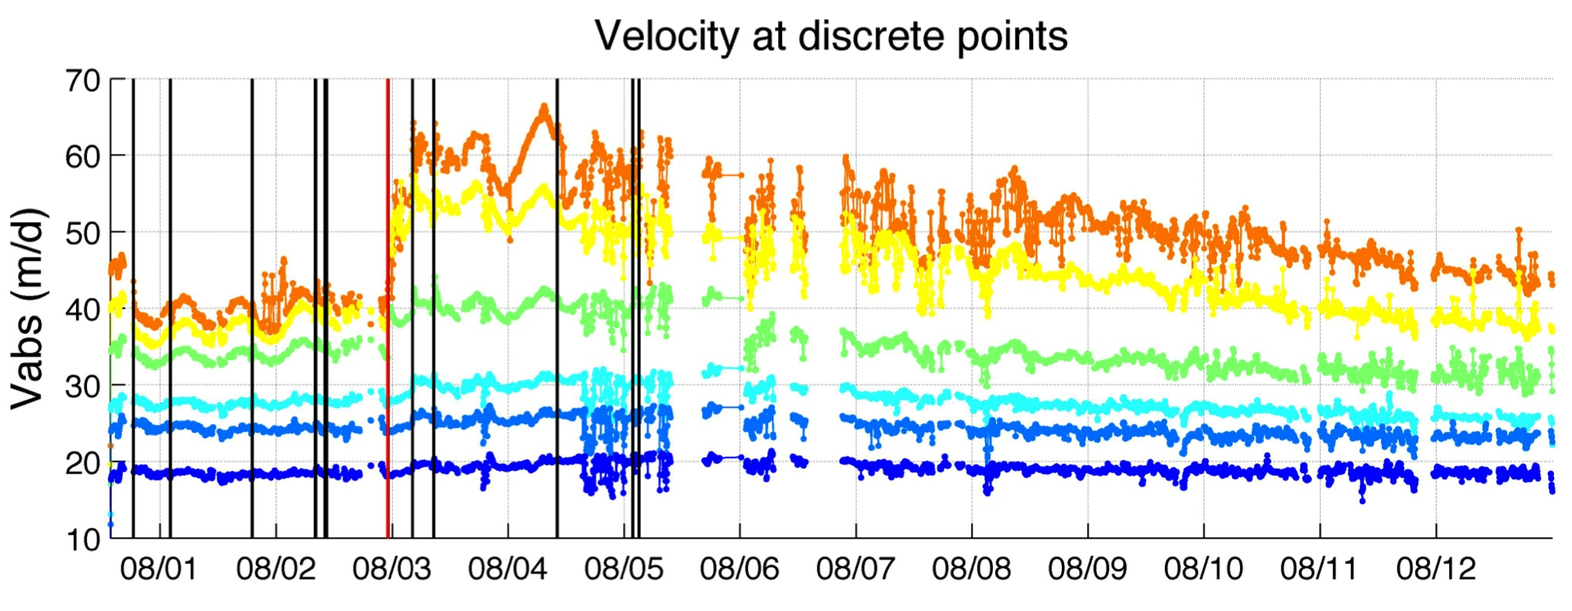
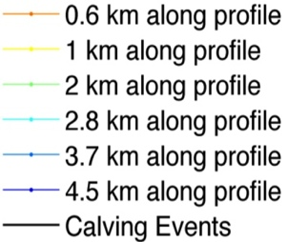
Glacier-Ocean Interactions on Short Timescales: can observations of tidal and calving
impacts on near-terminus ice flow inform us about controls on terminus stability?
Ryan Cassotto¹ (ryan.cassotto@wildcats.unh.edu) , Mark Fahnestock², Jason Amundson³, Martin Truffer²
¹Institute for the Study of the Earth, Oceans and Space, University of New Hampshire, Durham, New Hampshire; ²Geophysical Institute, University of Alaska Fairbanks, Fairbanks, Alaska; ³University of Alaska Southeast, Juneau, Alaska
ABSTRACT
RESULTS
Many tidewater glaciers have experienced rapid change over the last decade. Increases in velocity, enhanced thinning, and retreat of the calving fronts have increased Greenland’s contribution to sea level. Improving our understanding of the mechanisms related to terminus stability for these glaciers would seem important, but observations of short-term variability are difficult. Here we present observations made with a pair of ground based portable radar interferometers (GPRI) during a two-week deployment along Jakobshavn Isbrae during which we were able to observe the glacier flow response to the tide and multiple calving events. The range (~16 km) and fast acquisition time (3 minutes) of the GPRI allowed collection of thousands of interferograms showing ice flow in the lower 10+ kilometers of the glacier, as well as patterns of displacement in the pro-glacial ice mélange which covers the fjord. Our data show that of the ~12 different calving events observed only one produced a significant (~33%) increase in velocity that persisted for several days. The ice mélange response to calving varied spatially with the location of those events along the calving face. In addition, we were able to map the spatial extent and amplitude of the ice flow response to the tidal cycle for the lower glacier. These measurements are one way to probe controls on ice flow in the lower reach of a large tidewater glacier.
25-Jul-2012
Good agreement
Strain margins not observed by TSX
5-Aug-2012
16-Aug-2012
Improvement needed
MOTIVATING QUESTIONS
Figure 5: GPRI-II derived LOS velocities before (left) and after (right) a large calving event at 23:10 on August 2. The calving event caused a sudden increase in near-terminus velocities that was sustained for several days.
How do short-term perturbations at the glacier’s calving front affect the terminus stability
- How does velocity vary through a calving event?
- How does the mélange affect velocity and/or strain rate at the terminus?
- Can we constrain the spatial extent of tidal influence on terminus dynamics?
How do GPRI observations compare with satellite based Synthetic Aperture Radar (SAR) and GPS
measurements?
Figure 6: (L) TerraSAR-X (TSX) derived velocity maps for the time spanning the observation period; (R) TSX and GPRI derived velocities for profile 1 shown in Figure 2. GPRI observations are consistently lower than the TSX, suggesting phase unwrapping correction requires refinement. (TSX courtesy of I. Joughin)
CONCLUSIONS
METHODS
These results demonstrate the GPRI is a powerful instrument to monitor short-term perturbations at the calving fronts of fast moving tidewater glaciers; though additional refinement and validation of the image processing techniques is required (e.g. improved unwrapping methods, georeference verification), the GPRI provides valuable observations of target areas otherwise not observed by modern satellite technology.
Of the nearly 12 calving events that occurred during the field study, only 1 event caused significant change in the glacier’s stability; that event caused velocities up to 4.5 km behind the terminus to increase and remain high for several days before gradually returning to pre-event values more than 10 days later.
Prior to the large calving event the terminus flowed as a coherent mass; following the event the GPRI observed a reconfiguration of the terminus as the glacier stretched and velocities slowly converged to pre-event rates.
As expected, the grounded terminus of Jakobshavn Isbrae shows diurnal variability 180° out of phase with tidal modulations, the glacier is slowest during high tide and speeds up during during the low tide when when the water level (and subsequent forced imposed) is lower.
Field Study
In August 2012, 14-day study conducted at Jakobshavn Isbrae to monitor short-term dynamics at the calving front
Ground Portable Radar Interferometer (see below), tide pressure gauges (30-sec sampling), and 3 digital cameras (15-min & 10-sec sampling windows) were used to document the conditions at the terminus.
Ground Portable RADAR Interferometer (GPRI) Specs
Real Aperture Ku Band (17 GHz) Imaging Radar
Manufactured by Gamma Remote Sensing
Rotational scanner with a radius ~16 km
Resolution: 1-meter in range, 8 meters @ 1 km in azimuth
Sensitivity ~1 mm
North Terminus
South Terminus
cameras
GPRI
Profile 2
Profile 1
Figure 1: GPRI at Jakobshavn Isbrae terminus
North Branch
Figure 7: Velocity time-series along two profiles near the terminus. Black horizontal lines denote calving events, diamonds represent terminus locations along each profile, gray vertical lines show the location of pixels sampled for the time-series in figure 8.
π
25-Jul-2012
FUTURE WORK
Ice Mélange
Derive strain rates from the GPRI data and compare those observations with estimates of strain rate based on ice dynamics.
Perform similar interferometric analysis on ice mélange observations to better constrain mélange – glacier relationships
Develop a robust atmospheric correction and phase unwrapping techniques
Investigate the significance of the large calving event
August 4, 2012
South Branch
-π
Figure 2: GPRI-II Intensity Image superimposed on Landsat 7 image.
Profile 2
Figure 3: 3-minute differential interferogram
Data Acquisition and Processing
GPRI-II imaged the glacier and peripheral ice at 3-minute intervals
Gamma’s Differential Interferometry and Geocoding Software (DIFF/GEO) was used to generate backscatter intensity images (figure 2), differential interferograms (figure 3), and unwrap (calculate true phase offset – e.g. figure 5) from the radar’s Single Look Complex (SLC) data; Image multi-looking and adaptive spectral filters were used to reduce phase noise.
Once unwrapped, images were pulled into MATLAB® for data analysis and image displays
2π integer unwrapping errors were accounted for using a statistical approach (figure 4) and corrected.
Coherent flow
Profile 1
Stretching
CITATIONS
Figure 4: 2π integer unwrapping errors
Figure 8: Velocity time-series at discrete points show strong diurnal variability 180° out of phase with the tides, and also different behavior from two parallel profiles spaced ~ 1 km apart. Predicted record estimated using t-tide (Pawlowicz et al., 2002)
R. Pawlowicz, B. Beardsley, and S. Lentz, "Classical tidal harmonic analysis including error estimates in MATLAB using T_TIDE", Computers and Geosciences 28 (2002), 929-937.
I. Joughin, NASA MEaSURES, DLR for TerraSAR-X derived velocities
U.S. Geological Survey. Landsat Images. Department of the Interior/USGS. http://glovis.usgs.gov
Horizontal velocities were determined using true vector displacements obtained using a featuring tracking algorithm to the backscatter images.

