Slide 1
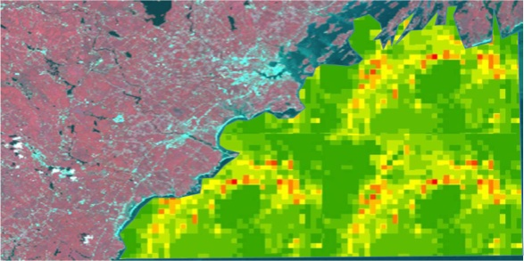




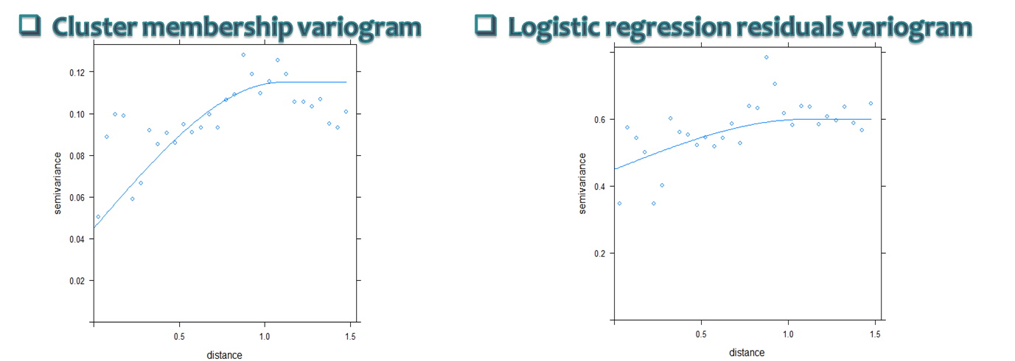
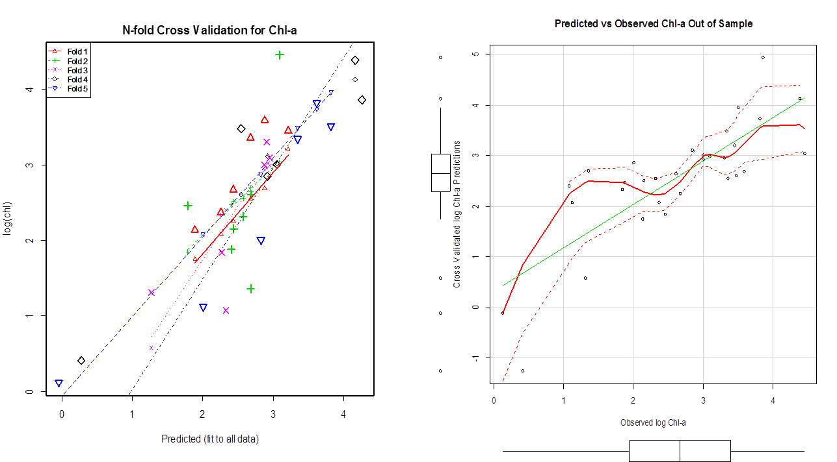
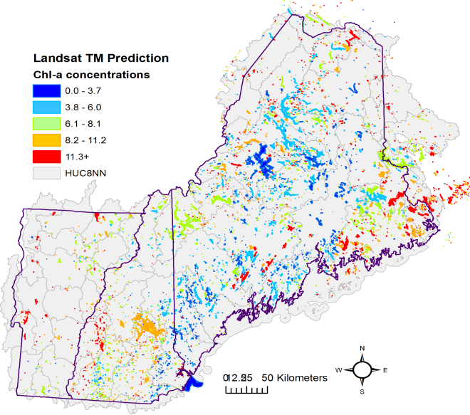
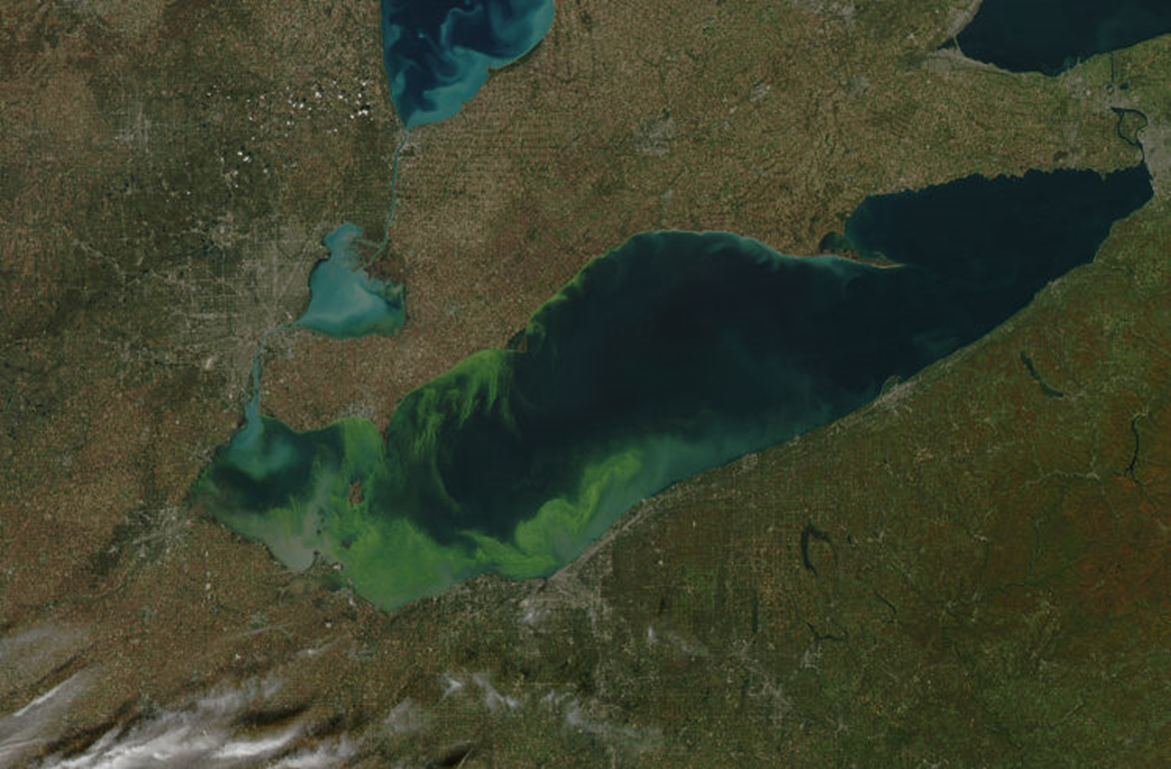
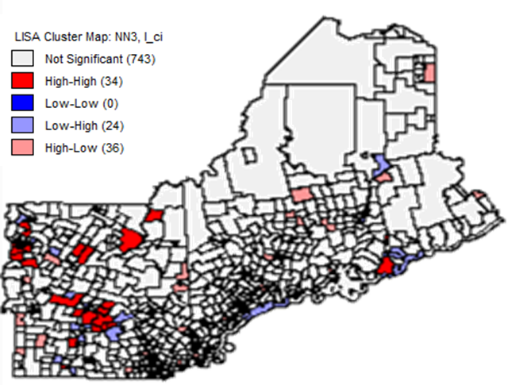
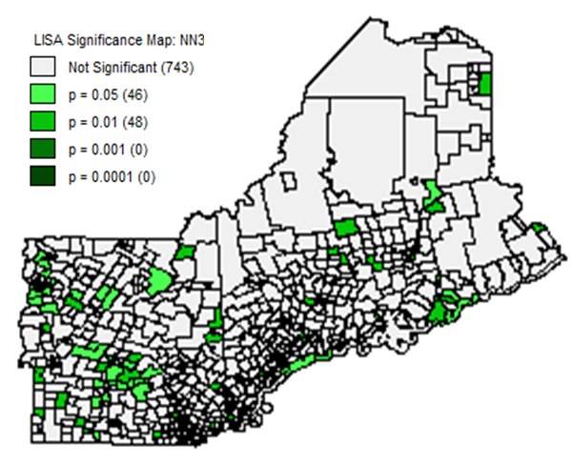
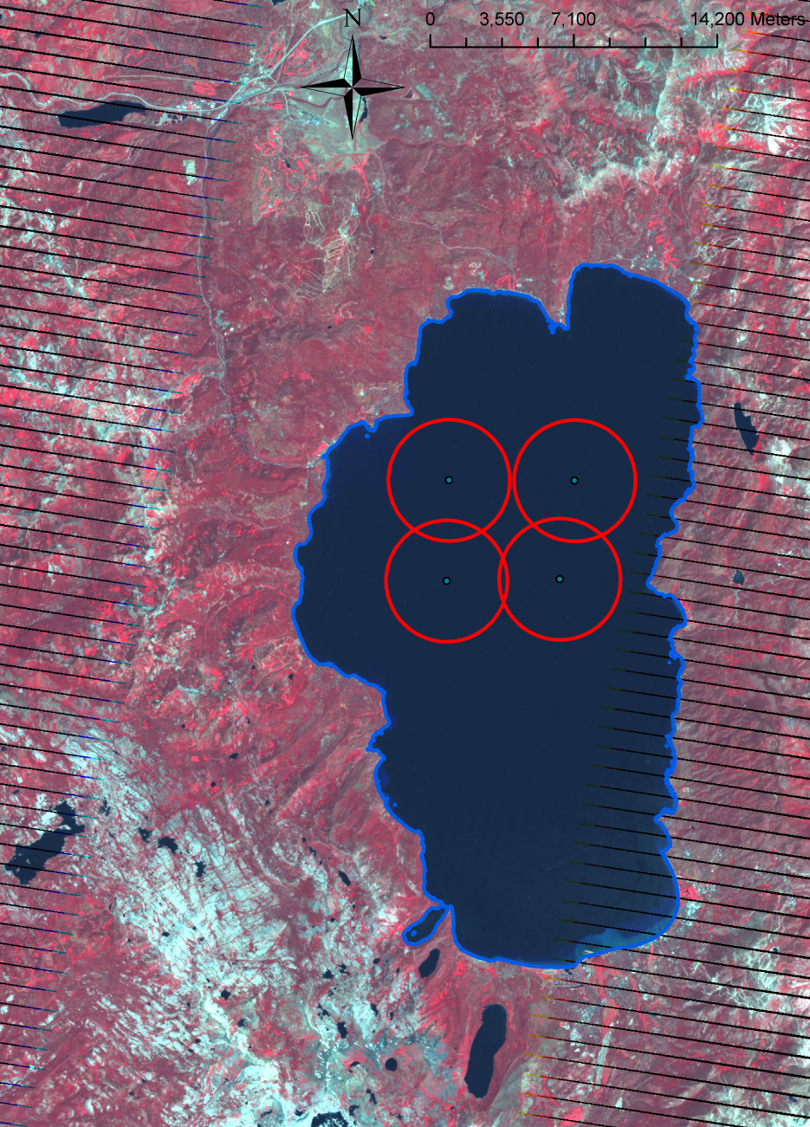
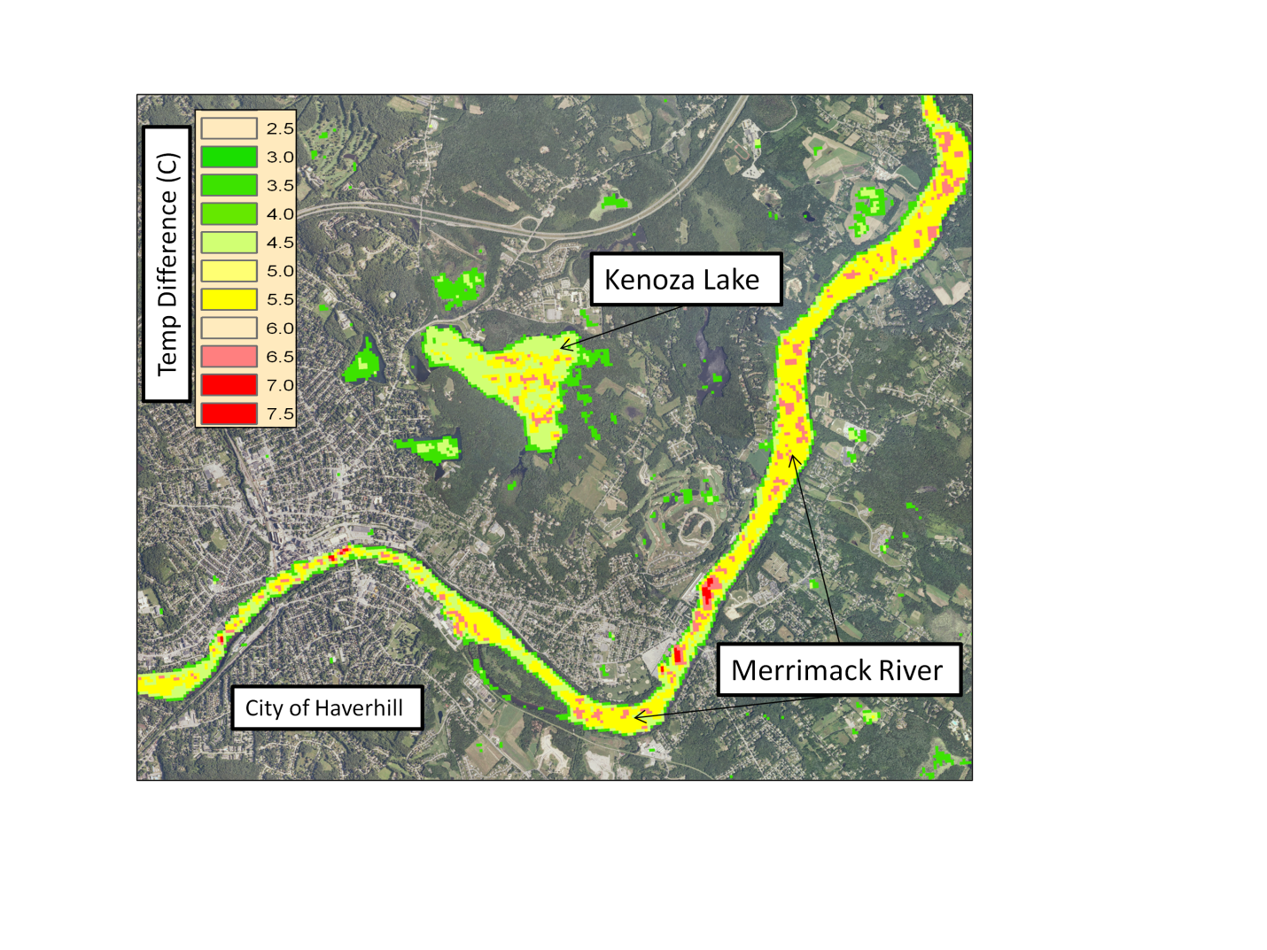
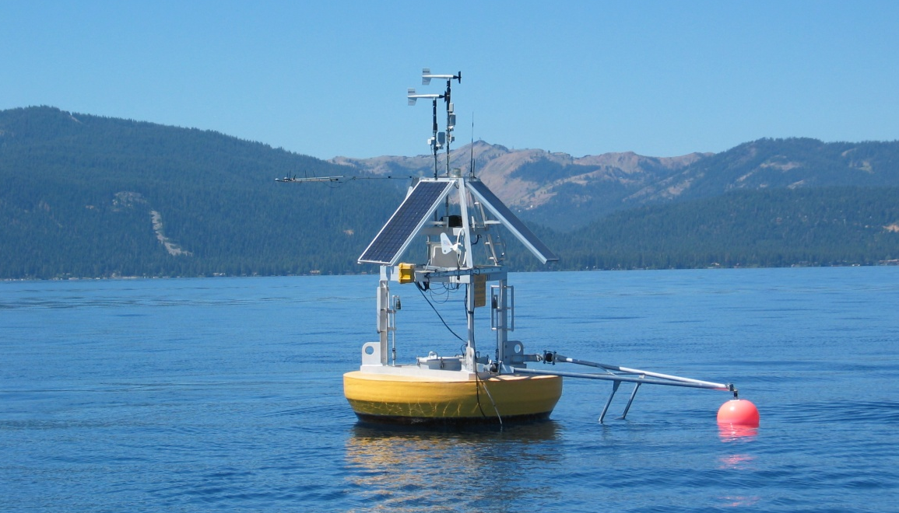
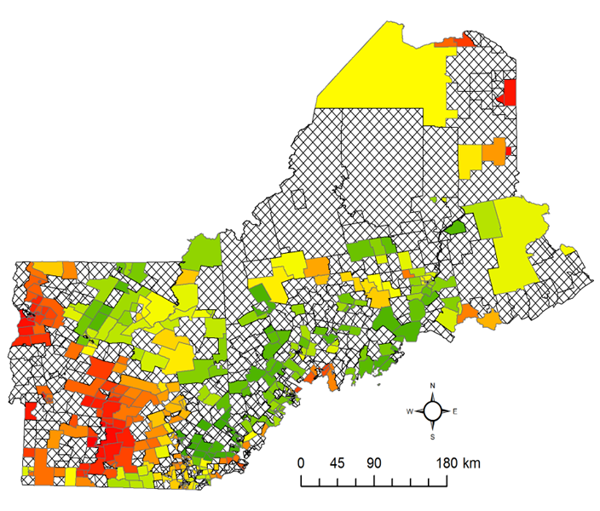

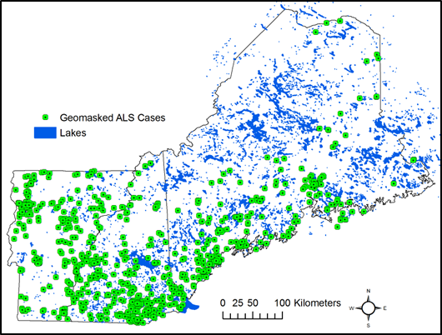
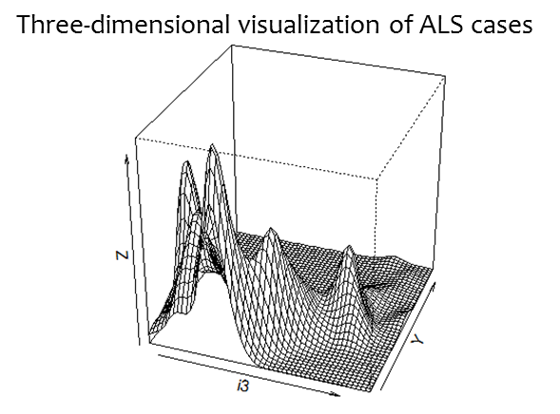




Mapping lake water quality & ALS risk factors across northern New England
Nathan Torbick: ntorbick@appliedgeosolutions.com, Megan Corbiere
Applied Geosolutions, LLC, Newmarket, New Hampshire, USA
Elijah Stommel, Dartmouth Hitchcock Medical Center
Overview
Concern over water quality and human health is rising as anthropogenic eutrophication and climate change are increasing the frequency, magnitude, and intensity of harmful algal blooms. The cyanotoxin, Beta-Methylamino L-Alanine (BMAA), has been identified as a risk factor for Amyotrophic Lateral Sclerosis (ALS). ALS is a progressive motor neuron disease with unknown etiology. Amyotrophic lateral sclerosis (ALS) is the most common adult onset motor neuron disease. The pathologic hallmark of ALS is the selective death of motor neurons in the brain and spinal cord that innervate skeletal muscles, producing debilitating symptoms of progressive weakness, muscle wasting and spasticity. A lack of water quality information has limited our ability to understand linkages among cyanobacteria toxicity and human health.
The goal of this project is the development of operational water quality and cyanobacteria risk maps that utilize multiscale satellite remote sensing platforms to drive an eco-epidemiological model for evaluating linkages between water quality and Amyotrophic Lateral Sclerosis.
Figure: NASA EOS Terra MODIS image. Lake Erie western basin, Microcystis aeruginosa bloom
Approach & Results
Operationalize Landsat maps of lakes >8 hectares for for wall-to-wall mapping of Chl-a, TN, and SD
Band ratio regression using MODTRAN corrected water leaving radiances
Operationalize cyanobacteria metrics for lakes >100 hectares with MERIS using spectra derivative shape filters
Figure: Example chlorophyll-a n-fold validation (left) used to help determine optimal algorithm. Scatterplot (center) between out of sample predictions and observations for chlorophyll-a concentrations were relatively strong (rho:0.80, p-vale<0.000) indicating a rigorous and scalable index. Example map product (right) using Landsat for one time slice across northern New England.
Clustering routines for examining ALS hot spots across northern NE
Figure: Local Indicator of Spatial Autocorrelation Map with a tract-level aggregation of ALS cases represented as normalized excess case counts. Map of the levels of statistical significance where clusters are present.
Spatial multi-logistic regression, Receiver Operating Characteristic , Area Under the Curve used to generate eco-epidemiological modeling framework
Figure: Risk of belonging to a localized cluster of higher than expected ALS counts based on eco-epidemiological model at census tract scale.
Results & Conclusions
A large portion of the spatial autocorrelation in hot spot membership is explained by use of spatially varying risk factors, as seen in the variograms above
Summary modeling results indicating role of water quality metrics influencing ALS cluster membership; lake water quality is an important risk factor
Minimum lake distance, number of lakes within 10km (NL10km), secchi depth of lakes within 30 km (SD30km), chlorophyll-a of lakes within 10 km (CHLA10km), and area weighted total nitrogen for lakes within 30 km (TN30km) were all significant predictors of ALS hot spots at a 5% level of significance
The odds of belonging to an ALS hot spot are approximately 2.7 times higher with an increase in total nitrogen and 59% lower for each meter increase in secchi depth
Figure: Currently assessing role of climate change / lake temperature trends as driver of lake status by using archives of thermal imagery and NOAA buoys for calibration
Operational Landsat metrics for Chl-a, TN, SD for all lakes >8 ha feasible
      R2 range from 0.65-0.88; tradeoff between research vs. products
    Operational MERIS metrics for Chl-a, PFT/cyanos, PC for large lakes feasible with shape based techniques
  Next Steps
  Refining model and scaling procedures and integration methods underway
Adding California, Finland, and Florida ALS case studies
Thanks to:
Map of risk hot spots: WQ & Geo Model by Tract
Data
Approach relies on multiple satellites:
Landsat 5 TM & 7ETM+, and LDCM scale imagery
    8-day intervals, 30m spatial, 180km swath, broad vis-nir channels
MERIS
    ESA platform, ~weekly Full Resolution, ~240m spatial, 15 narrow bands across vis-nir domain
MODIS
    high temporal frequency, 250m -1km spatial, large area, 2001- present
Human health ALS database
Dartmouth Hitchcock Medical Center is compiling an ALS database with more than 800 cases across northern New England. Records from DHMC, the Muscular Dystrophy Association of Northern New England, and surveys were searched to identify cases of ALS diagnosed between January 1997 and October 2009. When possible, we confirmed accuracy of diagnosis, year of diagnosis, and demographic history of patients identified by review of medical records, the Social Security Death Index, obituaries, and data supplemented from questionnaires.
Strict adherence to privacy and high standards for handling human health data

