Slide 1
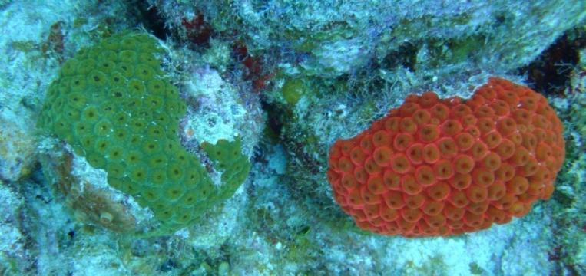
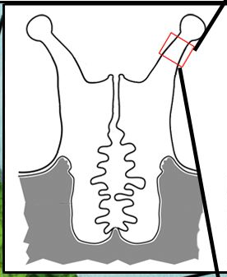
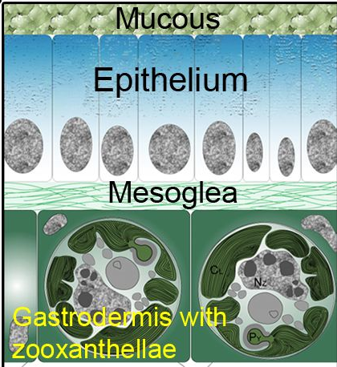
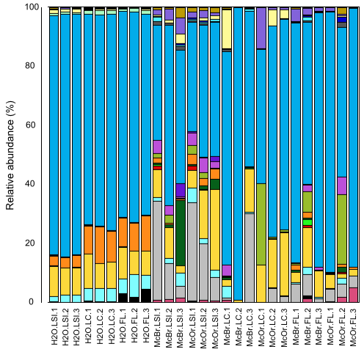
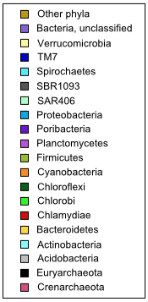
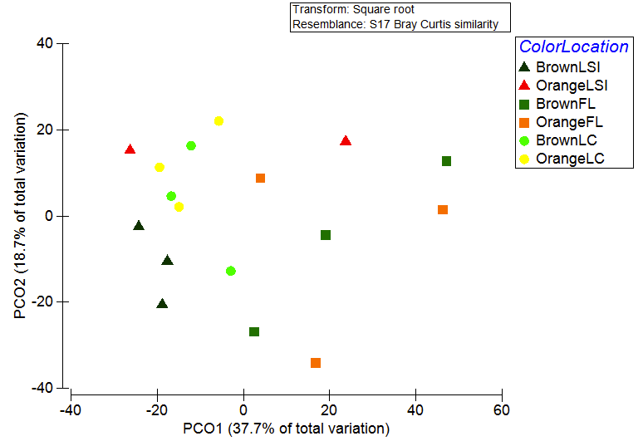
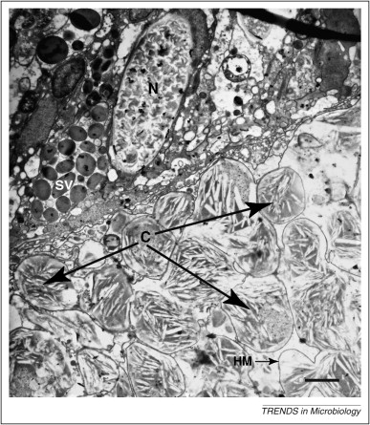
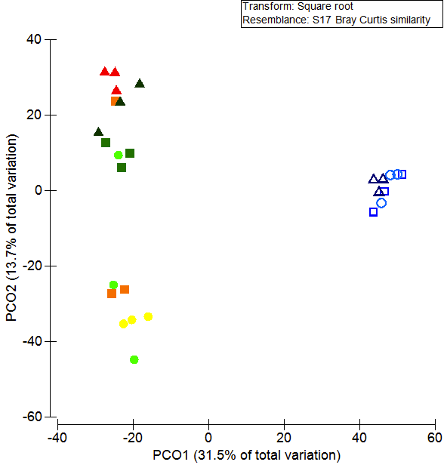
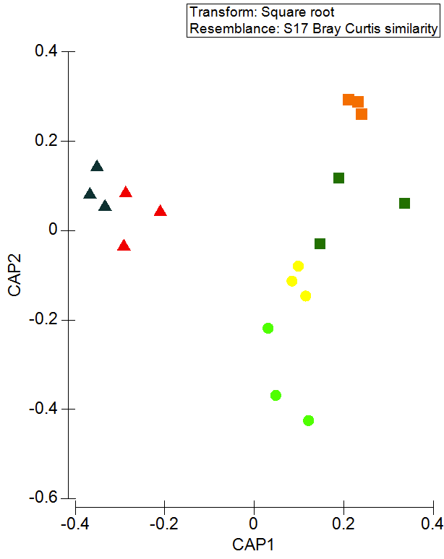
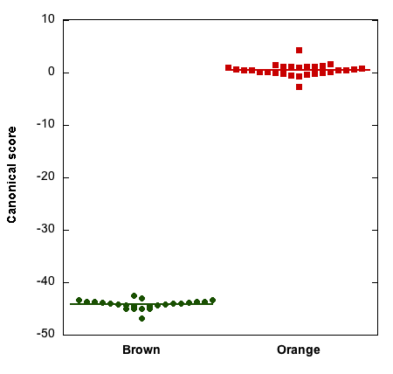
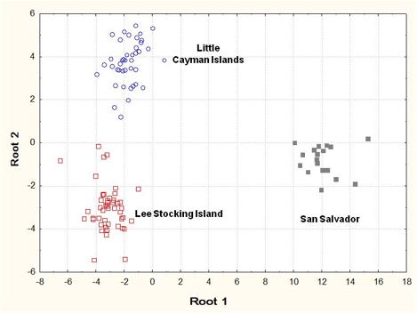
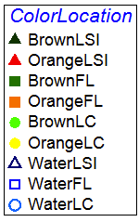
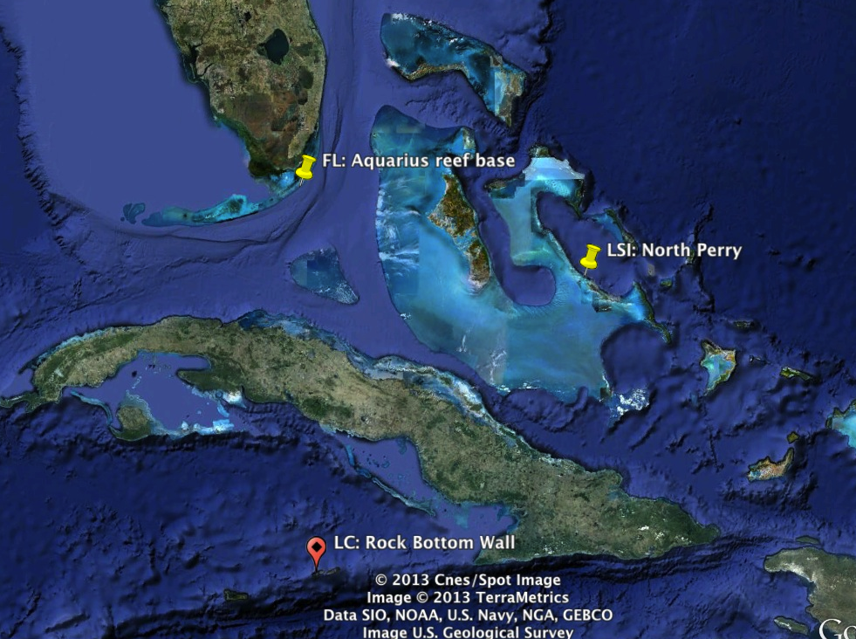
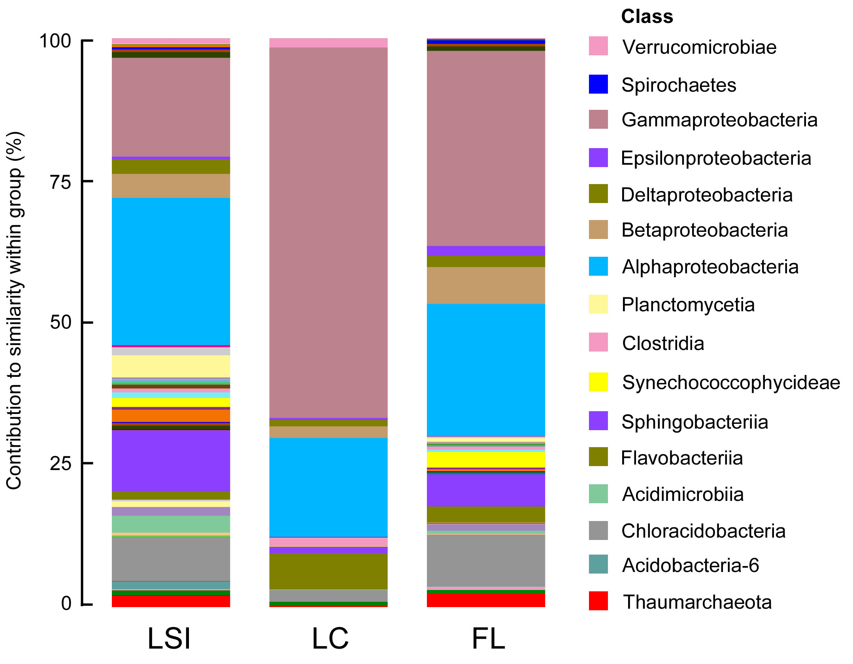
Biogeography of the coral Montastraea cavernosa in the Caribbean basin and associated changes in its microbial communities
Jessica K. Jarett^{1*}, Cara L. Fiore¹, Daniel Brazeau², and Michael P. Lesser¹
¹Molecular, Cellular, and Biomedical Sciences Department, University of New Hampshire, Durham NH. ²School of Pharmacy, University of New England, Biddeford ME
*jjarett@gmail.com
The Coral Holobiont
Prokaryotes associated with M. cavernosa are diverse and variable
Symbiodinium communities vary by geographic location, but not color
Coral host
Colonial animal with a calcium carbonate skeleton.
Symbiodinium sp. (“zooxanthellae”)
Photosynthetic dinoflagellates intracellular in gastrodermis, translocate fixed carbon to coral. High genetic diversity is functionally important.
Microbiota
Diverse bacteria, Archaea, fungi, and viruses live in mucus, tissue, and skeleton. Roles include defense against pathogens, nutrient cycling, and stress response.
Figure 1. Relative abundance of reads in the water column and associated with brown and orange M. cavernosa from FL, LC, and LSI, classified at the phylum level. Samples rarefied to even depth.
Figure 5. PCO of Symbiodinium communities in coral samples. Plotted from Bray-Curtis similarity of square-root transformed sequence counts (n= 6 to 21 sequences per sample).
PERMANOVA for location, p = 0.007; for color and interaction of color and location, p > 0.3.
Patterns of similarity in Symbidinium and prokaryotic communities were not significantly correlated (RELATE anlysis, p > 0.8).
Cyanobacteria in Montastraea cavernosa
Characteristic orange fluorescence. Intracellular in epithelium, N₂-fixing. Dense populations (10⁷ cells cm⁻²), presumed to be living heterotrophically. Fixed N is transferred to Symbiodinium.
Communities in coral and water are distinct and vary by geographic location, but not color
Coral hosts form genetically distinct populations based on location and color
Research Questions
What structures the diversity of the coral
holobiont?
What are the effects of symbiotic cyanobacteria on
the prokaryotic community?
What are the effects of geographic location?
Figure 6 (left). Dotplot of canonical scores from discriminant function analysis (DFA) of AFLP data from brown and orange corals from LSI, collected at depths from 3 to 76 m. DFA was able to correctly assign 100% of samples to their population of origin.
Figure 7 (right). Ordination of canonical scores from DFA of AFLP data from brown corals collected from LSI, LC, and San Salvador, Bahamas at depths from 3 to 90 m. Frequency of reassignment to correct location ranged from 89 to 100%. From Brazeau et al. 2013⁵.
Do members of the holobiont influence each
other?
Figure 2 (left). Principal coordinates analysis (PCO) of prokaryotic communities in coral and water samples. Plotted from Bray-Curtis similarity of square-root transformed read counts.
PERMANOVA for sample type, location (water samples), location (coral samples), p < 0.004; for coral color and interaction of color and location (coral samples), p > 0.08.
Figure 3 (right). Canonical analysis of principal coordinates (CAP) ordination of prokaryotic communities in coral samples. Derived from a subset of PCO axes (m=7). Trace statistic p = 0.0002.
Study Design and Methods
Synthesis and Conclusions
Sampling
Collections at 15 m depth at Lee Stocking Island, Bahamas (LSI); Little Cayman Island, Cayman Islands (LC); Conch Reef, Florida (FL). From each location, 3 orange (McOr) and 3 brown (McBr) colonies and 3 water (H₂O) samples were collected. Mucus was removed from coral samples by airbrushing.
Prokaryotic community profiling
Pyrosequencing of 16S rRNA PCR amplicons with MID-tagged universal primers for Bacteria and Archaea (V5-V6). Analyzed with QIIME² and PRIMER. Singleton reads were discarded, reads were clustered into OTUs at 97% similarity, and samples were rarified to an even sampling depth.
Symbiodinium genotyping
PCR, cloning and sequencing of ITS2 region of rRNA, reference database³ used to align sequences and identify types. Analyzed with PRIMER.
Many prokaryotic taxa make small contributions to differences in corals
All compartments of the holobiont differ by location
Symbiotic cyanobacteria do not affect prokaryotic or Symbiodinium communities in M. cavernosa
Patterns of diversity in prokaryotic and Symbiodinium communities are not correlated
Genetic differences in corals of different colors are not associated with changes in prokaryotic and Symbiodinium communities
The association between genetic differences in coral hosts of different colors and the presence of symbiotic cyanobacteria is unclear
Coral host fingerprinting
Amplified fragment length polymorphism (AFLP) analysis: restriction digest of genomic DNA, 2 rounds of selective PCR, bin PCR products based on fragment size. Allele frequencies were analyzed with AFLPOP⁴ and discriminant function analysis. Additional coral samples collected (Fig. 6, 7).
References and Acknowledgements
1. Holobiont figures: Fiore CL, Jarett JK, Olson ND, Lesser MP (2010) Trends in Microbiology 18 (10):455-463
2. Caporaso JG et al. (2010) Nature Methods doi:10.1038/nmeth.f.303
3. R. Gates from the University of Hawaii provided the Symbiodinium reference database.
4. Duchesne P, Bernatchez L (2002) Molecular Ecology Notes 3: 380-383
5. Brazeau DA, Lesser MP, Slattery M (2013) PLOS One 8 (5): e65845
6. Acknowledgements: Research supported by the National Geographic Society and National Science Foundation. JKJ was supported by a National Science Foundation Graduate Research Fellowship. We thank K. Thomas, H. Bik, M. Slattery, D. Gochfeld, E. Kintzing, C. Easson, E. Hunkin, S. Lee, W. Fitt, and the team at Aquarius Reef Base.
Figure 4. Contributions of classes of prokaryotes to the similarity of coral samples within a location; only selected classes shown in key. Similarity percentages (SIMPER) analysis of Bray-Curtis similarity of square-root transformed read counts for each OTU was performed, and results were summarized by class.

