Slide 1


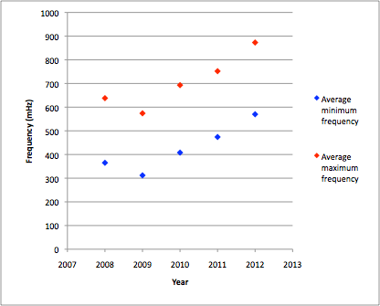
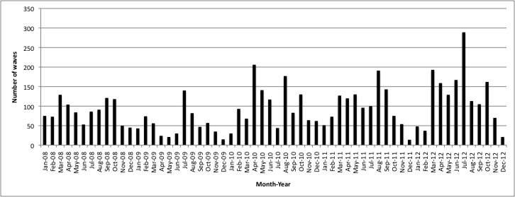
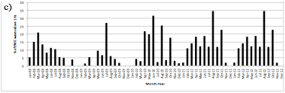
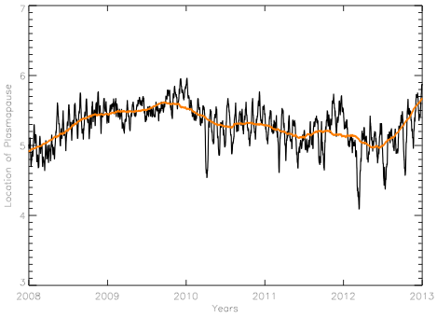
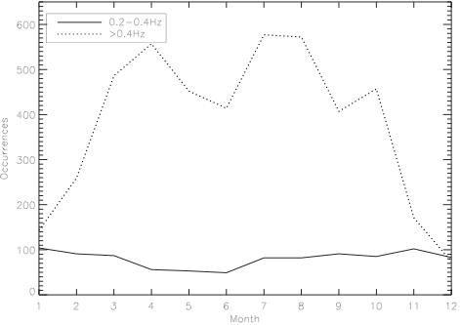
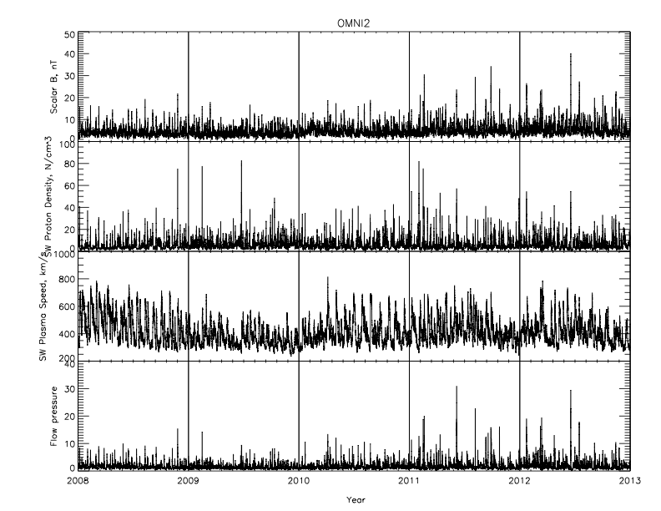
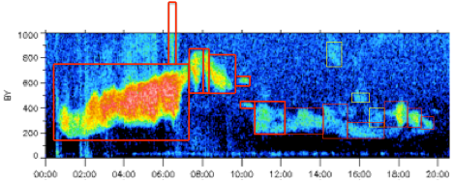
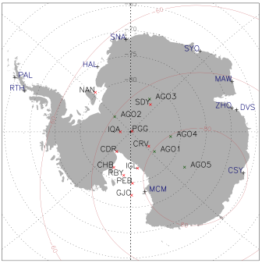
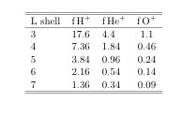
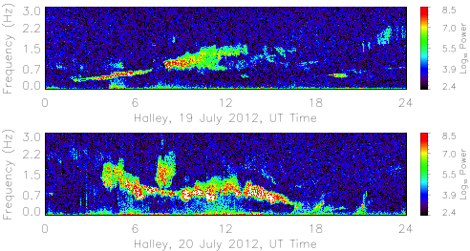
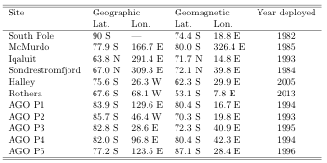
Solar cycle dependence of EMIC wave frequencies
Marc Lessard, Carol Weaver, Erik Lindgren Mark Engebretson
University of New Hampshire Augsburg College
Introduction
Spectacular sample event
Event Selection
Statistical study results - #1
Number of events recorded:
2008: 2009: 2010: 2011: 2012:
1029 624 1215 1174 1493
Statistical study results - #2
Proton temperature anisotropies in the magnetosphere can generate electromagnetic ion cyclotron (EMIC) waves. These waves, generated near the equatorial region, often propagate to the ionosphere and couple energy through the ionosphere to produce a signature that can be observed on the ground. Such observations, acquired at Halley Station in Antarctica since February 17th, 2005, were used in this statistical study. Here, we present results from a statistical analysis of EMIC waves at Halley from 2008 throughout 2012. The focus of this study was motivated by a casual observation that spectra of these waves were increasingly reaching above 1 Hz over the past few years.
During the study, we also noticed a clear seasonal dependence that was apparent only with the higher frequencies. A similar result is implied by Popecki et al., [1993], where the emphasis was on conjugate measurements. Here, we identify a frequency dependence of the penetration of these waves through a sunlit ionosphere.
The plot above shows the average minimum and maximum EMIC frequency per year from 2008 through 2012. Note the ~50% increase in frequencies from 2009 to 2012, concurrent with increasing solar activity. The increased frequency implies a shift in the location of the generation radially inward. For these particular frequencies, the location apparently changes from approximately L=6+ to L=5- (nearly an R_{E}).
The upper plot above shows the total numbers of waves for each month. The lower plot shows the percentage of waves observed with frequencies above 1 Hz. These plots motivated a closer look to determine whether there might be a clear cutoff on the seasonal dependence. The plot below gives the result, with the upper trace showing the seasonal dependence of wave penetration above .4 Hz, and the lack of seasonal (sunlight) dependence for waves below .4 Hz. We attribute this to the shorter perpendicular wavelengths of the higher frequency waves, which presumably fall below the ~1 km needed to be observed on the ground [Lessard and Knudsen, 2001].
Does the shift perhaps follow the location of the plasmapause (near dawn, where these events were primarily observed)? The plot on the right shows the plasmapause location (near dawn) as determined using the Moldwin et al. [2002] model, which is a K_{p}-driven empirical model. The plot does show a weak trend in the right direction, though perhaps only the order of ~.6 R_{E}. The implication is that the plasmapause may play a role here.
Conclusions
Observations from Halley Station in Antarctica (L=4.6) show that frequencies of EMIC waves have increased by approximately 50% from the solar minimum in 2009 through the end of 2012. These waves tend to be located near 0700 MLT.
The change may be associated with a shift in the location of the plasmapause and may also be associated with increased magnitudes of solar wind pressure pulses. This change affects possible interactions with radiation belt electrons.
We also note that penetration through the ionosphere of higher frequency waves (e.g., greater than .4 Hz) tends to be controlled by effects of sunlight (density profiles).
By the way, RBSP fans, EMIC waves interact with ~1 MeV electrons. From the AE-8 model, electron fluxes at L=6 during solar minimum at 1 MeV are 9.978E+05/cm^2-s. This changes during solar maximum and at L=5 to 2.794E+06/cm^2-s -- the EMIC waves move to a region of fluxes that are nearly tripled!!
The start and end time of an EMIC wave was determined to the closest quarter of an hour; wave duration was measured in increments of 15 minutes. The minimum and maximum frequencies were recorded for each event. Note that the event definition in this study differs from others in the sense that unless an event was clearly contiguous, it was treated as a superposition of multiple events. This is a result of recent work regarding ionospheric ducting of these waves, which implies that multiple sources of waves will superimpose to produce the blotchy appearance shown in the above plots.
Does the shift perhaps coincide increased solar wind pressure pulse magnitudes that might pressure perturbations deeper within the magnetosphere? Well, maybe. The plot above shows solar wind parameters over the same time period, with the bottom panel showing pressure. Clearly, pressure pulses increase both in magnitude and occurrence rate in the later years.
Acknowledgements
This research was supported by NSF grants ATM-0827903, ANT-0838917, ANT-0840133, and ARC-0806196 to Augsburg College, and grants ANT-0839938, ANT-0838910, and ARC-0806338 to the University of New Hampshire .We gratefully acknowledge contributions by UNH undergraduates Matt Blandin and John Heavisides.

