Slide 1
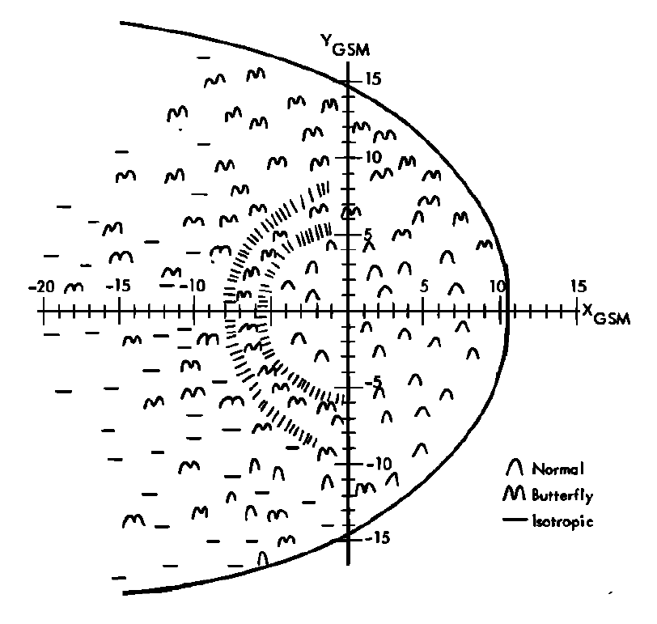
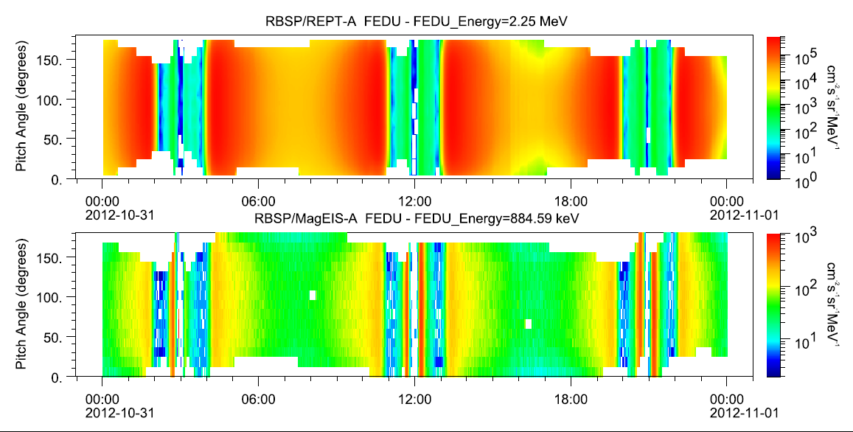
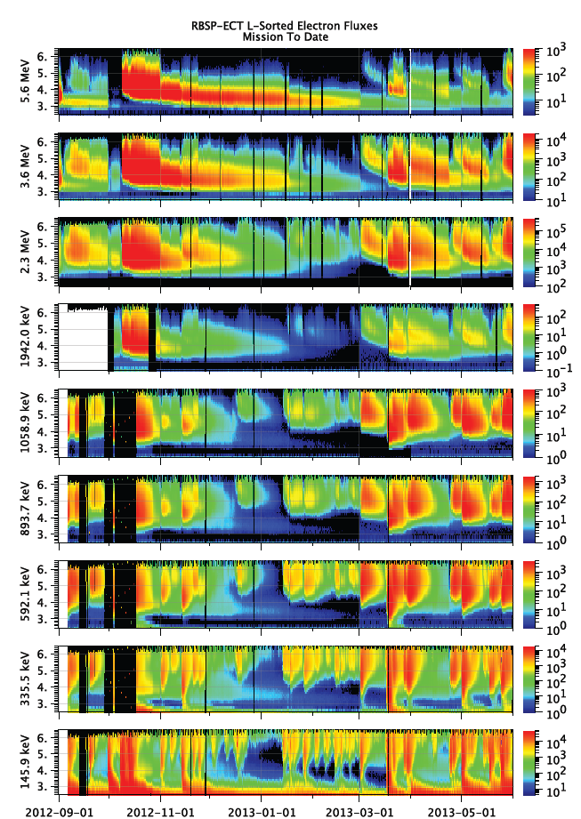
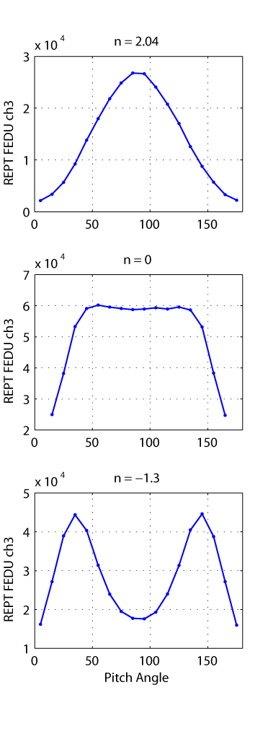
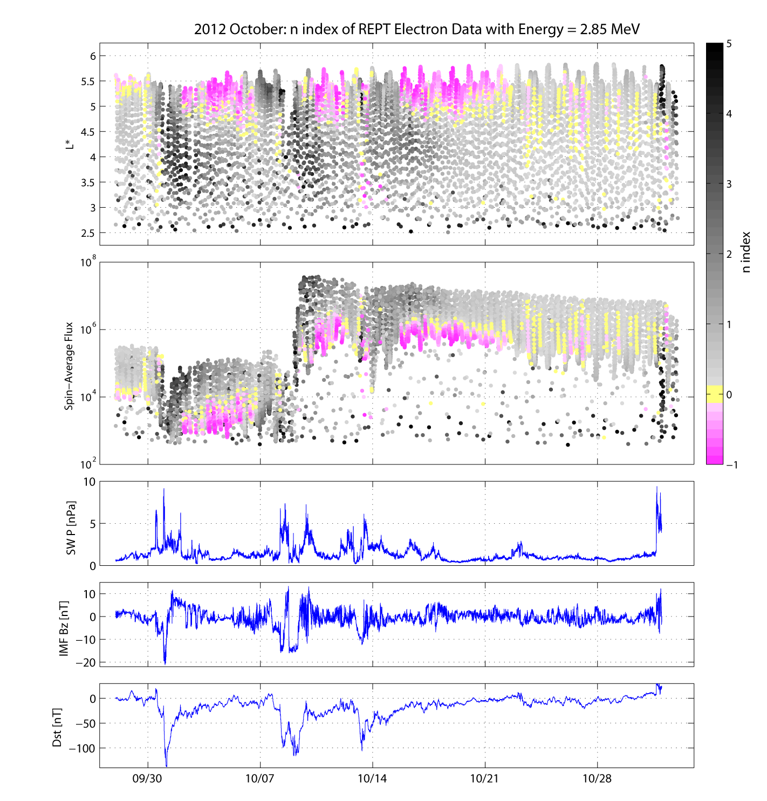
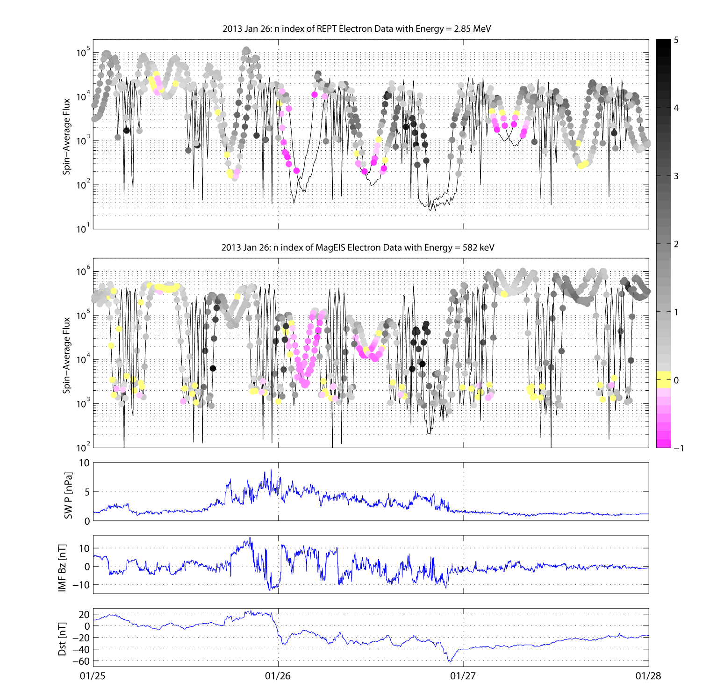
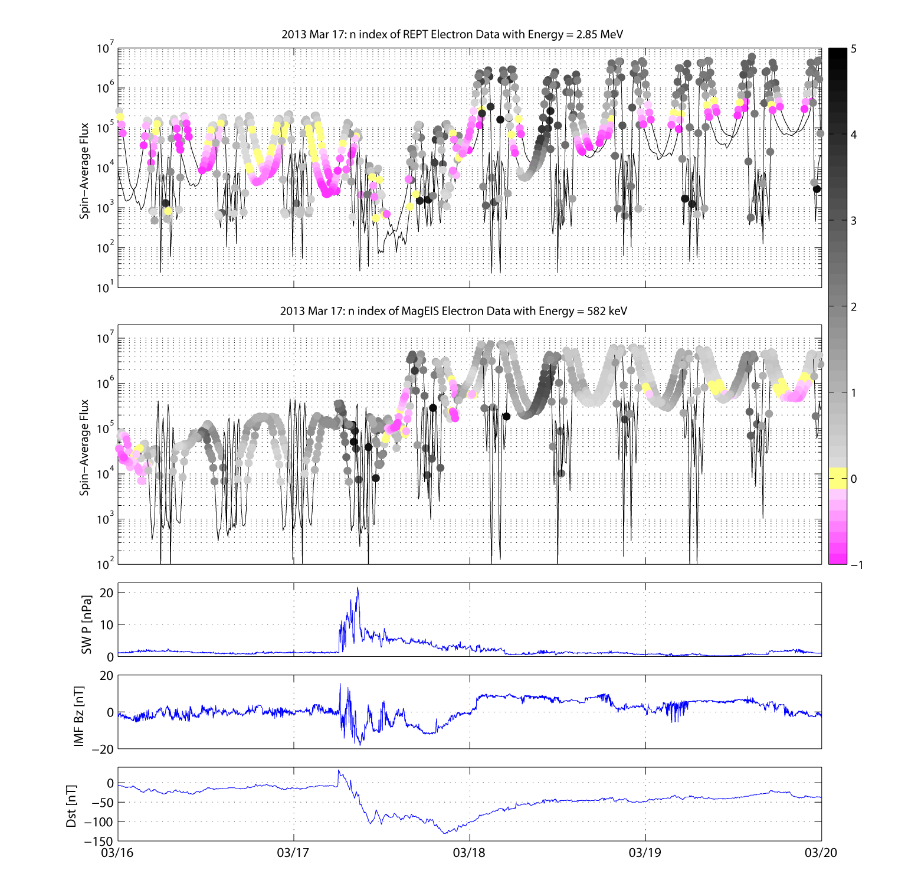



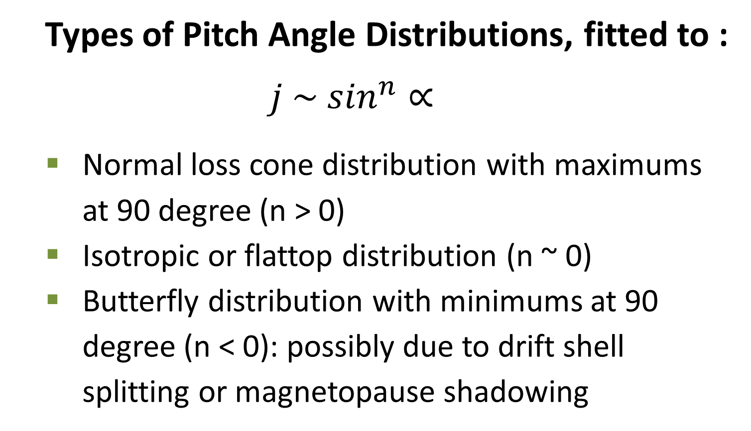
2013 GEM Workshop, Snowmass, CO
Electron Pitch Angle Distributions Observed by the Van Allen Probes
Chia-Lin Huang¹, Harlan Spence¹, Seth Claudepierre², Joe Fennell ² , Shri Kanekal³, and the RBSP ECT Team
¹ University of New Hampshire, ² Aerospace Corp, ³ NASA Goddard
Electron Pitch Angle Distributions
Van Allen Probes (or RBSP) : ECT-REPT and MagEIS Electron Pitch Angle Data
Ogo-5 Pitch Angle Measurements
Example of 3 types of PADs:
Normal
Types of Pitch Angle Distributions, fitted to :
$$j \sim \sin^{n}∝$$
Normal loss cone distribution with maximums at 90 degree (n > 0)
Isotropic or flattop distribution (n ~ 0)
Butterfly distribution with minimums at 90 degree (n < 0): possibly due to drift shell splitting or magnetopause shadowing
Isotropic
West, 1979
Butterfly
2012 October Storms – REPT Data
From RBSP-ECT SOC website
2013 January 26 and March 17 Storm Events – REPT and MagEIS Data
n index
n index
Summary: From electron pitch angle distributions, we can estimate the location of the spacecraft in the magnetosphere and understand the mechanisms controlling the space and time-varying radiation belt electrons.
Acknowledgement: BIG THANKS to the RBSP-ECT team!
Contact info: Chia-Lin.Huang@unh.edu

