Slide 1
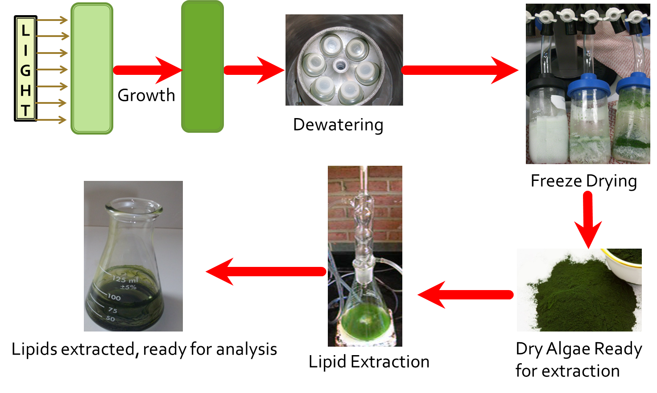
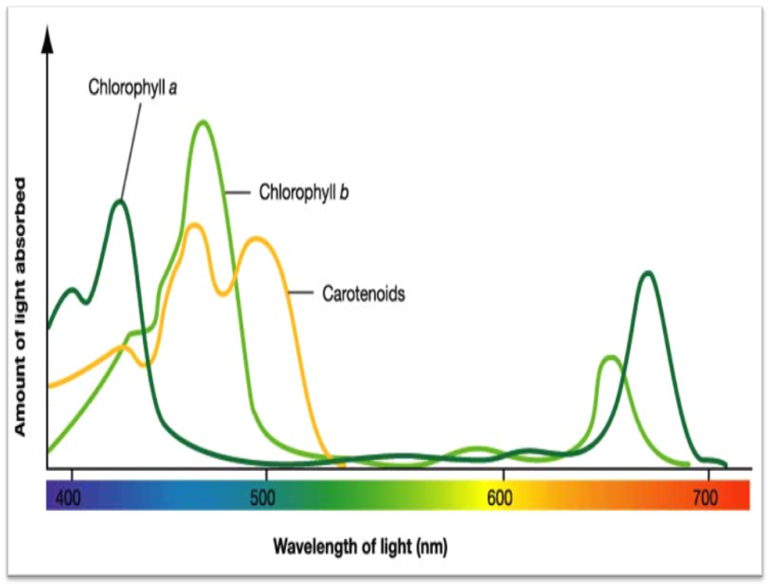
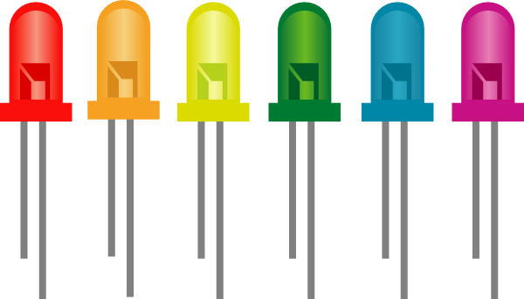
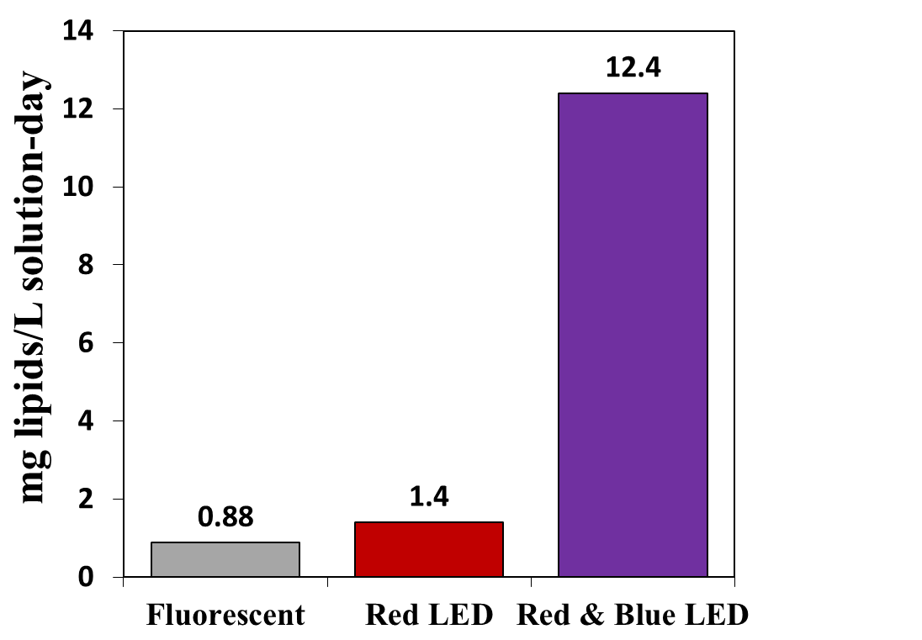
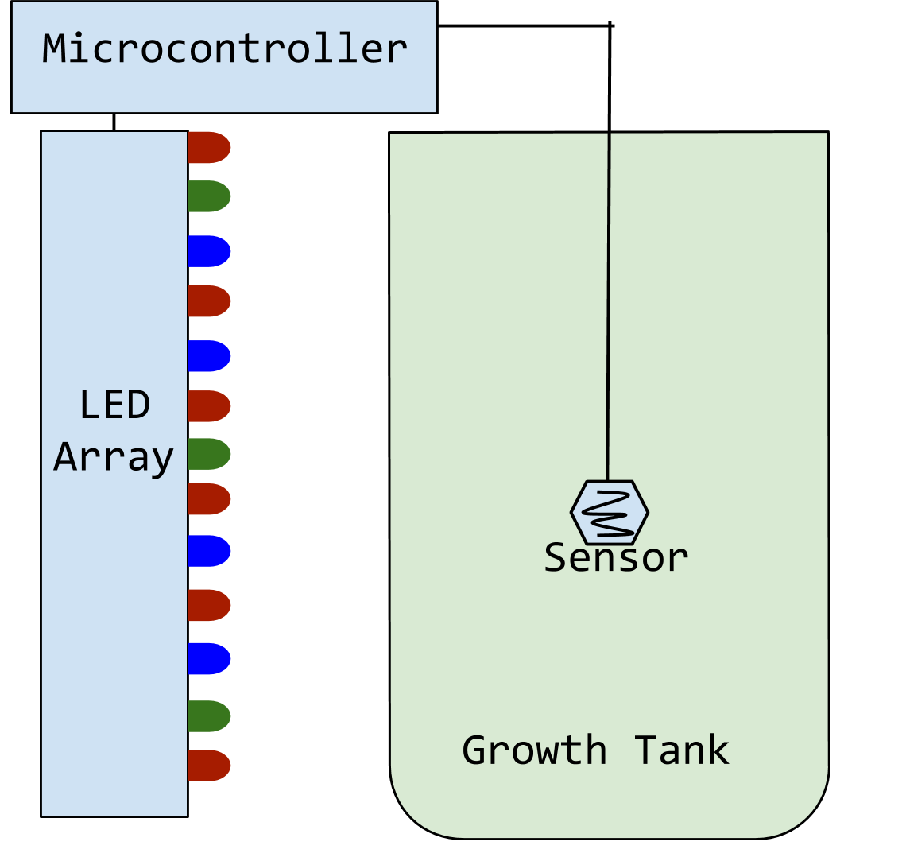
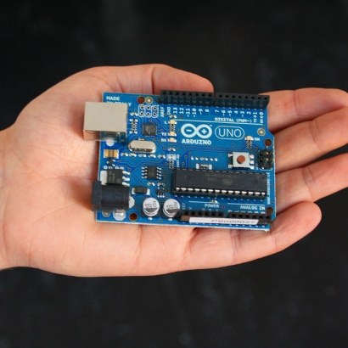
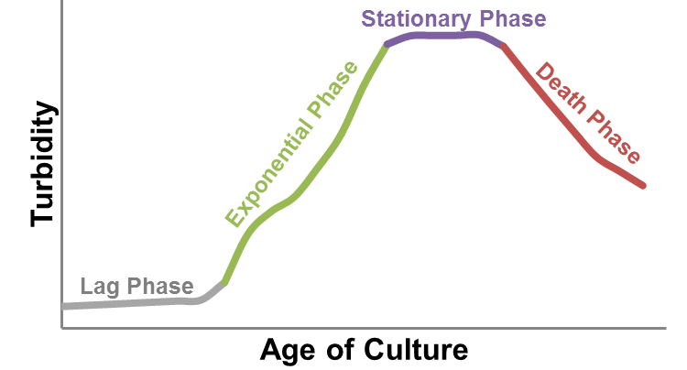
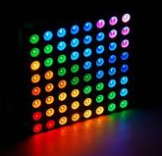
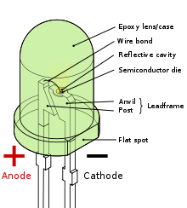
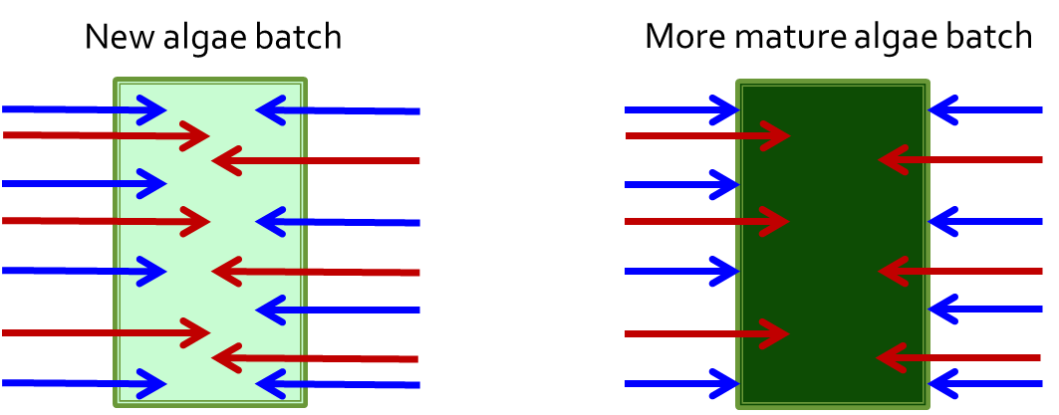
Greener algae growth in photobioreactors using LEDs and smart photokinetics
Daniel Eltringham
Department of Chemical Engineering
University of New Hampshire, Durham, NH
Importance
Algae oils, obtained from harvested algae are used in the manufacture of biodiesel and food products.
Objectives
Develop an LED array to produce only the wavelengths most useful for algae growth. A “smart” lighting prototype was developed to change lighting according to culture turbidity in the photobioreactor (PBR), allowing the energy cost of algae-based products to be reduced.
Light absorption in photosynthetic pigments
Research confirms that red and blue light increase production and reduce energy costs.
Turbidity and batch culture age
Ideally, algae will be harvested at the point of maximum lipid richness, which occurs immediately before the stationary phase. It is easy identify the end of the exponential phase after the stationary phase has been reached, but much more challenging to predict when the batch will enter the stationary phase.
Methods
Conclusions
Light spectrum affects lipid production
Selected wavelengths are superior to full-spectrum light
LEDs are an ideal source of selected-wavelength light
Real-time decision making increases lipid richness in harvested algae
Blue light is most well utilized early in growth; red light becomes more useful later; green light may be useful due to its abilities to penetrate turbid cultures.
Ideal lighting
Algae grown in 2L and 80L batch PBR
Spectrophotometer readings are used to assess turbidity at each stage of growth
Growth monitored using turbidity and cell counts
Grams lipids extracted per gram of dry algal mass is used to assess lipid richness
Rates of growth for each lighting profile are compared
Light type and intensity are the independent variables
Results and System Design
Effect of Light on Lipid Content
Design Goals
Data logging
Decision algorithm ignores minor fluctuations
Turbidity-response lighting
Prediction of ideal harvest time
Minimize labor
Program easily adapted based on observations
Automatic shutoff if overheating occurs
Notification mechanism indicating when it is time to harvest
2000 Lux
Early-growth
Mid-growth
Late-growth
Ongoing Investigation
Construction of an integrated data logging and real-time decision system
Identification of the most beneficial lighting profile for each stage of growth
Assessment of the efficacy and cost efficiency of green light as a component of late-stage PBR lighting
Although greater light intensity improves growth, it costs more energy. Smarter systems produce only wavelengths of light that will be useful to growth.
LEDs use less energy than conventional lighting sources and produce light in a narrow range of wavelengths; lighting profiles can be carefully tailored.
As the algal population increases, less light penetrates to the center. Hence, blue light is not well-utilized later in growth.
Smart lighting system
Ideal harvest time
Acknowledgments
National Science Foundation
Hamel Center for Undergraduate Research
Dr. Ihab Farag (Mentor)
Marian Elmoraghy
Kelsey Price
Light penetration in a PBR
The sensor array detects light intensity and temperature. The microcontroller uses a decision algorithm to determine the best lighting profile at any particular time and immediately adjust the lighting to ideal levels and composition. The sensor is color-independent so it always accurately records light penetration.
Notes:
Copyright Colin Purrington (http://colinpurrington.com/tips/academic/posterdesign).

