Slide 1


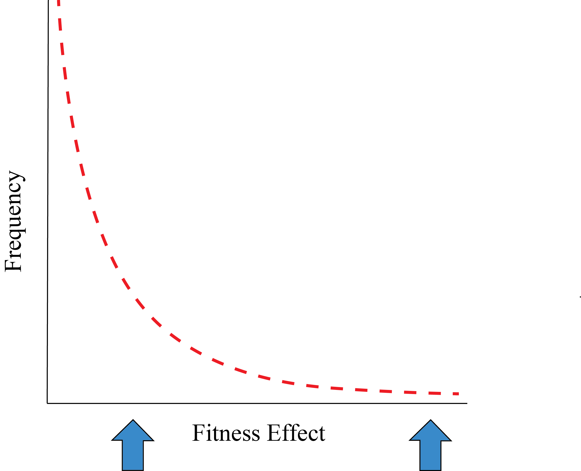
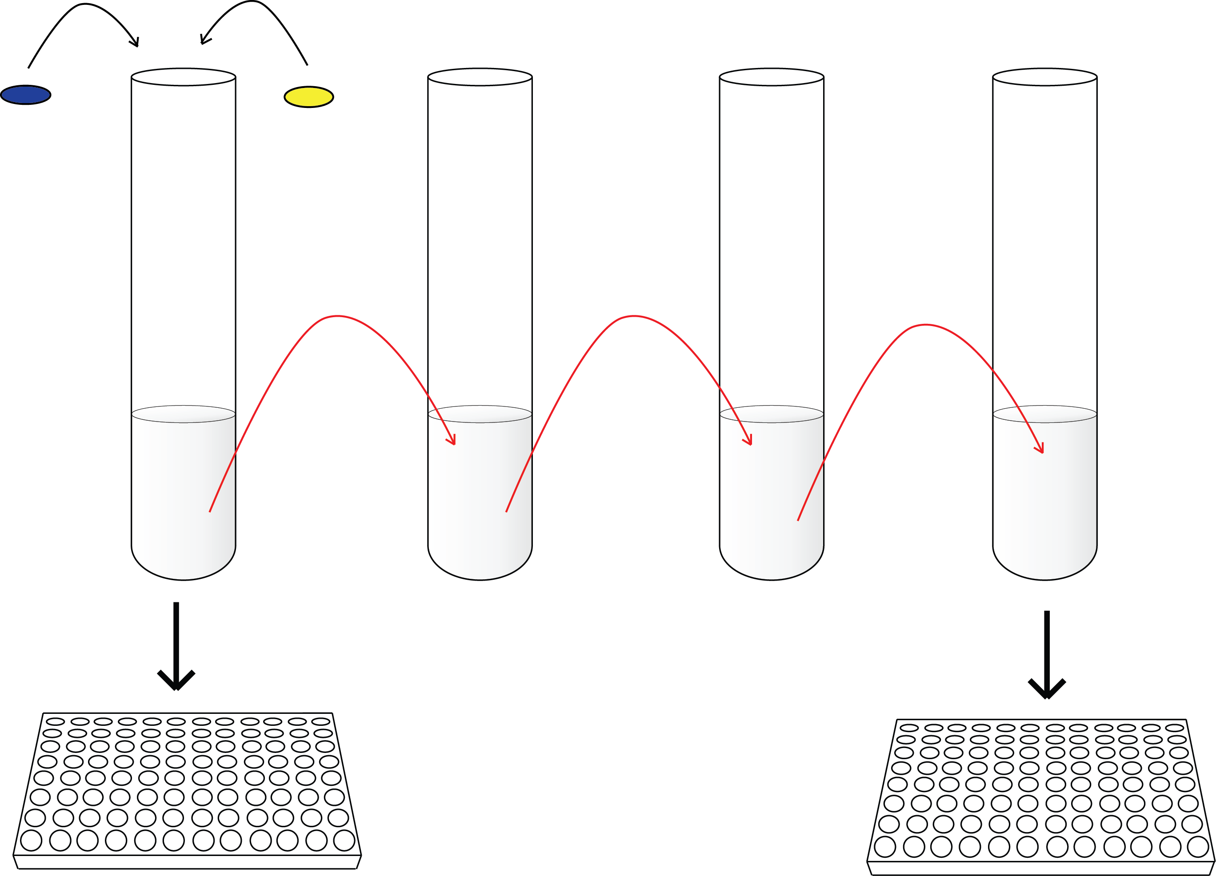
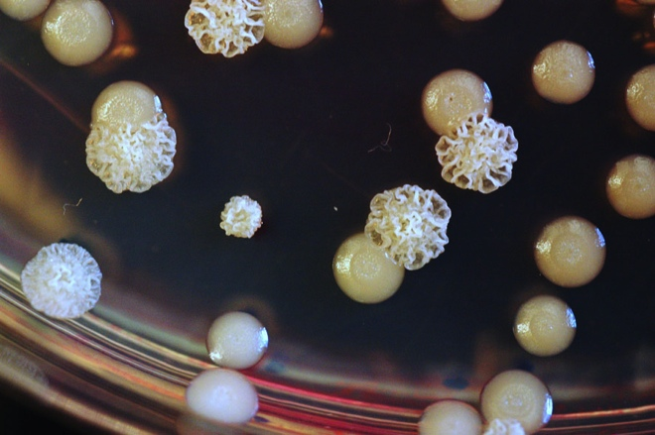
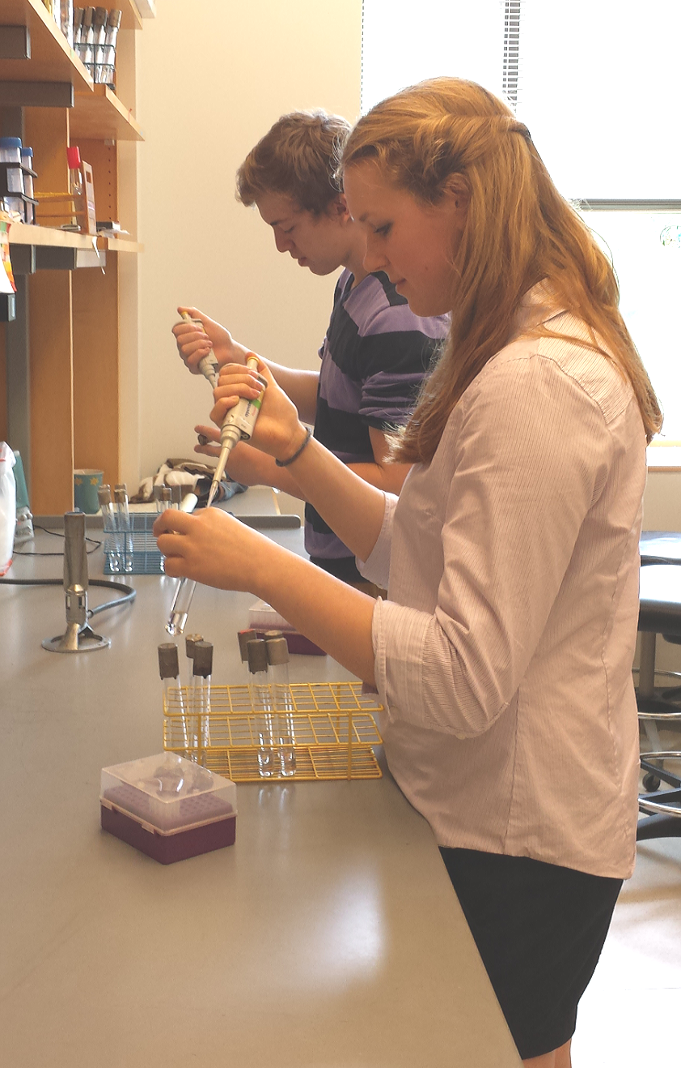
Evolution in action: The fitness effects of beneficial mutations in alternative environments
Taylor M. Warren and Vaughn S. Cooper*
University of New Hampshire, Durham, NH, USA.
Abstract
Evolution…
  Adaptation to new environments is facilitated by beneficial mutations that increase fitness; but how these mutations perform in alternative environments is poorly understood. Theory predicts that most mutations will be neutral or harmful under alternative conditions; however, some may be beneficial. The combined effect of these mutations is critical for determining the success or failure of an organism, particularly in populations that are challenged by dynamic environmental conditions. We predict that different selective environments will favor mutations with varying fitness effects. More specifically, mutants isolated from a more permissive environment will likely be of greater benefit across a range of alternative environments than those collected from a more strenuous environment. A single genotype of Escherichia coli was marked with two fluorescent markers, and was experimentally evolved in either a glucose or trehalose minimal medium. Mutants differing from their ancestor by a single beneficial mutation were collected through the use of flow cytometry, and the fitness effect of each was quantified. We are currently measuring fitness in an assortment of alternative environments, which will ultimately allow us to understand how mutants can be successful in one or many environments. We are also in the process of developing short-term evolution experiments for use in college and high school classrooms, allowing students to gain a broader range of evolutionary processes by studying “evolution in action” in microbial populations.
…in action
Isolation of First Step Beneficial Mutants via Flow Cytometry
When divergence from the trajectory was observed, a clone from both the winning and losing fraction was isolated for further analysis.
Fluorescently marked cells travel through the flow chamber one at time. As they pass through the chamber, a laser will hit the cell, exciting a fluorescent protein which will then emit light of a certain color.
Objective
Quantify pleiotropic effects in order to understand the dynamics of specialization and how organisms adapt to particular niches.
Hypothesis
Beneficial mutations isolated from a more challenging environment will tend to produce more tradeoffs.
Fitness of Effects of Mutants
via Plating
First step beneficial mutations were collected using the same serial transfer method. Mutants were captured using a visual marker which can be seen on agar plates.
Collected mutants were competed against their oppositely marked ancestor in their selective environment. Fitness of each mutant relative to the ancestor was calculated as the natural log of growth over a 72 hour period.
Figure 1: The fitness effects of beneficial mutations are thought to be exponentially distributed in that a majority of all mutations are of low benefit; however, a small number of mutations are of high benefit, and increase the organism’s fitness relative to its ancestor (1,2).
Serial Transfers
Transfers were carried out every 24 hours by transferring the culture into fresh media.
Samples were analyzed every three days by flow cytometry.
Challenge
Evolution is poorly understood, partly because it is not seen or taught as an empirical science.
Why Study Evolution by Experimentation with Microbes?
Seeing is not only believing, it is also understanding.
Evolution is current, not just historical.
The outcomes of evolution may be predictable.
Microbes are ubiquitous and important!
Objective
Promote learning of fundamental aspects of evolution and their applications to a broad spectrum of disciplines such as microbiology, physiology, engineering, medicine, public health, etc.
…in the classroom
Experimental Evolution in High School and
College Classrooms
Figure 2: Daily Serial Transfer
Methods
REL606 populations were founded using genetically identical E. coli ancestors, each containing a different fluorescent marker. Replicate populations were evolved in a minimal media containing 25 µL/mL glucose or trehalose (DM 25) and incubated at 37°C. Populations were diluted 1:10,000 fold into fresh media every 24 hours and analyzed every 3 days using flow cytometry as depicted in Figure 2. A skew towards one fluorescent marker indicated the presence of a first step beneficial mutant. At this point, evolutions were stopped; beneficial mutants were isolated and frozen for later analysis. Mutants were then directly competed against their ancestor (1:1) with a daily 1:100 fold dilution, and analyzed via flow cytometry to determine frequency over 72 hours. The fitness of each mutant relative to the ancestor was calculated as the natural log of growth over a 72 hour period.
Acknowledgments
References
Thanks to M. Dillon, R. Staples, C. Traverse, K. Flynn for their assistance and helpful comments. A special thanks to Romain Gallet for constructing the fluorescently marked E. coli strains that were used in these experiments. Also, thanks to The Hamel Center for Undergraduate Research and NSF CAREER DEB-0845851 for financial support.
1. Fisher, R. 1930. The genetic theory of natural selection. Oxford University Press, Oxford, UK.
2. Wilke, C. 2004. The speed of adaptation in large asexual populations. Genetics 167: 2045-2053.
*Contact Dr. Vaughn Cooper at: vaughn.cooper@unh.edu and Taylor Warren at: tmf46@wildcats.unh.edu

