Slide 1
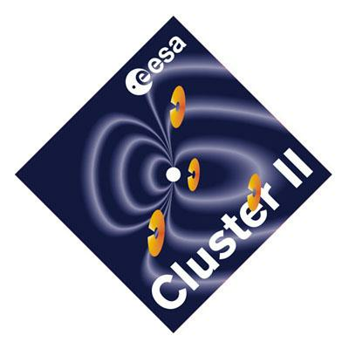
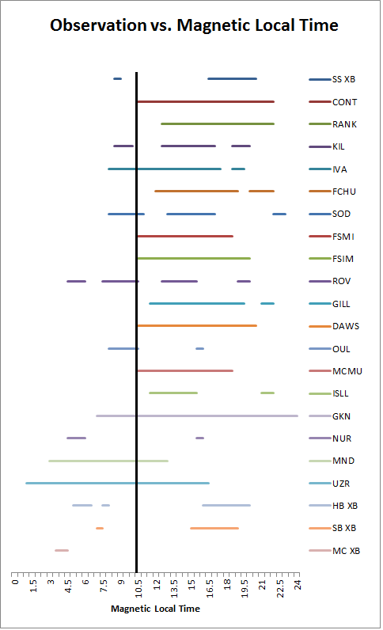
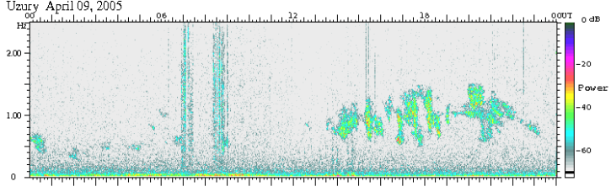
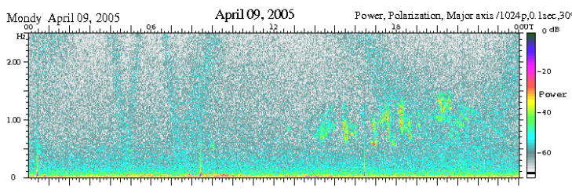
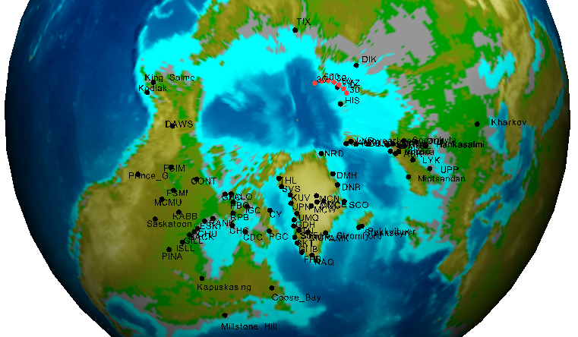
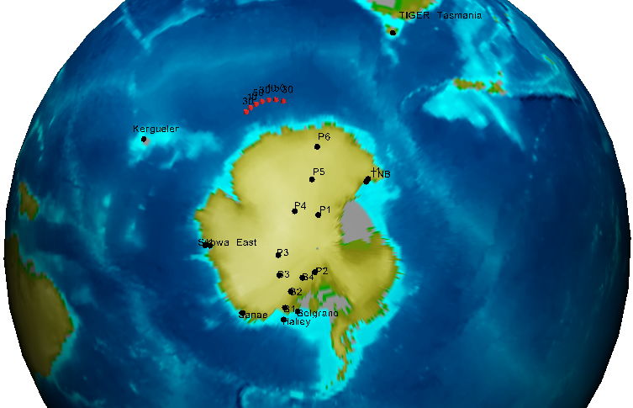
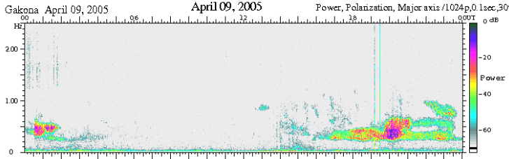
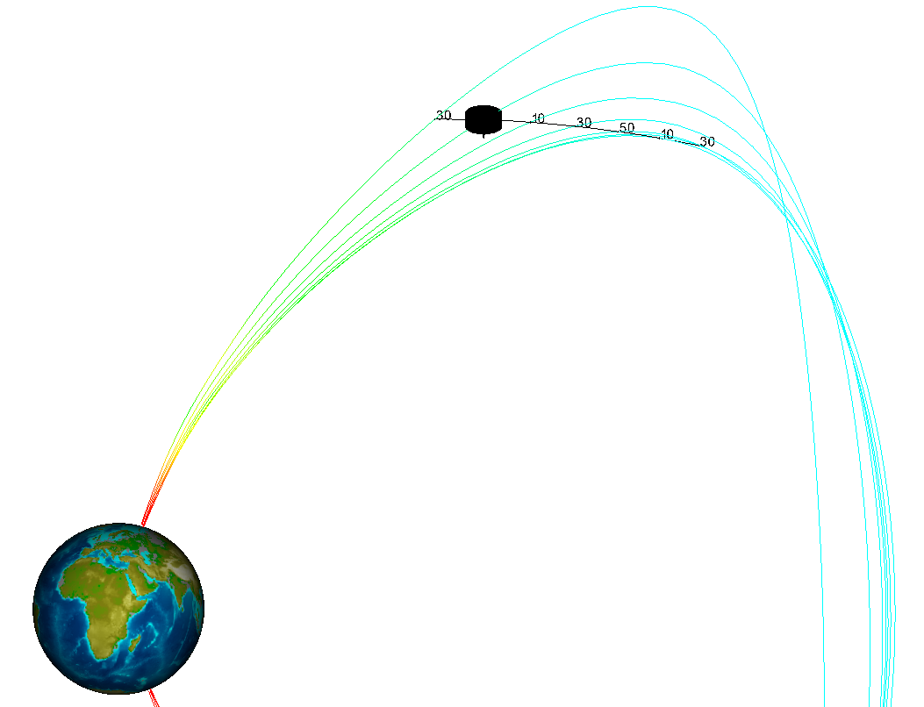


Ground-based observations of Cluster-detected EMIC waves
S. B. Pesavento¹, R. C. Allen¹, A. A. Saikin¹, J. -C. Zhang¹, L. M. Kistler¹
¹ Space Science Center, University of New Hampshire, Durham, NH, 03824, USA
2013 Project SMART Workshop, UNH, Durham, NH, July 26, 2013
Abstract:
Electromagnetic Ion Cyclotron (EMIC) waves are generated in space and some of them can propagate along magnetic field lines to the ground [Rauch and Roux, 1982]. In this study we selected an EMIC wave event detected in situ by the Cluster spacecraft on 9 April 2005, and connected it to multiple ground-based magnetometers. The Orbit Visualization Tool (OVT) has been used to map out Cluster's orbit along magnetic field lines to the Earth. Events, not observed by Cluster but by ground-based magnetometers around the 2005 event, are also included to reveal how multiple waves may be generated in space and observed at different times and locations on the ground.
Cluster-observed EMIC waves
All Ground-based Wave Observations
Cluster
Magnetometer | Latitude | Longitude | Location
SS XB | 72.3 N | 40 | Sondrestrom, Greenland
CONT | 72.82 N | 304.82 | Contowoyto Lake, Canada
RANK | 72.22 N | 335.97 | Rankin Inlet, Canada
KIL | 69.02 N | 20.86 | Kilpisjärvi, Finland
IVA | 68.55 N | 27.28 | Ivalo, Finland
FCHU | 68.32 N | 333.54 | Fort Churchhill, Canada
SOD | 67.42 N | 26.39 | Sodankylä, Finland
FSMI | 67.28 N | 306.9 | Fort Smith, Canada
FSIM | 67.23 N | 294.29 | Fort Simpson, Canada
ROV | 66.78 N | 25.94 | Rovaniemi, Finland
GILL | 66.03 N | 333.05 | Gillam, Canada
DAWS | 65.9 N | 273.89 | Dawson City, Canada
OUL | 65 N | 25.5 | Oulu, Finland
MCMU | 64.17 N | 309.2 | Fort McMurray, Canada
ISLL | 63.62 N | 333.36 | Island Lake, Canada
GKN | 63.1 N | 266.8 | Gakona, United States
NUR | 60.51 N | 24.65 | Nurmijärvi, Finland
MND | 46.8 N | 174.6 | Mondy, Canada
UZR | 48.44 N | 180.66 | Uzury, Russia
Halley Bay | 62.2 S | 29.8 | Weddell Sea, Antartica
SP XB | 74.3 S | 18.7 | South Pole, Antarctica
MC XB | 80 S | 326.5 | Ross Island, Antarctica
This noise line represents Cluster’s spin rotation and is purely artificial.
Cluster encountered this EMIC wave event on 9 April 2005, as it propagated along field lines towards both hemispheres of the Earth. The wave event occurs between 0.27 and 0.6 Hz, above the 0.25 Hz spin noise line.
Ground-based Magnetometer Observations of the Cluster Event
Arranged by latitude, from North to South, the above plot displays all times where any wave activity was observed on 9 April 2005 on the ground. The black vertical line at 10.2 MLT marks the time when Cluster started to observe the EMIC event.
Motivation
Perform a conjunction study of an EMIC wave event using observations both in space and on the ground
Extend the case study of the EMIC wave event on 9 April 2005 by including ground-based data [Allen et al., 2013].
Summary & Discussion:
After checking all available data from several ground-based magnetometer campaigns, ranging from Finland to Antarctica, those below witnessed this Cluster event:
The Mondy plot has been offset to show how slight changes in longitude can delay when a wave is observed on the ground in Universal Time.
Ground-based Stations vs. Cluster
Sondrestrom, Greenland | Kilpisjärvi, Finland | Sodankylä, Finland | Rovaniemi, Finland | Oulu, Finland | Gakona, United States | Uzury, Russia
Contowoyto Lake, Canada | Ivalo, Finland | Fort Smith, Canada | Gillam, Canada | Fort McMurray, Canada | Nurmijärvi, Finland | Weddell Sea, Antarctica
Rankin Inlet, Canada | Fort Churchhill, Canada | Fort Simpson, Canada | Dawson City, Canada | Island Lake, Canada | Mondy, Canada | South Pole, Antarctica
The Gakona plot has been offset to show how large changes in longitude can delay when a wave is observed on the ground in Universal Time.
However, other wave activity has been witnessed not in conjunction with this particular Cluster event, e.g., the South Pole magnetometer, suggesting that other EMIC waves may be generated at different locations in the Earth’s magnetosphere that propagated along field lines to the ground. Our future work will be to examine data taken from other satellites and attempt to connect their observations to these non Cluster-observed events.
3:
4:
5:
On 9 April 2005, a few hours after being observed by Cluster, ground-based magnetometers took data as the EMIC waves reached Earth’s surface. They have been offset to reflect longitudinal differences. See location plot for details.
Non Cluster-observed Event
Above are ground-based magnetometers in both hemispheres used in this study. The red points represent Cluster’s magnetic footprints. Plotted also is Cluster’s orbit in space along with the magnetic field lines of the Earth.
On 8 April 2005, the South Pole also detected wave activity, but not always associated with the above Cluster plot (that is, different wave frequencies; see the figure above). This infers that other places in the Earth’s magnetosphere may be generating waves at approximately the same time.
References
Acknowledgements
This project was made possible by the UNH Project SMART and NASA under grant number NNX11AO82G.
Allen, R. C., et al. (2013), JGR, submitted.
Rauch and Roux (1982), JGR.
Notes:
Pa color ranges to show better
Time_stamp(s), /off can be done in ccat.sh?
SW data remove two days each side and make same scale
Ah make linear
Make sure greek letters work (after popen, !p.font=-1) search through other programs. !6…!N
Change tick interval to half hour. Change bh scale
Zticks=3
Make figure fonts larger
change ytitles

