Slide 1
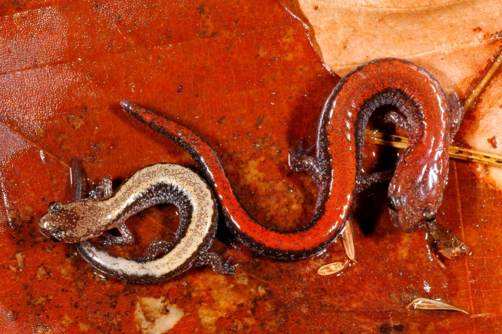
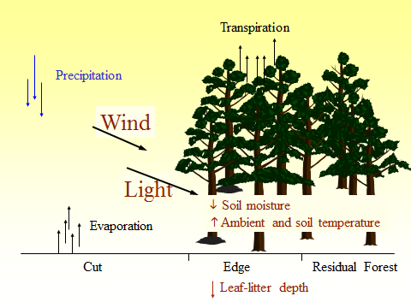
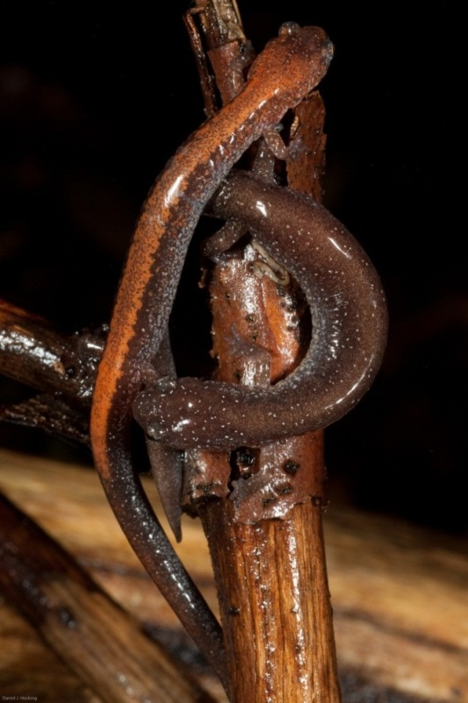
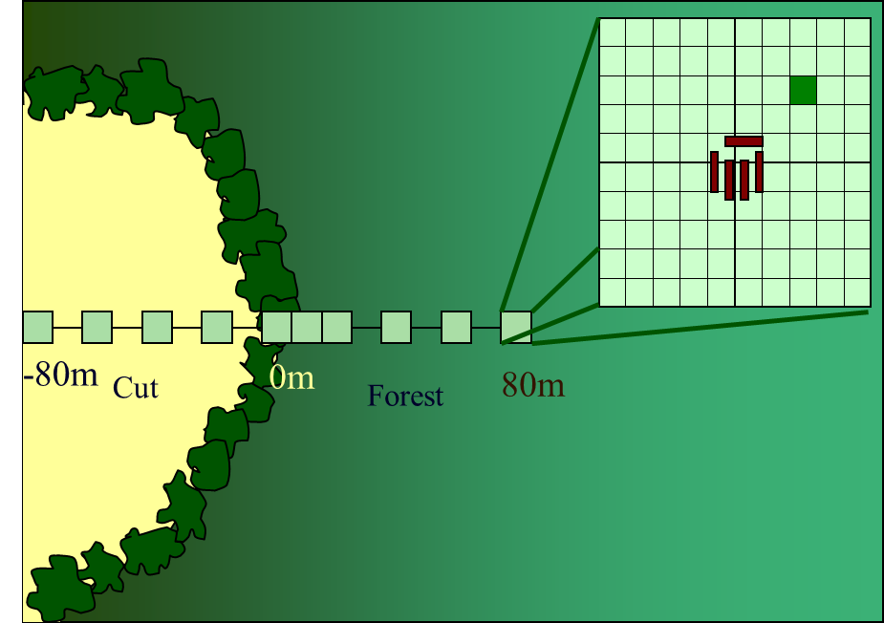
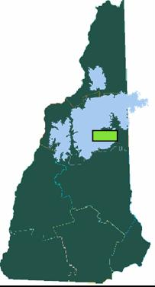
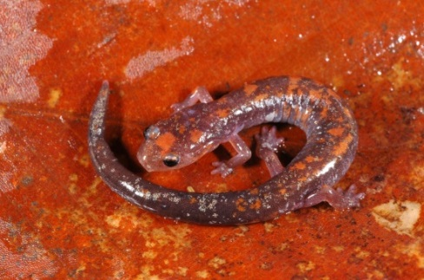
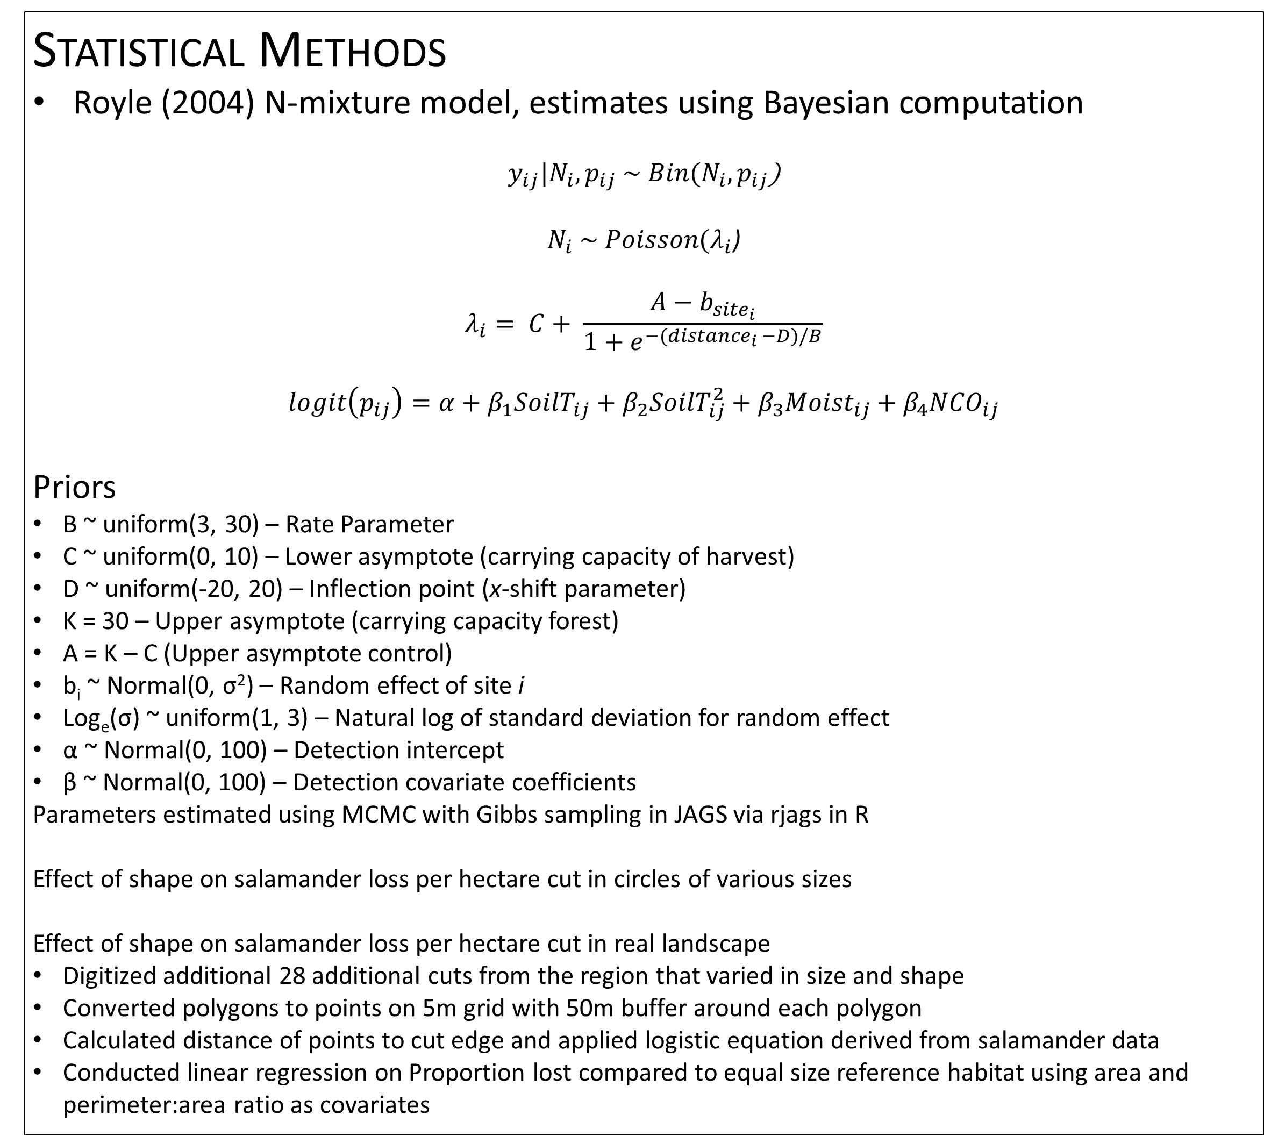
Improved Estimation of Forestry Edge Effects Accounting for Detection Probability
Daniel J. Hocking¹, Kimberly J. Babbitt¹, & Mariko Yamasaki²
¹Department of Natural Resources and the Environment, University of New Hampshire
²USDA Forest Service, Northern Research Station
Background
Forest-dependent salamander abundance is generally reduced by more than 50% initially following logging (Tilghman et al. 2012), and can be extremely abundance in mature forest habitat (Petranka 1998)
Land-use modifications, such as logging, often create ecotones between different habitats
Even-aged timber harvests create environmental gradients varying in light, temperature, moisture, vapor pressure deficit, humidity, and shrub cover, altering habitat conditions for plants and animals
We expect a logistic-type response in woodland salamander abundance along a harvest-forest edge with few salamanders deep in the cuts, increasing abundance in the edge habitat, and leveling off at the forest population carrying capacity some distance into the forest
Statistical Methods
Royle (2004) N-mixture model, estimates using Bayesian computation
$y_{ij}|N_{i},p_{ij} \sim Bin(N_{i},p_{ij}$)
$N_{i} \sim Poisson(λ_{i}$)
$$λ_{i}= C+ \frac{A−b_{{site}_{i}}}{1+e^{−({distance}_{i} −D)/B}}$$
$$logit\left(p_{ij}\right)=α+β_{1}{SoilT}_{ij}+β_{2}{SoilT}_{ij}^{2}+β_{3}{Moist}_{ij}+β_{4}{NCO}_{ij}$$
Priors
B ~ uniform(3, 30) – Rate Parameter
C ~ uniform(0, 10) – Lower asymptote (carrying capacity of harvest)
D ~ uniform(-20, 20) – Inflection point (x-shift parameter)
K = 30 – Upper asymptote (carrying capacity forest)
A = K – C (Upper asymptote control)
b_{i} ~ Normal(0, σ²) – Random effect of site i
Log_{e}(σ) ~ uniform(1, 3) – Natural log of standard deviation for random effect
α ~ Normal(0, 100) – Detection intercept
β ~ Normal(0, 100) – Detection covariate coefficients
Parameters estimated using MCMC with Gibbs sampling in JAGS via rjags in R
Effect of shape on salamander loss per hectare cut in circles of various sizes
Effect of shape on salamander loss per hectare cut in real landscape
Digitized additional 28 additional cuts from the region that varied in size and shape
Converted polygons to points on 5m grid with 50m buffer around each polygon
Calculated distance of points to cut edge and applied logistic equation derived from salamander data
Conducted linear regression on Proportion lost compared to equal size reference habitat using area and perimeter:area ratio as covariates
More Results
Assume 460 ha area and want to harvest 100 ha
Assume circular cuts ranging from 1 ha to 100 ha
Result: 22% logged area =
  21% decline in salamanders in 100 ha cuts (24% area effected)
  22% decline in salamanders in 10 ha cuts (31% area effected)
  26% decline in salamanders in 1 ha cuts (55% area effected)
Amphibians are especially sensitive to changes in moisture and temperature and may alter their behavior and distributions in response to edge habitat
Forestry edge effects on amphibians vary by species, season, and location, but in the northeastern US, forest-dependent amphibian abundance is reduced 20-35 m into forests surrounding recent timber harvests ((DeGraaf and Yamasaki 2002; deMaynadier and Hunter 1998; Urbina-Cardona et al. 2006)
Most previous studies of edge effects used ANOVA, Linear Regression, or Nonparametric methods (Loess regression or smoothing splines) on count data to determine edge effect distances
Circular Harvests
Projection on Real Landscape
Linear Regression Results
Number of salamanders lost per hectare following logging as function of Perimeter|Area
adj-R² = 0.988; F = 2486, DF = 1, 35
Variable | Estimate | SE | t-value | Pr(>|t|)
(Intercept) | 112865 | 448.4 | 251.69 | <2e-16
Perimeter/Area | 11758 | 235.8 | 49.86 | <2e-16
Discussion
Red-backed salamanders, as with other woodland salamanders, experience significant reduction in abundance following logging (reviewed by Tilghman et al. 2012)
The effect of logging is greater in areas with higher maximum summer temperatures (Tilghman et al. 2012)
Edge effects have ability to greatly increase the total area effected by timber harvest
We found that red-backed salamanders reach 95% of forest carrying capacity 34 m into forest surrounding harvests
Carrying capacity was previously estimated from adjacent, undisturbed, reference forest plots (Hocking et al. in review)
Smaller and more irregularly-shaped cuts have greater total areas effected than large, round curs (less perimeter:edge) to extract the same amount of timber
Larger circular cuts (> 10 ha) have less impact on total salamander abundance than small circles totally the same harvested area
High perimeter:area ratios significantly reduce abundance by increasing area of edge per cut unit
Benefits of method
  Method accounts for imperfect detection
  Because parametric, results can be projected across landscapes and used to estimate the total effect of planned cuts of various sizes and shapes
Decades are required for population recovery following clearcutting; however, little is known about recovery in the edge habitat. The balance of internal harvest effects and exterior edge effects could change over time. This reduction in edge effects would make smaller cuts less detrimental over time.
Objectives
To account for imperfect detection to determine unbiased salamander abundance along a harvest-forest edge
To use nonlinear, parametric regression to quantify salamander abundance along this edge gradient
Quantify the change in abundance accounting for edge effects for harvests (patches) varying in size and shape
Methods
Nine sites harvested the previous year varying in size (0.06 – 10.8 ha) and shape and 8 reference sites (undisturbed forest) in New Hampshire White Mountain National Forest
Results
We captured a total of 308 red-backed salamanders during 4 sampling occasions in fall 2000 at 110 plots over 9 cut-forest gradients
Transect at each harvest site with plots from -80 into cut to 80 m outside the cut at 10-20 m intervals. Three plots were located in each reference site
At each plot red-backed salamanders (Plethodon cinereus) were counted under coverboards and adjacent 1m² searches of leaf litter and natural cover objects (NCO)
We sampled each plot 4 times in fall 2000, assuming population closure
At each plot and sampling occasion, we measured soil temperature, number of NCO searched, and soil moisture
1ha
1ha
Parameter | Mean | SD | 2.5% | 97.5%
Abundance:
A | 28.300 | 1.060 | 25.688 | 29.767
B | 9.974 | 3.620 | 4.153 | 18.132
C | 1.700 | 1.060 | 0.233 | 4.312
D | 5.064 | 5.101 | -4.869 | 15.644
Random site SD | 8.257 | 3.629 | 3.080 | 16.861
Detection:
Intercept | -3.291 | 0.167 | -3.608 | -2.966
SoilT | -0.146 | 0.125 | -0.402 | 0.089
SoilT² | -0.184 | 0.095 | -0.377 | -0.004
Moist | 0.078 | 0.093 | -0.099 | 0.264
NCO | 0.141 | 0.090 | -0.034 | 0.320
This method can be applied to other species and habitat gradients
The balance of the interior vs. exterior edge effects depends on the shape of the curve, especially the steepness of the response (B) and the location of the inflection point (D)
If inflection point shifted right (into forest) and the response is shallower (smaller B = longer edge effect) then smaller cuts and more irregular cuts might be more detrimental
While many small cuts initially appear detrimental to red-backed salamander abundance, these findings have to be balances with timber and multi-species management as well as long-term management goals
10 ha
Study Area
Cut Area: 10 ha
Edge/Area: 112 m/ha
Area Effected: 14.2 ha
Rel. Salamander Loss: 1
Cut Area: 10 ha
Edge/Area: 354 m/ha
Area Effected: 25.7 ha
Rel. Salamander Loss: 1.2
Future Directions
Consider how best to include random effect of site on parameters other than just upper asymptote
Examine effect of close proximity cuts where buffers overlap (as with group cuts)
Examine if edge effects differ depending on the cut size and landscape characteristics
Examine effects of re-entry and rotation times foe even and un—even aged timber harvests
Simulate random landscapes to more precisely determine effects of size and shape on abundance
Time to recovery including edge effects
Estimate edge effects for additional species and ecotones
R package or automated system for land managers to apply this to a various harvest plans
Area 10 ha cut
Area 1 ha cut
Acknowledgments
We would like to thank S. Callahan, T. Luther, K. Starke, S. Fay, C. Costello, M. Medeiros, and J. Sweeney, M. Baber, J. Clancy, A. Shutt, E. Baldwin, M. Libby, M. Cole, C. Meaney, G. Barr, H. Givens, M. Tarr, T. Tarr for help on various aspects of this project. The USDA Forest Service and University of New Hampshire Cooperative Extension provided funding for this research project.

