Slide 1


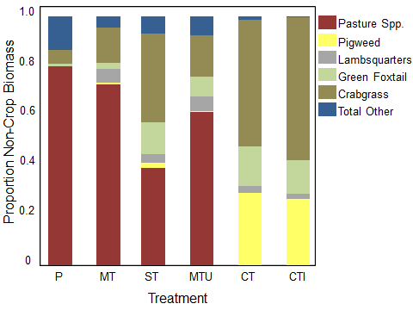
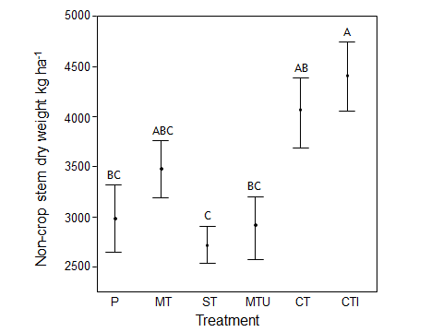
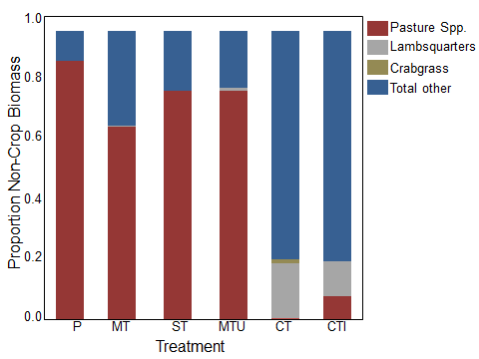
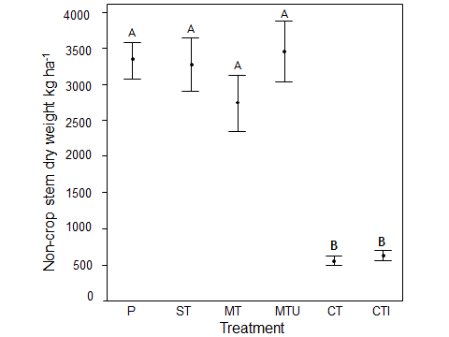
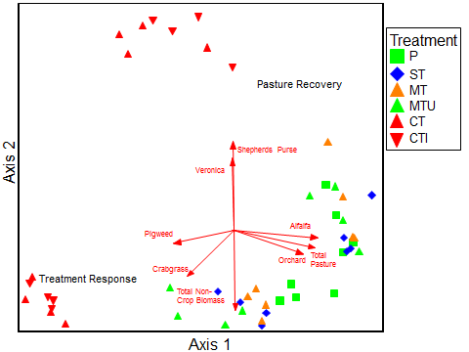
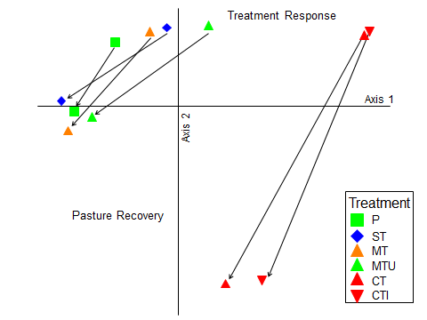
Disturbance and Recovery in a Pasture Plant Community along a Tillage and Intercropping Intensity Gradient
J. A. Wilhelm*, R. G. Smith; University of New Hampshire, Durham, NH
Department of Natural Resources and the Environment *Contact: jwilhelm@unh.edu
INTRODUCTION
Response to Treatments (Summer 2012)
RESULTS
Organic dairy farmers in New England have identified weed control as one of their most challenging management issues. Intercropping and tillage are two approaches for reducing weed populations in organic cropping systems; however, these approaches may work antagonistically when combined. This experiment investigated different approaches to establishing annual feed grains into a perennial pasture and identify optimal combinations of tillage and intercropping intensity to effectively manage weed pressure.
Plant community composition differed across treatments, with Amaranthus spp., Chenopodium album, Digitaria sanguinalis, and Setaria viridis dominating the conventionally-tilled treatments (CT and CTI) and perennial pasture species dominating the plant communities in the minimally-tilled treatments (Fig. 1).
Total non-crop plant biomass increased with tillage intensity, with higher weed abundance in conventionally tilled treatments compared to the minimally-tilled intercrop treatments and pasture control (Fig. 2).
By spring 2013, pasture species comprised the largest proportion of the non-crop biomass in minimally-tilled treatments compared to conventionally-tilled treatments, which had a larger proportion of weed species, but lower total biomass. (Figs. 3 & 4).
Plant communities in the minimum-tillage treatments were more similar to the pasture control and were less temporally variable than were plant communities in the conventionally-tilled treatments(Fig. 5).
OBJECTIVES
Figure 1. Weed and pasture biomass as a percent of total non-crop biomass for each treatment. Measured at peak biomass, August 2012.
Figure 2. Total non-crop biomass per treatment. Data are means ± SE. Bars sharing the same letter are not significantly different at P<0.05 (Tukey’s HSD Test)
Assess late summer weed abundance and community composition in response to the tillage and intercropping treatments.
Determine the extent of pasture recovery in each treatment in the following spring
Pasture Recovery (Spring 2013)
METHODS
P | Pasture—Established mixture of alfalfa and grass , control
MT | Minimal Till—Establishment into living pasture following mowing and subsoil tillage (Yeoman’s Plow)
MTU | Minimal Till Undercut—Establishment into living pasture following mowing and subsoil tillage with undercutting (Yeoman’s Plow with undercut bars)
ST | Strip Till—Establishment into living pasture following mowing and strip-tillage (Unverferth Ripper Stripper)
CT | Conventional Till—Full-tillage (moldboard plowed and disked, not intercropped)
CTI | Conventional Till, Interseeded—Full-tillage, with crimson clover interseeded following feed grain emergence
CONCLUSIONS
Figure 3. Weed and pasture biomass as a percent of total non-crop biomass for each treatment. Measured in spring 2013.
Figure 4. Total non-crop biomass per treatment in spring 2013. Data are means ± SE. Bars sharing the same letter are not significantly different at P<0.05 (Tukey’s HSD Test)
These results illustrate the important link between soil disturbance and weed abundance in agroecosystems. These results also suggest that pasture recovery following intercropping with feed grains can be improved by implementing minimum tillage approaches to feed grain establishment.
A
B
Summer 2012
Spring 2013
Six treatments (above), each replicated four times, were established in 2012 in a randomized complete block design at the University of New Hampshire Organic Dairy Research Farm in Lee, NH.
Aboveground weed biomass was measured at peak biomass (late summer 2012) and late spring 2013.
Weeds were sorted by species, dried to constant biomass and weighed.
FUNDING & ACKNOWLEDGEMENTS
This research is funded by a New England Sustainable Agriculture Research and Education (NESARE) Graduate Student Grant from the USDA. We would like to thank Dorn Cox, Nick Warren, Kelsey Juntwait, Liz Hodgdon, Matt Morris, and the COLSA farm crew at the Organic Dairy Research Farm.
Spring 2013
Summer 2012
Figure 5. (A) NMDS ordination of plant species abundance in each treatment in summer 2012 and spring 2013; symbols are plots (r² = 0.96). (B) Same data; symbols are treatment centroids; arrows show change in species abundance in each treatment from summer 2012 to spring 2013 (r² = 0.96)

