Slide 1


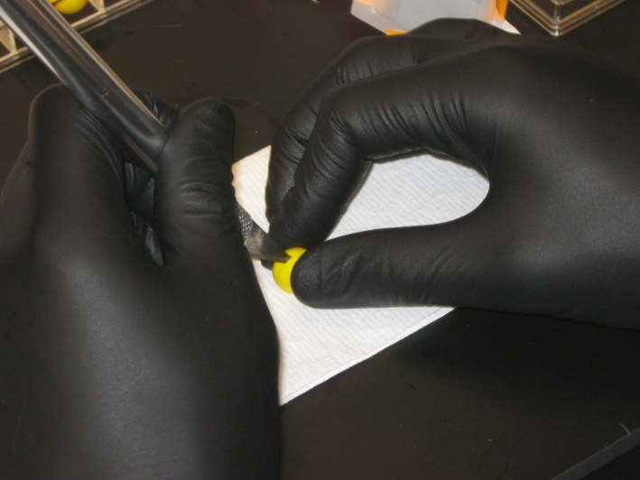
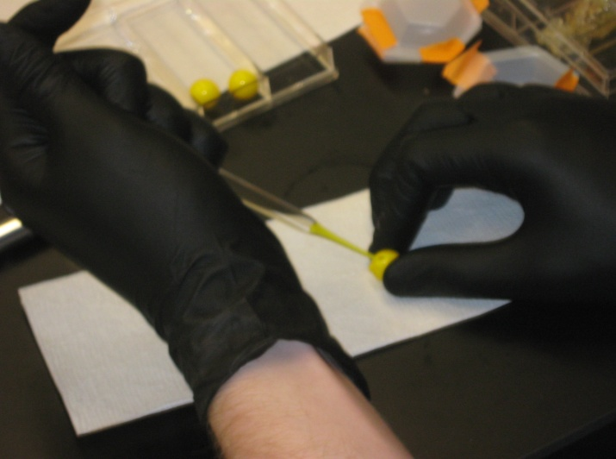
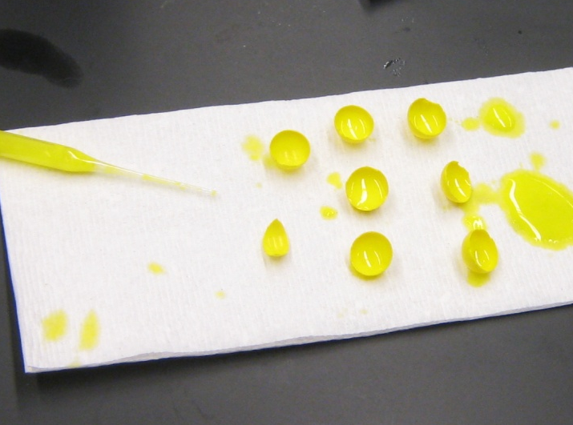
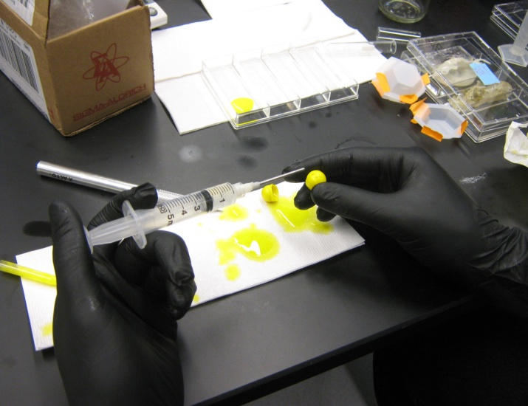
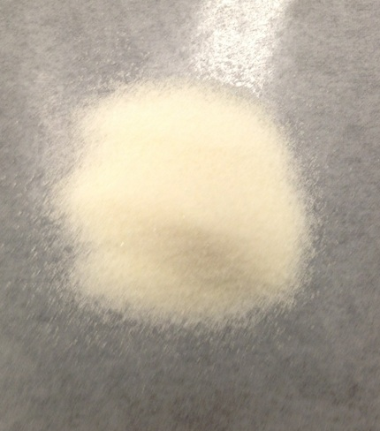
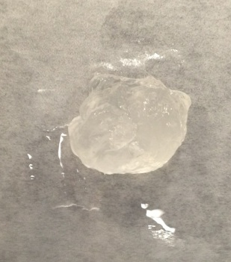
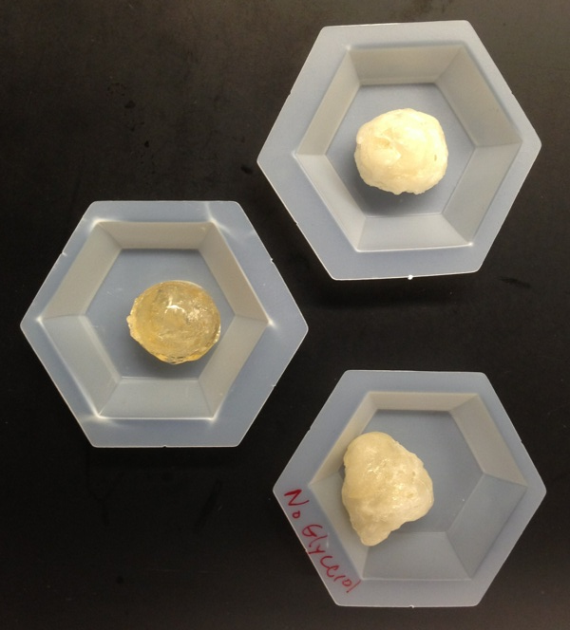
Encapsulation of Polyacrylamide Gel
Using Gelatin Solutions
Gregory J. Samuel, Jr.
gja9@wildcats.unh.edu ; Parsons Hall, 23 Academic Way, Durham, NH 03824
Introduction/Background
Encapsulation processes are beneficial in a variety of fields from pharmaceuticals to food preparation. The objective of this study was to develop a shell to encapsulate a 10% wt. polyacrylamide gel. The shell needed to be impermeable enough to retain most of the water content, while still maintaining the ability to burst under pressure and release the contents over a surface. Preliminary testing (Method 1) was performed using commercially available 0.50 caliber (0.50 inch diameter) gelatin-shell paintballs. These capsules seemed to demonstrate the desired capsule properties, prompting further studies of gelatin encapsulation. Three solutions containing gelatin, water, and glycerol were prepared and tested (Method 2) to determine an optimal gelatin recipe for encapsulation of the polyacrylamide gel.
Method 1
Paintball shell capsules – Paintballs were cut open, paint was removed, and the shells were left as
hemispherical pieces. Shells were dried overnight then layered over a hollow paintball to increase the
shell thickness. Assembled shells were injected with the polyacrylamide gel to complete the capsules.
Method 2
Gelatin capsules – Various gelatin solutions were prepared and heated until a liquid was obtained. Glass test
tubes were briefly dipped into the solution to develop gelatin coats on the bottom of the test tubes. Upon cooling, the gelatin coats were removed, yielding hemispherical shells. Two of these shells were melted together using a hot metal spatula to form a capsule. The capsule was injected with polyacrylamide gel and the injection site was sealed by melting gelatin over the hole to create an airtight capsule.
[1] Slicing open a gelatin paintball
[2] Removing paint from core using glass pipette
[3] Paintball remnants used to thicken shells in final product
[4] Injection of polyacrylamide gel into empty capsule
CAPSULE 2:
45% gelatin
40% water
15% glycerol
Results and Discussion
Over a five-hour drying test, capsules 1, 2, and 3 retained 89.01%, 91.90%, and 87.83% of their mass, respectively. This lost mass is assumed to be water escaping through the gelatin shell. Capsule 2 performed better than the others, suggesting that water retention is improved by higher concentrations of gelatin and the presence of glycerol.
CAPSULE 1:
41% gelatin
46% water
13% glycerol
Figure 1: Plot of capsule mass versus drying time under controlled humidity. Capsules 1 and 2 were similar in mass, while capsule 3 was slightly heavier.
CAPSULE 3:
56% gelatin
44% water
0% glycerol
[1] Gelatin powder used to form capsule shell
[2] 10% wt. polyacrylamide gel used to fill capsules
Figure 2: Plot of mass fraction versus drying time under controlled humidity. Capsule 2 retained the greatest amount of mass and seemed to be the most water impermeable capsule.
Conclusions and Future Work
Gelatin is a promising encapsulation material with immediate large-scale production potential. Remaining issues include control of shell thickness and uniformity, capsule strength, and consistency in capsule rupture pressure. Further research will be necessary to develop a gelatin recipe to improve in these areas, particularly focusing on the effects of glycerol and shell thickness on permeability.
Acknowledgements
Funding and support from the Joan and James Leitzel Center for Mathematics, Science, and Engineering Education is gratefully acknowledged,
as is support from Dr. Nivedita Gupta and the UNH Department of Chemical Engineering. This research was funded through the NSF grant #1132648.
References
1) Jr. Geronimo I. Elias, Cliff J. Scribner. Dispensing Anti-Traction Material. WO2006001881 A2. Washington, DC: U.S. Patent and Trademark Office. <http://www.google.com/patents/WO2006001881A2?cl=en>
2) Rousselot International. Gelatine for Paintballs. <http://www.rousselot.com/en/applications/technical-applications/gelatine-for-paintballs/>

