Slide 1
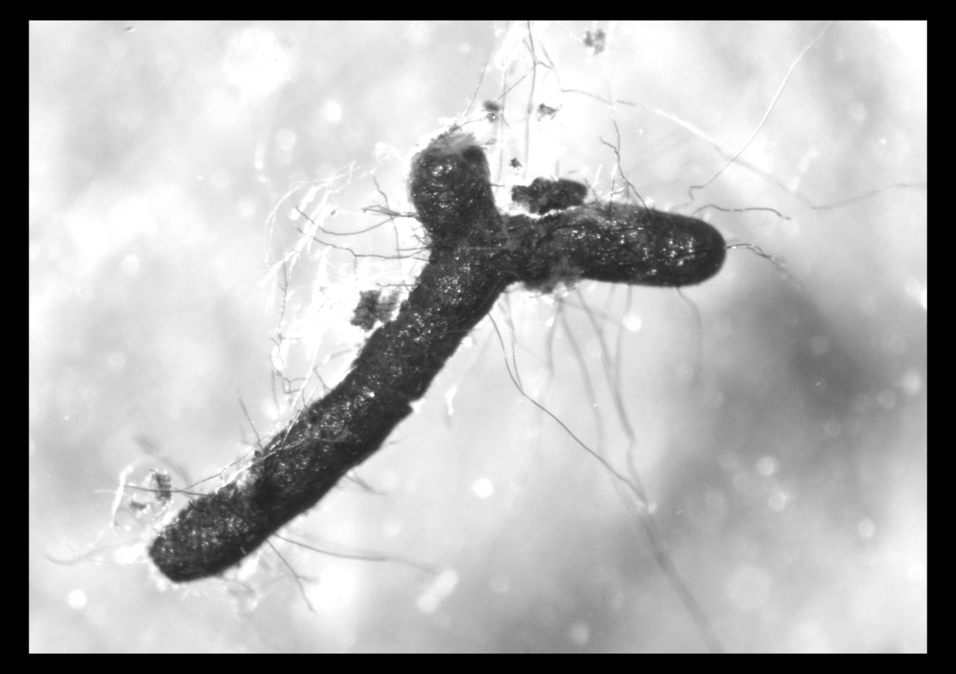
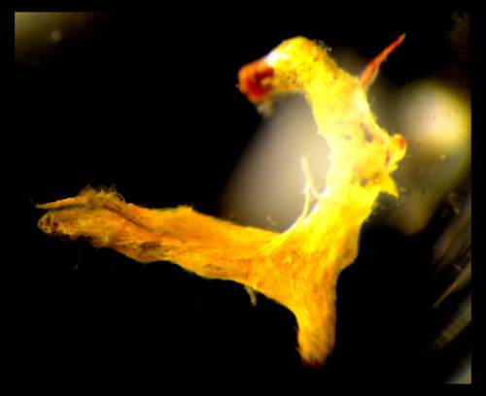
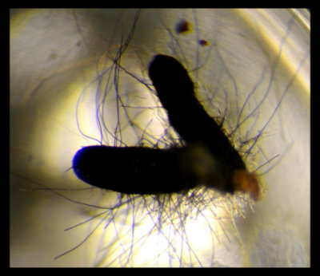
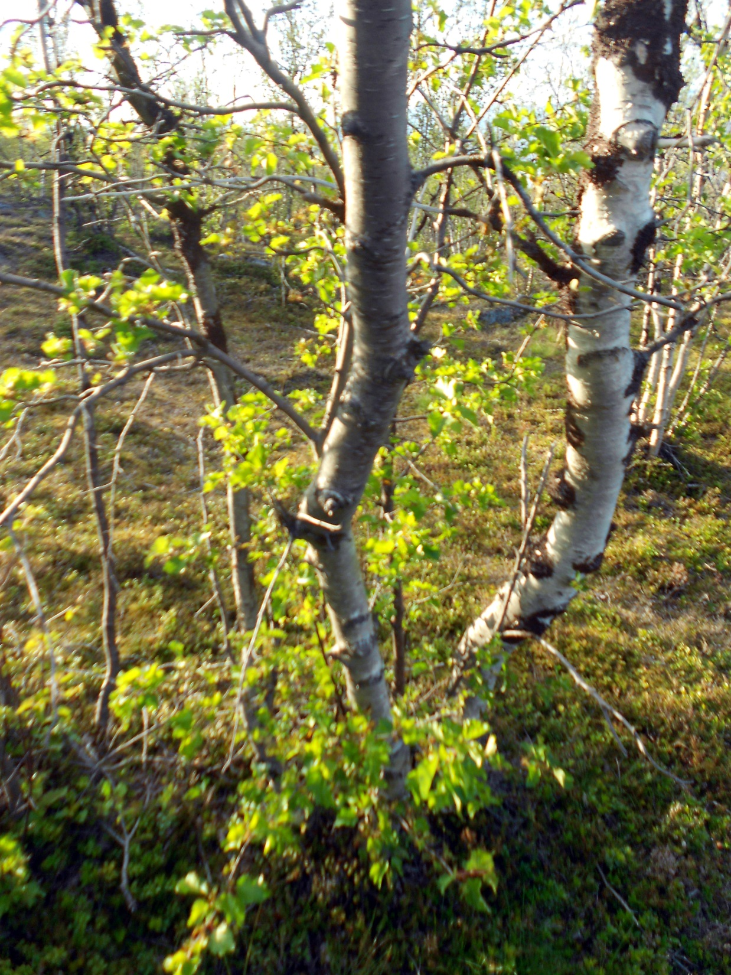
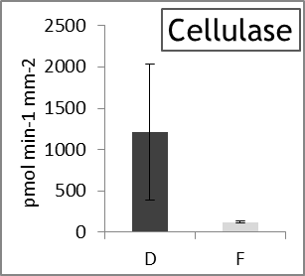
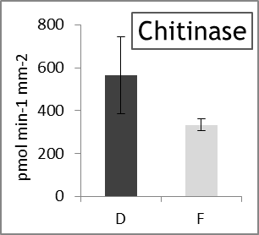
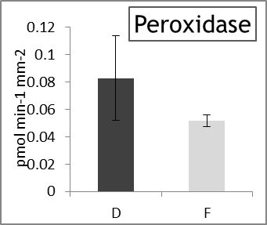
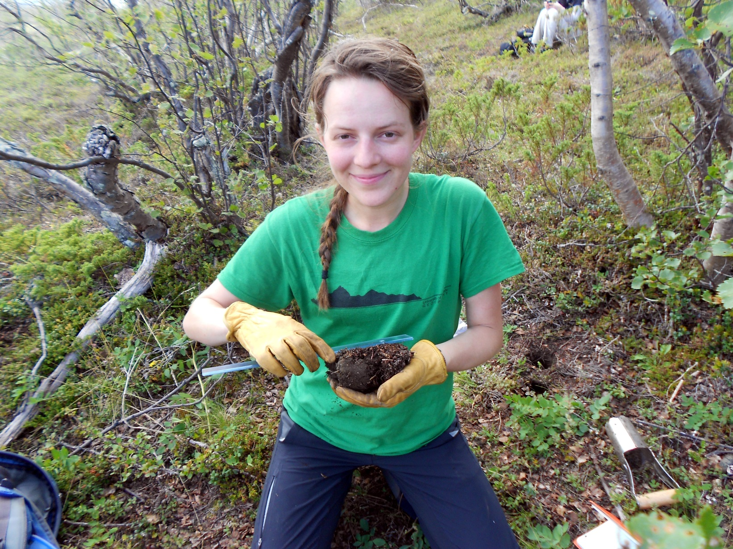
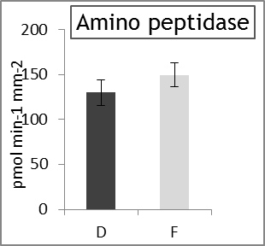
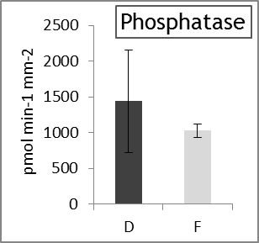
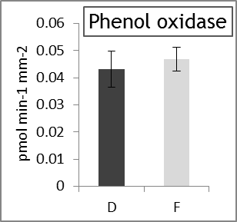
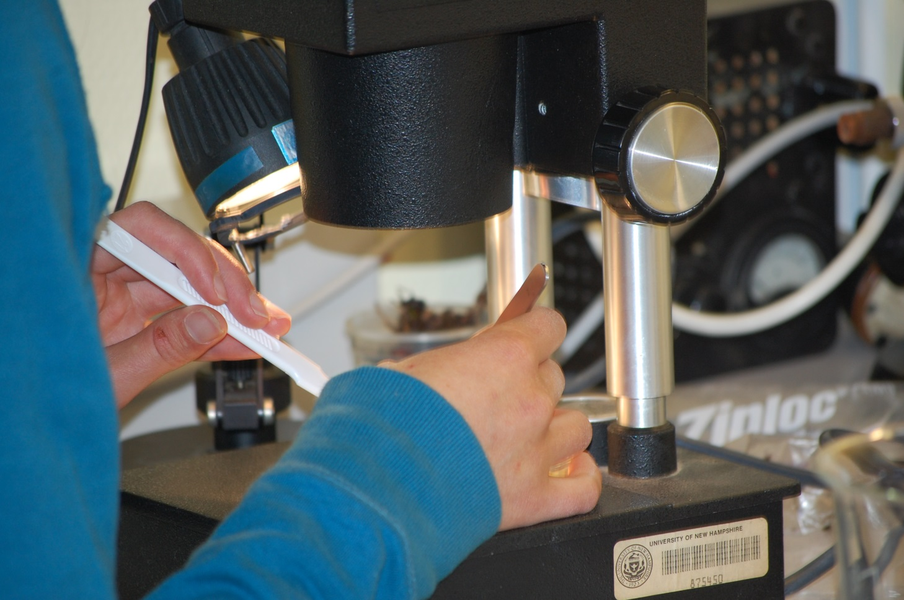





Enzymatic activity of Ectomycorrhizal Fungi in a
Defoliated Betula pubescens Forest near Abisko, Sweden
Elizabeth S. Golden¹, Serita D. Frey², Jesse Sadowsky², Haley Dunleavy³, Julia G. Bryce⁴
¹Department of Ecology and Evolutionary Biology, University of Colorado, Boulder, CO USA
²Department of Natural Resources & the Environment, University of New Hampshire, Durham, NH USA
³Department of Environmental Science, Alaska Pacific University, Anchorage, AK
⁴Department of Earth Sciences, University of New Hampshire, Durham, NH USA
RESULTS
Background
figure A
figure B
figure C
•Ectomycorrhizal fungi (ECM) form a mutualistic association with woody plant species and transfer water and nutrients to the host species in exchange for photosynthate carbon. This association is especially important to plant fitness in the Arctic where soils are shallow and nutrient deprived.
•Carbon limitation may alter ECM ecological function eliciting saprotrophic behavior and/or the ability to actively extricate carbon from the soil solution.
•We took advantage of a natural defoliation event by the autumnal moth Epirrata autumnata and subsequent carbon limitation in a mountain birch (Betula pubescens)-dominated forest near Abisko, Sweden to examine differences between ECM species and enzyme activity between foliated and defoliated mountain birch stands.
Objectives
figure D
figure E
figure F
•Characterize and compare ECM species in foliated and defoliated Betula
pubescens forest stands.
•Examine ECM species composition in relation to their enzyme activity
•Describe soil chemical and physical properties from both organic and
mineral layers.
•Characterize and analyze vegetation for clumping patterns that would
indicate competition-dependent growth patterns.
Figures A – F show the enzymatic activities of ectomycorrhizal fungi. Assays were performed on individual root tips collected from defoliated (D) and foliated (F) B. pubescens stands.
Preliminary results suggest that cellulase, chitinase, and peroxidase enzymes increased in the defoliation
treatment, whereas amino peptidase, phosphatase, and phenol oxidase enzymes were unaffected. DNA
sequencing (in progress) will be utilized to determine if defoliation effects on enzymes of ECM fungi at the
community scale are due to changes in species composition.
CONCLUSIONS
Methods
Soil cores were collected from the top 10 cm of organic soil in a foliated and defoliated Betula pubescens stand. Samples were taken from three slope positions: toe-slope, mid-slope and summit .
Turgid root tips were isolated from rinsed and sieved soil.
The following enzyme assays were perfomed on individual ECM root tips: β-D-1,4-cellobiosidase, β-1,4-N-acetyl-glucosaminidase, leucine amino peptidase, acid phosphatase, phenol oxidase, and peroxidase
ECM species were determined using molecular techniques
Soils were analyzed for moisture content, pH, total C&N, and nutrient concentrations.
We thank Mike Palace, Ashley Lang, Maddie Halloran, Samantha Anderson, Michael Layne, Sophie Burke, and Maurice Crawford for assisting with vegetation sampling. Thanks to Eric Morrison, Mel Knorr, and Brian Godbois for assistance in the Frey Lab.
This research was supported through the Northern Ecosystems Research for Undergraduates program (NSF REU site EAR#1063037)

