Slide 1





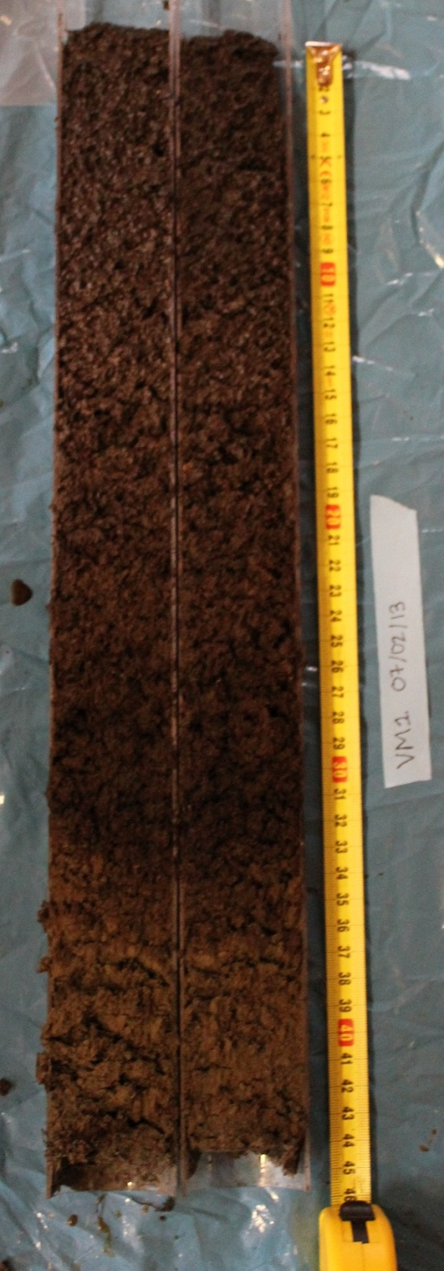
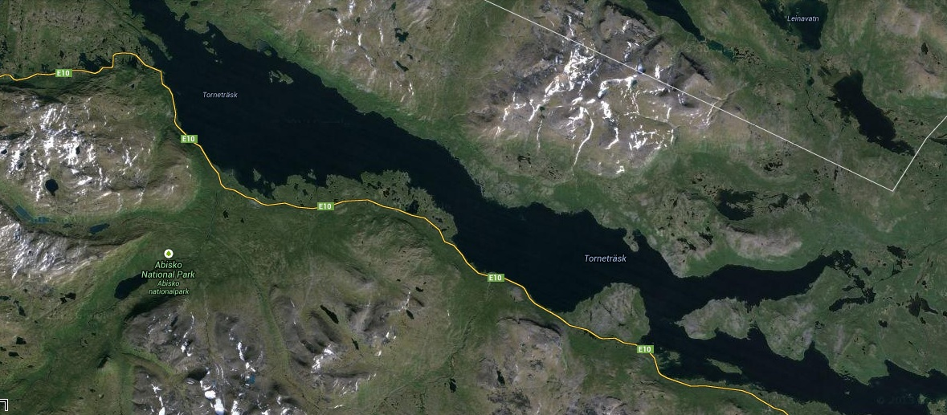
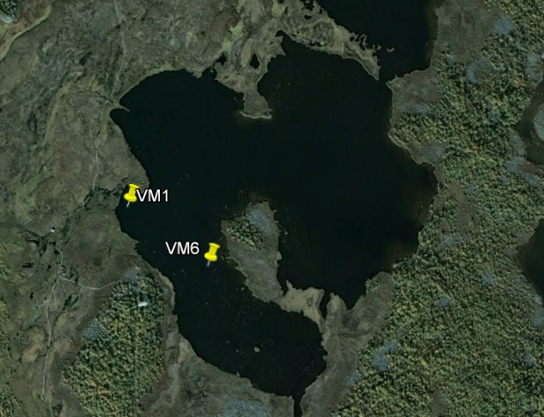
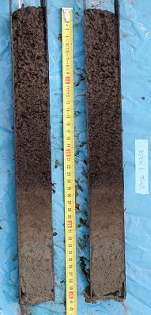
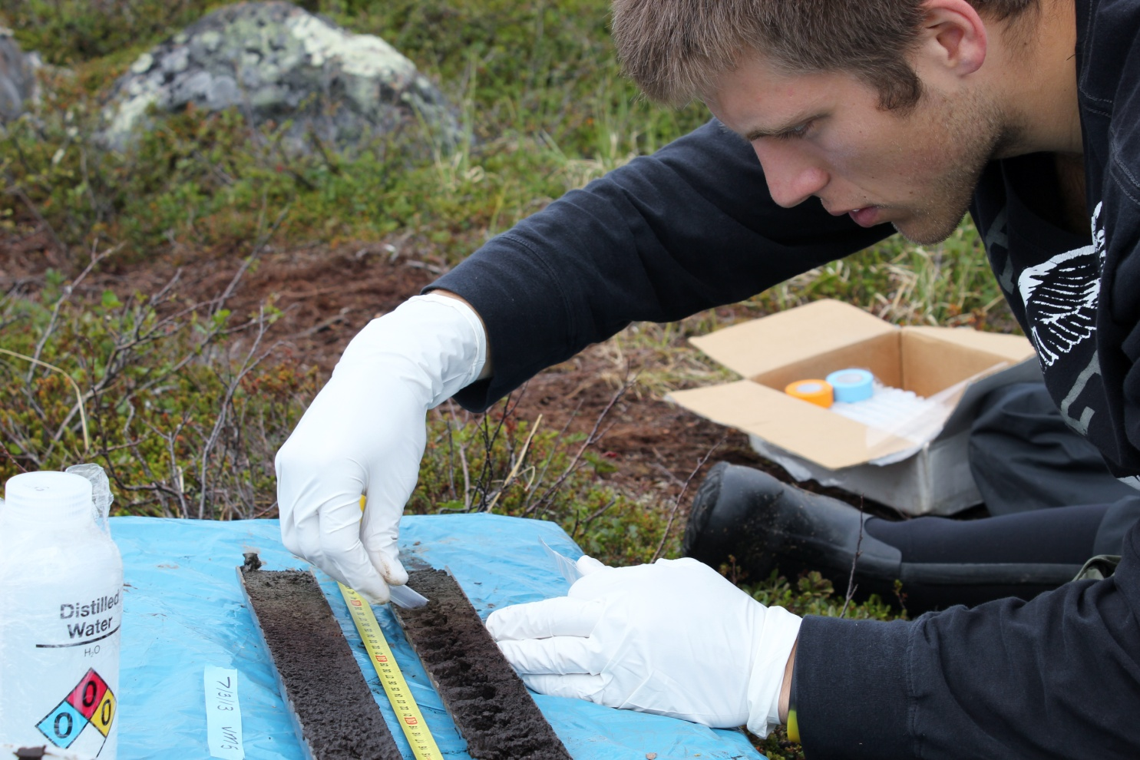
Mercury Dynamics In Sub-Arctic Lake Sediments Across A Methane Ebullition Gradient
Lance Erickson¹, lericks5@gustavus.edu; M. Florencia Meana-Prado²; Martin Wik³; Joel P. DeStasio⁴; Madison J. Halloran⁵; Jacob B. Setera²; Julia G. Bryce²; Patrick Crill⁵; Joel E. Johnson²; Ruth K. Varner⁴
¹Department of Geology, Gustavus Adolphus College, St Peter, MN, USA, ²Department of Earth Sciences, University of New Hampshire, Durham, NH, USA, ³Department of Geological Sciences, Stockholm University, Stockholm, Sweden, ⁴Institute for the Study of Earth, Oceans and Space, University of New Hampshire, Durham, NH, USA, ⁵Department of Environmental Studies, Carleton College, Northfield, MN, USA
Introduction:
Today, sub-arctic environments are among the most sensitive environments susceptible to changing climate.
Climate change enhances:
  Water runoff into local and regional basins
  Release of Methane (CH₄) and its potential positive feedback
Methane has three pathways of release: diffusion, plant assisted transport, and ebullition.
Mercury (Hg), a toxic substance, is exported in aqueous form while associated with organic carbon.^{1,2}
Lake sediments could potentially be an important store of Hg to sub-arctic environments.¹
This study investigates the influence of CH₄ ebullition on Hg dynamics throughout the sediment column in a sub-arctic lake.
Results:
40km
Abisko
Photo Credit: Florencia Meana-Prado
Figure 1 (above) – Aerial photo of Abisko and Lake Tornetrask region. Photo courtesy of Google Maps, 2013.
Study Site:
Stordalen Mire, Abisko Scientific Research Station, Abisko, Sweden
200km north of arctic circle
Discontinuous permafrost zone
Lake Villasjӧn, average ~1m depth
Stordalen Mire
Lake Villasjӧn
145m
Figure 2 (below) – Aerial photo of Stordalen Mire, highlighting the locality of Lake Villasjӧn within the mire. Figure 2 reflects the local scale of Stordalen Mire compared to the Lake Tornetrask Region. Photo courtesy of Google Earth, 2013.
Methods:
Sediment cores were taken using a modified AMS hammer corer.
Cores were taken at known high and low ebullition sites corresponding with high and low CH₄ concentrations
Cores were sampled every 2cm
All sampling equipment was acid cleaned prior to sampling to prevent contamination.
Hg contents were acquired via cold vapor Inductively Coupled Plasma Mass Spectrometry.
CH₄ concentrations were acquired via Gas Chromatography
Grainsize was acquired via Mastersizer laser particle analyzer
Total organic carbon (TOC) was acquired via Perkin-Elmer CHNS 2400 analyzer
Photo Credit: Florencia Meana-Prado
Discussion/Conclusions:
Increased Hg concentrations exist in upper portions of the sediment sequence in the high ebullition site (VM1).
Hg positively correlates with TOC and Total Sulfur in the high ebullition site.
Hg concentration negatively correlates with DIC (CH₄, CaCO₃) in the high ebullition site.
Low ebullition site (VM6) had more variability of Hg links with other geochemical data (e.g., TOC, C, nitrogen, S, DIC).
Assessing overall Hg behavior in lakes requires cores in multiple locations.
Ultimately, influences on CH₄ mobilization also have impacts on Hg dynamics within lake sediments.
Photo Credit: Florencia Meana-Prado
Sources:
¹Rydberg, J., Klaminder, J., Rosén, P., Bindler, R. 2010. Climate driven release of carbon and mercury from permafrost mires increases mercury loading to sub-arctic lakes. Science of the Total Environment 408, 4778-4783.
²Klaminder, J., Yoo, K., Rydberg, J., Giesler, R. 2008. An explorative study of mercury export from a thawing palsa mire. Journal of Geophysical Research. Volume 113.
Acknowledgments:
First, I would like to thank the Northern Ecosystems Research for Undergraduates program for giving me this opportunity and for funding this research. Secondly, I would like to thank the Abisko Naturvetenskapliga Station (Abisko Scientific Research Station) for allowing us to use its facilities while conducting field/lab work in Sweden.

