Slide 1

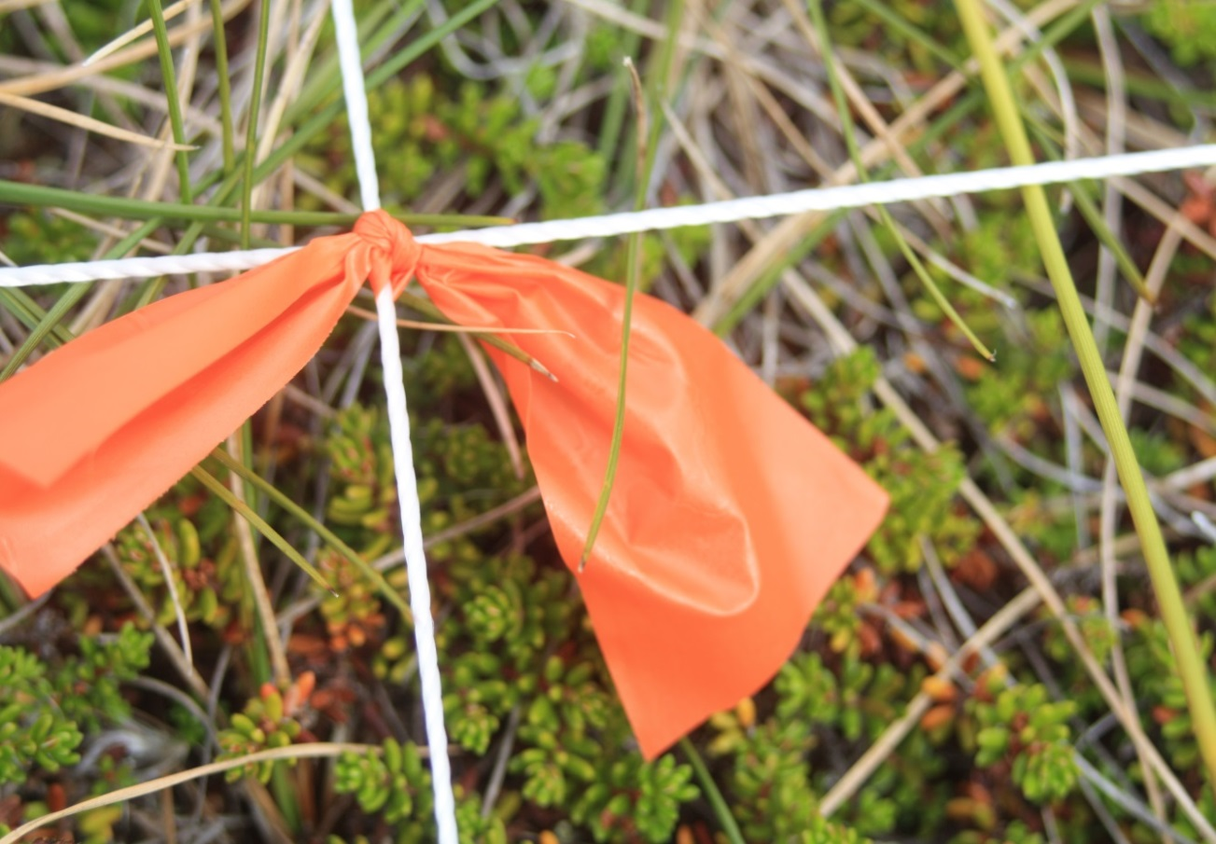




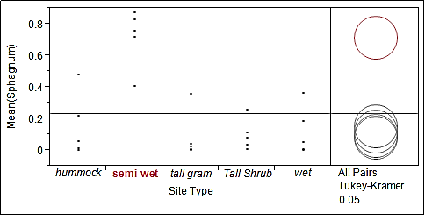
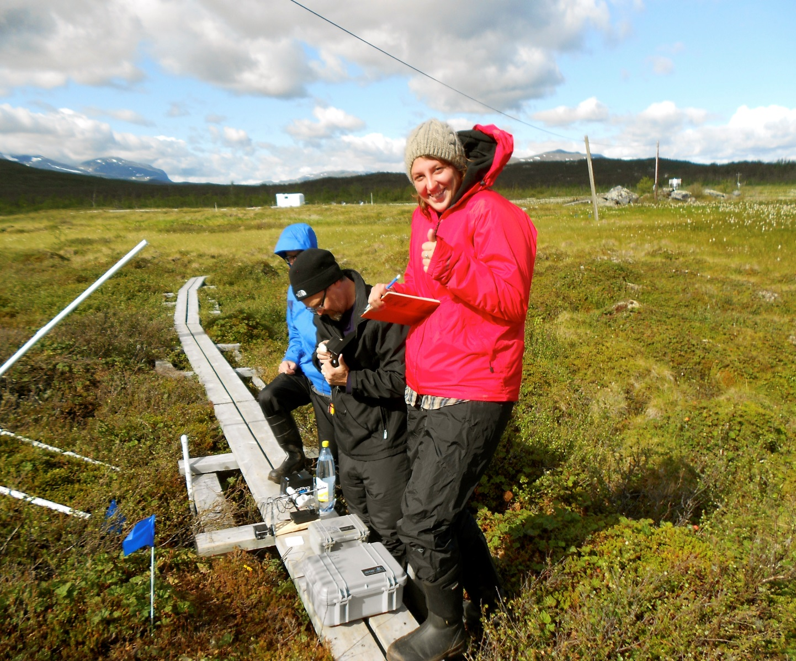
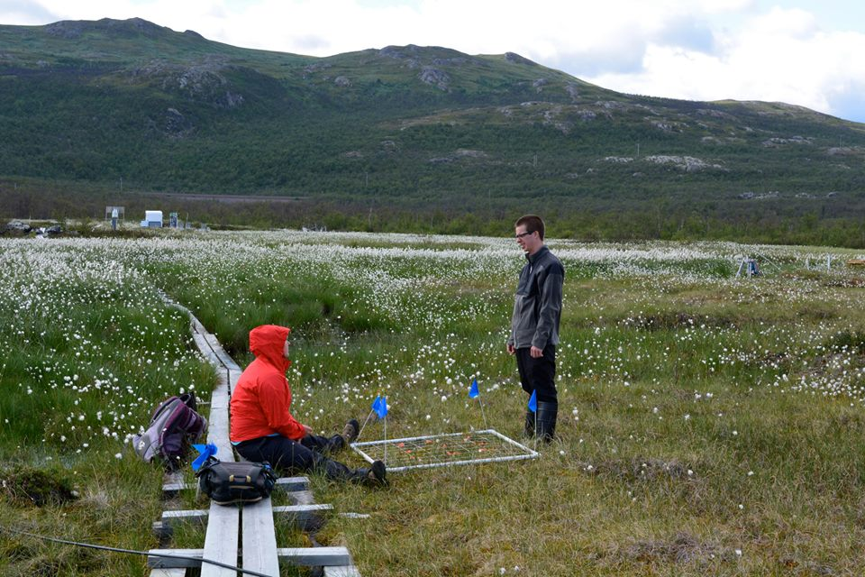
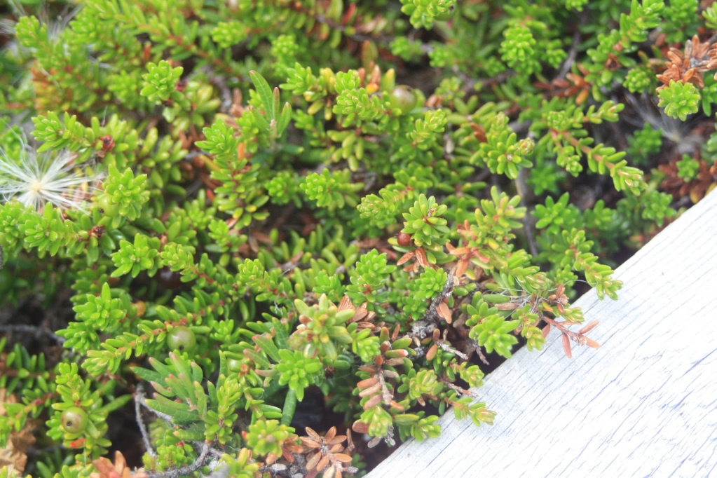
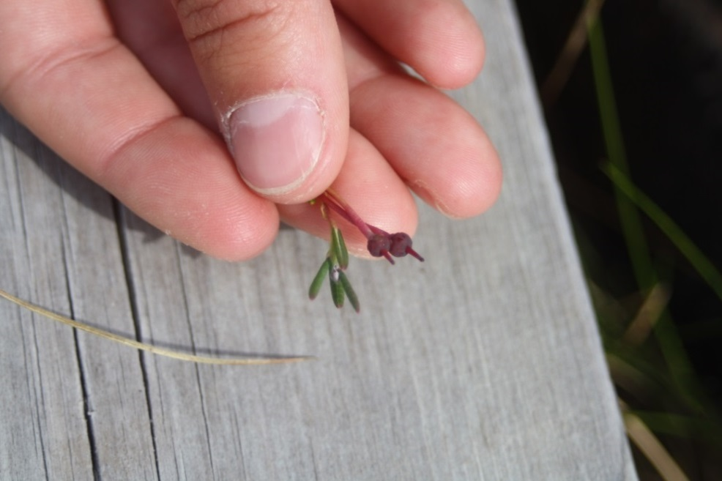
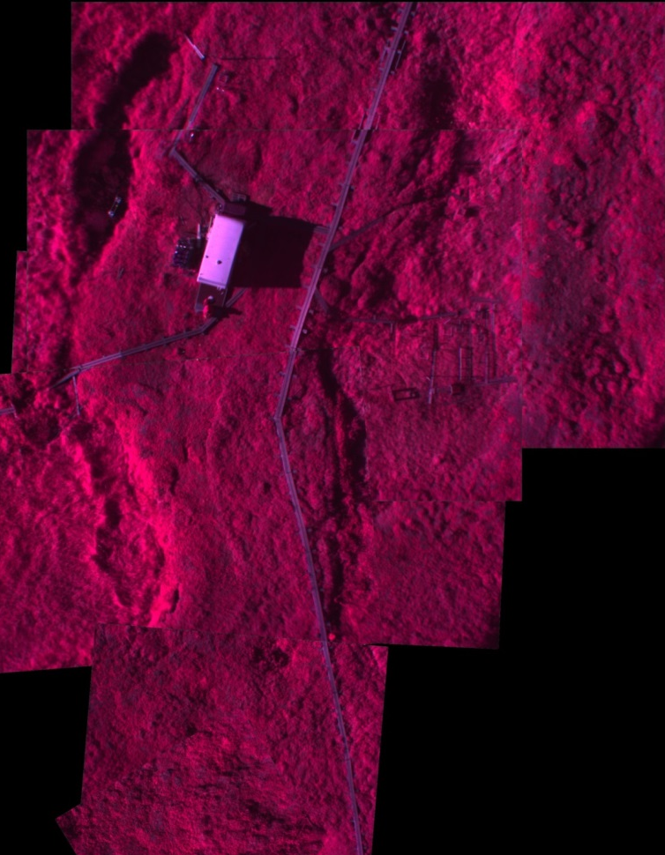
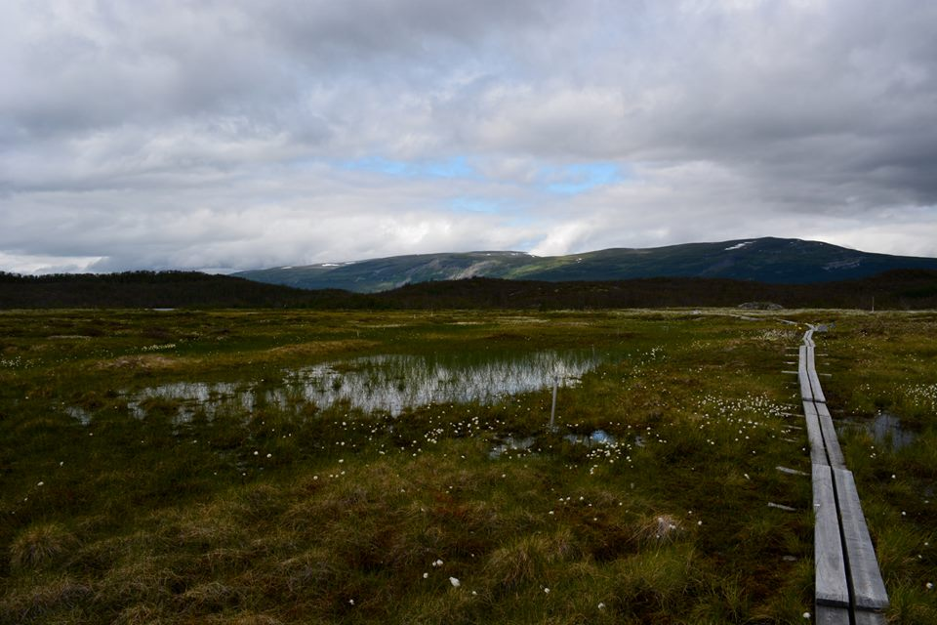
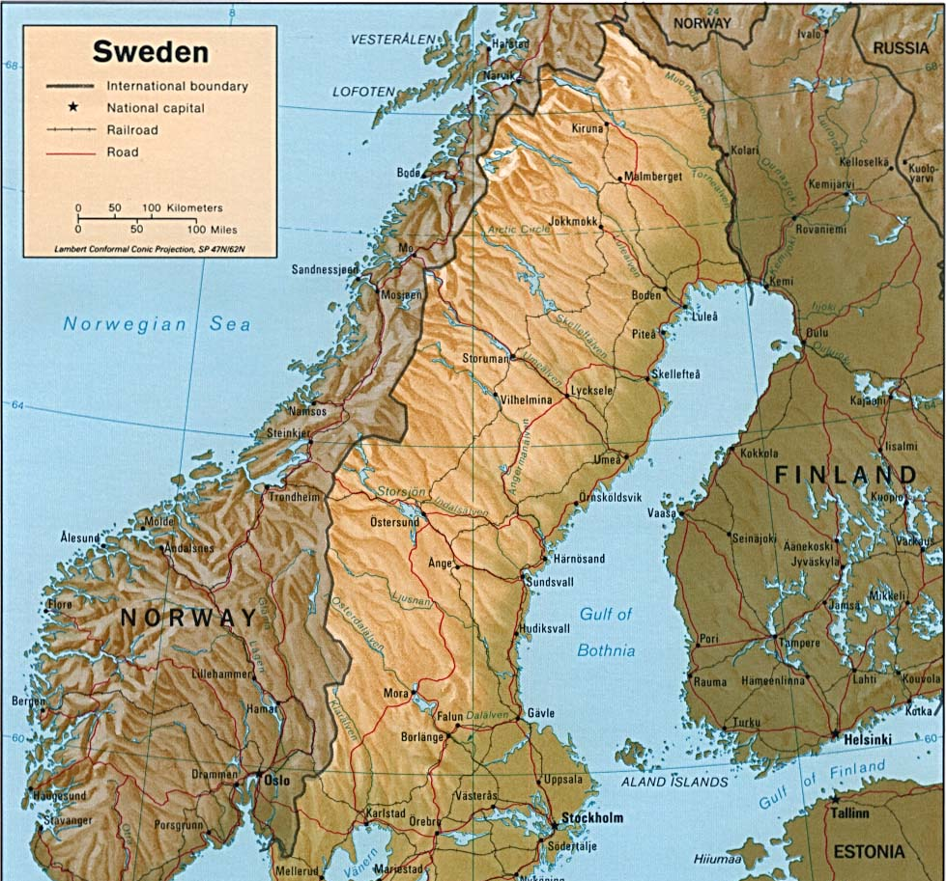

Species Composition at the Sub-meter Level in Discontinuous
Permafrost in Subarctic, Sweden
Authors: Samantha Anderson ¹ Michael W Palace ¹, Michael Layne ², Ruth K Varner ¹, Patrick M Crill ³
Institute for the Study of Earth, Ocean and Space, Earth System Research Center, University of New Hampshire, Durham, NH, USA.
Division of Science and Environmental Policy, California State University: Monterey Bay, Marina, CA, USA.
Department of Geological Sciences , University of Stockholm, Stockholm, Sweden.
Introduction
Northern latitudes are experiencing rapid warming. Wetlands underlain by permafrost are particularly vulnerable to warming which result sin changes in vegetative cover.
Species composition including diversity and richness has been associated with greenhouse gas emissions therefore knowledge of species composition allows for the analysis of systematic change and quantification of emissions. Species composition varies on the sub-meter scale based on topography and other microsite parameters.
This complexity and the understanding of vegetation on the landscape level proves vital in our estimation of carbon dioxide (CO₂) and methane CH₄) emissions and changes in these emissions over time.
Results
5 Site Types
Vegetation Parameters
We ran a Tukey tests to determine if a species would
be influenced by site type.
Figure 1.
Rubus chamemorus (Cloudberry) and Empetrum nigrum (Crowberry) were found to be statistically significant in the tall shrub and hummock sites compared to the “wetter” sites.
Betula nana (Dwarf Birch) and Carex were on the opposite sides of the spectrum were Betula nana was prevalent in the tall shrub areas where as Carex was in the tall graminoid areas.
Can we predict site type with species?
Wet Site
Species richness: 4
Semi-wet
Species richness: 5
Table 1.
(Sphagnum was the base layer that covered the mire but it was found that it was significant in the semi wet sites and relative in the others.)
Research Questions
What is the species composition at the sub-meter scale using remote sensing?
Will the species change according to topography?
Can we predict site type with the species composition?
(Multiple regression analysis determining species through site type. )
Hummock
Species richness: 8
Tall Shrub
Species richness: 9
Remote Sensing Parameters
  Methods
Randomly selected 25 plots that were representative of five major cover types: Semi-wet, wet, hummock, tall graminoid, and tall shrub.
Used 1x1m quadrat with 64 subplots to measure percent cover for 26 species.
We collected ground based remote sensing (RS )at each plot to determine species composition using an ADC lite(near infrared, red, green) and GoPro (red, blue, green)
Normalized each image based on a Teflon white chip placed in each image. Textural analysis was conducted on each image for entropy, angular second momentum, and lacunarity.
A logistic regression was developed to examine vegetation cover types and remote sensing parameters. We used a multiple linear regression using forwards stepwise variable selection.
Lacunarity, angular second momentum and entropy were three factors that we measured. Lacunarity measures spatial patterns and indicates gap size. The bigger the gaps the greater lacunarity. Entropy measures the number of ways a system can be arranged.
Can remote sensing predict site type ?
Tall Graminoid
Species richness: 4
Table 2a.
Field Site
Stordalen mire in Abisko, Sweden
(N 68⁰ 21’.182” E 19⁰ 2’.800”)
Average temperature: 12⁰C
Situated on the most marginal of the discontinuous permafrost zones.
1
2
(Forward stepwise regression estimates.)
(Photos by: Samantha Anderson. 1: Empetrum nigrum (crowberry) 2. Andromeda polfolia (bog rosemary))
Hummocks are ombrotrophic where as the hollows are minerotrophic
Table 2b.
Photo by: Haley Dunleavy
Forward stepwise regression results
Conclusions
In most cases species were found to be important according
to site type. Tall shrub and hummock were significantly different
at an alpha level of 0.05 due to the hydrology. Semi wet, wet
and tall graminoid had similar species and site characteristics.
Topography determined which species were established across
the mire.
Although the r² values were low the p-values made the relationship significant at the level of <0.001.
Acknowledgements: I would like to thank the Macro-systems grand for funding my research, it would not have been possible for me to achieve my goals without them. I also would like to thank my advisor Ruth Varner and mentor Michael Palace for guiding and supporting me throughout this project. I would like to thank the Macro-systems grand for funding my research, it would not have been possible for me to achieve my goals without them. A special thanks to my partner in crime Michael Layne who was there through think and thin, I will be forever grateful.
Photo: http://www.lib.utexas.edu/maps/europe/sweden

