Slide 1


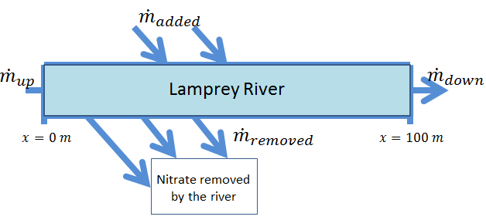
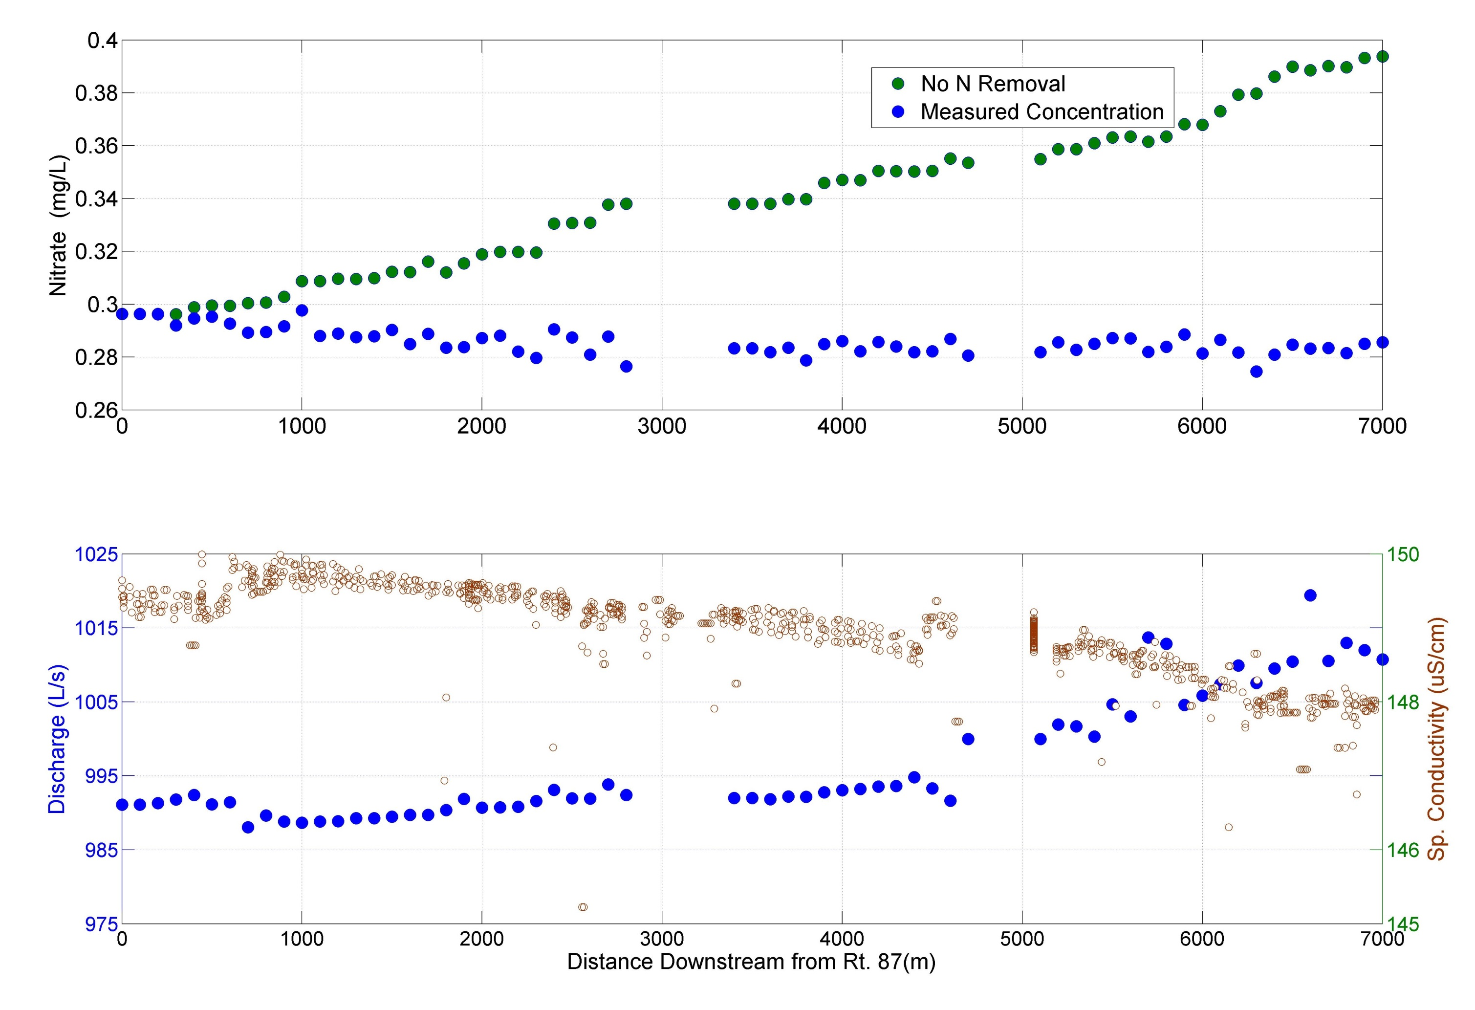
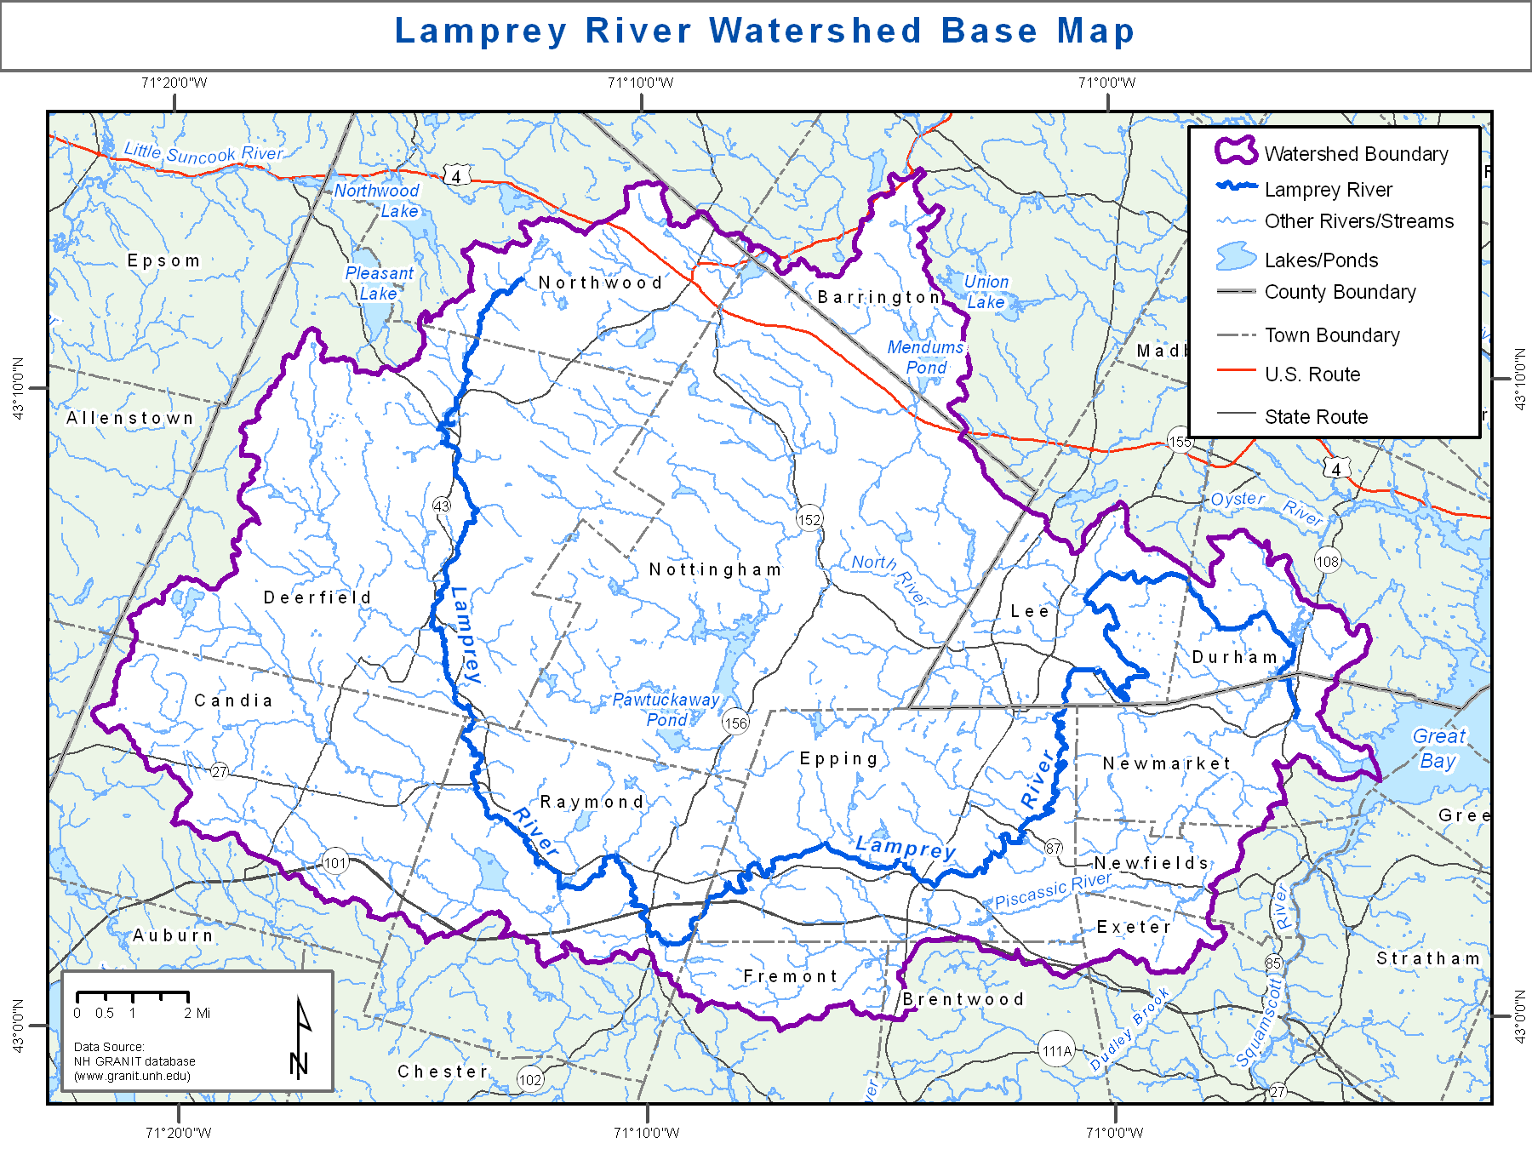
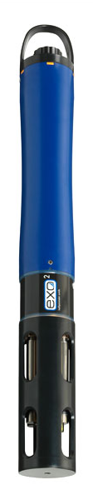
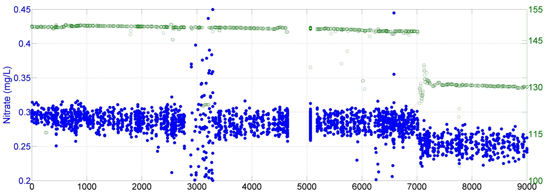
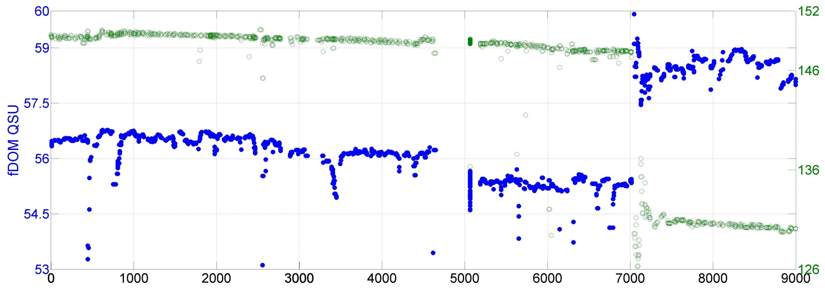
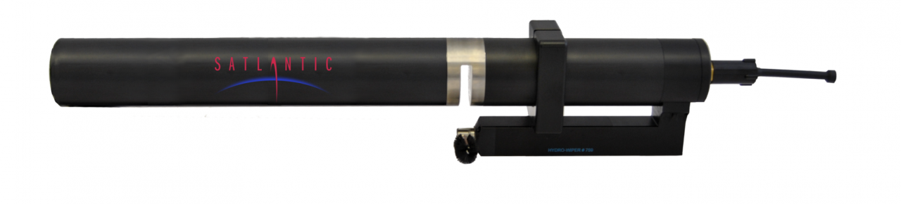
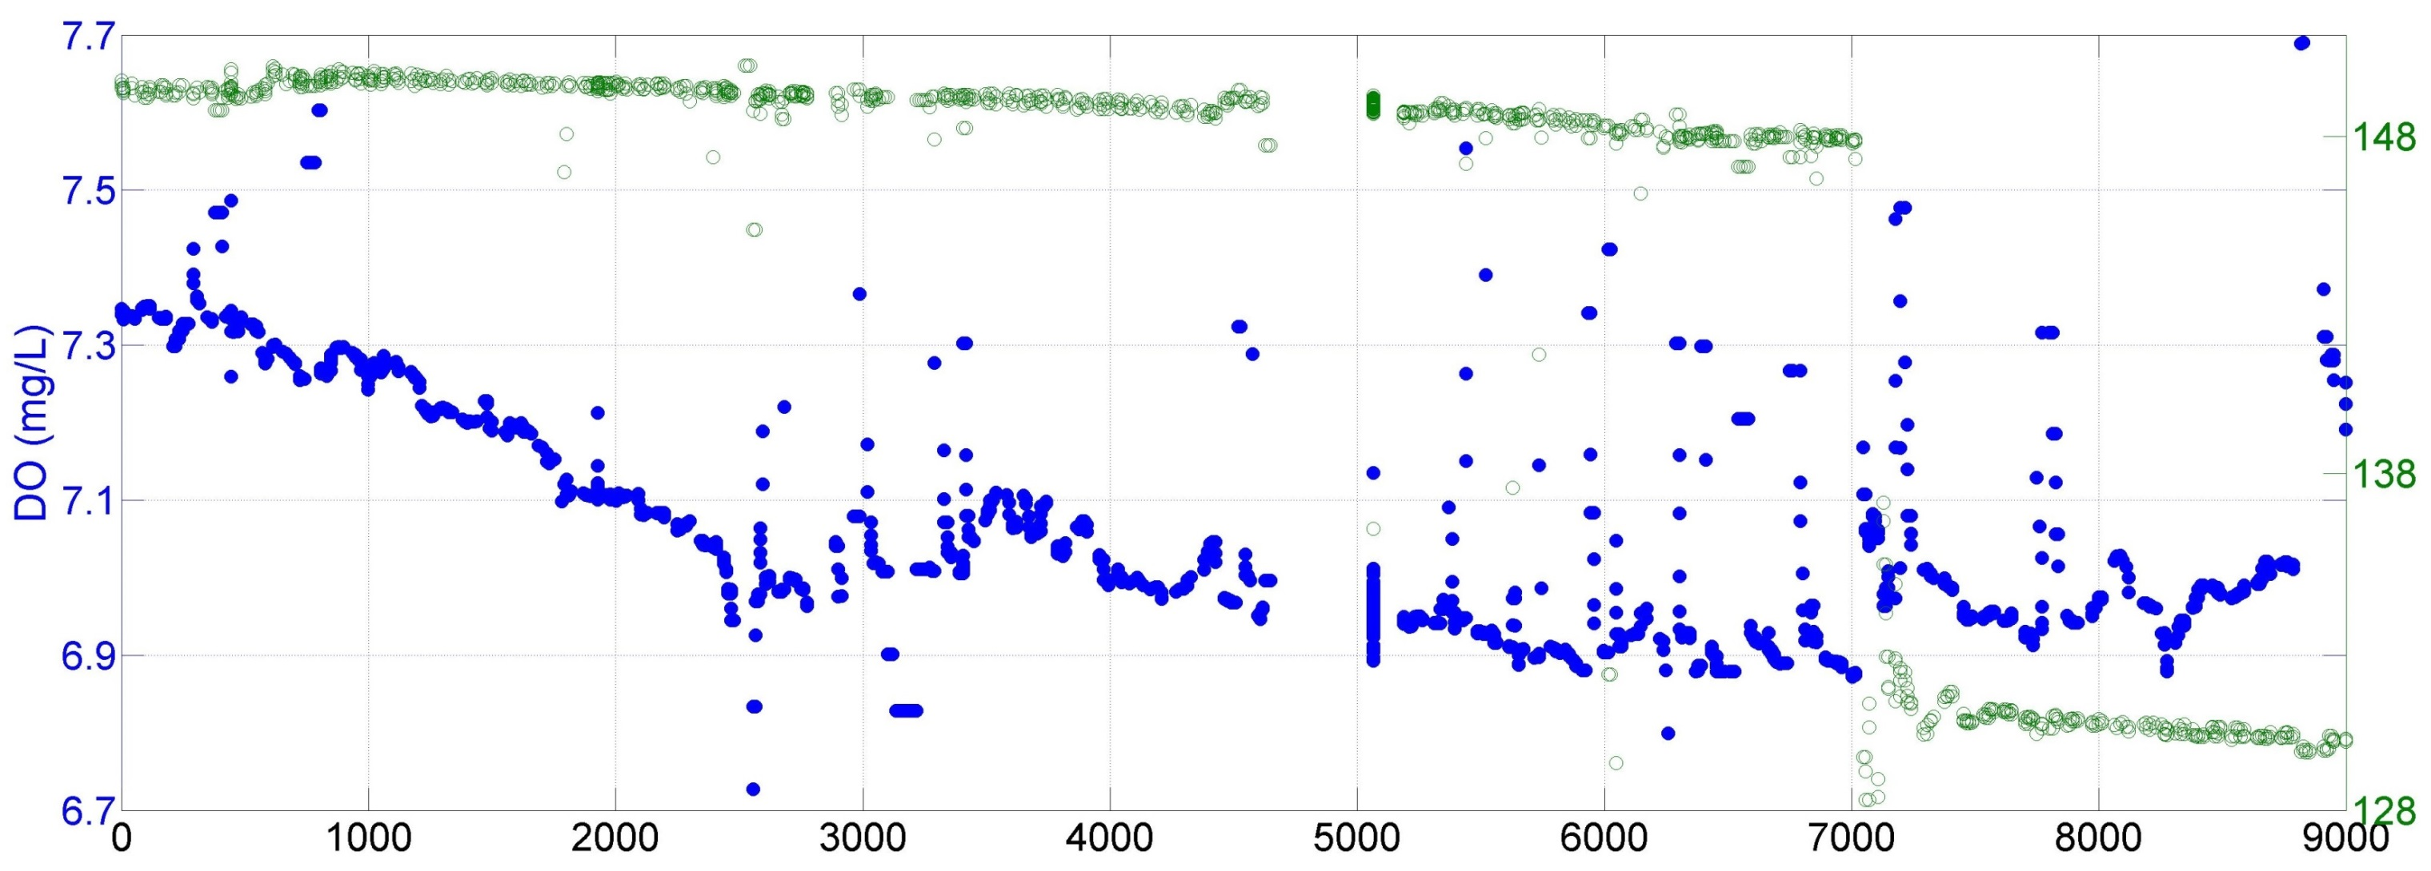
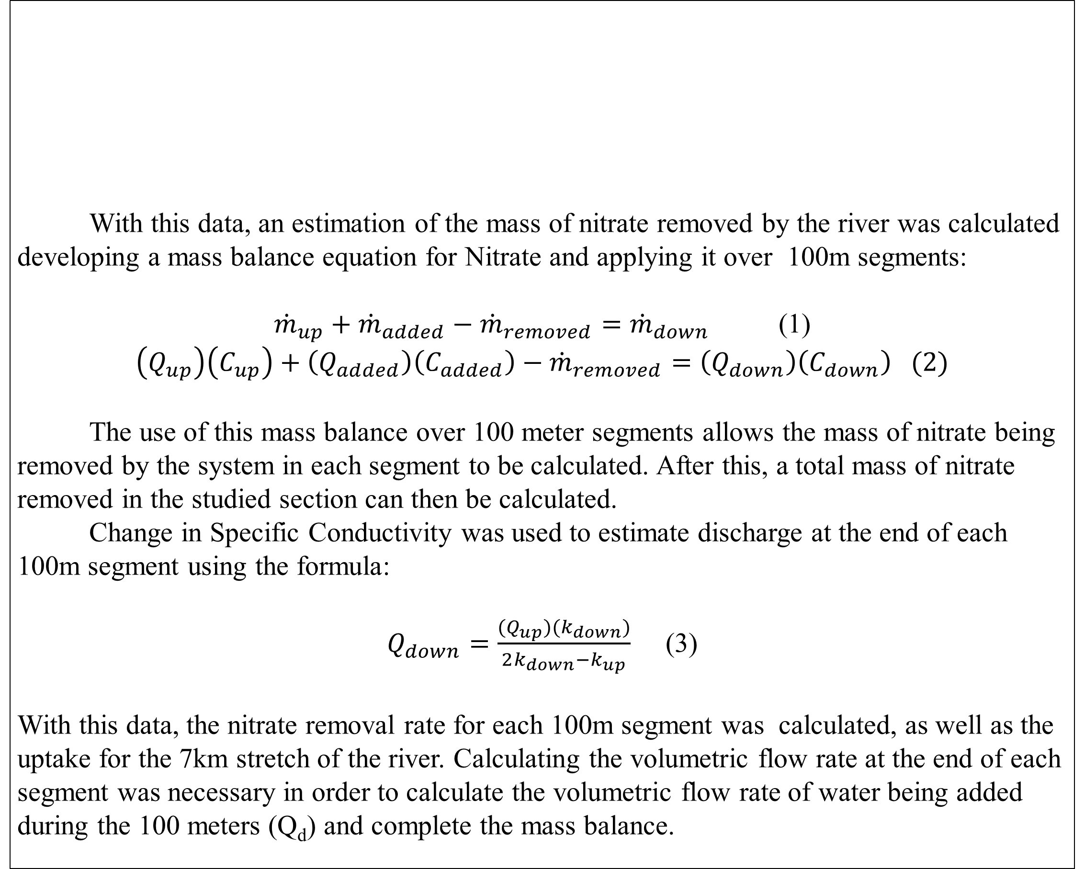
Estimation of Nitrate Removal in the Lamprey River Using Longitudinal Profiling
with High Frequency Sensors
Jeffrey Rano Gopal Mulukutla
Department of Chemical Engineering, UNH Earth Systems Research Center, UNH
Abstract
Methods
Results
The objective of this work was to develop a methodology to determine Nitrate uptake rates at ambient concentrations in medium to large rivers at using longitudinal profiling (Lagrangian Measurements) with high temporal frequency water quality sensors. The data was collected by floating a canoe equipped with multiple sensors and taking data over a roughly 9 kilometer stretch. The data allows the examination of various nutrient concentrations and variations over distance. With the data collected, an estimation of the total amount of Nitrate removed in the river was made.
With this data, an estimation of the mass of nitrate removed by the river was calculated developing a mass balance equation for Nitrate and applying it over 100m segments:
${\dot{m}}_{up}+{\dot{m}}_{added}−{\dot{m}}_{removed}={\dot{m}}_{down}$ (1)
$$\left(Q_{up}\right)\left(C_{up}\right)+\left(Q_{added}\right)\left(C_{added}\right)−{\dot{m}}_{removed}=\left(Q_{down}\right)\left(C_{down}\right) (2)$$
The use of this mass balance over 100 meter segments allows the mass of nitrate being removed by the system in each segment to be calculated. After this, a total mass of nitrate removed in the studied section can then be calculated.
Change in Specific Conductivity was used to estimate discharge at the end of each 100m segment using the formula:
$Q_{down}=\frac{(Q_{up})(k_{down})}{2k_{down}−k_{up}}$ (3)
With this data, the nitrate removal rate for each 100m segment was calculated, as well as the uptake for the 7km stretch of the river. Calculating the volumetric flow rate at the end of each segment was necessary in order to calculate the volumetric flow rate of water being added during the 100 meters (Q­_{d}) and complete the mass balance.
Figure 2: Nitrate removal model and calculated discharge over distance
Introduction/Background
Nutrient Dynamics in Rivers and Streams is a complex interaction process of physical, chemical and biological processes occurring over many spatial and temporal scales. An understanding of these interactions is essential to the prediction of nutrients quantities being exported from these water bodies and gain a better understanding of global scale nutrient cycling and how human development and climate change are affecting the ecosystems. High temporal frequency sensors that measure biogeochemical water quality parameters like Nitrate, Dissolved Organic Matter etc. are rapidly becoming an integral part of scientific research .
But almost all of the applications involve the use of an Eulerian approach to conduct the measurements i.e. the sensors are deployed at a specific location and variations in processes occurring over time scales ( hours, weeks, seasons and annual cycles) are studied. This approach, while producing new scientific insights is limited by the fact that the heterogeneous nature of Rivers and Streams makes it difficult to assess if the variations occurring are similar upstream or downstream of the deployed location.
This study documents one of the first attempts at setting up Lagrangian measurements in a medium sized hydrologically varying river in order to examine ambient nutrient concentration variability and uptake in the time scales of measurements (several hours).
Conclusion/Summary
Discussion
1. Missing data caused by Interference due to the pump drawing in sediments, portages , and GPS Logging errors led to the loss of data for resulting in the lack of a continuous 9 km profile of nutrient and other water quality parameters.
2. The longitudinal profiles were studied in three different segments for a total estimated length of 7 kilometers (7000 m) , with an estimated minimum segment length of 100 m. The North River segment is not reported in this study, as a planned future survey will cover a longer segment of this river.
3. The appearance of a tributary or an inlet to a headwater stream saw abrupt changes in Specific Conductivity and in spike in Nitrate and dilution in FDOM (Chromophoric Dissolved Organic Matter).
4. North River, a major tributary of the Lamprey River appears to be a major source of DOC.
5. The uptake value estimated for the 7 km stretch of the river is 0.333 mg/m/day.
6. The estimated amount of total Nitrate input into the river is 314.1 mg.
7. Estimated amount of total Nitrate removed is 114.7 mg.
8. The estimated percentage of Nitrate removed by the river is 36.5%.
Results
YSI - EXO2 SONDE
Figure 1: Plots of measured Nitrate, fDOM, and DO over distance compared to Specific Conductivity
North River
Source:100yearflood.org
Specific Conductivity (uS/cm)
SUNA –UV Nitrate Analyzer
Acknowledgements
Profs. Wil Wollheim, and Bill McDowell for letting us borrow their sensors, pump and datalogger.
Chris Cook for assistance with the survey, without which this study would not have been possible.
Brian Godbois for letting us borrow his Canoe.
Lisle Synyder for calibrating the SUNA and YSI EXO2 prior to deployment.
Raghu Mulukutla, and Saurabh Bollapragada., undergraduate students at GITAM University, Visakhapatnam, India for developing the GPSlogger Android App without which this study would not have been possible.
Steve Hale for providing support through the NH EPSCoR office.
Methods
North River
In order to collect data on the Lamprey River, a canoe was outfitted with a YSI EXO2 water quality sonde (measuring Conductivity, DO, FDOM, Turbidity, pH and water temperature), a mobile GPS app on android tablet, SUNA UV Nitrate Analyzer, and a Campbell Scientific CR1000 data logger. A submersible pump was used to bring water to the flowcell equipped SUNA. With these in place, the canoe was then floated down the river for roughly 9 kilometers while the sensors took data at varying intervals. Data from each sensor was then matched to one another using the timestamps for each measurement. Further data processing was performed using MATLAB.
Distance Downstream from Rt. 87 (m)

