Slide 1
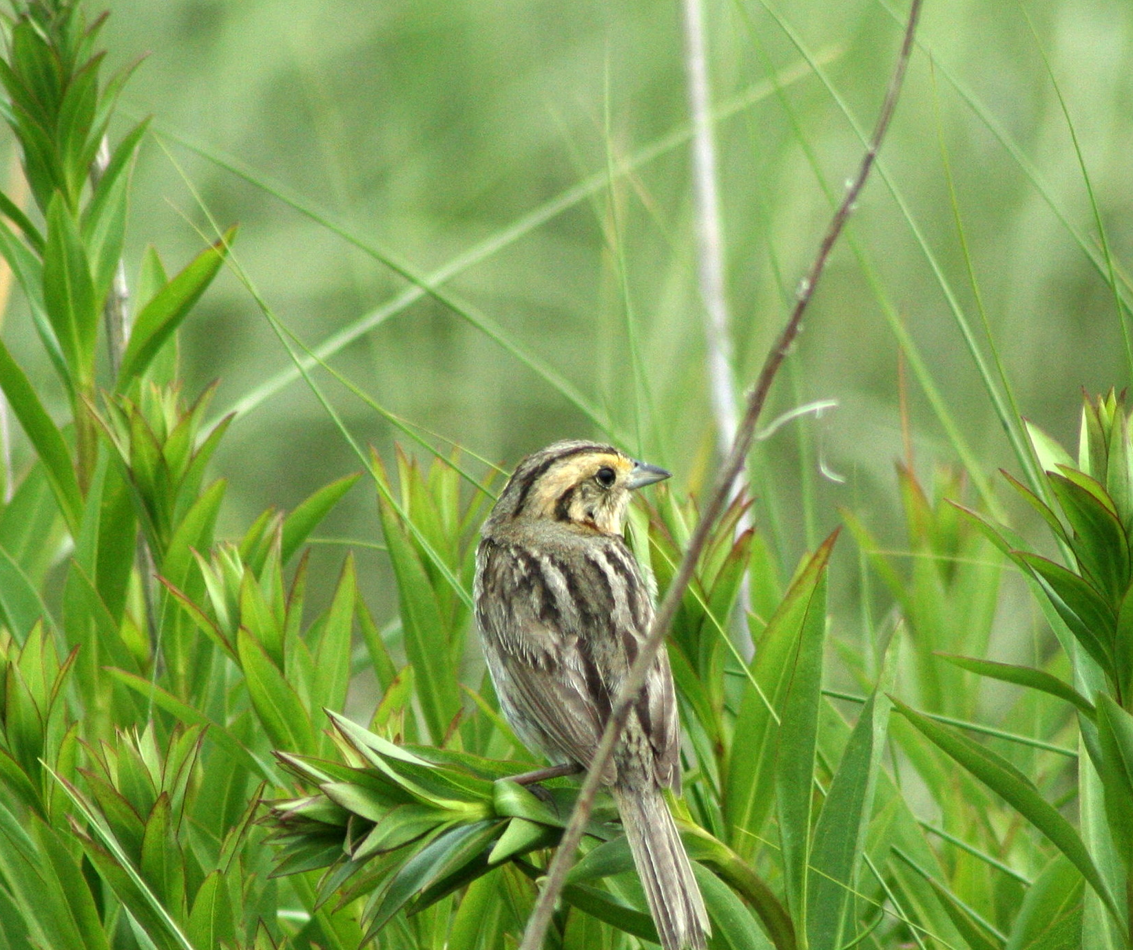
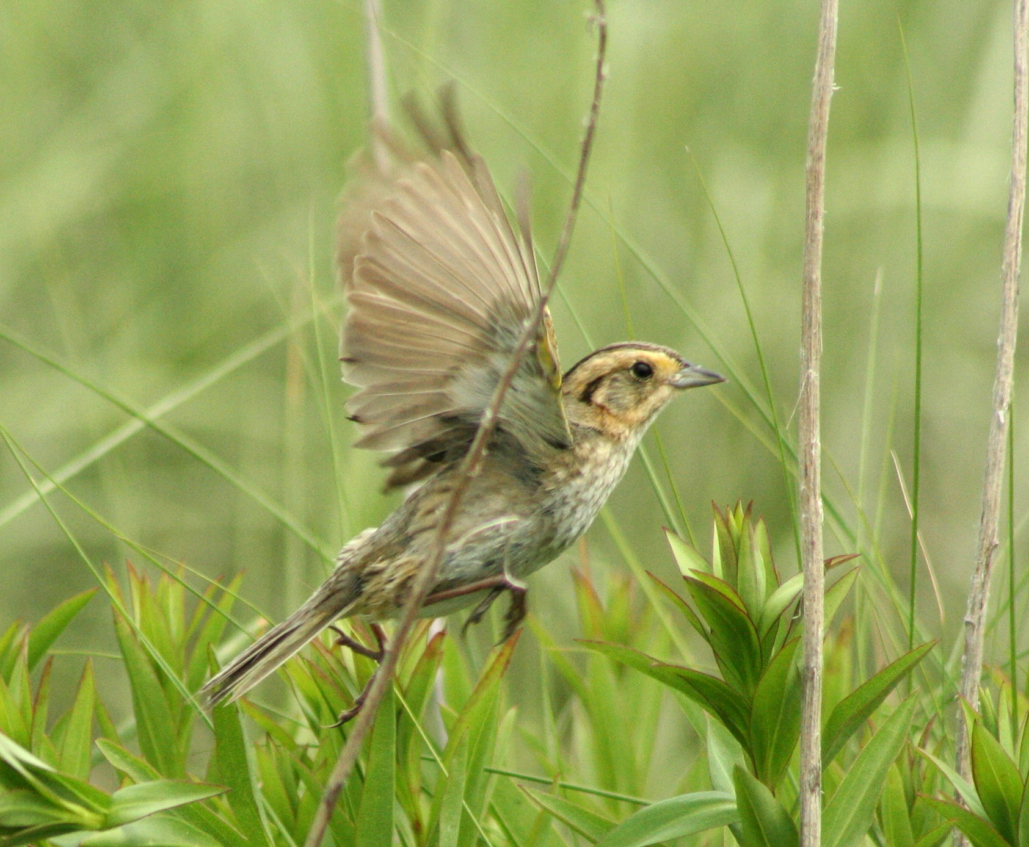
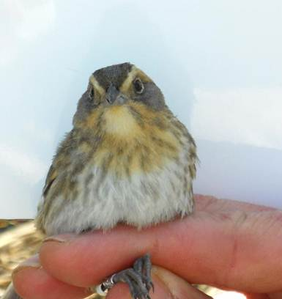
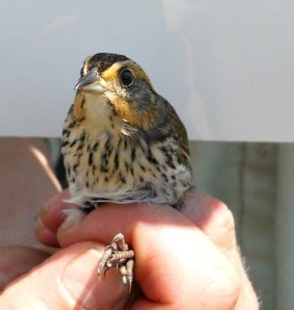

Developing a Genetic Hybrid Index for Saltmarsh and Nelson’s Sparrows
Jennifer Walsh and Adrienne I. Kovach
Natural Resources and Earth Systems Science
Introduction
Results
Hybridization is influential in shaping species dynamics and has a number of conservation and evolutionary implications. Investigating patterns of interspecific hybridization requires the accurate identification of genotypic classes of hybrid individuals (e.g. F1s and F2 backcrosses), for estimating rates of introgression and inferring spatial and temporal patterns.
Our research seeks to characterize hybrid zone dynamics between two tidal marsh birds endemic to the Northeast Atlantic coast, the Nelson’s (Ammodramus nelsoni) and Saltmarsh (A. caudacutus) sparrow. The two species occur sympatrically and hybridize in an overlap zone extending from Southern Maine to Northern Massachusetts¹. The parental species can be identified by morphological differences, while the hybrids exhibit a gradient of variation. Sequence variation of 1.2% at the mitochondrial COI gene and limited differentiation (FST = 0.15) using neutral, non-diagnostic microsatellite markers present challenges for studying introgression.
Table 1. Characterization of 34 near diagnostic microsatellite loci developed from whole genome sequences of A. nelsoni and A. caudacutus. For each locus, columns present repeat motif, fragment size range, primer sequences, annealing temperature, number of individuals screened, number of alleles, observed and expected heterozygosities, number of private alleles, the proportion of shared alleles and most common allele and frequency in each species.
Locus | Repeat motif | Size Range (bp) | Primer sequences (5' - 3') | TA (°C) | n | NA | H_{O} | H_{E} | Private Alleles | Proportion of Shared alleles | Most Common Allele/Frequency in nelsoni | Most Common Allele/Frequency in caudacutus
Ammo001 | ACTC | 118-154 | F: CTTTCATCCATCCCTGTGCT R: AGGTCAAGCCTTGCATCTGT | 63 | 95 | 9 | 0.649 | 0.626 | 1 | 0.57 | 138/0.361 | 118/0.556
Ammo002 | AAT | 194-242 | F: GGTGTTAGCAGCCCAGGTAT R: CCTCAGGAGGTCAGTTTTGC | 60 | 23 | 9 | 0.436 | 0.684 | 7 | 0.63 | 209/0.318 | 197/0.542
Ammo003 | GAT | 139-157 | F: TGTTTGAGAAACAAAAGCCAAT R: CCCATTTCTCTCAAGGACCA | 60 | 95 | 5 | 0.513 | 0.494 | 0 | 0.93 | 154/0.806 | 151/0.471
Ammo005 | AAAT | 184-224 | F: TGCCTTTTCCTGTGGAGACT R: CCTGTCGCTTGCTAATGGAT | 60 | 23 | 9 | 0.523 | 0.601 | 8 | 0.24 | 196/0.409 | 184/0.667
Ammo006 | ACAT | 228-264 | F: TTCCAGCCCTTTTTGTTGAG R: GCAAGGAAATCAGGCTGTGT | 60 | 95 | 10 | 0.520 | 0.716 | 2 | 0.49 | 244/0.403 | 260/0.347
Ammo008 | GAT | 238-250 | F: AAGGCAGATGTTCCCAACAC R: CGCAAACTCCCAGAACTGTA | 60 | 95 | 4 | 0.377 | 0.337 | 1 | 0.98 | 244/0.569 | 250/0.944
Ammo009 | AAAC | 242-270 | F: TGGGTGACTTAAGGGTGTCAG R: GGGCTTGAAAAGCTTGTAATTG | 56 | 22 | 7 | 0.545 | 0.636 | 5 | 0.52 | 246/0.364 | 262/0.636
Ammo010 | AAAC | 230-254 | F: AGCCCTCATGCAGGTAAGAA R: TCCAGAGGGTTTGCTCAACT | 60 | 22 | 7 | 0.275 | 0.597 | 4 | 0.66 | 230/0.550 | 242/0.625
Ammo011 | AAT | 206-236 | F: GGCACCTCTGACGATCAAAT R: ATAACAGCAAGACCGCCACT | 60 | 23 | 9 | 0.424 | 0.503 | 7 | 0.58 | 206/0.909 | 215/0.250
Ammo012 | GTT | 177-201 | F: TTTGAACAATTCCTTCAATGG R: CAGCATTCCGCAAGTCATAA | 56 | 87 | 5 | 0.292 | 0.311 | 2 | 0.11 | 177/0.984 | 189/0.803
Ammo013 | ACCT | 252-272 | F: GAAGCAATGCAGGAGGAAAC R: CTGAAAATGTGCTTGCCATC | 60 | 23 | 6 | 0.254 | 0.466 | 5 | 0.19 | 256/0.818 | 268/0.542
Ammo014 | ATT | 178-193 | F: GAGAAACCTCATTGGGCTTG R: GCTTGTGTGCAGGTCTGTGT | 60 | 20 | 4 | 0.400 | 0.350 | 3 | 0.43 | 178/0.850 | 184/0.700
Ammo015 | AGG | 241-256 | F: TCACCCAAAGGAGGAGTTTG R: TCCCCTGGGATGTGTAATGT | 60 | 95 | 6 | 0.167 | 0.170 | 3 | 0.42 | 241/0.972 | 253/0.819
Ammo016 | AAT | 245-263 | F: GCAAAGCATGCACTGACAAT R: CCTCACCTGCTTTCAACTCC | 60 | 95 | 6 | 0.210 | 0.410 | 0 | 0.93 | 245/0.944 | 257/0.386
Ammo017 | AATC | 112-136 | F: GCTCTGGAGTGCTGCAAAAT R: AGGGTCAAAACAGAGCATGG | 60 | 95 | 7 | 0.532 | 0.539 | 2 | 0.95 | 116/0.736 | 124/0.583
Ammo018 | ATTT | 200-236 | F: GGCTCGAAGACCTGGATGTA R: AGCCTCAAATCCAACATTCC | 60 | 24 | 8 | 0.542 | 0.569 | 6 | 0.58 | 228/0.292 | 204/0.792
Ammo019 | ATT | 150-171 | F: CCTGCAGGAAATGAGAGAGC R: TGCGCATGAAGTCATAGTCAT | 60 | 22 | 4 | 0.182 | 0.432 | 3 | 0.66 | 150/0.773 | 150/0.545
Ammo020 | AAT | 265-292 | F: TTGGTTTCAAAGGAGATTTTTCA R: GGTCTAATCAAGGTGGCACAA | 60 | 23 | 9 | 0.867 | 0.739 | 3 | 0.69 | 265/0.545 | 277/0.292
Ammo021 | CTGT | 146-166 | F: GGGTGGCACAGTCACATTTT R: GTGTCAAGGTCCACCTGCTT | 63 | 24 | 6 | 0.917 | 0.660 | 4 | 0.45 | 150/0.500 | 154/0.292
Ammo022 | CCT | 239-263 | F: TGAGAGTCCTGCAGCCTTG R: CAGCAAACACAAAGGTGGAA | 60 | 23 | 7 | 0.133 | 0.536 | 5 | 0.47 | 254/0.636 | 242/0.667
Ammo023 | ATT | 211-256 | F: GGAACCAGAGAGTCCCACCT R: AAAGGCTTCTGCATCAGAAAAT | 60 | 95 | 16 | 0.726 | 0.741 | 3 | 0.65 | 223/0.403 | 214/0.571
Ammo024 | AAAT | 268-284 | F: TTTCAAAGGTCTGGTACAGCAA R: CCTCAAGTCCTTTGCCATGT | 60 | 22 | 4 | 0.364 | 0.390 | 2 | 0.63 | 268/0.909 | 276/0.545
Ammo025 | ATT | 183-225 | F: GCTTCCCCTTCTTTCCAAGT R: CTCCTGGTACGTGCCATTTT | 60 | 22 | 12 | 0.592 | 0.780 | 8 | 0.59 | 201/0.300 | 201/0.458
Ammo027 | AAAG | 188-228 | F: AAAAGGAAAGCTTCAGTGACAAA R: ATTTAAGGGGCTGCTCTTGG | 63 | 95 | 10 | 0.609 | 0.601 | 2 | 0.64 | 188/0.500 | 212/0.306
Ammo028 | ATCC | 228-260 | F: GCAGCTGCTTCCTAACCTTG R: GGCACTTAACGTGGGTTTGT | 60 | 24 | 9 | 0.750 | 0.793 | 3 | 0.89 | 252/0.375 | 236/0.292
Ammo029 | AATG | 116-148 | F: TGAAACAAAGGAATTTGGAAAGA R: CTGGAAAATGCCCAGACACT | 63 | 20 | 6 | 0.450 | 0.675 | 3 | 0.80 | 144/0.350 | 140/0.600
Ammo030 | ATT | 243-279 | F: GCCAATGAACGTCCTCAAAT R: GAACAGTGCAGCCAACTTCA | 60 | 95 | 8 | 0.377 | 0.413 | 3 | 0.59 | 264/0.319 | 243/1.00
Ammo031 | ACT | 244-259 | F:AAAAGCTAAAACCTTAGACATCAC R: TTCATTTCCTTAGGGAGGAACA | 60 | 23 | 4 | 0.174 | 0.349 | 2 | 0.65 | 247/0.636 | 244/0.917
Ammo032 | GAT | 137-158 | F: AAAACCCTAGGGGAAGGACA R: ACACACAAGTGGCAGCTGTT | 63 | 23 | 6 | 0.871 | 0.637 | 4 | 0.56 | 137/0.545 | 149/0.333
Ammo033 | ATCC | 262-278 | F: TACCAGGAAATGCCACACAA R: TGTTCTGCAAGGTGCTATGG | 60 | 22 | 5 | 0.545 | 0.630 | 1 | 0.95 | 270/0.591 | 266/0.500
Ammo034 | AAT | 129-165 | F: AGGGAAGAATCTGTACCTGCT R: GCAGATGCAGCATAACAAGC | 60 | 21 | 9 | 0.864 | 0.765 | 5 | 0.57 | 138/0.409 | 135/0.350
Ammo035 | ATCT | 161-229 | F: ACACCGCAAGCCAAAGTAGT R: GACCGGGATTTCCATTCATA | 60 | 24 | 11 | 0.583 | 0.825 | 4 | 0.83 | 209/0.250 | 209/0.375
Ammo036 | CTT | 191-215 | F: TCAGAGGCGTTGTCCTTTCT R: TTGAGGAGAAGGGTTGATGG | 60 | 95 | 9 | 0.569 | 0.512 | 2 | 0.34 | 191/0.764 | 194/0.443
Ammo037 | ATCT | 268-312 | F: CATGCTGCTTGGACTTCTCA R: TGAGTGATGCTGACCTGTGC | 63 | 23 | 10 | 0.739 | 0.646 | 7 | 0.74 | 300/0.636 | 300/0.458
Figure 1. Histograms of assignment scores for simulated pure, F1, and backcrossed individuals using a previous set of 12 non-diagnostic markers (right) and the new panel of markers from this study (left).
Table 2. Locus-specific F_{ST} values for the new panel of 12 microsatellite loci comparing allopatric and sympatric populations of A. nelsoni and A. caudacutus .
The Purpose of this Study:
 | F_{ST}
Locus | Allopatric nelsoni/Allopatric caudacutus | Allopatric nelsoni/Sympatric caudacutus | Allopatric caudacutus/Sympatric nelsoni | Sympatric nelsoni/Sympatric caudacutus | Allopatric nelsoni/Sympatric nelsoni | Allopatric caudacutus/Sympatric caudacutus
Ammo001 | 0.3033 | 0.2592 | 0.4037 | 0.3707 | 0.0703 | 0.0027
Ammo003 | 0.4019 | 0.3946 | 0.3653 | 0.3477 | -0.0312 | -0.024
Ammo006 | 0.281 | 0.2237 | 0.2524 | 0.1813 | -0.0234 | -0.0182
Ammo008 | 0.6245 | 0.5498 | 0.6262 | 0.5204 | 0.0078 | -0.0326
Ammo012 | 0.8190 | 0.7123 | 0.6915 | 0.4454 | 0.0632 | 0.1041
Ammo015 | 0.8073 | 0.849 | 0.7748 | 0.8202 | -0.0387 | 0.0111
Ammo016 | 0.5586 | 0.6217 | 0.4856 | 0.5076 | -0.0183 | 0.0202
Ammo017 | 0.3968 | 0.4448 | 0.2555 | 0.2814 | 0.0056 | -0.0213
Ammo023 | 0.2629 | 0.2185 | 0.1842 | 0.1371 | 0.0169 | -0.0135
Ammo027 | 0.2144 | 0.2421 | 0.3734 | 0.489 | 0.1711 | -0.0027
Ammo030 | 0.5198 | 0.3685 | 0.694 | 0.4561 | 0.0006 | 0.064
Ammo036 | 0.4352 | 0.465 | 0.4172 | 0.4614 | -0.0241 | 0.0166
Overall | 0.4667 | 0.4282 | 0.4567 | 0.4137 | 0.0272 | 0.0040
Use next generation sequencing to develop a panel of high resolution, diagnostic, microsatellite markers for accurate assignment of pure Nelson’s and Saltmarsh Sparrows and their hybrids to genotypic classes.
Methods
Sample Collection and Marker Development
Table 3: Power analysis in NEW HYBRIDS of the panel of 12 newly developed microsatellite loci (in bold) in comparison to our previous marker set (plain text below). Mean posterior probabilities for simulated individuals assigned to F1 and backcrossed categories are presented in the first three columns. Percent accuracy (last column) indicates the percentage of individuals assigned to the correct category.
High quality (100x coverage) de novo assembly draft genomes of A. caudacutus and A. nelsoni were generated from Illumina sequencing
MSATCOMMANDER² was used to identify 6262 tri- and tetra-nucleotide repeat motifs within the A. caudacutus assembly
A custom Perl script was used to compare repeat motifs discovered in the A. caudacutus assembly to those in A. nelsoni by repeat number
37 sequences that differed by ≥4 repeats between the 2 species were chosen for primer development using PRIMER 3³
 | Assigned category: mean posterior probabilities
True Category | F1 Hybrid | BC nelsoni | BC caudacutus | % Accuracy
F1 Hybrid | 0.947 0.686 | 0.016 0.174 | 0.035 0.139 | 97.6 78
BC nelsoni | 0.016 0.106 | 0.983 0.878 | 0 0.012 | 98.3 89
BC caudacutus | 0.029 0.116 | 0 0.019 | 0.969 0.861 | 97.4 87
Screening and Marker Validation
Conclusions
37 selected markers were initially screened on 12 individuals of each species using fluorescently labeled ChromaTide Alexa Fluor dUTPs
The 12 most diagnostic loci were then dye labeled (FAM, HEX or NED) and combined into 2 multiplexes for screening in an additional 95 individuals of sympatric and allopatric origin on an ABI 3130 sequencer.
34 of 37 identified microsatellite markers amplified in both species.
Although none of the markers were completely diagnostic, a panel of 12 markers were found to have high resolution for differentiating the two species and high accuracy in assigning individuals to hybrid and backcross classes.
This new panel of near diagnostic markers will enhance research in hybridization and aid conservation efforts which rely on differentiating the species.
Analyses
Marker polymorphism was characterized by the number of alleles, allelic richness, and heterozygosity.
Diagnostic potential of each marker was evaluated by private alleles, shared alleles, and locus-specific F_{ST} between the 2 species.
To assess the power of the markers, we simulated 1000 hybrid and backcrossed genotypes using the program HYBRID LAB⁴ and evaluated the proportion of accurate assignments of simulated individuals to their appropriate hybrid class using the program NEW HYBRIDS⁵
Morphological differences in Nelson’s Sparrow (left) and Saltmarsh Sparrow (right). Nelson’s Sparrows have smaller body and bill, and pale plumage with narrow, indiscrete ventral streaking in comparison to Saltmarsh Sparrows, which are more vibrant in plumage, with more distinct streaking patterns and richer orange facial coloration.
Literature Cited
Hodgman, T.P., W.G. Shriver, and P.D. Vickery. 2002. Redefining range overlap between the Sharp-tailed Sparrows of coastal New England. Wilson Bulletin 114:38-43
Faircloth B.C. 2008. MSATCOMMANDER: detection of microsatellite repeat arrays and automated, locus-specific primer design. Molecular Ecology Resources 8:92-94
Rozen S. and H. Skaletsky. 2000. PRIMER 3 on the WWW for general users and for biologist programmers. Methods in Molecular Biology 132:365-386
Nielsen, E.E., L.A. Bach, and P. Kotlick. 2006. HYBRIDLAB (version 1.0): a program for generating simulated hybrids from population samples. Molecular Ecology 6:971-973
5. Anderson, E.C. and E.A. Thompson. 2002. A model-based method for identifying species hybrids using multilocus genetic data. Genetics 160:1217-1229
Acknowledgments
Funding for this research was provided by the UNH NSF ADVANCE grant, United States Fish and Wildlife Service, and the New Hampshire Agricultural Experimentation Station. We also thank KT for help with genome sequencing and JR for writing the custom PERL script.

