Slide 1
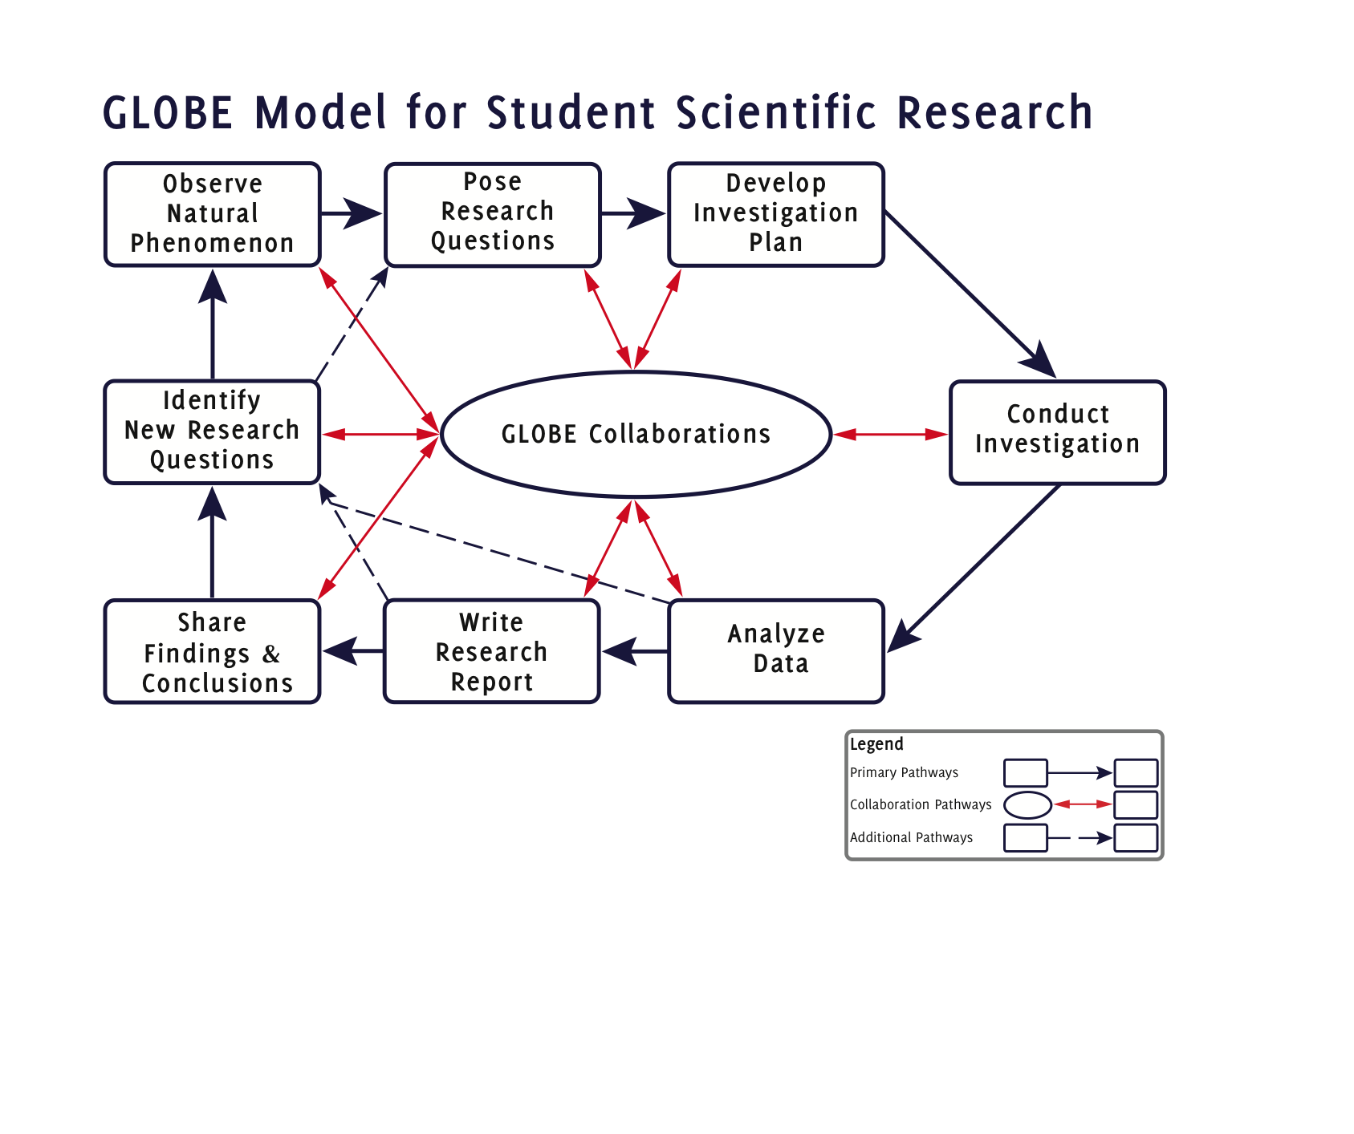
Notes:
File Name: GMSSR Core Final 01202011

