Slide 1

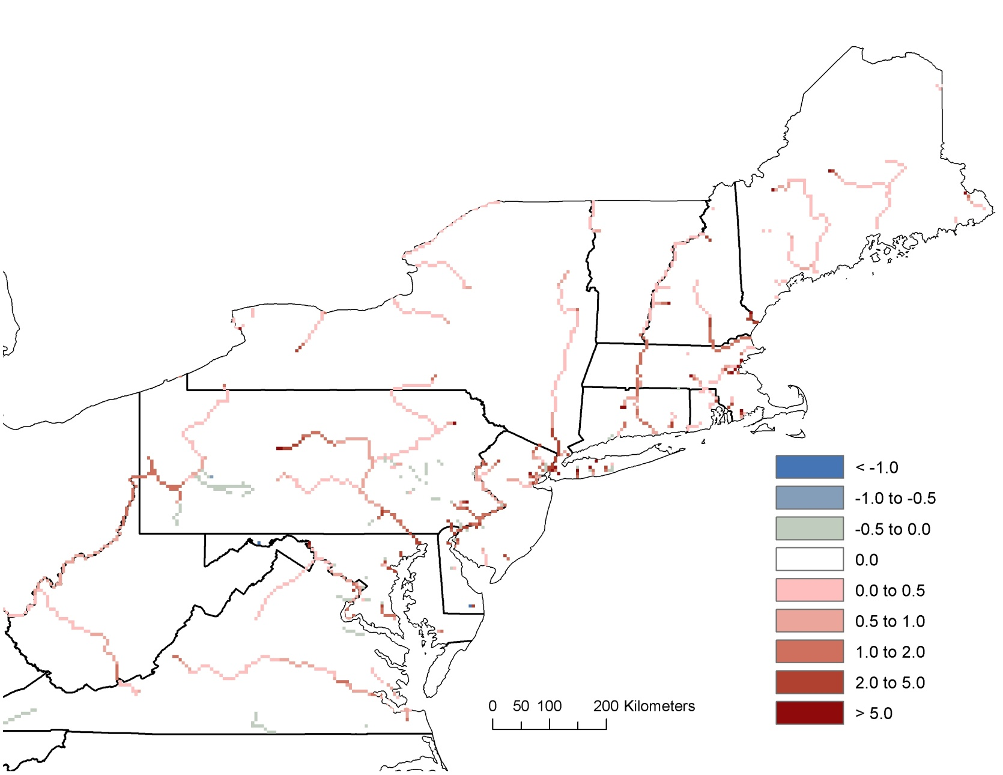
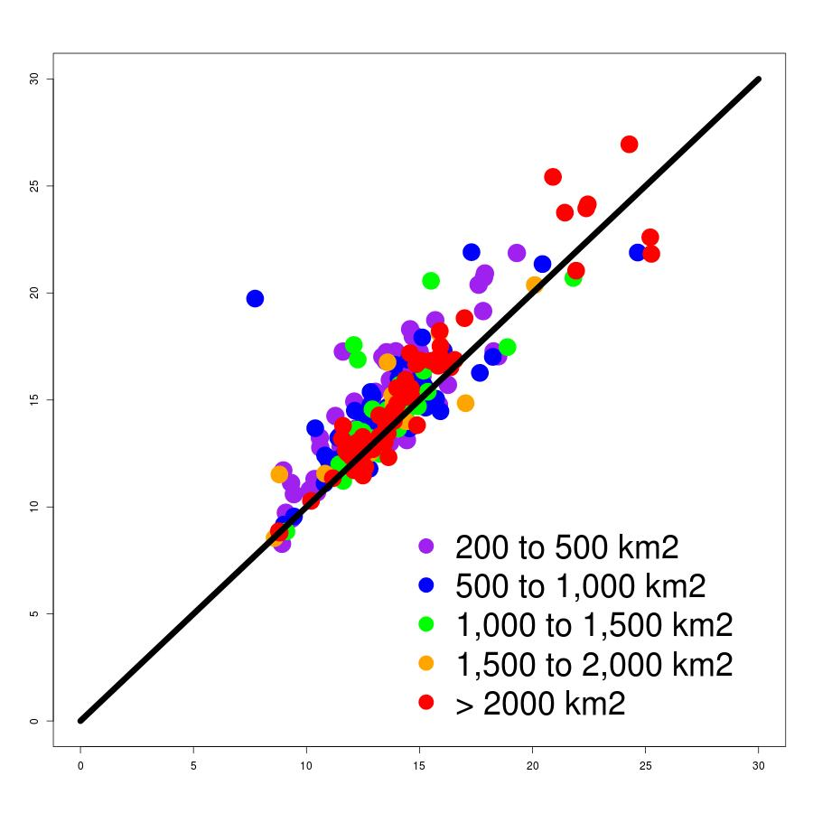
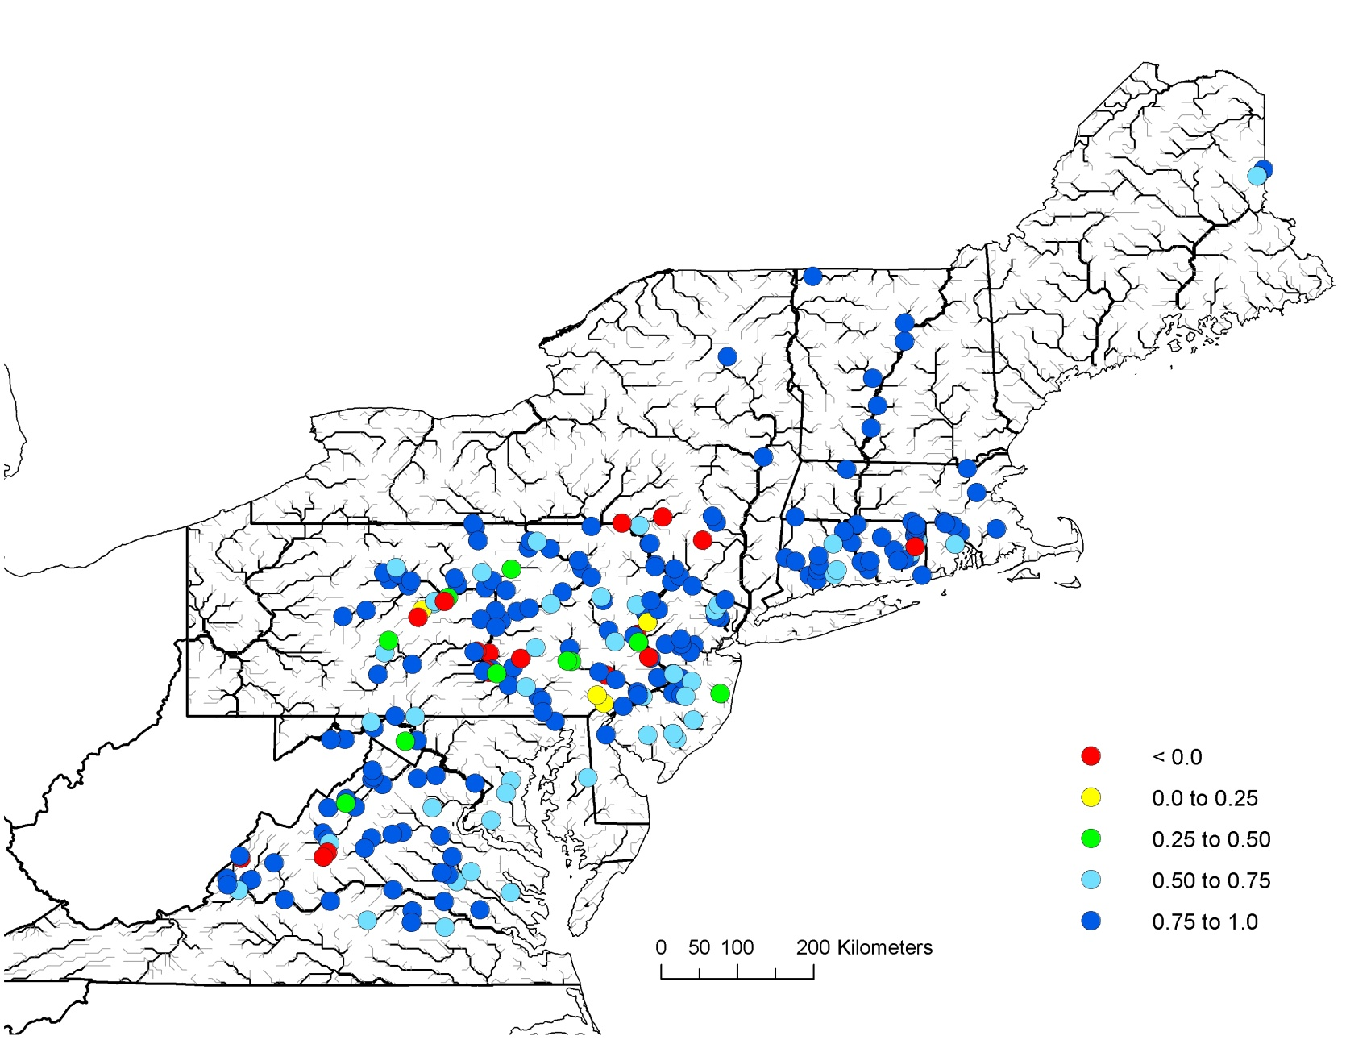
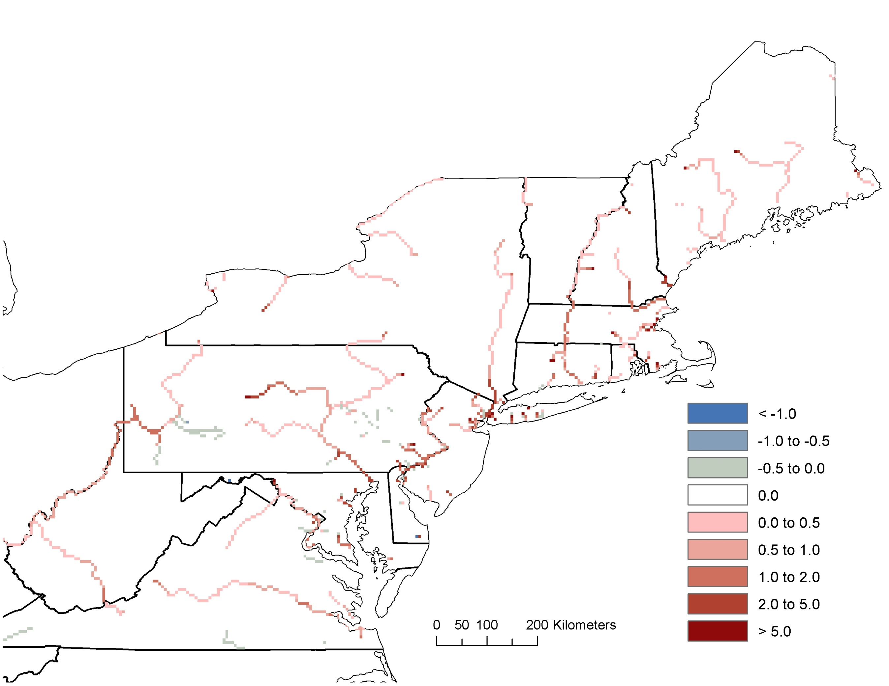
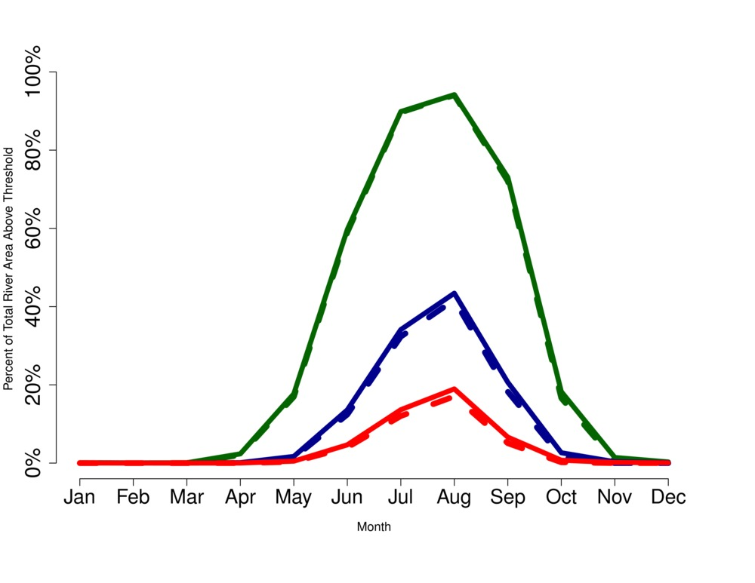
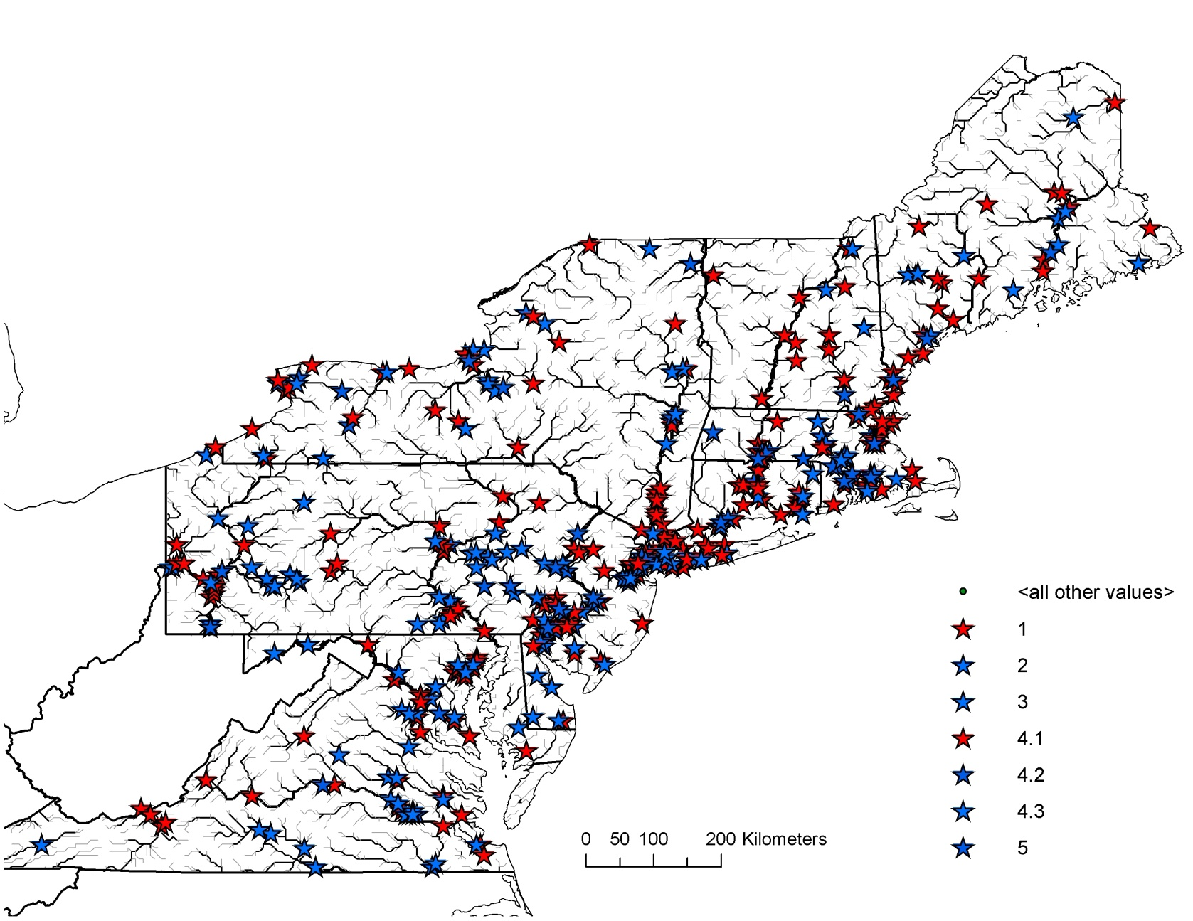
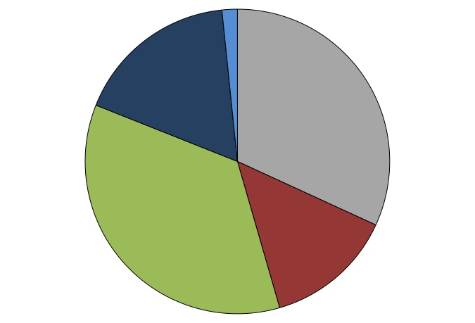
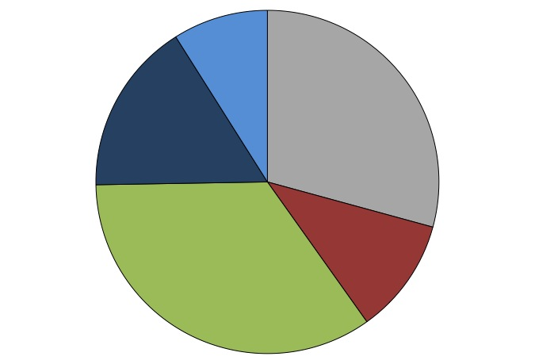
Horizontal Cooling Towers: Thermal Regulation By Rivers
Support Electricity Generation in the Northeastern United States
University of
New Hampshire
Water Systems
Analysis Group
National Science
Foundation
R.J. Stewart¹ (rob.stewart@unh.edu), W.M. Wollheim^{1,2}, A. Miara³, C.J. Vörösmarty³, B. Rosenzweig³, B. Fekete³
(1) Earth Systems Research Center, University of New Hampshire, Durham, NH, (2) Department of Natural Resources and Environment, UNH, (3) CUNY Environmental Crossroads, CCNY, NY
Introduction:
Questions:
What proportion of northeastern U.S. electricity production depends on engineered approaches vs. ecosystem services by rivers for cooling of waste heat?
What are the tradeoffs and unintended consequences of relying on ecosystem services in terms of altered temperature regime and fish habitat?
Rationale:
Thermoelectric power plants generate 90% of US electricity, and cooling them requires the single largest share of freshwater withdrawals.
Re-circulating approaches rely on engineered cooling and consumptive water use, while “once-through” depend one ecosystem services (cooling) in rivers, which comes at cost of elevated temperatures until re-equilibration is achieved.
We must understand river’s natural ability to mitigate heat loads in face of increased energy demands and changing climate. This ability is a function of various ecosystem properties, river flow, runoff, and atmospheric conditions.
The balance of energy use and cooling strategies will affect fish habitat, either through flow regime (consumptive use) or temperature regime (“once-through”)
Approach: Use a daily time-step, spatially-distributed, dynamic, river network hydrology and water temperature re-equilibration model linked to a thermoelectric energy model to quantify the relative importance of each type of cooling strategy, their impacts on rivers in the northeastern U.S., and ecosystem services provided by river systems to attenuate thermal pollution.
L
L
Validation:
Impacts on Water Temperature
Model output was compared with observed
temperatures at 242 USGS gauges (DA > 200 km²)
Mean annual water temperatures are most accurate in large rivers (DA > 2000 km²), but performance is good across entire spectrum
Modeled water temperatures accurately
represent daily water temperatures in region
Thermal pollution from power plants leave a considerable footprint on avg. water temps
30
Avg. Summer
25
MAE = 2.7
Nearly 1,700 km of river
length is increased at least
1 ºC during the summer
20
15
Temp. Increase
Due to Plants (ºC)
Mean Modeled Water Temperature (ºC)
Re-equilibration with atm.
conditions is more rapid
during the winter
10
Comparison at
USGS Gauges
5
0
0
5
10
15
20
25
30
Mean Observed Water Temperature (ºC)
Nash-Sutcliffe
Coefficient
Unsuitable Habitats for Fish
(Cold = 20 ºC, Cool = 26 ºC, Warm = 30 ºC)
< 0.00
0.00 to 0.25
0.25 to 0.50
0.50 to 0.75
0.75 to 1.00
Power plants slightly elevate water temperatures above critical thresholds for cold water fish.
Warm water fish are the most heavily impacted.
20º C
26º C
Percent of Total River Length Above Temp. Threshold
30º C
Heat Generated at Thermoelectric Plants
Dashed lines:
Scenario w/o
Power Plants
Power plants in the northeast rely as heavily on rivers as they do on cooling towers for heat dissipation during power generation
Re-equilibration of water temperatures to atmospheric conditions attenuates a significant proportion of total heat input to rivers during winter months
Consumption of water for evaporation in cooling towers is relatively minor
Model and Data:
Framework for Aquatic Modeling in the Earth System (FrAMES) for simulation of hydrology and runoff temperatures
Dingman (1972) for re-equilibration of water temperatures to atmospheric conditions during discharge routing
Thermoelectric Power Plant Model (TPPM, Miara 2012) for dynamic calculation of power generation, water use, and thermal pollution
Climate datasets acquired from MERRA (2000 through 2010)
Power Plant data assembled from UCS and EIA databases
Conclusions
Basin | % Total Ann. Heat to Eng. | % Total Ann. Heat to Rivers | % Heat Atten. by Rivers | % Ann. Flow Withdrawn | % Ann. Flow Consumed
Conn. | 11.0 % | 47.9 % | 14.7 % | 19.5 % | 0.02 %
Merr. | 11.7 % | 38.9 % | 11.7 % | 6.40 % | 0.03 %
Susq. | 32.6 % | 28.5 % | 39.9 % | 15.5 % | 0.35 %
Region | 30.3 % | 22.5 % | 24.3 % | 5.51% | 0.14 %
River networks (horizontal cooling towers) are 24.3% effective in dissipating heat and account for the cooling of 30.3% of the total heat generated for electricity production in the northeast US.
The cost of using this ecosystem service is an increase in the total unsuitable habitats habitats for cold, cool, and warm water fish by 0.2%, 5.6%, and 11.1%
Impacts in terms of river length are more widespread during the summer due to the reduced efficiency of re-equilibration associated with warm ambient atmospheric conditions
Engineered technologies such as re-circulating cooling towers have minor impacts on flow regime and often reduce river temperatures due to cold return flows
This highlights the buffering capacity of river networks to mitigate anthropogenic impacts to the system, and represents an important ecosystem performed by rivers in the northeast
Re-Equilibration of Water Temperatures during Routing*
Model Domain and
Power Plant Locations
Total Heat
To Rivers
Allocation of Total Heat Generated by Plants
(Northeast Region)
Heat Attenuated
By Rivers
Solar
Radiation
Energy Exchange
Function
Cloud
Cover
Eng.
Cooling
Excess Heat Leaked to Ocean
Eng.
Cooling
Initial
Water
Temp.
Air
Temp.
Relative
Humidity
Geometry
Wind
Speed
Elec.
Elec.
Other
“Once-through”
Flow Rate
Water
Temperature
“Re-circulating”
Other Heat Sinks
* Dingman, 1972
Summer
Winter

