Slide 1
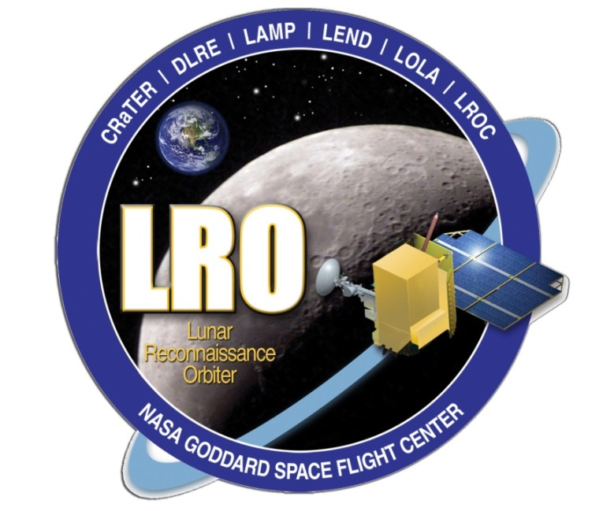
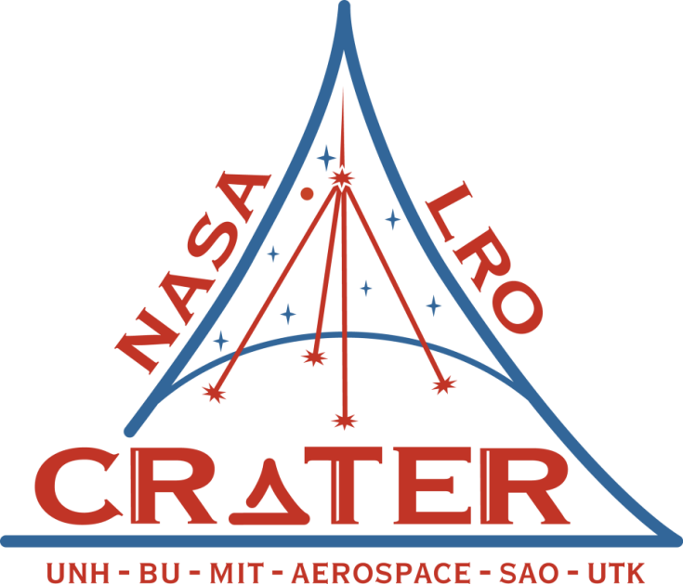
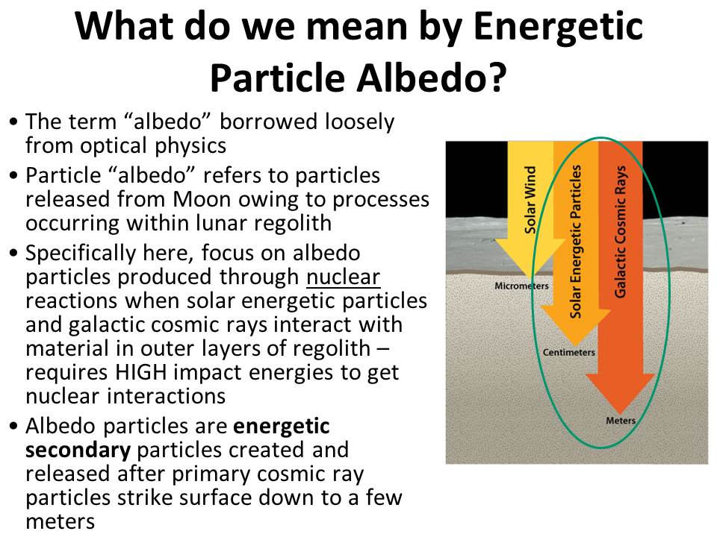
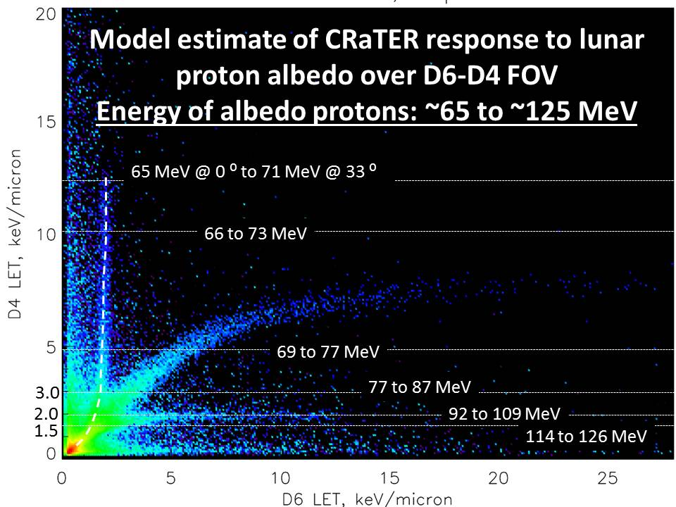
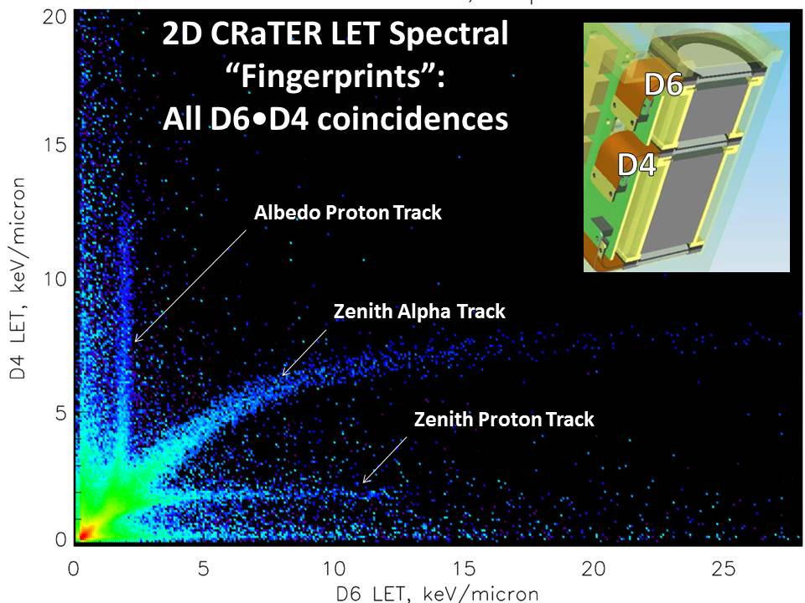
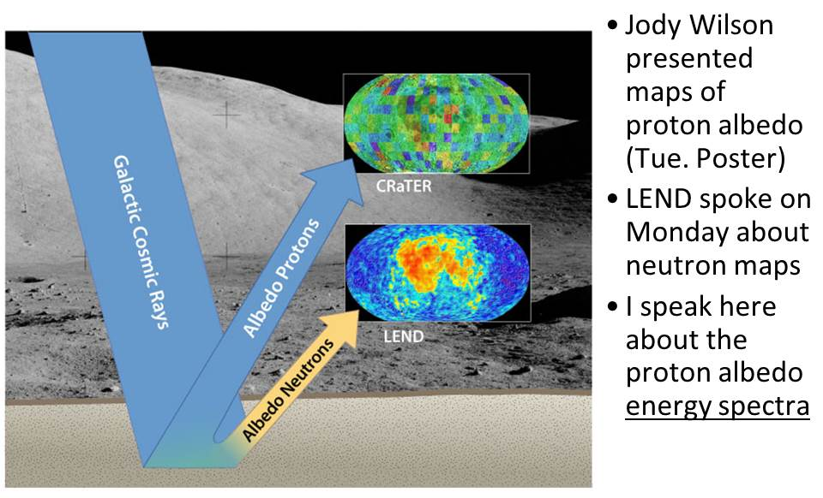
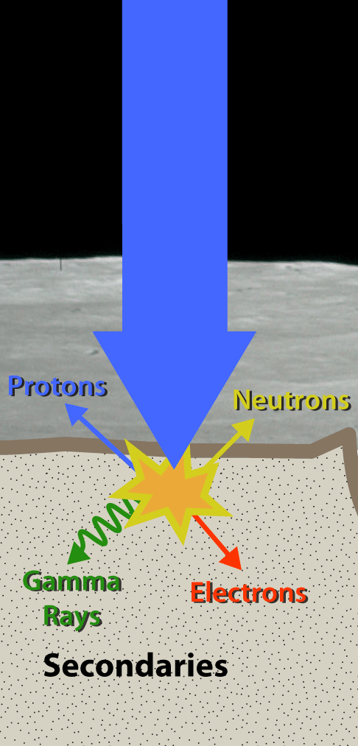
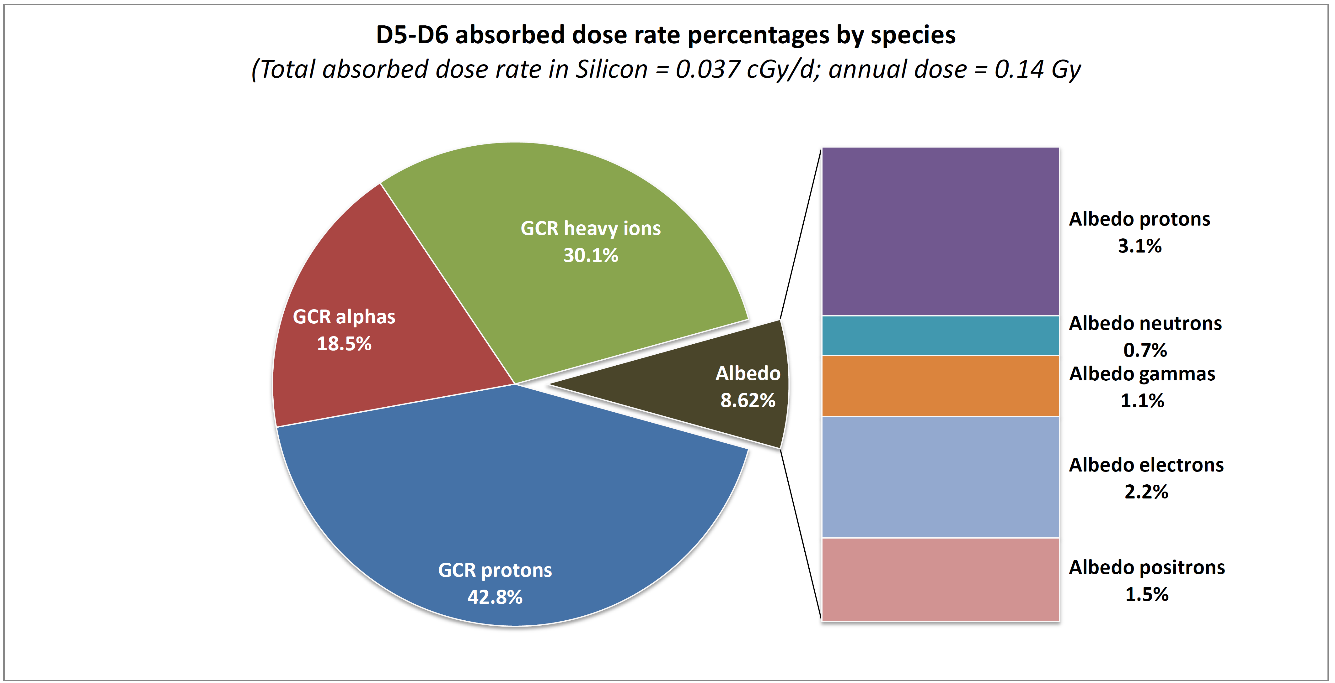
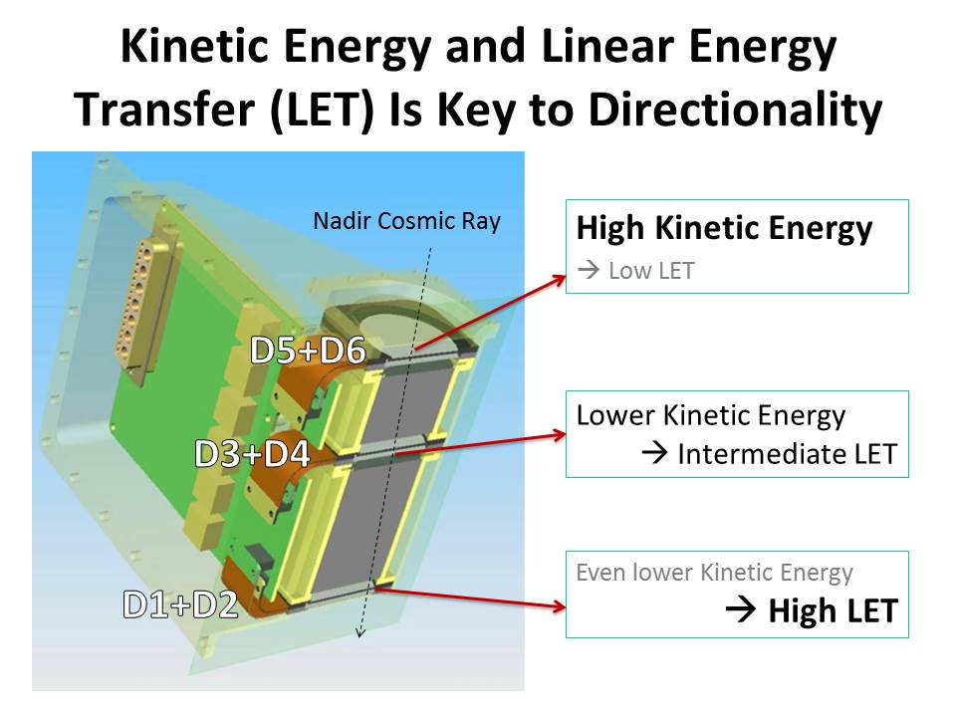
RELATIVE CONTRIBUTIONS OF GALACTIC COSMIC RAYS AND LUNAR PARTICLE ALBEDO TO RADIATION DOSE
H. E. Spence¹, M. J. Golightly¹, C. Joyce¹ , M. D. Looper², N. A. Schwadron¹, S. Smith¹, L. W. Townsend³, J. K. Wilson¹ , and C. Zeitlin⁴
¹Institute for the Study of Earth, Oceans, and Space, University of New Hampshire, Durham, NH 03824, Harlan.Spence@unh.edu,
² The Aerospace Corporation, El Segundo, CA 90009, ³ Department of Nuclear Engineering, University of Tennessee, Knoxville TN 37996,
⁴ Southwest Research Institute-EOS, Durham, NH 03824
Introduction: The Cosmic Ray Telescope for the Effects of Radiation (CRaTER) [1] has been immersed in the radiation environment of the Moon since launched on NASA’s Lunar Reconnaissance Orbiter (LRO) [2] in June 2009. CRaTER measurements yield robust estimates of the linear energy transfer (LET) [3] of extremely energetic particles traversing the instrument, a quantity that describes the rate at which particles lose kinetic energy as they pass through and interact with matter. The resultant ionizing radiation of these interactions poses a radiation risk for human and robotic space explorers subjected to deep space energetic particles [4]. CRaTER employs strategically placed solid-state detectors and tissue equivalent plastic (TEP), a synthetic analog for human tissue, to quantify radiation and shielding effects [5] pertinent to astronaut safety.
Proton Albedo: Though designed to measure galactic cosmic rays (GCR) and solar energetic protons [6] coming from zenith and deep space, CRaTER observations have been used also to discover an energetic proton “albedo”, caused by a process known as nuclear evaporation coming from the lunar surface [7].
Identifying Directionality and Albedo Protons via LET Signatures in Multiple Detectors: Within CRaTER, we establish ionizing radiation directionality statistically by exploring energy loss in detector pairs, particularly pairs separated by intervening matter that slows them substantially (i.e., between D2 and D4 in the zenith direction and between D4 and D6 in the nadir direction) .
Albedo Proton Energy Spectrum: Using multiple-detector energy deposits we infer the incident spectrum. This technique allows us to reconstruct the incident proton albedo spectrum between ~65 and ~125 MeV, which agrees with GEANT4 model.
(See Wilson et al. poster for latest CRaTER proton albedo map)
Dose and Dose Rate: In the figure below, taken from [9], we show that near the Moon GCR accounts for ~91.4% of the total absorbed dose, with GCR p+ accounting for ~42.8%, GCR α particles ~18.5%, and GCR heavy ions ~30.1%. The remaining ~8.6% of the dose at LRO altitudes (~50 km) arises from secondary lunar species, primarily “albedo” p+’s (3.1%) and electrons (2.2%). Other lunar nuclear evaporation species contributing to the dose rate are positrons (1.5%), gammas (1.1%), and neutrons (0.7%).
GCR Primaries
Figure above shows a D4 vs.D6 LET spectrogram. Color indicates number of events (red:high to blue:low), over the ranges of LET (keV/µ) of CRaTER’s response to incident protons (p+) and alpha (α) particles. We identify three “tracks”: p+’s traversing the CRaTER instrument from zenith, α particles (doubly-ionized helium) also coming from zenith, and the albedo p+ track.
Kinetic Energy vs. LET: Particles moving through CRaTER at high energies lose fractionally little energy; as they slow, and even stop, they lose increasing energy in the matter they traverse.
Modeled LET Spectra of Primary GCRs and Lunar Secondaries: We develop a GEANT4 numerical model [8] to simulate CRaTER’s response to both the primary GCR (p+ and all heavier ions) as well as to all lunar albedo secondaries (see figure above). We use this validated radiation transport model of the CRaTER instrument and its response to both primary GCR and secondary radiation, including lunar protons released through nuclear evaporation, to estimate [9] their relative contributions to total dose rate in silicon (0.037 cGy/day) and equivalent dose rate in water (0.071 cSv/day).
Summary and Conclusions:
Lunar p+ albedo quantified (should also be at other airless bodies such as NEAs, Phobos/Deimos, Mercury, ~Mars); maps reveal variations but whose origins remain a mystery
CRaTER senses p+ albedo spectrum between ~65 MeV and > ~125 MeV; likely extends to lower and higher energies
The Moon blocks ~1/2 the sky, thus halving dose rate near Moon relative to deep space, but secondary albedo adds back a small amount (~9%) that can and now should be accounted for quantitatively in radiation risk assessments
References: [1] Spence, H. E., et al., (2010), Cosmic Ray Telescope for the Effects of Radiation on the LRO Mission, Space Sci. Rev., 150(1-4), 243-284. [2] Chin, G., et al., (2007) Lunar Reconnaissance Orbiter Overview: The Instrument Suite and Mission, Space Sci. Rev., Volume 129, Number 4, pp. 391-419. [3] Case, A. W., et al., (2013) The Deep Space Galactic Cosmic Ray Lineal Energy Spectrum at Solar Minimum, Space Weather, DOI: 10.1002/swe.20051. [4] Schwadron, N. A., et al., (2012) Lunar radiation environment and space weathering from the Cosmic Ray Telescope for the Effects of Radiation (CRaTER), J. Geophys. Res. – Planets, 117, DOI: 10.1029/2011JE003978. [5] Zeitlin, C., et al., (2013) Measurements of Galactic Cosmic Ray Shielding with the CRaTER Instrument, Space Weather, DOI: 10.1002/swe.20043. [6] Joyce, C. J., et al., (2013) Validation of PREDICCS Using LRO/CRaTER Observations During Three Major Solar Events in 2012, Space Weather, DOI: 10.1002/swe.20059. [7] Wilson, J. K., et al., (2012) The first cosmic ray albedo proton map of the Moon, J. Geophys. Res. – Planets, 117, DOI: 10.1029/2011JE003921. [8] Looper, M. D., et al., (2013) The Radiation Environment Near the Lunar Surface: CRaTER Observations and Geant4 Simulations, Space Weather, DOI: 10.1002/swe.20034. [9] Spence, H. E., et al., (2013) Relative contributions of Galactic Cosmic Rays and lunar proton “albedo” to dose and dose rates near the Moon, Space Weather, in review.
Acknowledgments: We thank all CRaTER and LRO team members whose dedication, skills, and labor made this experiment and mission possible. This work was funded by the NASA under contract numbers NNG11PA03C and NNX13AC89G.

