Slide 1


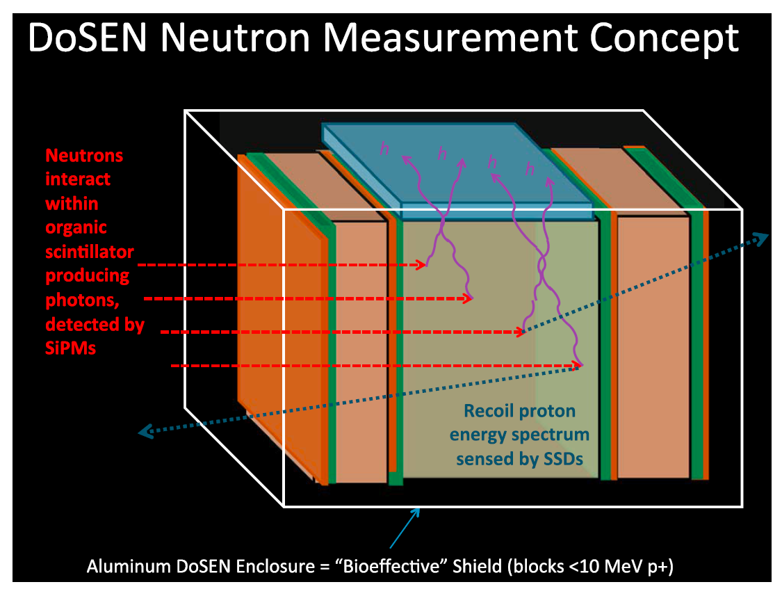
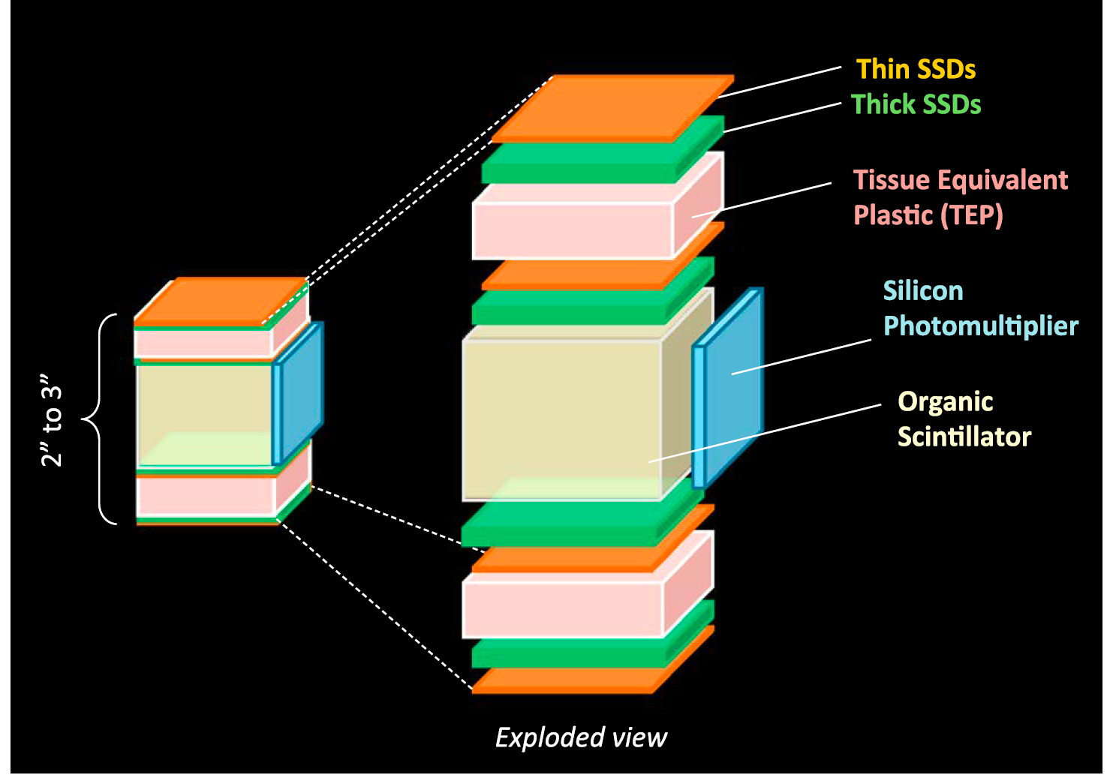
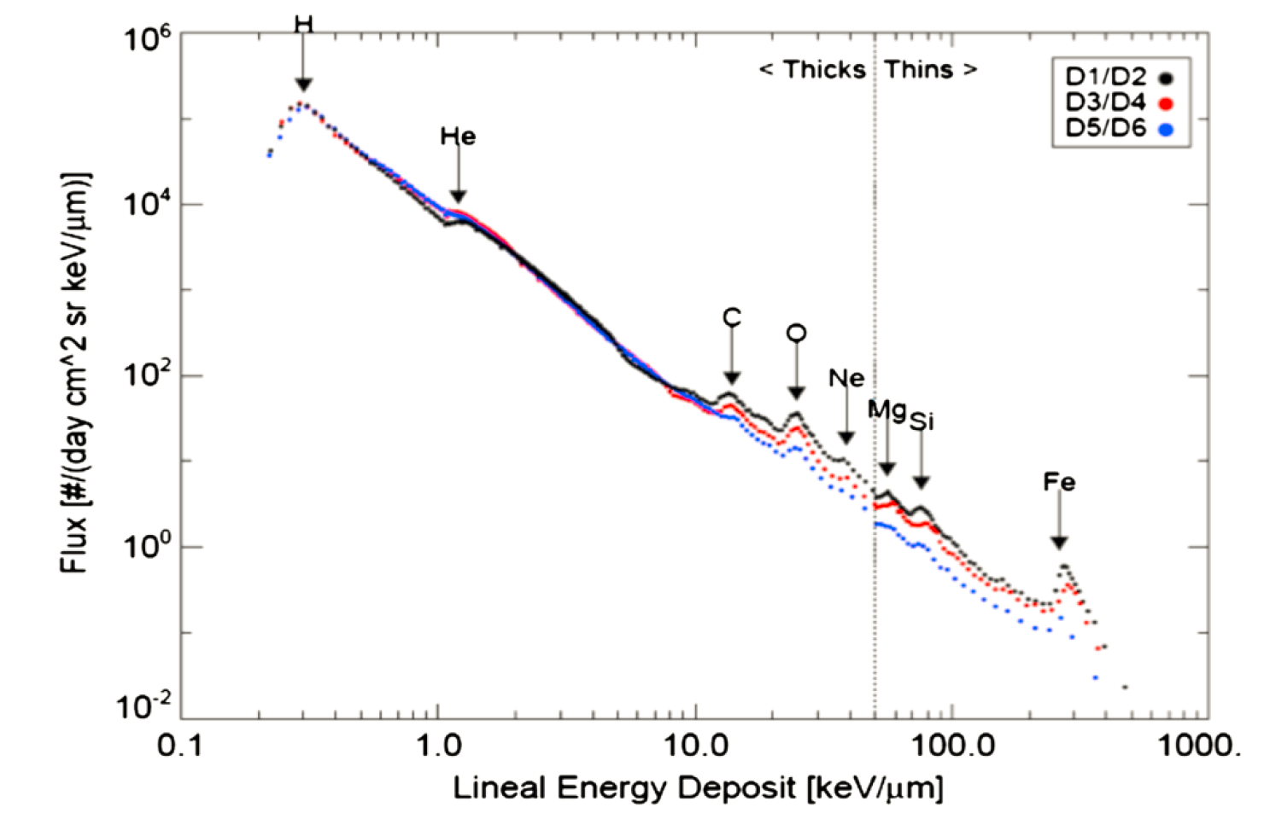
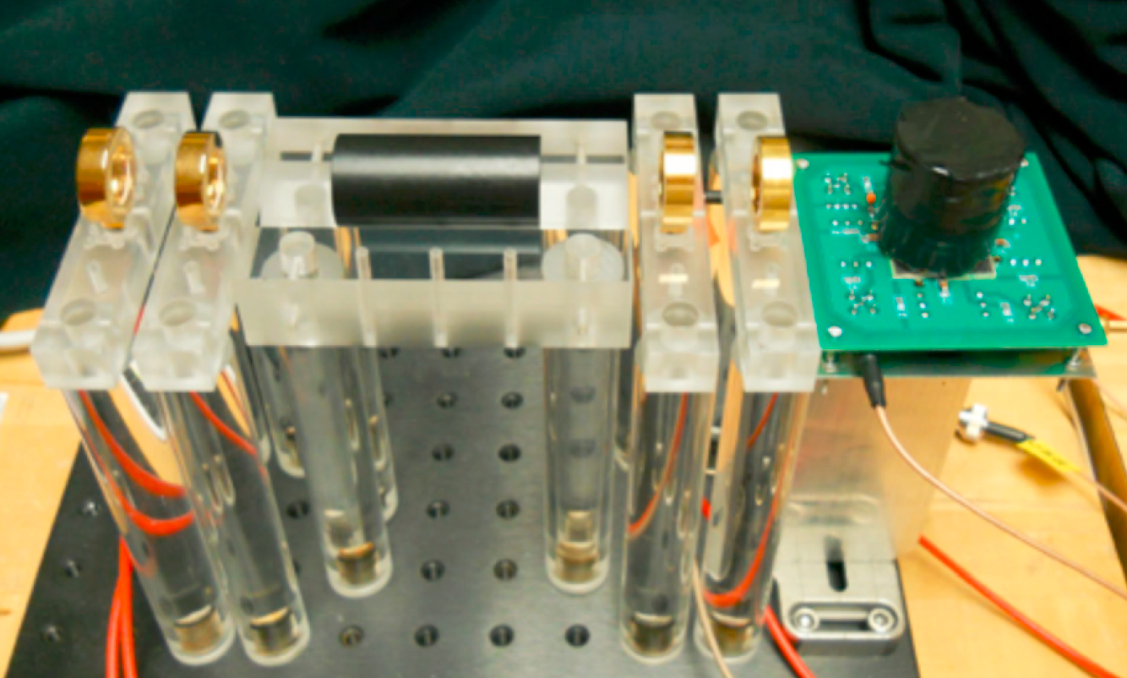
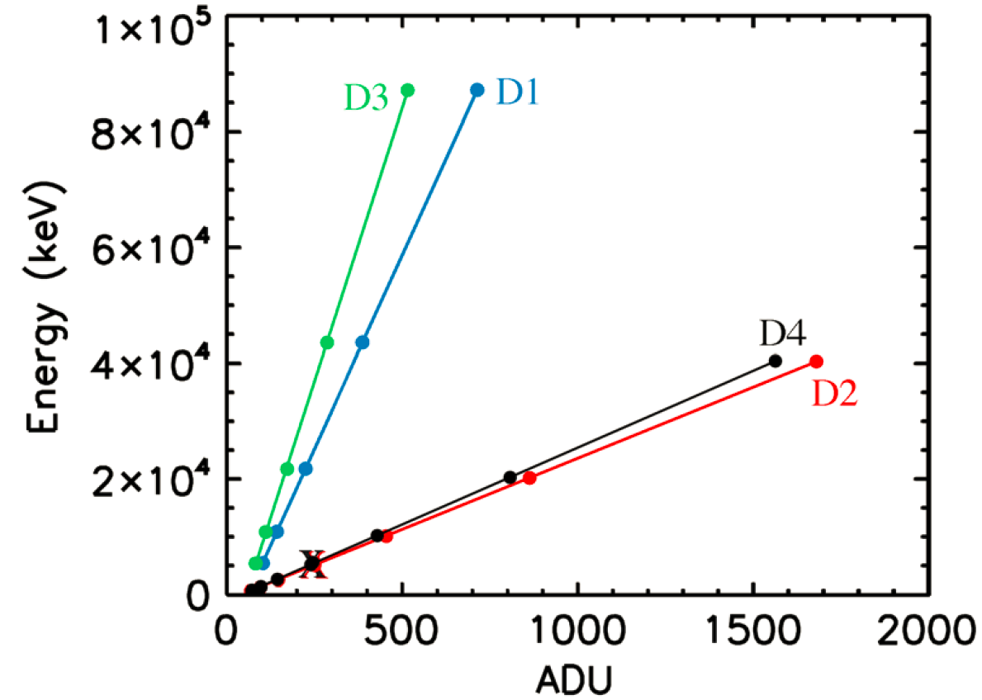
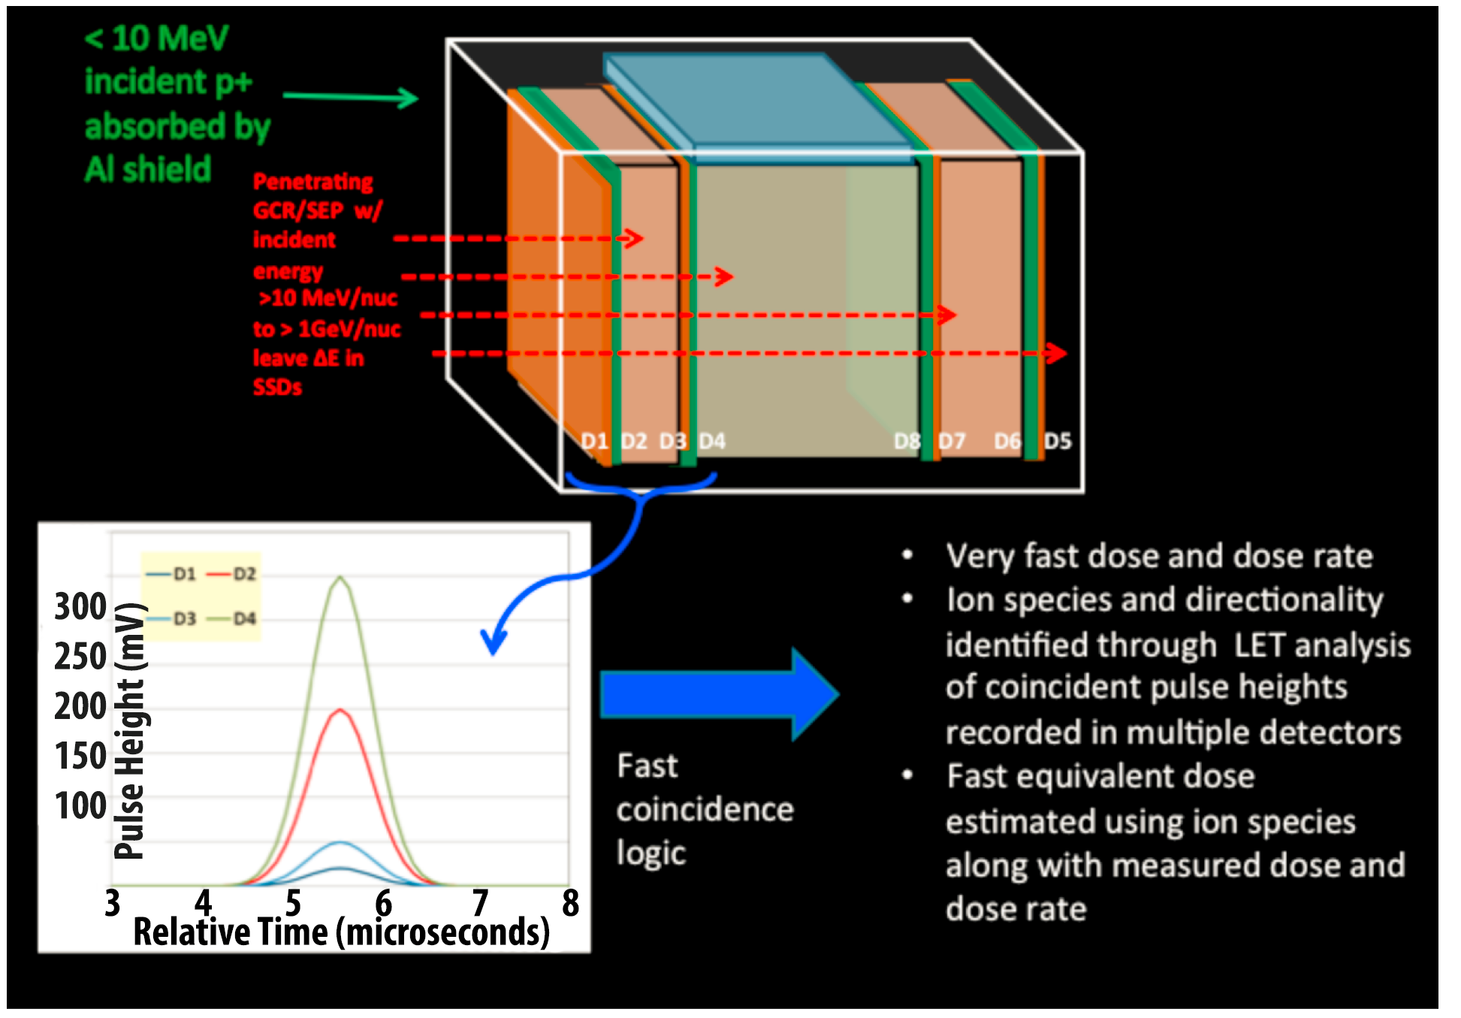
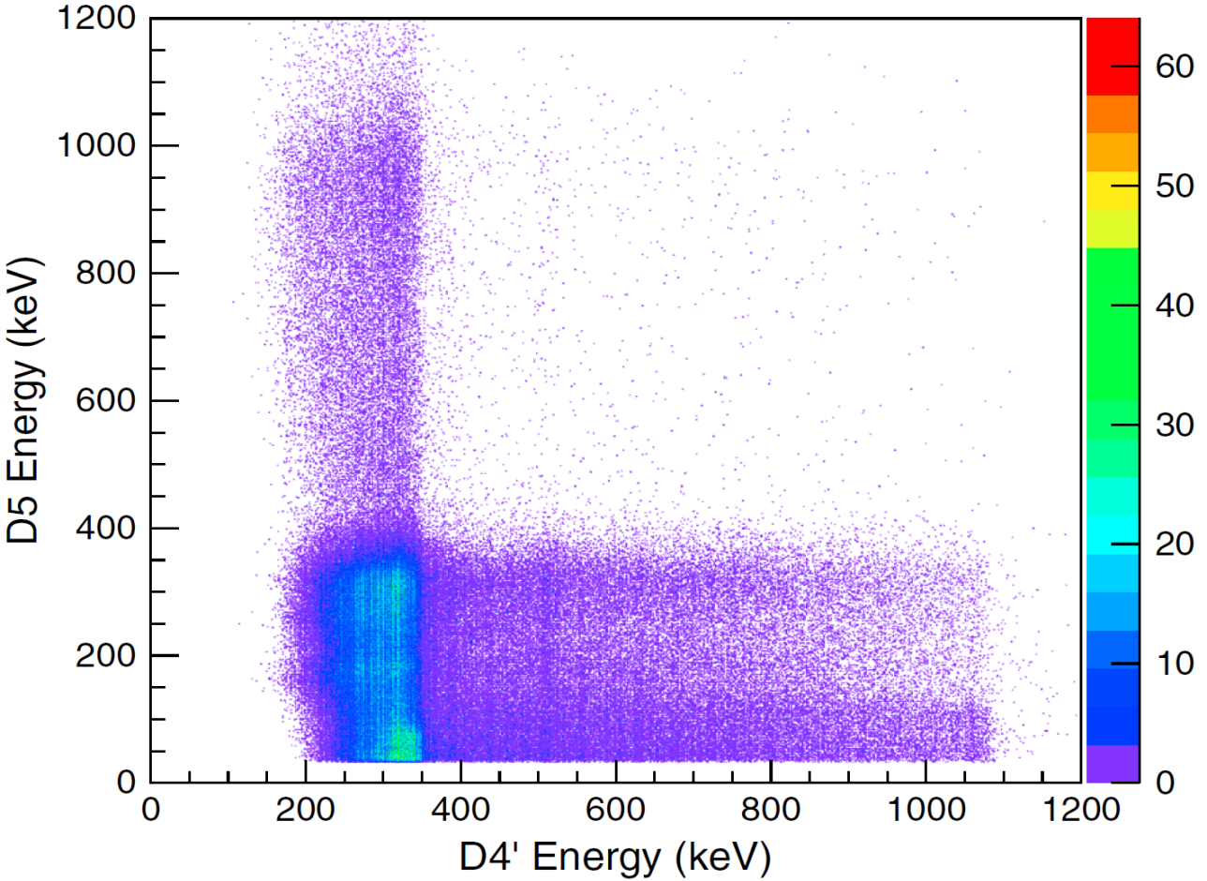
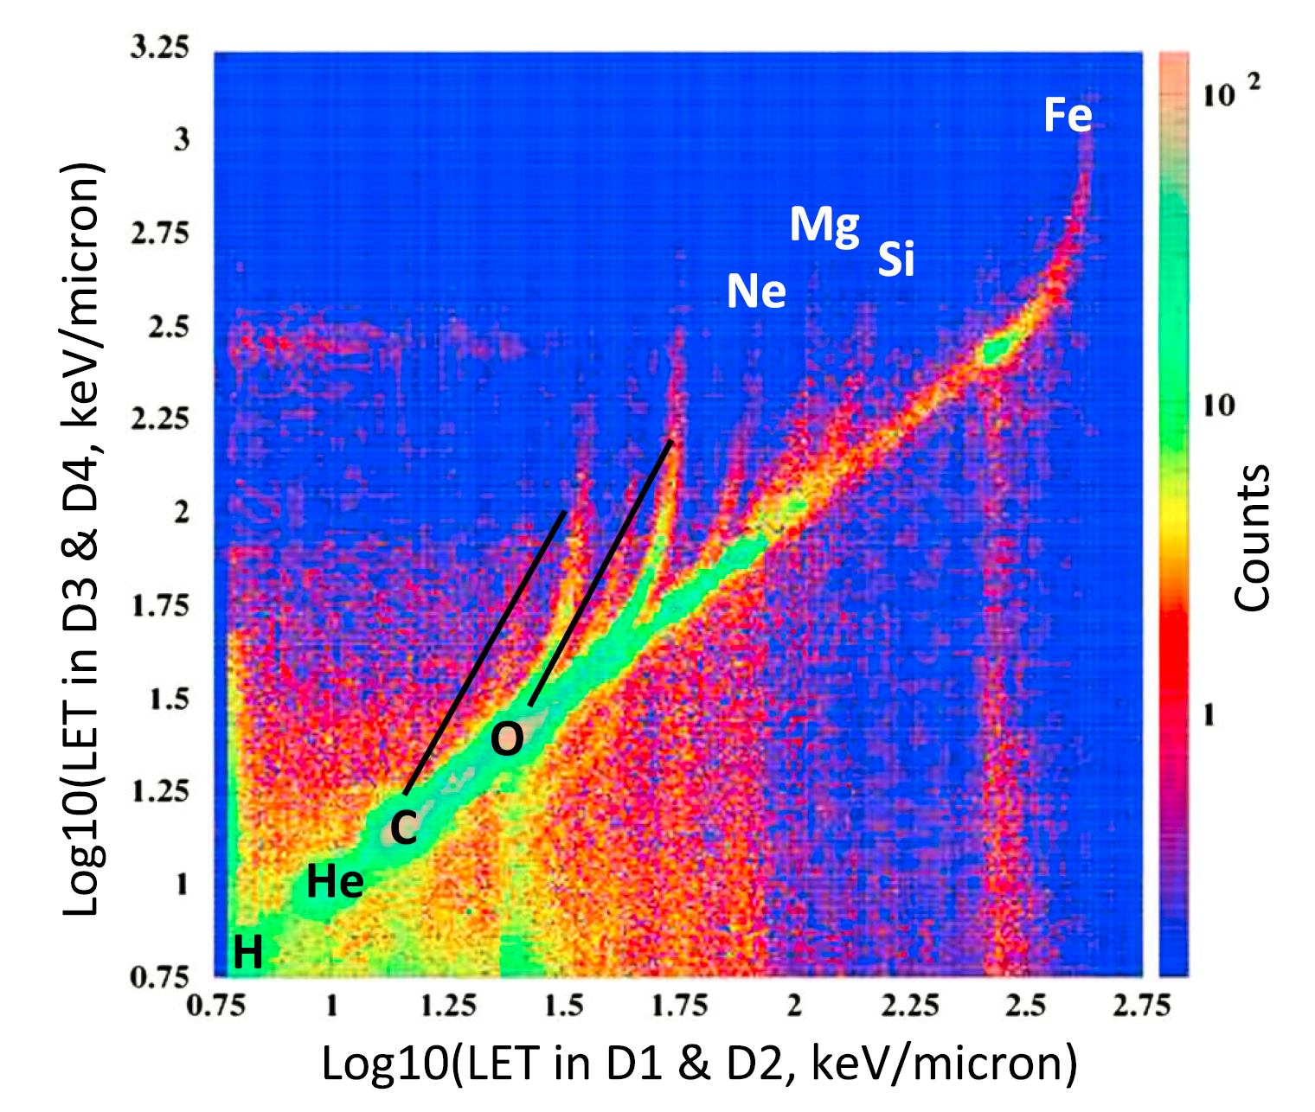
DOSE SPECTRA FROM ENERGETIC PARTICLES AND NEUTRONS (DoSEN)
S. Smith¹, N. A. Schwadron¹ C. Bancroft¹, P. Bloser¹, J. Legere¹, J. Ryan¹, H. E. Spence¹, C. J. Zeitlin²
¹Institute for the Study of Earth, Oceans, and Space, University of New Hampshire, Durham, NH 03824, Sonya.S@unh.edu,
² Southwest Research Institute-EOS, Durham, NH 03824
Introduction: DoSEN is an early-stage technology research project that combines two advanced complementary radiation detection concepts with fundamental advantages over traditional dosimetry. DoSEN not only measures the energy but also the charge distribution (including neutrons) of energetic particles that affect human (and robotic) health in a way not presently possible with current dosimeters. For heavy ions and protons, DoSEN provides a direct measurement of the Lineal Energy Transfer (LET) spectra behind relevant shielding material (tissue equivalent plastic), based on a successful design with rich spaceflight heritage.
Motivation and Background: As we prepare to have human explorers leave the safety of near-Earth orbit, the need for assessment of the radiation environment in deep space is more important than ever. For long journeys to anticipated exploration destinations (such as the Moon, Mars, asteroids, or beyond), radiation risk reduction depends on accurate knowledge of the many sources of ionizing radiation facing manned and robotic missions, including galactic cosmic ray (GCR) ions and solar energetic particles (SEP). Pioneering work in understanding and quantifying these effects is ongoing with the Cosmic Ray Telescope for the Effects of Radiation (CRaTER) [Spence et al., 2010] on the NASA Lunar Reconnaissance Orbiter (LRO) mission [Chin et al., 2007]. DoSEN is a prototype instrument development program that miniaturizes the CRaTER instrument , adds a neutron measurement capability, and provides for prompt reporting of dose, dose rate, and dose equivalent [Schwadron et al., 2013].
CRaTER Technique for Species Identification: The previous figure shows CRaTER-derived “cross-plots”, namely the LET spectra from the CRaTER D1/D2 detectors versus the LET spectra from the D3/D4 detectors. CRaTER cleanly resolves the different GCR ion species that contribute to the radiation dose and dose equivalent. The labels for H, He, C, and O show where these particles are identified in the crossplot. Note that there are tracks that curve up from the diagonal coincidence region. Each track is associated with an individual cosmic ray element. The black diagonal solid lines extending from the C and O coincidence peaks indicate the associated element tracks.
DoSEN – A CRaTER with Neutron Detection and Dosimetry Capability: The DoSEN sensor configuration includes not only the charged particle and TEP components (see figure below of bench prototype), but also an organic scintillator (Stilbene) with PSD, and Si photomultipliers (SiPMs) allowing coincident detection of both energetic particle and neutron LET. This unique coincidence promises a significant advance over present dosimetry capabilites.
D1
D2
TEP
D3
D4
Stilben/SiPM
DoSEN – A Miniaturized CRaTER : DoSEN’s design is based on CRaTER’s (see above figure) but miniaturized for all future exploration missions. DoSEN extends CRaTER’s capability by including neutron detection and dosimetry. DoSEN direct LET measurements provide fast, active readout of dose, dose rate, dose equivalent rate from GCR, SEP, and secondary particles, all with sufficient energy to penetrate the thin housing and thus be of interest for exploration. As in CRaTER, DoSEN’s multiple detection coincidence allows GCR ion species to be identified, from which measured LET and biological impact can be estimated through an LET-dependent quality factor. The figure below illustrates DoSEN’s concept of operation for ion detection; the figure at the top of the next column for neutrons.
252 mm
Basis for LET Measurements :
GCR LET spectrum observed by CRaTER (in a ~50 km altitude lunar orbit) is shown in the figure above. Labeled peaks correspond to the minimum ionizing LET for each of the indicated species [from Case et al., 2013]. D1/D2, D3/D4, and D5/D6 refer to the three thin/thick (~150 μm/ ~1000 μm) silicon detector pairs; each detector pair is separated by tissue equivalent plastic [Spence et al., 2010]. The zenith direction is toward D1 while D6 faces nadir. GCR from deep space first penetrate the D1/D2 detector pair and then pass through the TEP and possibly other silicon detectors. The higher flux in the D1/D2 detector pair and lower in D3/D4 and D5/D6 reflects energy losses as the radiation traverses the telescope.
Calibration curves for each of the four DoSEN solid state detectors using ²⁴¹Am for thin detectors (D1 and D3) and ¹³⁷Cs for thick detectors (D2 and D4) then extended to higher energy using an external calibrated electronic pulser. ADU refers to analog digital unit, the output of the electronics; the vertical axis is energy in keV of the source.
A gamma ray (γ) energy deposit crossplot (D4 vs. D5) reveals an almost rectangular feature in the lower left corner which is the result of coincident 511 keV γ’s from ²²Na hitting both D4 (solid state detector) and D5 (Stilbene), demonstrating good coincidence between the two detector types.
Current State of DoSEN Development and Next Steps: Bench prototype built (and performance of charged particle LET spectroscopy and neutron detection demonstrated (see calibration curve and coincidence crossplot above); meets or exceeds DoSEN design goals. Upcoming ion and neutron beam runs will validate design and pave way for next phase in development to a flight unit.
References: Case, A., et al., (2013) Space Weather, 11, 361-368; Chin G. S. et al. (2007) Space Sci. Rev., 129(4), 391-419; Schwadron N. et al. (2013) Space Weather, 11, 1-10; Spence H. E.. et al. (2010) Space Sci. Rev., 150(1-4), 243-284.
Acknowledgements: Work on the DoSEN project was supported by NASA under grant number NNX13AC89G.

