Slide 1


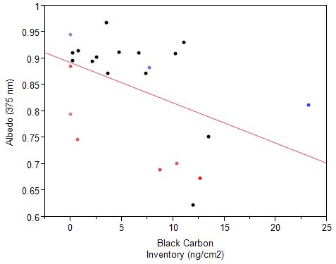
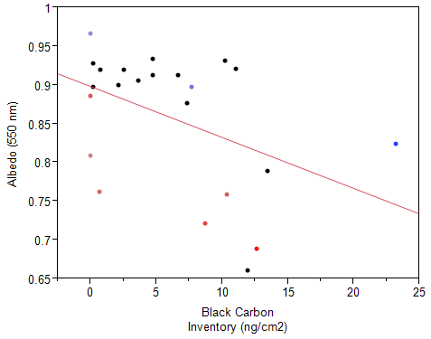
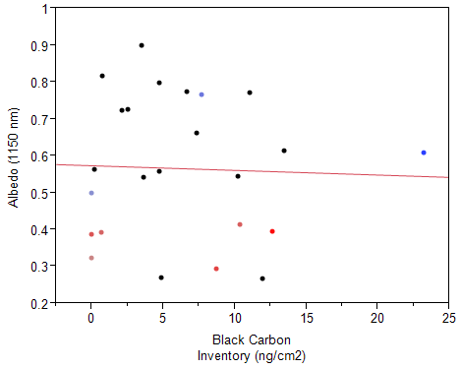
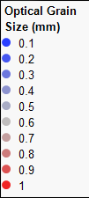
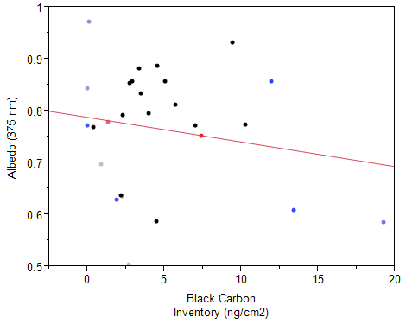
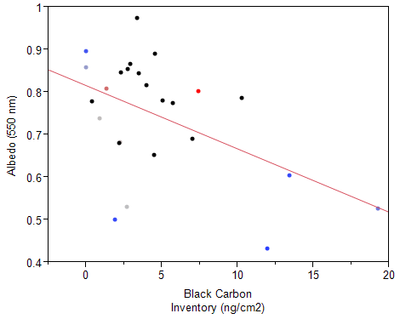
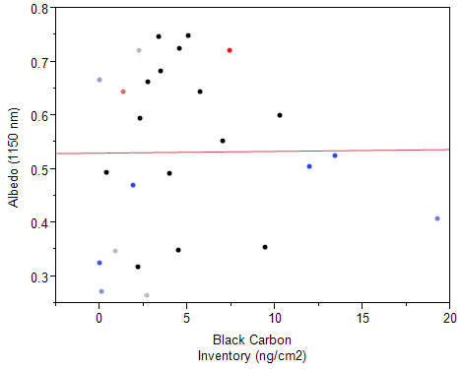

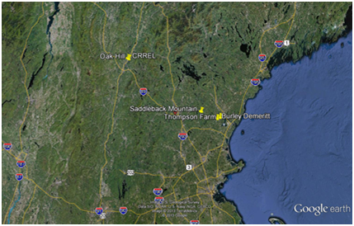
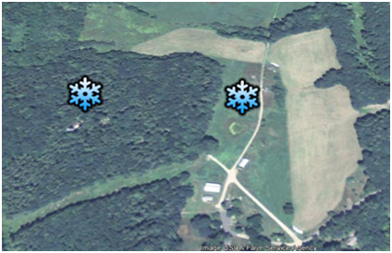
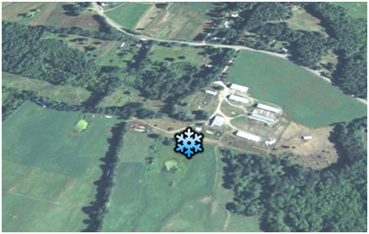
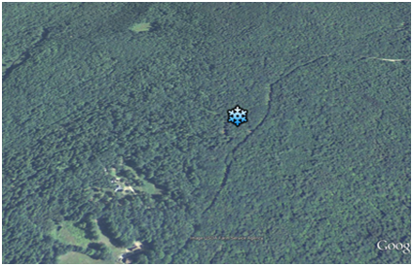
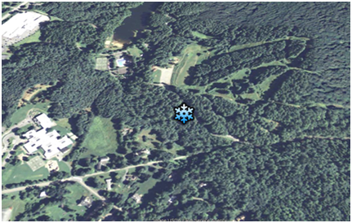
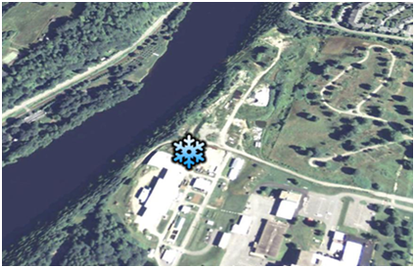
What’s the Dirt on Snow?: The Distribution and Movement of Chemical Impurities in Snow and the Impacts on Albedo
Jacqueline Amante ^{1,2}, Jack Dibb ^{1,2}, Alden Adolph³, Mary Albert³, Eric Scheuer ² , Sarah Schulenberg²
¹ Department of Earth Science , University of New Hampshire, Durham, NH, USA
²Institute for the Study of Earth, Oceans and Space, University of New Hampshire, Durham, NH, USA
³Thayer School of Engineering, Dartmouth College, Hanover, NH, USA
Introduction:
Results:
Snow containing chemical impurities has a significantly lower albedo than pure snow (Warren &Wiscombe 1980).
Much concern is placed on black carbon due to its light absorbing qualities (Brandt et al. 2011).
Levels as low as 10-100 ppb by mass of black carbon can reduce albedo by 1-5% (Hadley & Kirchstetter 2012).
Changes in albedo can also occur because of changes in grain size as the snow ages (Warren &Wiscombe 1980, Brandt et al. 2011).
Few studies have looked at the chemical evolution of a snowpack (Hollinger et al. 2010).
In order to reduce the uncertainty surrounding albedo in climate models, detailed, high quality surface albedo data is needed on a variety of snow covered landscapes (Qu & Hall 2007).
Thompson Farm Open:
Figures A-C: Results from Thompson Farm Open (TFO) sampling site. Biweekly albedo, black carbon and optical grain size measurements were taken throughout the entirety of winter. These data are representative of only the top 5 cm of the snowpack. Figures A-C show the same relationship at differing wavelengths; (A) 375nm, (B) 550nm, (C) 1150nm.
Thompson Farm Canopy:
Research Hypotheses:
1. There will be an inverse correlation between albedo and chemical impurity concentrations.
2. The distribution of pollutants throughout the depth of the snow pack will change rapidly and significantly during the melt season, likely impacting albedo.
3. Snow grain characteristics will likely influence the distribution of chemical impurities and effect albedo.
Figures D-F: Results from Thompson Farm Canopy (TFC) sampling site. Biweekly albedo, black carbon and optical grain size measurements were taken throughout the entirety of winter. These data are representative of only the top 5 cm of the snowpack. Figures A-C show the same relationship at differing wavelengths; (A) 375nm, (B) 550nm, (C) 1150nm.
More variability in albedo values than anticipated.
The open site generally had higher albedo than the forested site at 375nm and 550nm while results are more similar at 1150nm.
As predicted, larger grain size and higher inventories of BC corresponded to lower albedo values.
Experimental Design and Site Locations:
All Sites
TFO & TFC
Collected spectral albedo data using the ASD FieldSpec 4 at all sampling sites.
Completed chemical depth profile of each snow pack by collecting samples and analyzing for major ion concentrations and black carbon concentrations.
Completed grain size depth profile for each snow pit.
Collected samples from each site at least twice a week (sampled 5 days/week) so that the evolution of the snowpack could be captured.
Future Work:
Continue sampling regimen this upcoming winter.
Find a way to efficiently visualize this large complex dataset.
Repeat the above analyses with other chemical impurities including; Ca²⁺, Mg²⁺, Cl⁻, Na⁺, NO₃⁻, SO₄²⁻.
Include meteorological parameters within the above analyses to see if other factors contribute to the relation between albedo, chemical impurities and grain size.
.
BDO
SBC
OHC
CYO
.
Acknowledgements: Research was funded by National Science Foundation grant # EPS 1101-245. I would like to thank Elizabeth Burakowski for her assistance with the MATLab code and ASD. I would also like to thank Chelsea Corr for her help in analyzing data.
References:
Brandt, Richard E., Stephen G. Warren, and Antony D. Clarke. "A Controlled Snowmaking Experiment Testing the Relation between Black Carbon Content and Reduction of Snow Albedo." Journal of Geophysical Research 116 (2011): D08109.
Hadley, Odelle L., and Thomas W. Kirchstetter. "Black-carbon Reduction of Snow Albedo." Nature Climate Change 2 (2012): 437-40.
Hollinger, D.Y., Ollinger, S.V.; Richardson and others. “Albedo estimates for land surface models and support for a new paradigm based on foliage nitrogen concentration.” Global Change Biology 16 (2010): 696-710.
Warren, Stephen G., and Warren J. Wiscombe. "A Model for the Spectral Albedo of Snow. II: Snow Containing Atmospheric Aerosols." Journal of the Atmospheric Sciences 37.12 (1980): 2734-745.
Qu, Xin, and Alex Hall. "What controls the strength of snow-albedo feedback?." Journal of climate 20.15 (2007): 3971-3981.
Image Credit: Google Earth

