Slide 1





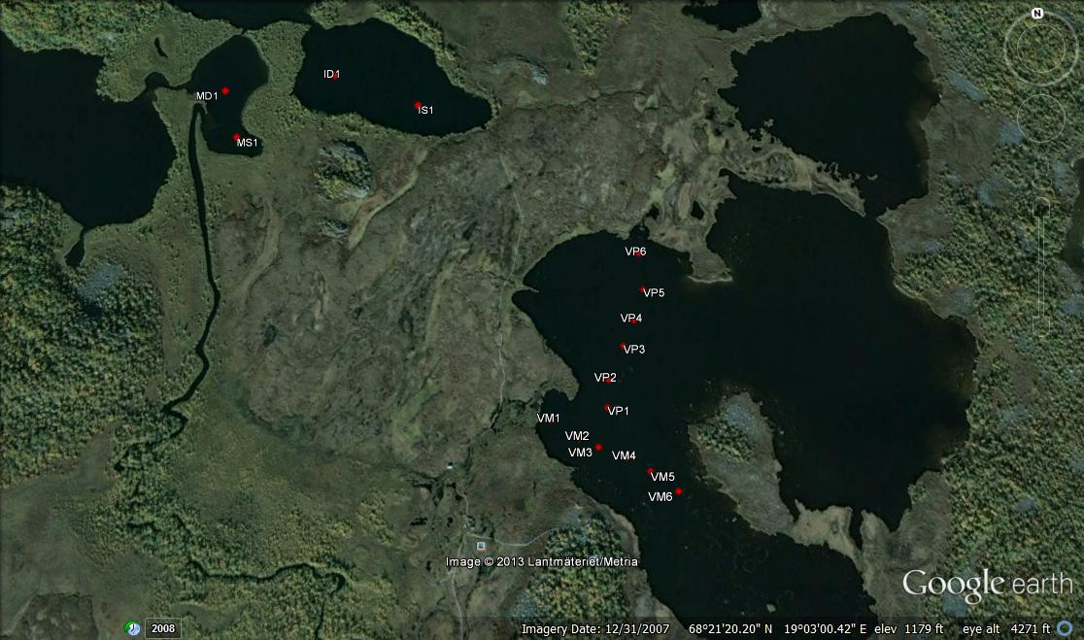
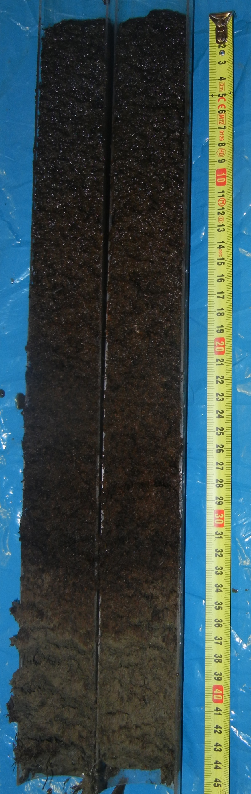
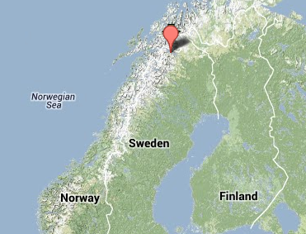
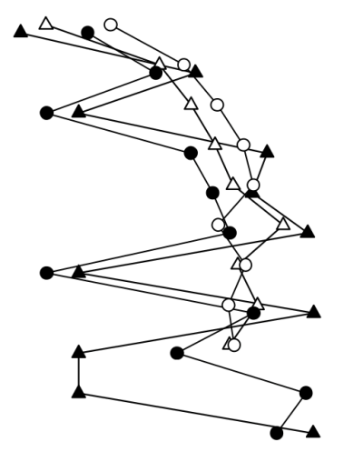
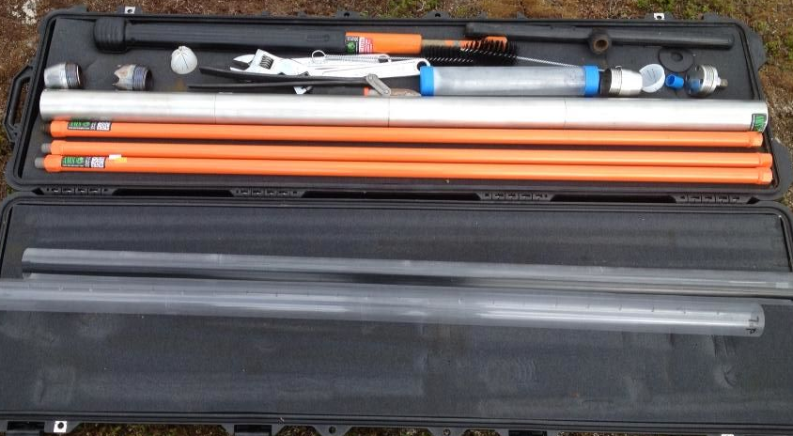
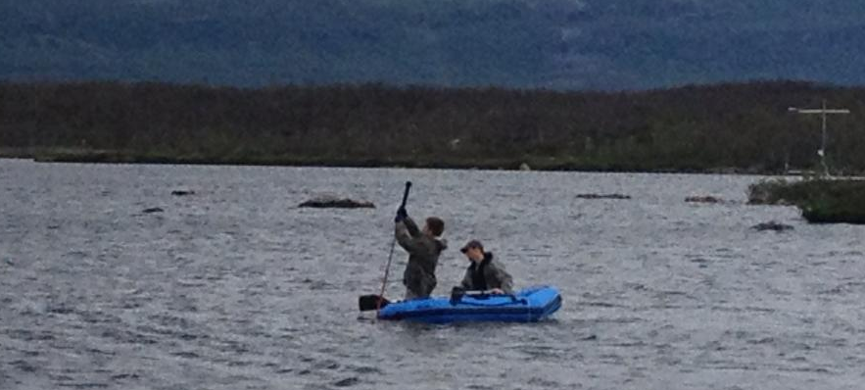
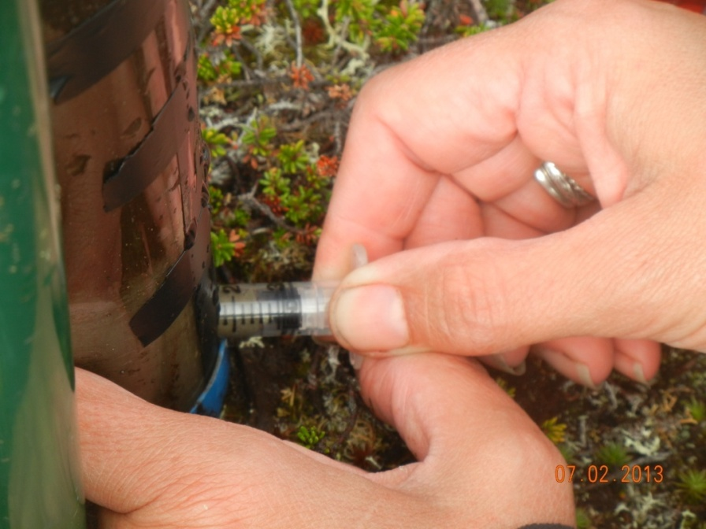
Methane Concentrations and Biogeochemistry in Lake Sediments from
Stordalen Mire in Sub-Arctic Sweden
Madison Halloran¹ , Joel DeStasio², Lance Erickson³ , Joel E. Johnson⁴, Ruth K.Varner², Jacob B. Setera⁴, Martin Wik⁵, Florencia Meana-Prado⁴, Patrick Crill⁵
¹Department of Environmental and Technological Studies, Carleton College, Northfield, MN ²Institute for the Study of Earth, Oceans, and Space, University of New Hampshire, Durham, NH ³Department of Geology, Gustavus Adolphus College, St Peter, MN ⁴Department of Earth Sciences, University of New Hampshire, Durham, NH ⁵ Department of Geological Sciences, Stockholm University, Stockholm, Sweden
Introduction
Site Map
Results
Core
Stratigraphy
Lake sediments are an important global carbon sink, storing carbon from both allochthonous and autochthonous inputs¹.
The burial of organic carbon in natural lake sediments globally is estimated in the range of 30 to 70 Tg C/a ¹.This organic carbon can be mobilized into the atmosphere through the movement of gases, particularly methane (CH₄)².
Although freshwater lakes cover a large area in northern peatlands³, few studies have quantified their contribution of greenhouse gas emissions to the atmospheric carbon budget.
In July of 2013 we took 48 cores at 16 sites throughout three lakes in the Stordalen Mire, Abisko, Sweden to characterize the sedimentology and geochemistry of the lake sediments in order to understand the production, distribution,and flux of CO₂ and CH₄ from these lakes. These sites differed in water depth and ebullition (bubbling) rates. Concentrations of dissolved inorganic carbon (DIC), dissolved CH₄ and potential production rates of CO₂ and CH₄ were determined, and are linked to bulk TOC, TC, TN, TS, and CaCO₃, as well as grain size fractions.
Mellan Harrsjön
Inre Harrsjön
Core Site: VM1
Villasjön
Villasjön
Upper layer: organic rich sediment
Middle layer: transition of mixed organic and lithogenic materials
Deep layer:
grey lithogenic clay with less organic carbon
Inre Harrsjön
Figure 1. Map of shallow and deep coring sites in Inre Harrsjön (IS1 and ID1) and Mellan Harrsjön (MS1 and MD1) as well as coring transects in Villasjön (VM1-6, VP1-6). Site IS1 is approximate, all other locations were plotted using GPS waypoints. Images courtesy of Google Earth, 2013.
Core | Analysis | Method
1 | CHNS and grain size | split core take 1 cm³ sample every 5 cm down the core bulk TOC, TC, TN, TS, and CaCO3 (by difference) using a CHNS Elemental Analyzer Grain size fractions using a laser particle size analyzer
2 | CO₂ and CH₄ production rates | 2 cm³ sample “plug” of sediment taken every 5 cm of length Duplicates from three depths in the core stored at +5⁰C and +20⁰C 10 mL samples of headspace collected daily for 5 days 5 mL sample run on GC 1 mL sample (with duplicates) run on IRGA
3 | CH₄ sediment concentrations | 2 cm³ sample plug taken every 5 cm of length GC
4 | Dissolved Inorganic Carbon (DIC) | Rhizons used to extract 10mL of porewater, then added to 0.2mL 30% phosphoric acid (H₃PO₄) in vials flushed with N₂ gas • Samples degassed CO₂ 1.0 mL sample of vial headspace run on IRGA
Mellan Harrsjön
Summary and Future Work
Maximum TOC, TS, and CH₄ is in the upper 40 cm of the lake sediments. Methane is diffusing away from this maximum zone.
Core sites with known high lake surface methane fluxes from bubble trap measurements also show high methane concentrations in the sediment, high DIC concentrations in the pore fluids, and δ ¹³C signatures of DIC ranging from 0 to 10, consistent with methanogenesis.
Future work, including ¹⁴C dating, microbial community profiling, and δ¹³C signatures of CH₄ will yield more insight into the biogeochemical mechanisms that regulate sediment methane distributions.
Figure 4a. The AMS soil coring kit, which was adapted using only one piece of the stainless barrel, duct taped to a plastic core liner
Figure 4b. Lance and Joel coring on Villasjön
Figure 4c. Taking a sediment sample to analyze for methane concentration
from holes drilled into a plastic core liner
4a.
4b.
4c.
References: 1. Downing et al., 2008; 2. Gorham, Eville. "Northern Peatlands: Role in the Carbon Cycle and Probable Responses to Climatic Warming." Ecological Applications 1.2 (1991): 182-95. Print; 3. Gore, A.J.P., editor. 1983. Ecosystems of the world. Mires: swamp, bog, fen and moor. 4A, General studies, and 4B, Regional studies. Elsevier, Amsterdam, The Netherlands.

