Slide 1



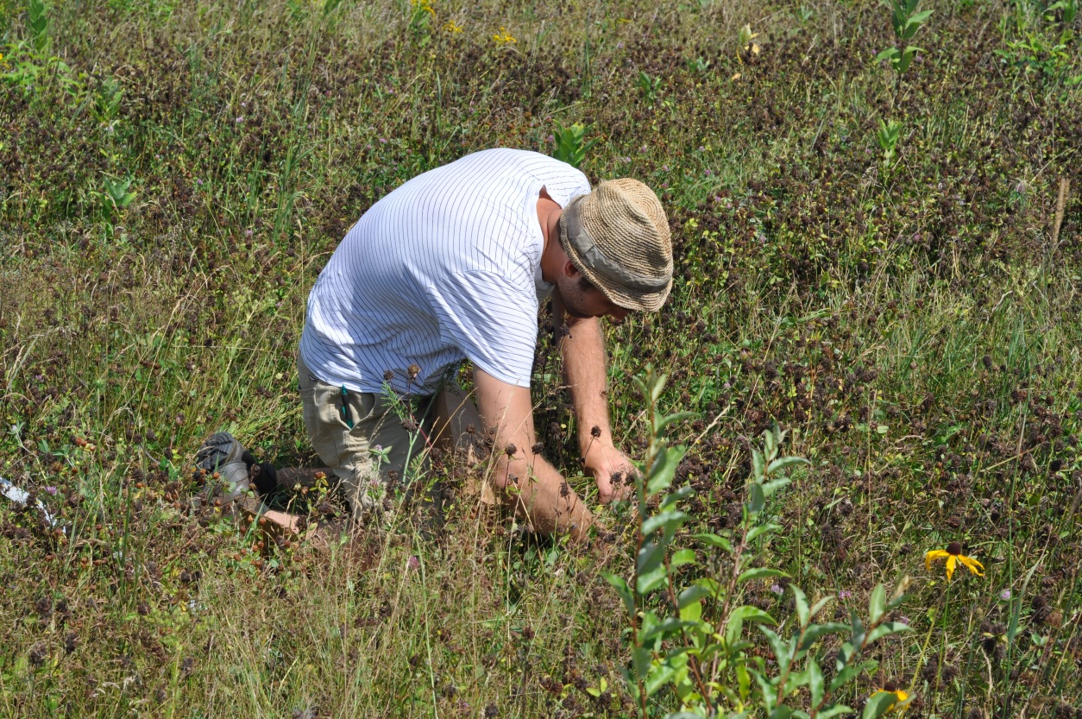
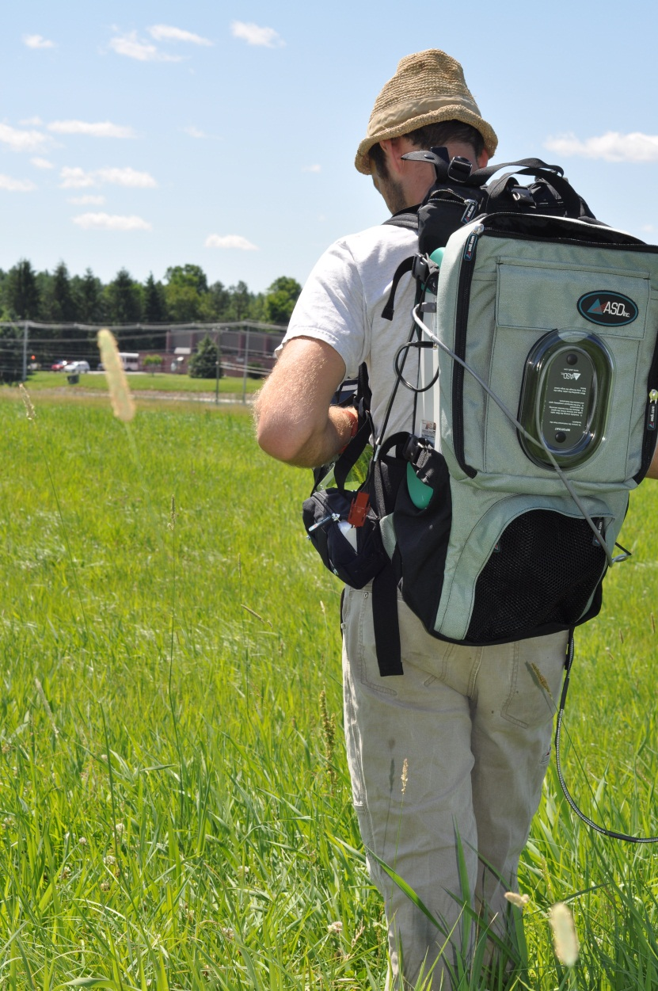
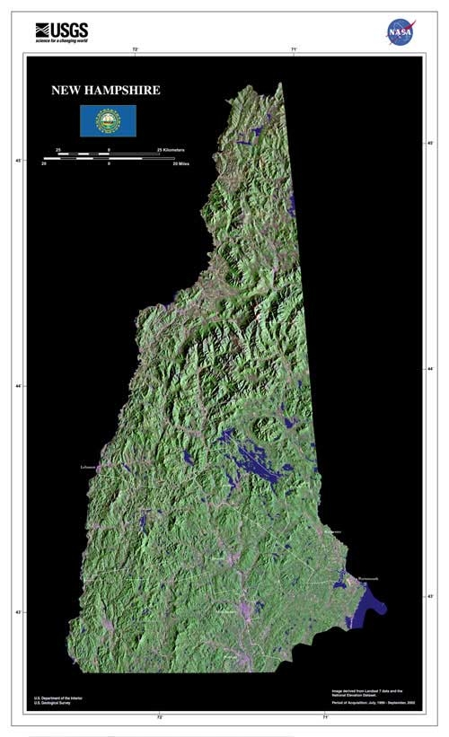
Remotely Sensed Estimates of Aboveground Net Primary Production of Cultivated Grasslands in a Suburbanizing Landscape
By: Paul A. Pellissier, Scott V. Ollinger, Lucie C. Lepine
--Abstract--
Field Collection:
Two summers, two aims:
The goal of summer 2012 was to collect data critical to relating airborne and field-based spectra, whereas during summer 2013 efforts were focused on determining relationships between plant /environmental conditions and ground based spectra.
Data 2012
Airborne imagery: approx. 500km² , spatial resolution 5m²
Eighteen field sites established
Ground-based canopy reflectance
Canopy height
Foliar biomass and N content
Data 2013
Intensive ground based reflectance, sub-meter spatial resolution
Canopy height
Foliar biomass and N content
Leaf water content
Soil moisture
Leaf mass per area
Photosynthetic capacity
Spectral Relationships:
Attribute Spectral Prediction Important Regions
The current study aims to determine generalizable relationships between aboveground NPP and spectral reflectance in both turf and agricultural grasslands.
Hyperspectral measurements of canopy reflectance collected over two growing seasons are correlated with foliar and environmental attributes.
Relationships derived from ground-based canopy reflectance will be applied to watershed-scale airborne imagery.
Foliar %N
Prediction and importance plots based on Partial Least Squares (PLS) regression of 11 extracted factors . Sample size, n=27. Root mean PRESS= 0.73447. The Importance plot shows the heavy influence of chlorophyll absorption in the blue region and reflectance in the green region. The PLS analysis also values the red edge, and a possible water absorption feature near 1300nm.
Photo 1: UNH wants to cut my grass? Collecting biomass at one of our sites located in Deerfield, NH. (Photo by L. Lepine)
Photosynthetic Capacity
--Background--
Prediction and importance plots based on PLS regression of 2 extracted factors. Root mean PRESS=0.589011
PLS regression was preformed using 8 modeled light response curves incorporating 80 instantaneous photosynthetic assimilation readings (plotted)
Importance plot shows importance of short wave infrared, red edge, and green regions
Components of Net Primary Production?
In many terrestrial ecosystems Nitrogen (N) is central to, and often limits, net primary production (NPP) of terrestrial plants.
In cultivated grasslands N is often supplied, by way of fertilizer, to achieve management goals. This may lead to other limiting factors such as available water.
Understanding how these systems function in terms of N cycling and carbon storage at the landscape level is important in quantifying their environmental impacts at the regional to global scale.
Dry Biomass
Prediction and importance plots based on PLS regression of 4 extracted factors . Sample size, n=29; Root mean PRESS=0.93348. Importance plot shows the heavy influence throughout the visible wavelengths including blue, green and red edge regions.
Photo 2: Collecting field measurements of hayfield canopy reflectance with a portable field spectrometer at the UNH Fairchild Dairy, Durham, NH. (Photo by L. Lepine)
--Grass is More Than Just Green--
--Methods--
Site Description-- Lamprey River Watershed:
Fifth order river located in southern New Hampshire
Area: 479 square kilometers
Encompasses nine towns
Population density ranges from 0 to 630 people km⁻²,with an average of 129.
17.5% of land area is non-forested
Surface waters currently impaired from excess N
Foliar Water Content
Prediction and importance plots based on PLS regression of 5 extracted factors . Sample size, n=29; Root mean PRESS=1.02361. Regions of influence include the blue green transition zone, chlorophyll absorption well, red edge, and NIR plateau.
Lamprey River Watershed
Looking Forward:
Future efforts will focus using the relationships shown here to predict NPP, scaling these predictions to the watershed scale, and interpreting any observed spatial patterns in NPP.
Figure 2: Averaged spectral reflectance curves of grass canopies by management regime. Curves represent over 3500 individual spectra taken at 18 sites located within the Lamprey River watershed. Average spectral reflectance differs significantly (P<0.003) for several regions ( 750-920nm*, 920-1150nm, 1151-1350nm**)in the NIR plateau . *Hay fields and pasture P=0.0165. **Hay field and pasture P=0.6933.
Figure 1: Site location within New Hampshire.
Prepared by Paul A. Pellissier for the NSF EPSCoR National Conference, 4th November 2013

