Slide 1


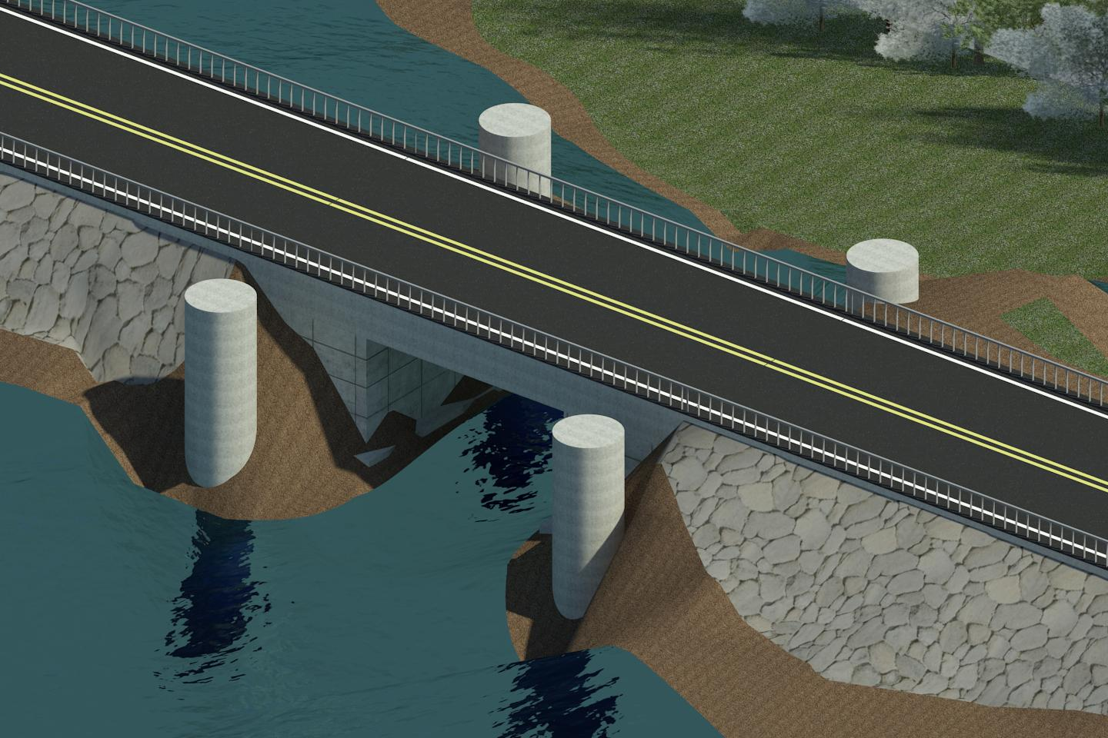
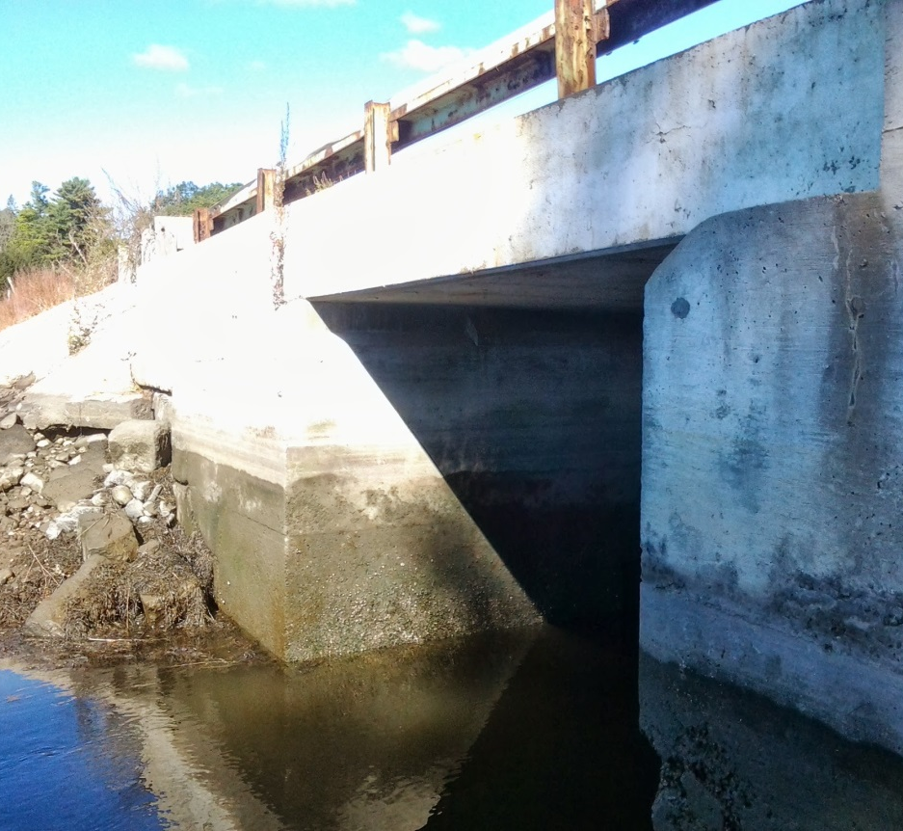
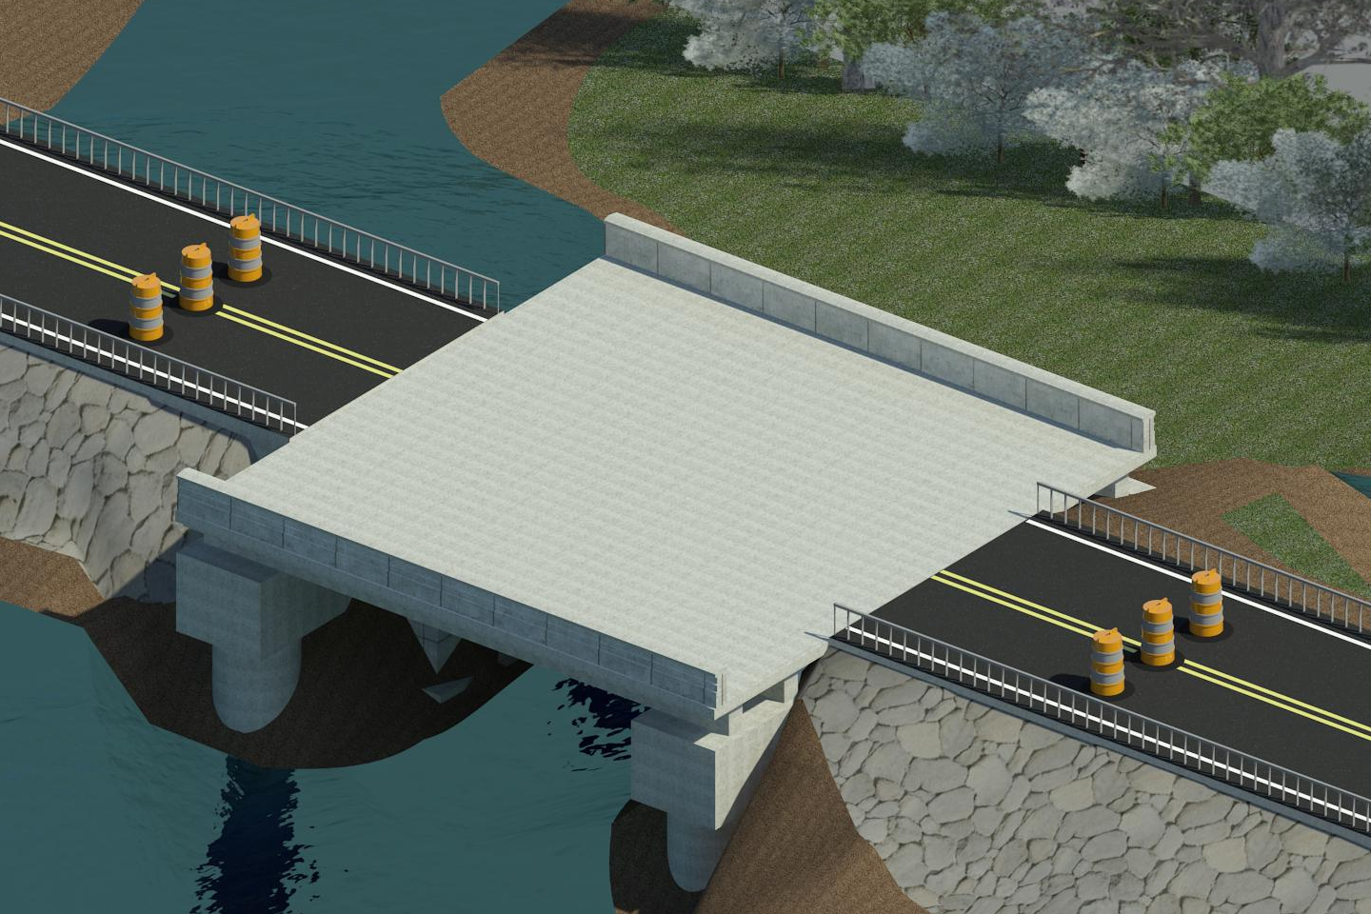
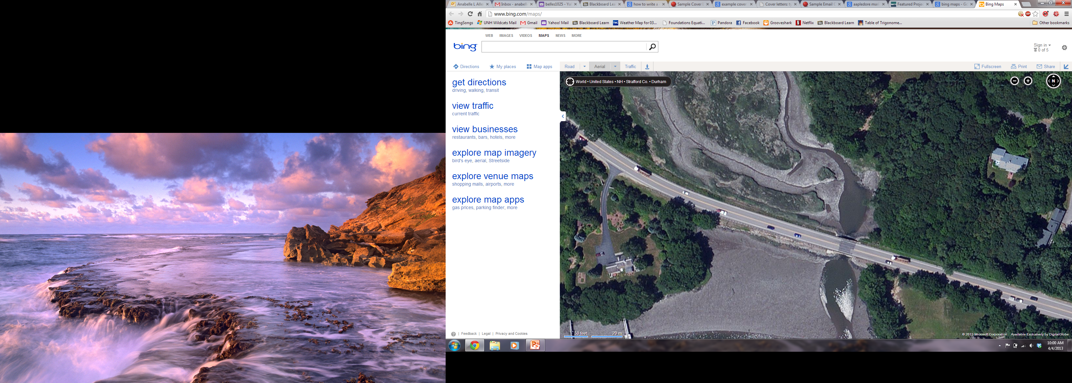
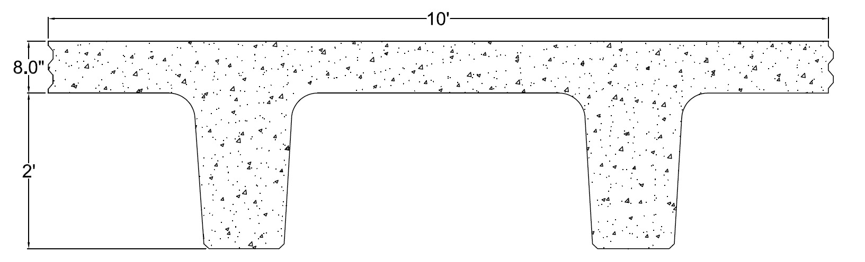
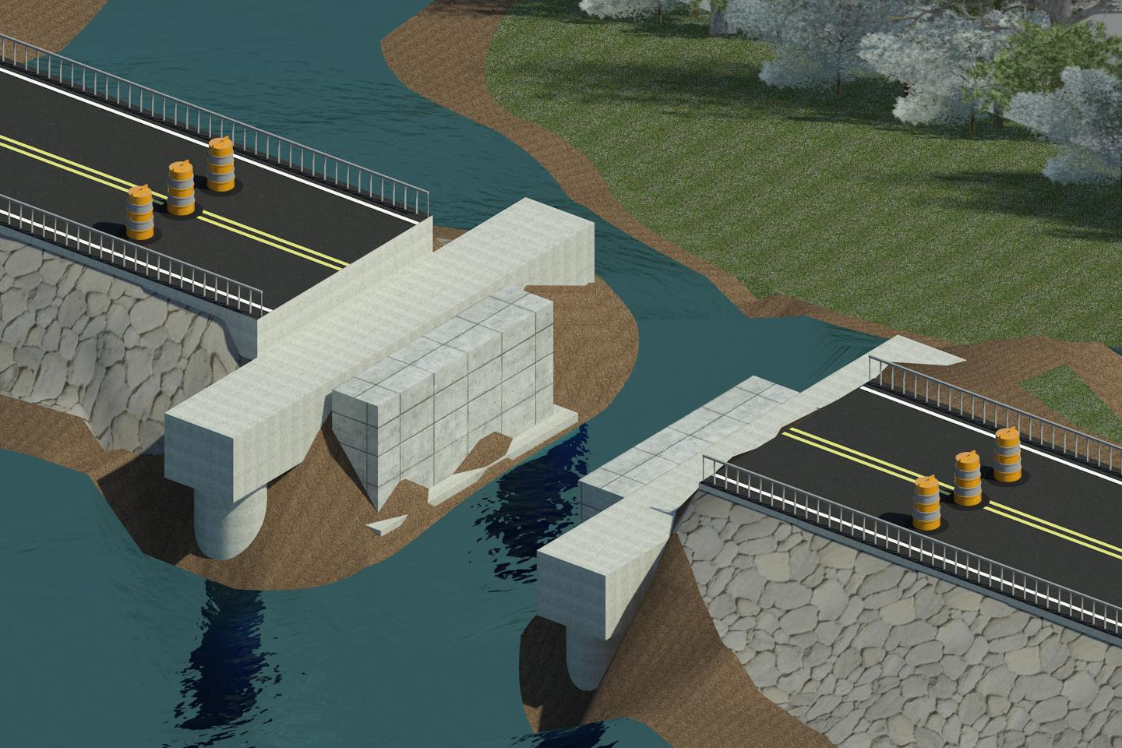
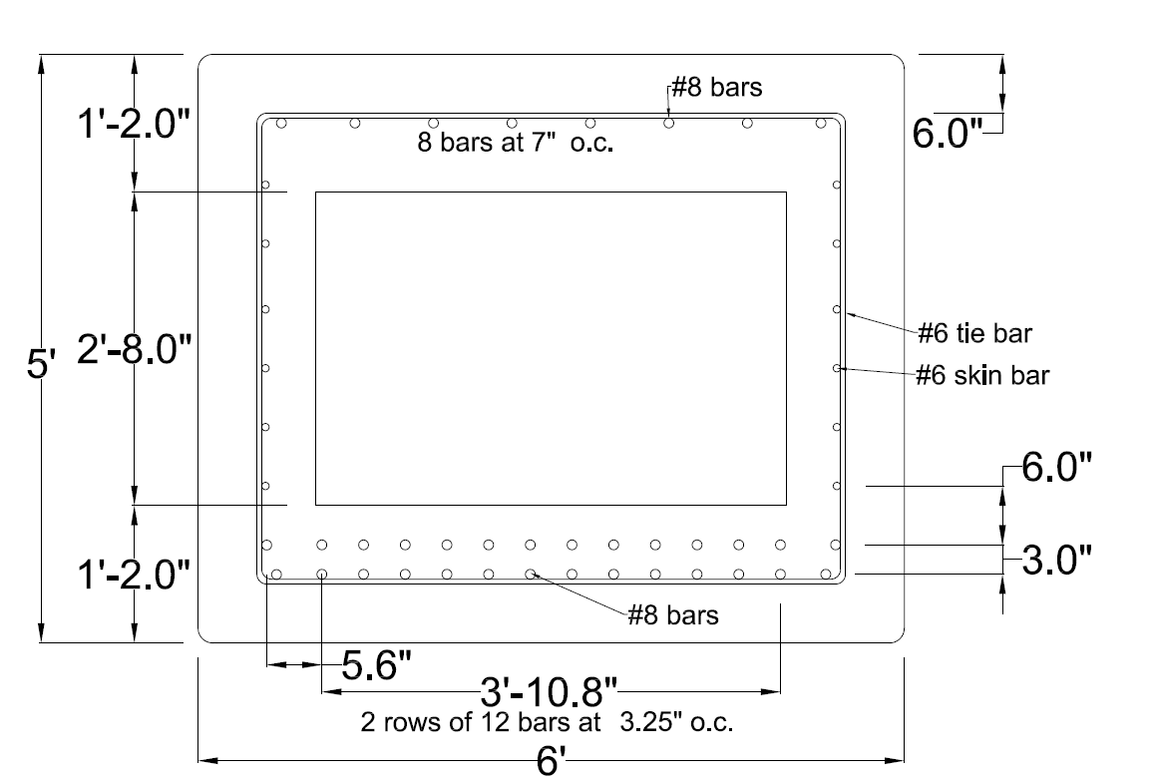
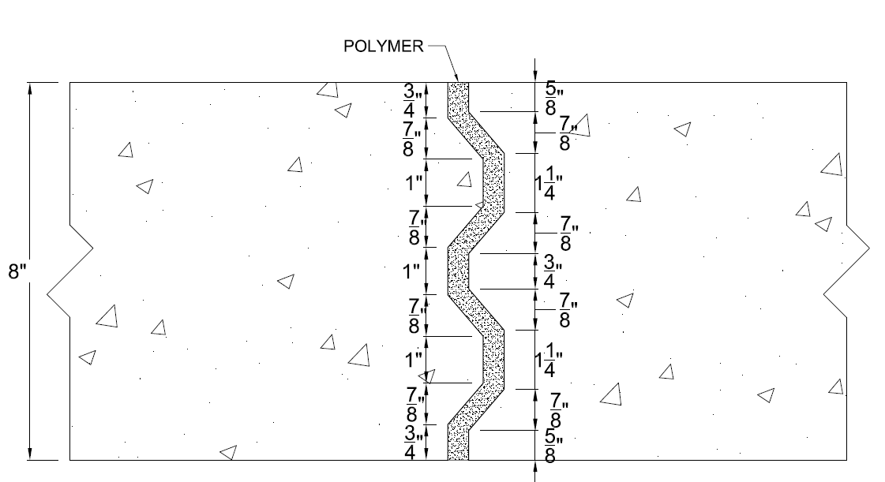
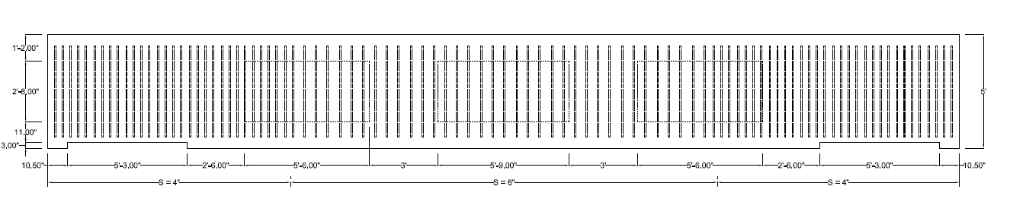
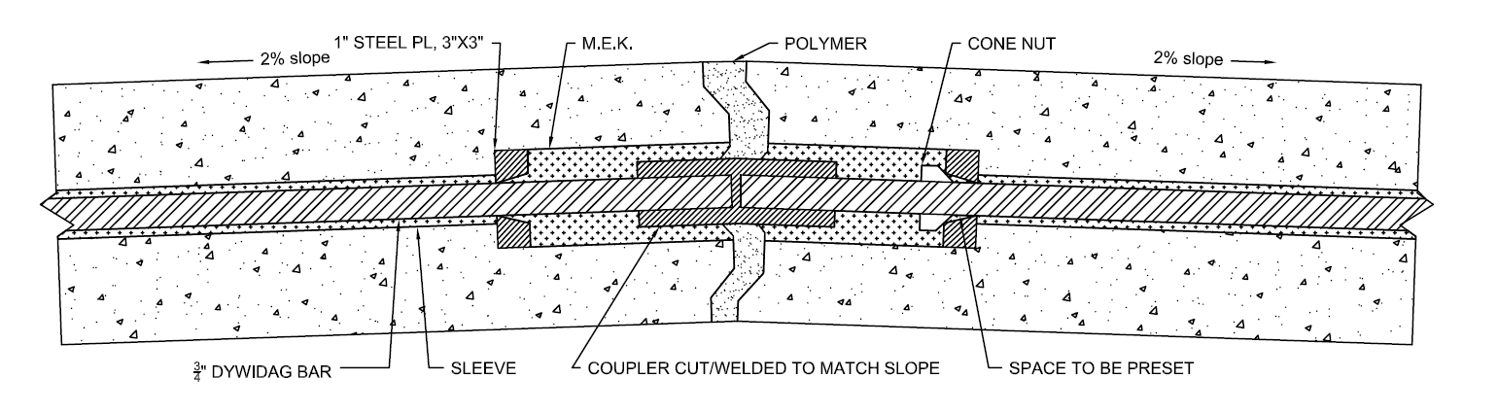
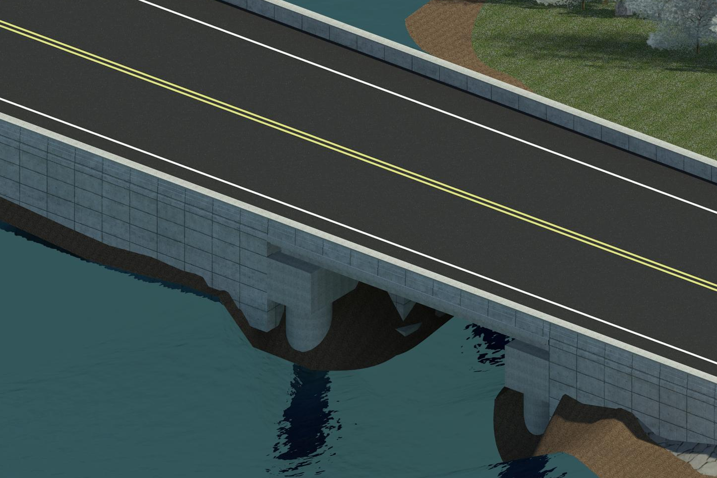
Accelerated Bridge Construction
Bunker Creek Bridge, Durham NH
Columns
NEXT D Beams
Drilled Shaft 1 ft outside of current roadway.
Cast in place with early high strength concrete.
Shaft will need to extend to +40’ in order to create a moment connection to bedrock. Surrounding soil is clay/silt mixture.
Background:
Originally built in the 1930’s
Various repairs through the year
Substructure mostly original
Considerations:
High Traffic Volume/Truck Route
Long Detour
Environmentally Sensitive Area
4- 10’ wide NEXT 32 D beams will be used. Due to Flange width, no additional concrete is needed for deck.
Beams will be prestressed, precast off site.
Pilecaps
Precast offsite
Current NH truck limit for 8 or more axles is 150 kips without special permits.
Design without cutout was 176 kips, but with cutouts is 148 kips (using 7 ksi concrete)
Bunker Creek
Durham
RT 4
NEXT 32D
Oyster River
Portsmouth
Shear connections between the four NEXT 32 D beams will be accomplished with a Tongue and Groove Shear Key that is sealed with a polymer.
Project Concepts
Use ABC methods to complete project as quickly and efficiently as possible using mostly precast/prestressed concrete members
CROSS SECTION
Initial Site Work - minimal daily lane closures
Site Preparation
Column Installation
Bridge Replacement – Full Road Closure
5 to 14 days
Remove current bridge
Install new bridge
Post Site Work- minimal daily lane closures
Stone Wall Installation
Shoulder Widening on roadway
Post tensioning will be done using DYWDAG bars. Due to 2% hunch needed in roadway, a coupler will be cut/welded to match the slope. Computer modeling foresees negligible stresses across the center from the hunch, however laboratory tests still need to be accomplished.
SIDE VIEW
Roadway Widening
Granite blocks stacked vertically and tied into bank in order to create a steeper slope that remains within current bank width.
Area will be filled in using geotextiles.
After compaction, a wider shoulder can be added and guard rails moved outwards.
Carbon Fiber-Reinforced Polymer (CFRP) grid will be used on top and bottom of flange in place of traditional Temperature and Shrinkage Steel.
By: Elizabeth Kinney
Advisor: Dr. Charles Goodspeed

