Slide 1



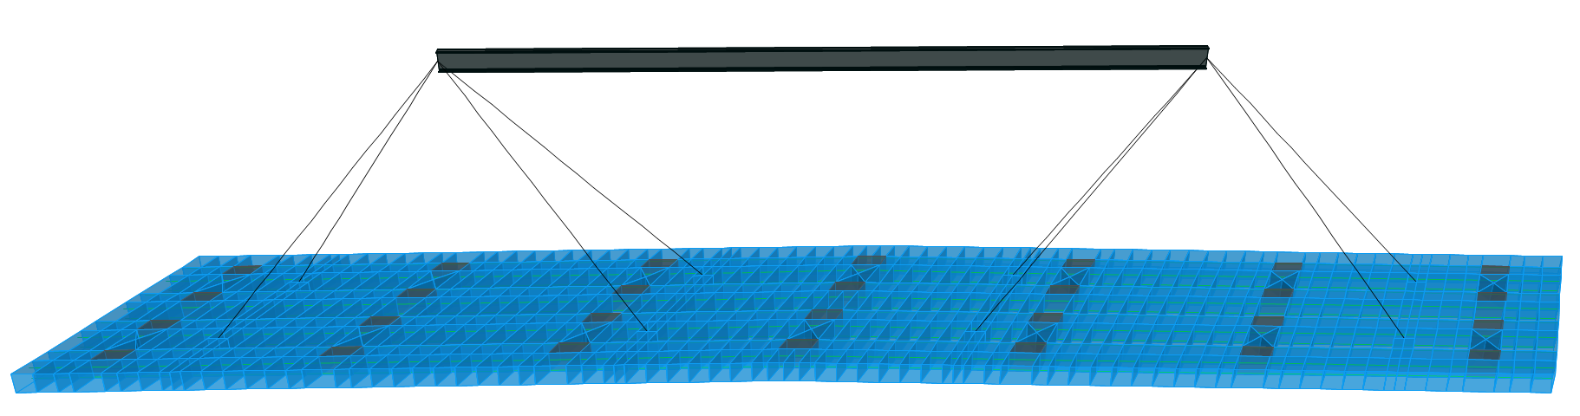
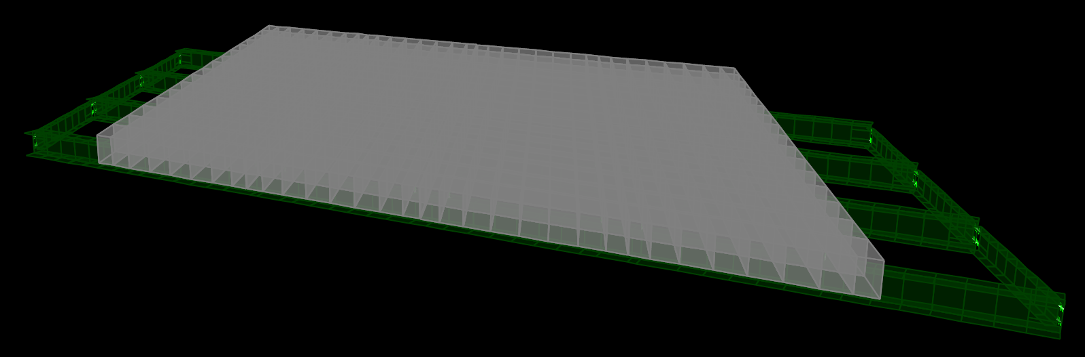
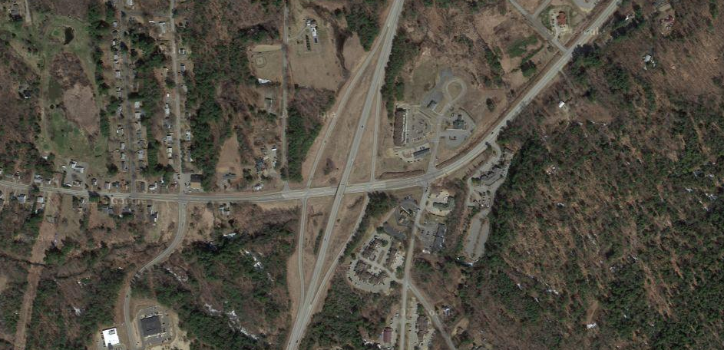
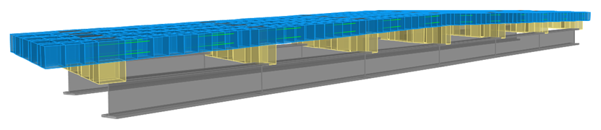

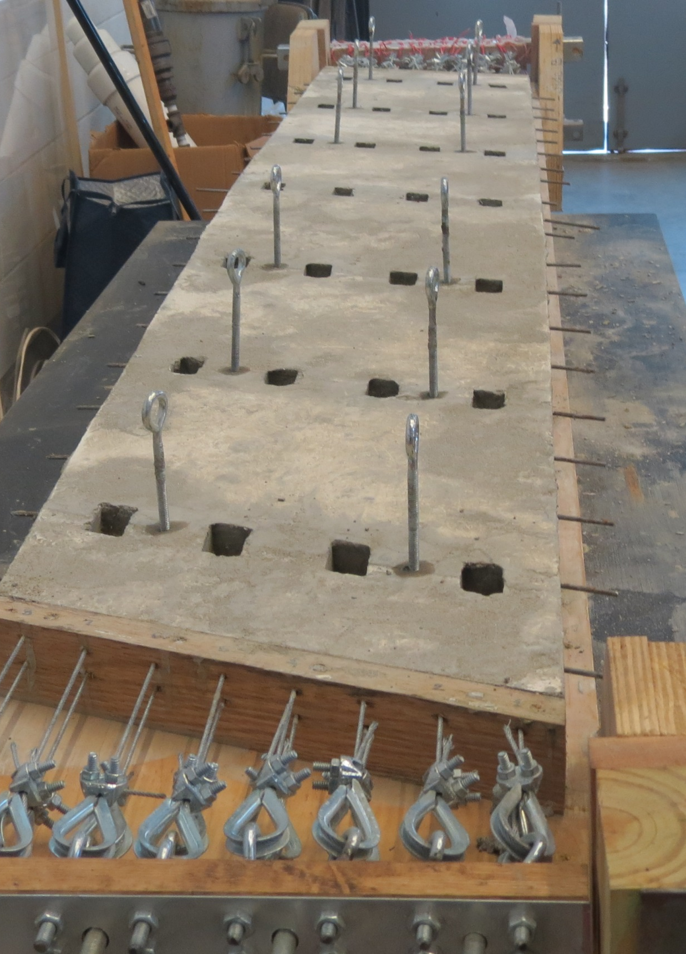
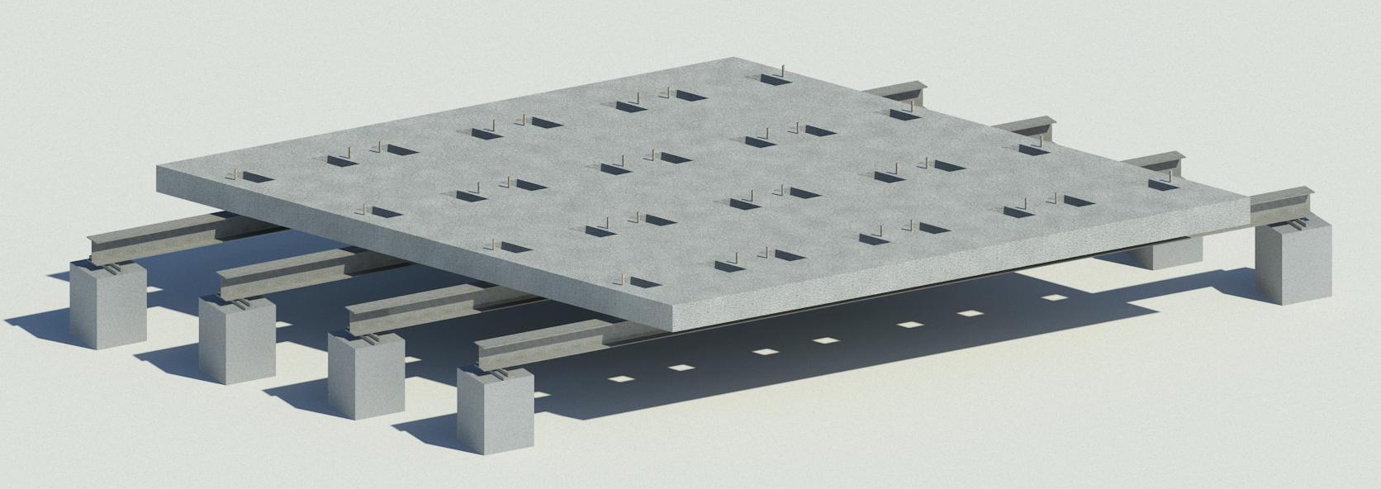
Accelerated Bridge Construction
Segmented Deck Replacement, Gilford NH
Lifting Analysis per PCI
Characteristics:
76’ Span Length
49’ Deck Width
23° Skew
7 – W36x194 Girders
Considerations:
Sound Superstructure
Degraded Deck
High Traffic Volume
Finite Element Modeling and Analysis
Lifting from 8 points
49’ slab with 23° skew and 2% crown
Finite element model for determination of expected load distribution to leveling devices
Transportation Analysis
Gilford →
Use steel frame to support slab on truck with shims to account for crown and deflection of the steel frame under dead load
Daniel Webster Highway
Field Analysis and Construction Program
← Laconia
Simplified field analysis program for the determination of leveling device lengths based on existing girder conditions
Project Concepts
Use precast, prestressed, full depth deck panels to rapidly replace bridge deck while minimizing local impact due to construction
60 hour closure period
Use existing ramps for rotary traffic control
Prefabricated full depth, full width deck slabs with centerline crown
Handling and transportation of full width bridge slabs
Surveying of existing girder vertical profiles
Field analysis to determine leveling device settings
Accelerated placement of deck panels using transverse shear joints, polymer sealant, and post tensioning rods
Finite Element Modeling and Analysis
Lab model of Gilford Bridge slabs
-81” x 12.5” x 1.25”
-23° skew
-2% crown
Fiber Reinforced Plastics (FRP) will be used in full size slabs
Laboratory Testing
4 panels, 25’ span laboratory model
for method verification and proof of concept
By: Anabelle Allen and Carter Terry
Advisor: Dr. Charles Goodspeed

