Slide 2
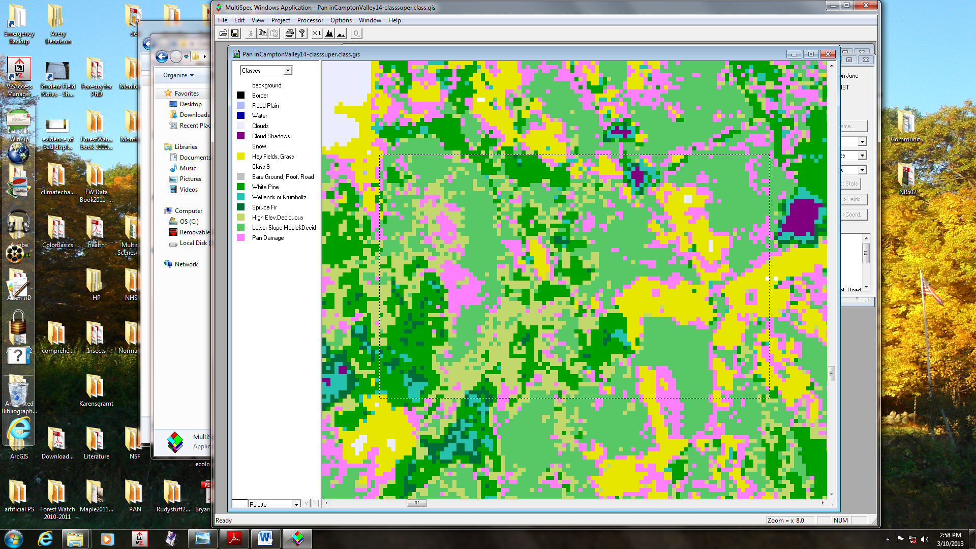
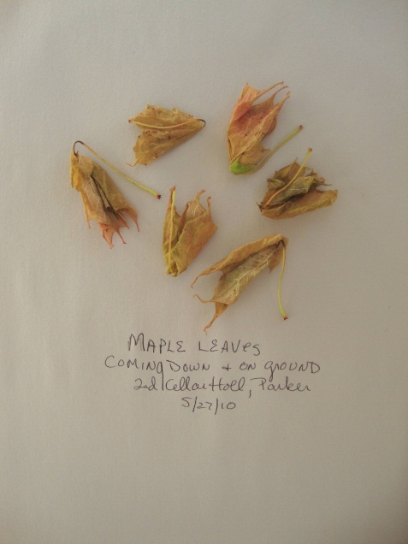
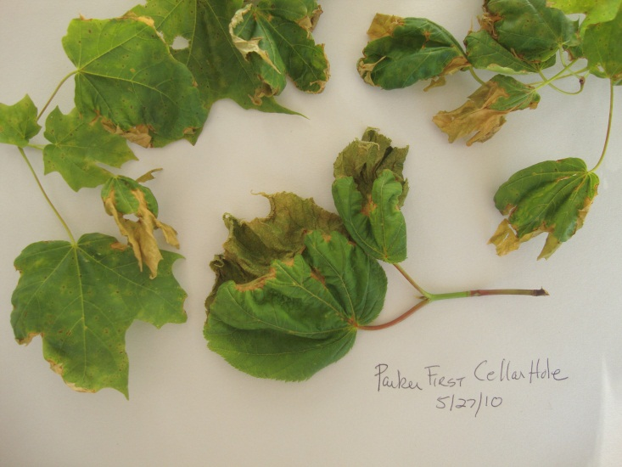
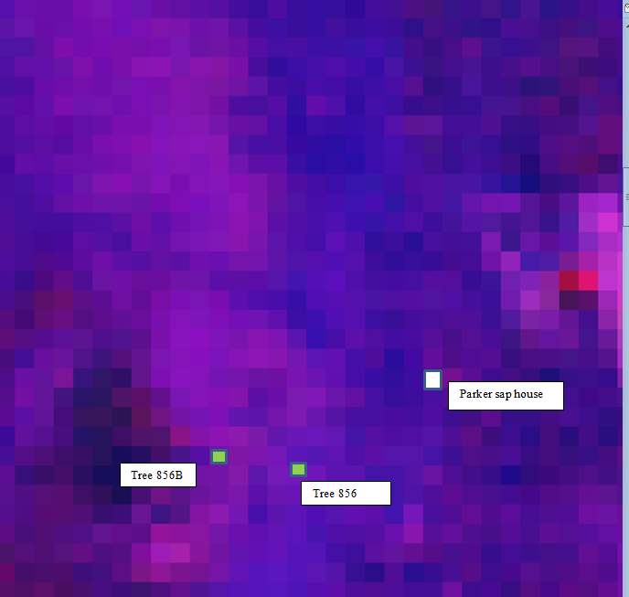
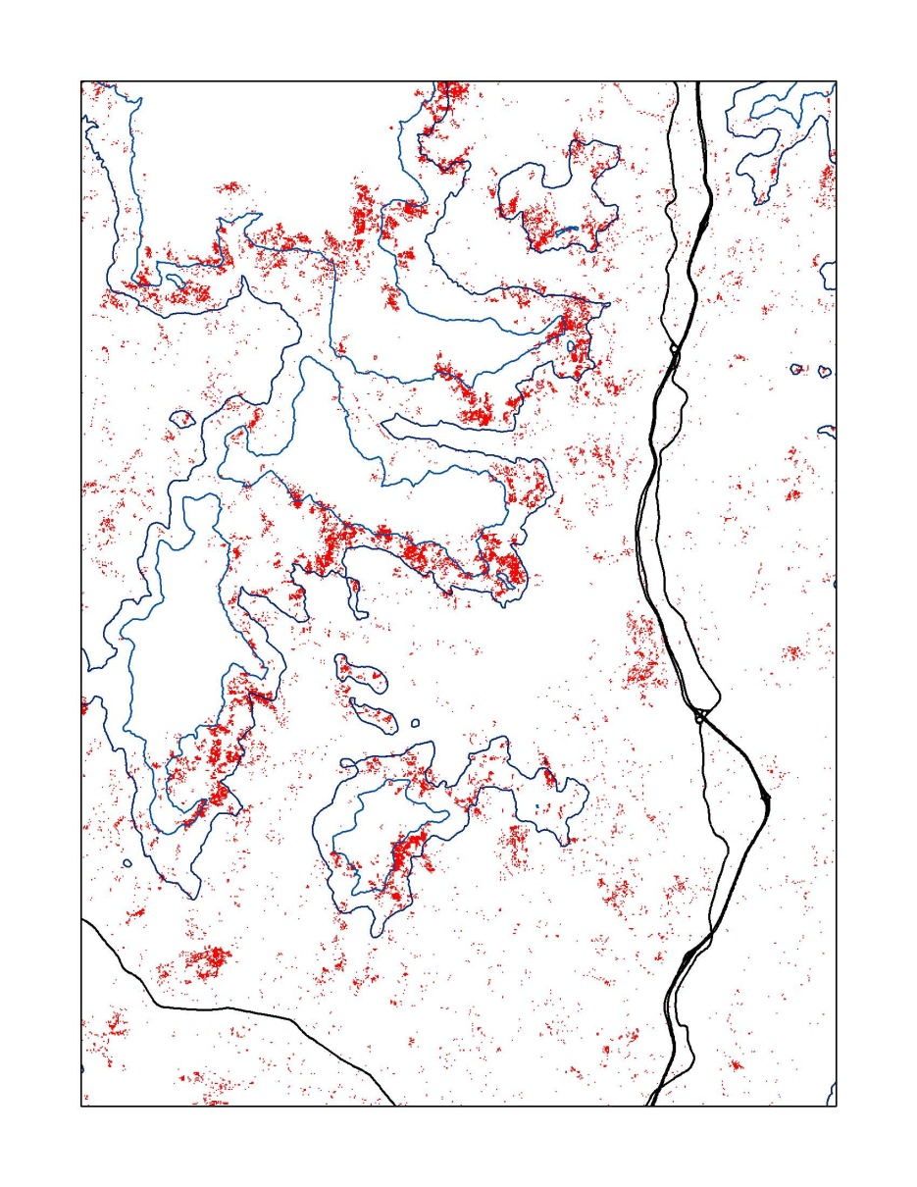
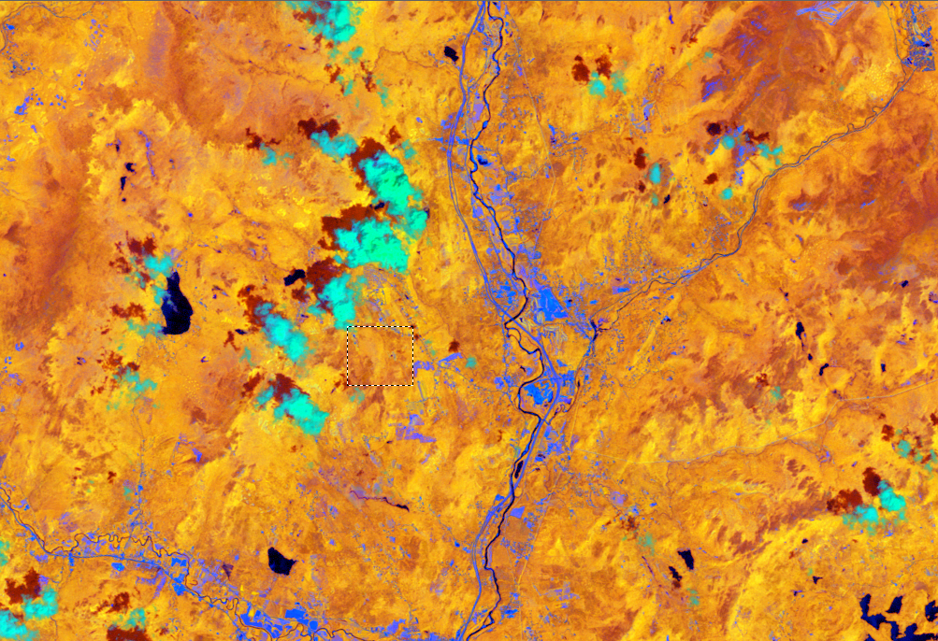
Mapping the PAN Event
Martha Carlson, Natural Resources and Earth Systems Science, University of New Hampshire
Bald Mt. Maples—damaged by PAN.
Unidentified stress areas.
Wind patterns, temperature, atmospheric chemistry and the condition of the foliage, suggest peroxyacetyl nitrate (PAN) as the defoliant. How extensive was the damage?
A supervised classification of the scene, starting from the Bald Mt. site, known by its latitude and longitude, teases out the damaged maples from other trees that show water stress and thin spring canopies. High elevation birch and aspen are removed. Then lowland marshes are removed.
Multispec calculates that 11,500 hectares in the White Mountains show the same spectral signature as the Bald Mt. Maples. A topographic band, 1700 to 2000 feet, isolates the damaged areas—a ribbon of maples. Now we are ready to ground-truth.
Sugar maples defoliated on May 26, 2010. Leaves at 1750 feet were partially damaged. Leaves at 1900 feet were completely desicated.
PAN is a power reactive nitrogen gas which steals electrons from whatever it encounters, in this case, tender mesophyll cells in young maple leaves.
A ratio of Band 5/Band 4, displayed as a false color image (6,3,5) shows water stress in damaged foliage. The site can be located but the image is too dark to decipher damaged from healthy foliage.
I-93 and the Pemmigewasset
River, Campton Valley, NH
Hubbard Brook Experimental Forest
Bald Mt. site
A Landsat LT4-13-29-June 2, 2010, image, taken just one week after the PAN event, is interpreted with MultiSpec software.
An NDVI index, using Band 4 and Band 3, above, displayed as a false color image (7,4,6) helps to discern the differences in high elevation conifers and mid-elevation deciduous trees.
Areas of damage are identified in red. Topographic lines outline forest elevations between 1700 and 2000 feet.

